Slide 1
Portable “Keyboard”
Abdul Sayed

Slide 2
Why?
Inspiration from the C8 lab.
Wanted to expand on the features of the Il Matto
Interested to see how far I could take the audio generation capabilities

Slide 3
What?
Expand single analog input into 32 touch-sensitive keys
  Important for scalability – easy enough to scale, just add more MUXes.
Low latency
  Calculate frequency of note in real-time
Have a range of 128 notes
  0 to 127
Portable
  No bulky buttons
Notes:
These are the specifications
Add more muxes and change the predefined macro values in the c code
It was this that led to the idea of capacitative touch sensing buttons

Slide 4
How?
Only a few ADC pins on the Il-Matto
  But 27 keys needed
Therefore, had to use the ’74HC0451’ MUX to expand
  8:1 MUX
  Used 4 of these
    Select lines connected to PC0, PC1 and PC2 – mux input
    Z connected to PA0 to PA3 – mux output
    VEE, GND, Enable connected to common GND
    VCC connected to common VCC
Used a piezo for the speaker output – PD5
Used a wire to simulate a “perfect touch”
Notes:
- Expand on what keys and why 27 not 25 needed, 25 for two octaves normally, and 26 and 27 and 28 used for octave shifts
It is an 8:1 mux, only needed 4, due to 32 keys being provided
For Z, added a 10 mega ohm resistor, one leg connected to PC0 and other connected to VCC
Added a resistor in series to reduce sound volume
To test it out, one end connected to GND and the other end, touching Y0 to Y7 on the muxes (the ‘keys’).

Slide 5
Huh?
S2, connected to PC2, did not work
  Port C pins used by default for JTAG debugging
Ghost sound and random audio output
  Wires acted as antenna, picking up noise from environment
Pressing a key would trigger an output from another MUX
  Charge left over
Sometimes, USB connection drops
  Breadboard power-rail instability
Notes:
1. S2, constantly in a high state, thus only outputs y 4 to y7 on the mux were responding
2. due to the use of 10 mega ohm resistors which led to a high impedance
3. Left over from the ADC internal sample-and-hold circuit

Slide 6
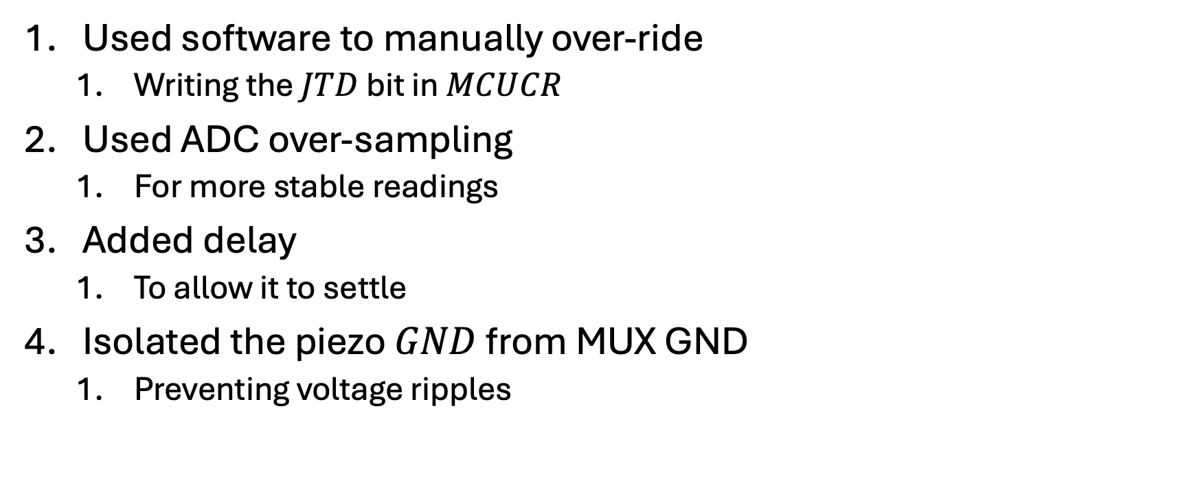
Fixes
Used software to manually over-ride
  Writing the $JTD$ bit in $MCUCR$
Used ADC over-sampling
  For more stable readings
Added delay
  To allow it to settle
Isolated the piezo $GND$ from MUX GND
  Preventing voltage ripples
Notes:
1. Had to write it twice within four clock cycles
2. Essentially just making the adc take more readings and then take an average
3. Between the mux address switching and ADC conversion
4. The piezo was the speaker I used for the output. The voltage ripples are small fluctuations in the VCC when a component draws lots of current. The ripples are seen by the adc as changes in the sensor signal, generating sound

Slide 7
Logic
for (uint8_t i = 0; i < 8; i++) {
PORTC = (PORTC & 0xF8) | (i & 0x07);
_delay_us(10);
for (uint8_t j = 0; j < 4; j++) {
ADMUX = (ADMUX & 0xF0) | (j & 0x0F);
ADCSRA |= _BV(ADSC);
if (ADC < THRESHOLD) {
detected_key = (j * 8) + i;
}
}
}
Selecting the key
Selecting the MUX based on which key pressed
Allow time to settle
Switch the ADC port
Start conversion
Tells il-matto which key is being pressed
Notes:
Adc ports – PA0 to PA3
Analogy
Treat like a house
Select the room, all the floors open that room
Switch to the floor
Now, if for example we have room 3, floor 1, then it would be room 11

Slide 8
Logic (2)
Note generation
Only trigger if signal drops below 800
If key is 25 or 26, go octave up or octave down or octave reset
Then calculate the target frequency
Find the corresponding index in the note_table
Otherwise, set to 0 - silence
if (adc_val < THRESHOLD_VALUE) {
int8_t temp_key = (j * 8) + i;
if (temp_key == 25 && lock == 0) {
octave_shift++;
lock = 1;
}
else if (temp_key < 25) {
int16_t target = OCTAVE_OFFSET + temp_key + (12 * octave_shift);
OCR1A = note_table[target];
TCCR1A |= _BV(COM1A0);
}
} else {
TCCR1A &= ~_BV(COM1A0);
}
Notes:
How to generate sound based on the key being pressed
On the left we see octave up presented – key 25, when it is pressed, the octave shift is incremented
For key 26 opposite, octave shift decremented
And for key 27, it is reset to 0
Now that you have all three variables, the temp_key (key pressed), the octave_shift (based on keys 25 and 26 and 27 and octave_offset declared in a macro at the top.
The frequency is calculated by adding the key (0 to 7) added with the octave offset which is 36 - three octaves - added with the (12 * octave_shift) based on the keys 25 and 26 and 27
Note_table is an array of numbers which has all the frequencies pre-generated, generated using python, where using the equation from the datasheet calculated frequencies for 128 keys.

Slide 9
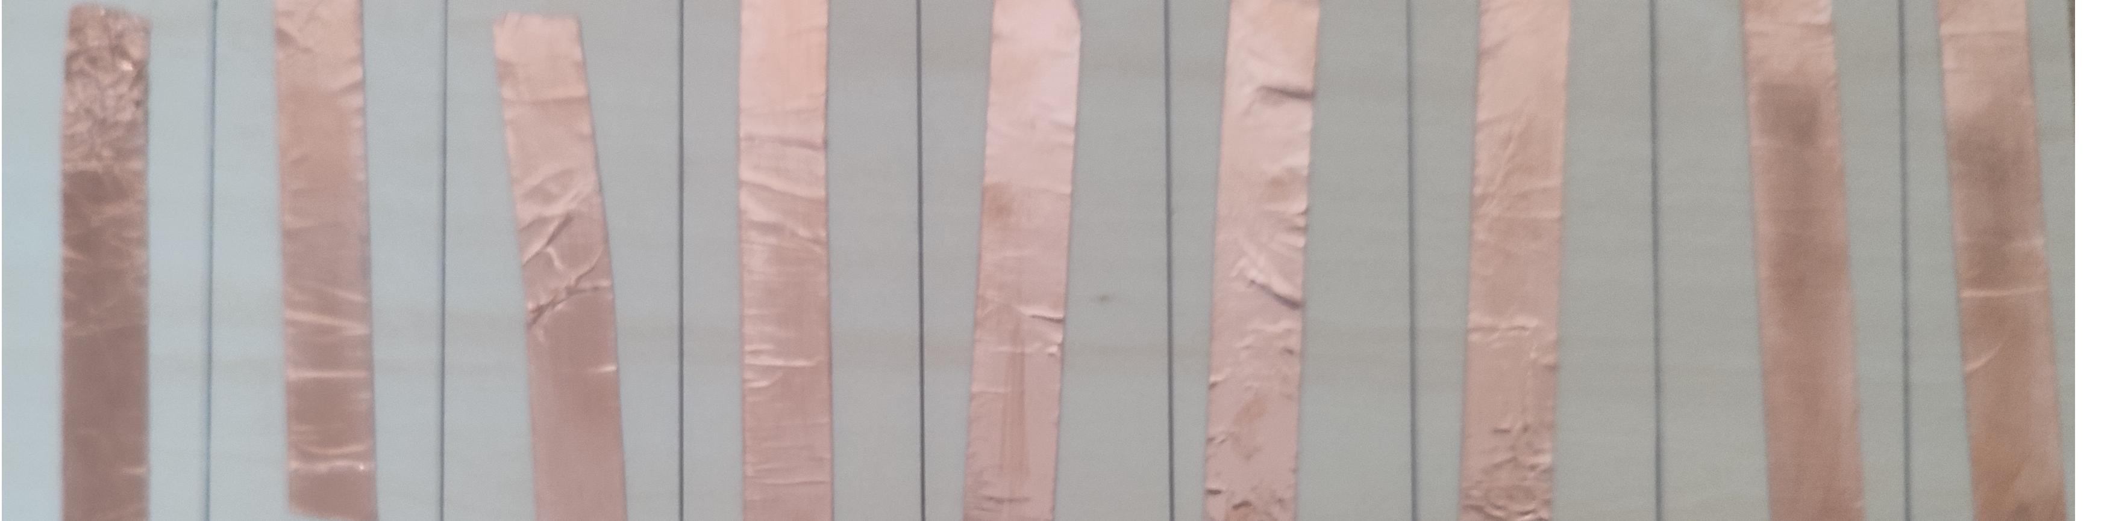
Future
Add copper touch-pads which the user can press
  Non blocky – easy for portability
Make more like an electronic keyboard
Build it on an RTOS
Notes:
And the increased capacitance of the human finger will cause a change in signal, as can be seen in the bottom image using copper tape
By adding pedal and fading audio, and pressing harder causes a different sound, but this involves different buttons
Real time operating system – but this would use more of the ilmatto small storage so perhaps not the best idea

