Slide 1

WHITE BOARD PROJECT
NAME: Ayush Trivedi
ROLL NO: 24MCS111

Slide 2
OBJECTIVE AND SCOPE
The project comprises of basic Canvas board functionalities such as,
writing, erasing, downloading the canvas,
adding notes (with minimizing it, closing It, dragging it around on the page),
uploading the image (features same as of notes),
undo and redo actions.
Added real-time drawing functionality using Socket.io by connecting to server using Express.js

Slide 3
TECHNOLOGIES AND MODULES
TECHNOLOGIES :
Here are just a few instances of how technology used in project management is changing the game for the better :
HTML
CSS
JavaScript
Express.js
Socket.io

Slide 4
MODULES
MODULES :
Module is a collection of source files and build settings that allow you to divide your project into discrete units of functionality.
NPM Modules
Socket.io--> For real-time drawings
Express.js--> For creating socket server

Slide 5
HARDWARE REQUIREMENTS
Hardware refers to the physical, tangible computer equipment and devices, which provide support for major functions such as input, processing (internal storage, computation and control), output, secondary storage (for data and programs), and communication.
Processor: Intel i3 eq or >
RAM: 6 GB or >
ROM: 64 GB or >

Slide 6
SOFTWARE REQUIREMENTS
A Software requirements describes the intended purpose, requirements, and nature of software/application/project to be developed.
All the OS which can afford node version v14.17.6 or > like Windows 10, Mac OS, etc.
Necessary JS modules

Slide 7
EXISTING SYSTEM
Following are some of the existing online interactive white board soft wares:
These software uses text, images, videos, animations, etc.
Canvas board’s stylus bar enables users to create content utilizing highlighter, eraser, virtual keyboard, and zoom-in/zoom-out tool.
The interactives module allows teachers to build custom activities such as jumbled sentences, number sequences, tic tac toe, and multiplication/division, among other exercises.
The document management functionality lets users import, export, categorize, and duplicate files on a centralized platform.

Slide 8
PROPOSED SYSTEM
I have Developed basic Canvas board functionalities such as writing, erasing, downloading the canvas, adding notes (with minimizing, closing, dragging it around the page Uploading the image ( features same as of notes), undo and redo actions.)
Added real- time drawing functionality using SOCKET.IO by connecting to server using EXPRESS.JS
Created Undo-redo features for the board using Array as Stack by storing positions, colors and width of the pen and eraser.

Slide 9
j
Adding notes and uploading image:
By clicking red button, notes can be closed. Similarly for uploading images. Using green button, we can minimize the notes .
Real-time drawing:
Real-time drawing can be achieved by the people using same link at same time.
Basic tools :
The color of the line: The "Color" button (1) changes the color of your writing.
The eraser: The "Eraser" button (3) allows you to choose the size of the tool that allows you to clear all or part of the text you've written.

Slide 10
pro
The stylus bar:
The tool "Annotate the document" can allow to write using your stylus.
The tool "Clear the annotation" is used to precisely erase what you have written with the stylus.
The tool "Select and modify objects" is used to select an object on your page to move it and apply changes (selection, resizing, deletion, rotation) .
The tool "Zooming in" and "Zoom out" can allow to enlarge or reduce the area on the screen.
The tool "Write text" creates a text object on your page.

Slide 11
v
Advanced tools :
Undo / Redo : The buttons "Undo" and "Redo" function as in text editors.
Pictures: The "Pictures" folder provides access to your library of images. During the first installation, Canvas board automatically creates a folder "Canvas board" in folder pictures of your personal computer .
The mode "Desktop" The button "Desktop" will hide Canvas board to use other software or navigate freely on your desktop. This mode displays a specific version of the stylus bar that can make annotations on your desktop or capture

Slide 12
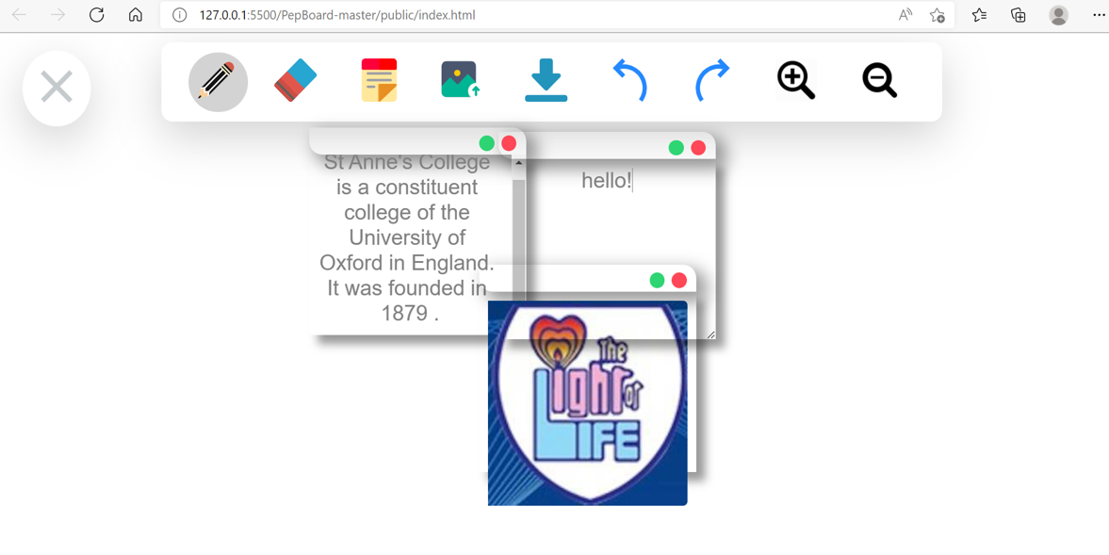

Slide 13
SUMMARY
Shows / hides the tool palette linked to stylus
Draw using pencil (3 different colors, scale the pencil size) . Erase the drawn area using eraser(scale the eraser size)
Include a sticky note to make notes (feature to add multiple sticky notes, move sticky note around the drawing area, minimize and close the sticky note)
Upload an image or gif (feature to add multiple files, feature to move the file, close the file).

Slide 14
V
Download the drawing part on the user screen.
Redo or undo the drawing content changes.
Zoom in or zoom out the drawing content.
Real-time virtual environment for drawing and erasing.
Erase the drawn area using eraser(scale the eraser size) .

Slide 15
IMPLIMENTATION
We can run on our local machine:
Replace Canvas boardparidhi.herokuapp.com/ with http://localhost:3000/ in index html file.
Open the folder in VS code.
Open terminal and write these commands: npm init Press Enter.
Then, npm install socket.io npm install --save-dev node mon node app.js
Now open the browser and type localhost:3000.

Slide 16
CONCLUSION
The Project is being implemented. In this proposed system, we have provided many essential features such as downloading the canvas, adding colourful and attractive sticky notes, and one major feature that we have implemented in this project is real-time collaboration through which two user can connect with each other efficiently

Slide 17


