Slide 1
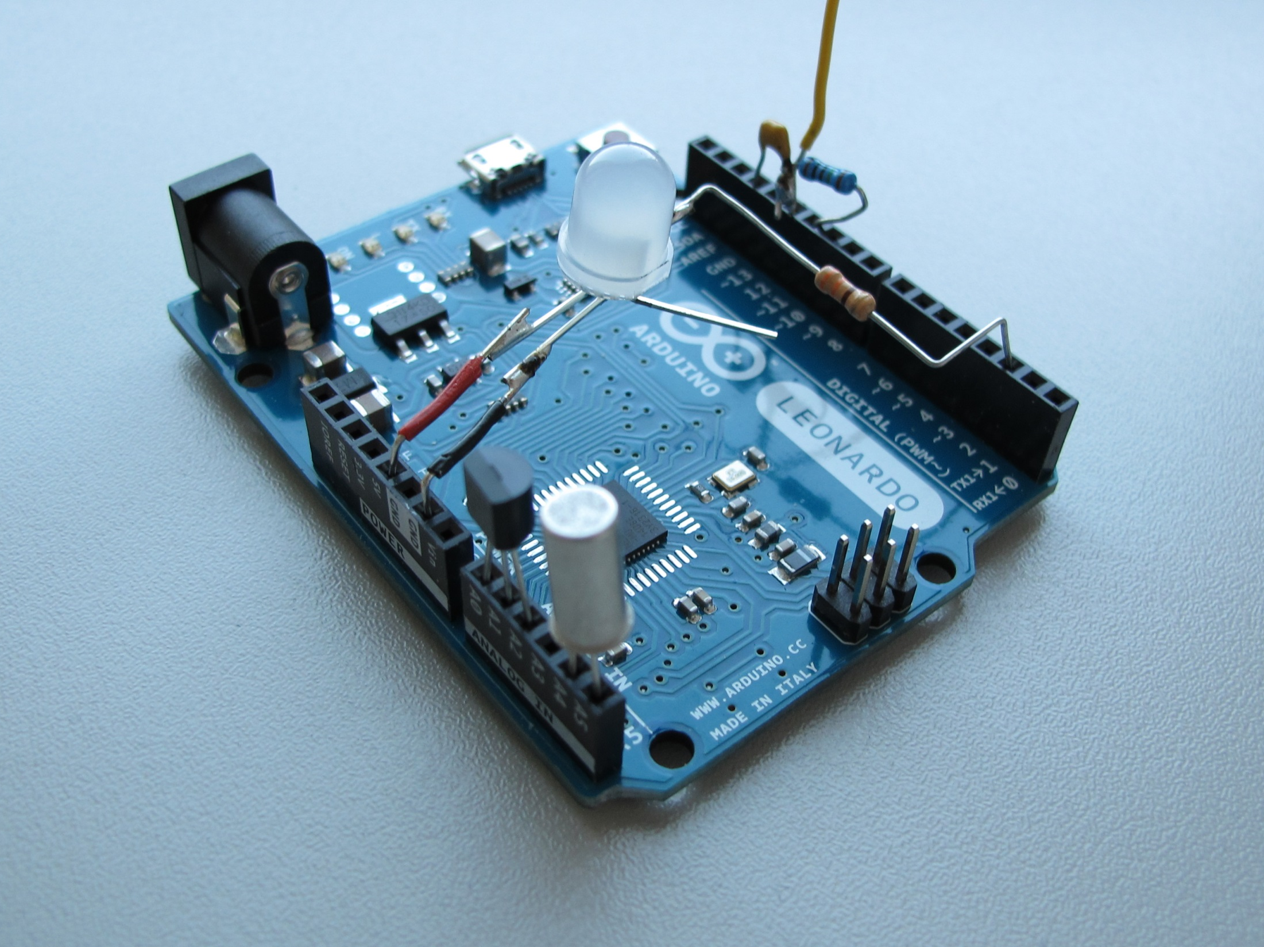

Touch Sensor Capacitor: pin GND
Touch Sensor Antenna: pin 12
Touch Sensor Resistor: pin 10
WS2812 LED
+5V
GND
WS2812 LED
DIN: pin 2
flat side!
TEMPERATURE SENSOR
(LM35):
pins A4 and A5
TILT SENSOR: pins A4 and A5

