Slide 1
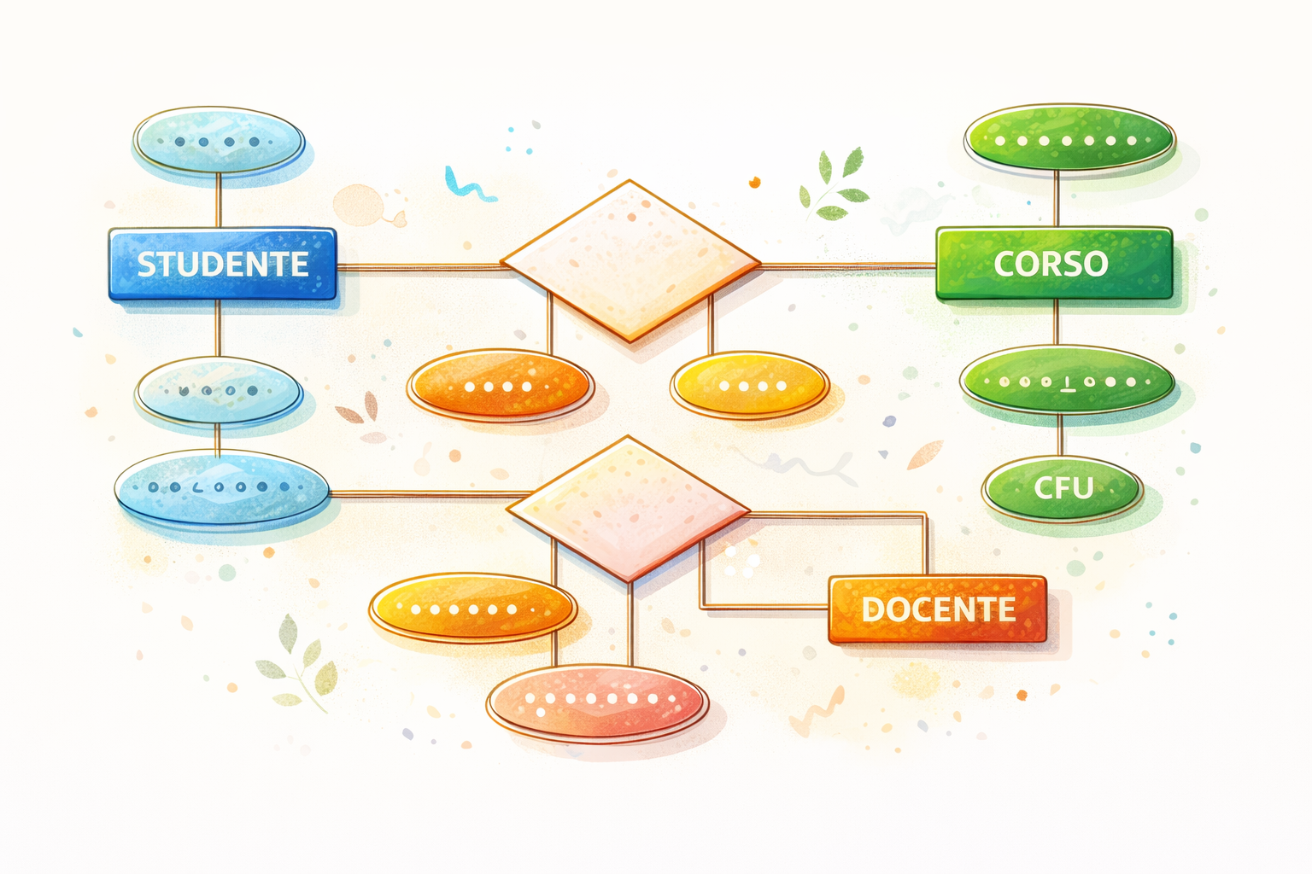
Data Modeling Using the Entity-Relationship (ER) Model

Slide 2
Overview of Database Design Process
Two main activities:
Database design
Applications design
Focus here on conceptual database design
To design the conceptual schema for a database application
Applications design focuses on the programs and interfaces that access the database
Generally considered part of software engineering

Slide 3
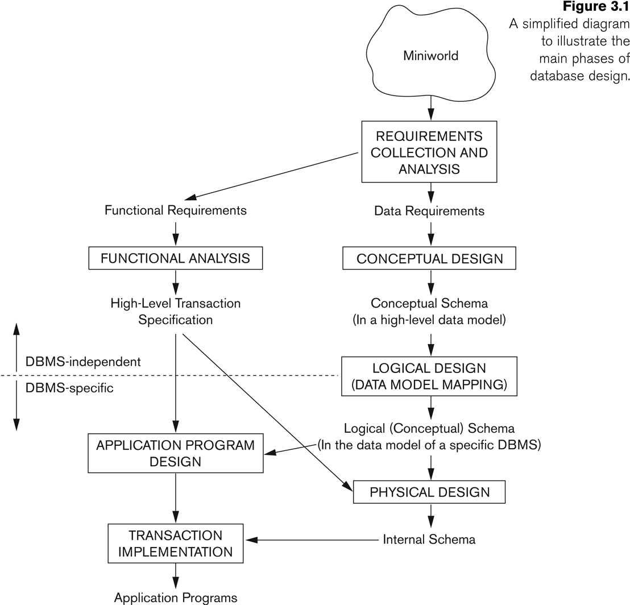
Overview of Database Design Process

Slide 4
Methodologies for Conceptual Design
Entity Relationship (ER) Diagrams
Enhanced Entity Relationship (EER) Diagrams
Use of Design Tools in industry for designing and documenting large scale designs
The UML (Unified Modeling Language) Class Diagrams are popular in industry to document conceptual database designs

Slide 5
Example COMPANY Database
We need to create a database schema design based on the following (simplified) requirements of the COMPANY Database:
The company is organized into DEPARTMENTs. Each department has a name, number and an employee who manages the department. We keep track of the start date of the department manager. A department may have several locations.
Each department controls a number of PROJECTs. Each project has a unique name, unique number and is located at a single location.

Slide 6
Example COMPANY Database
The database will store each EMPLOYEE’s social security number, address, salary, sex, and birthdate.
Each employee works for one department but may work on several projects.
The DB will keep track of the number of hours per week that an employee currently works on each project.
It is required to keep track of the direct supervisor of each employee.
Each employee may have a number of DEPENDENTs.
For each dependent, the DB keeps a record of name, sex, birthdate, and relationship to the employee.

Slide 7
Example COMPANY Database
We need to create a database schema design based on the following (simplified) requirements of the COMPANY Database:
The company is organized into DEPARTMENTs. Each department has a name, number and an employee who manages the department. We keep track of the start date of the department manager. A department may have several locations.
Each department controls a number of PROJECTs. Each project has a unique name, unique number and is located at a single location.

Slide 8
Example COMPANY Database
The database will store each EMPLOYEE’s social security number, address, salary, sex, and birthdate.
Each employee works for one department but may work on several projects.
The DB will keep track of the number of hours per week that an employee currently works on each project.
It is required to keep track of the direct supervisor of each employee.
Each employee may have a number of DEPENDENTs.
For each dependent, the DB keeps a record of name, sex, birthdate, and relationship to the employee.

Slide 9
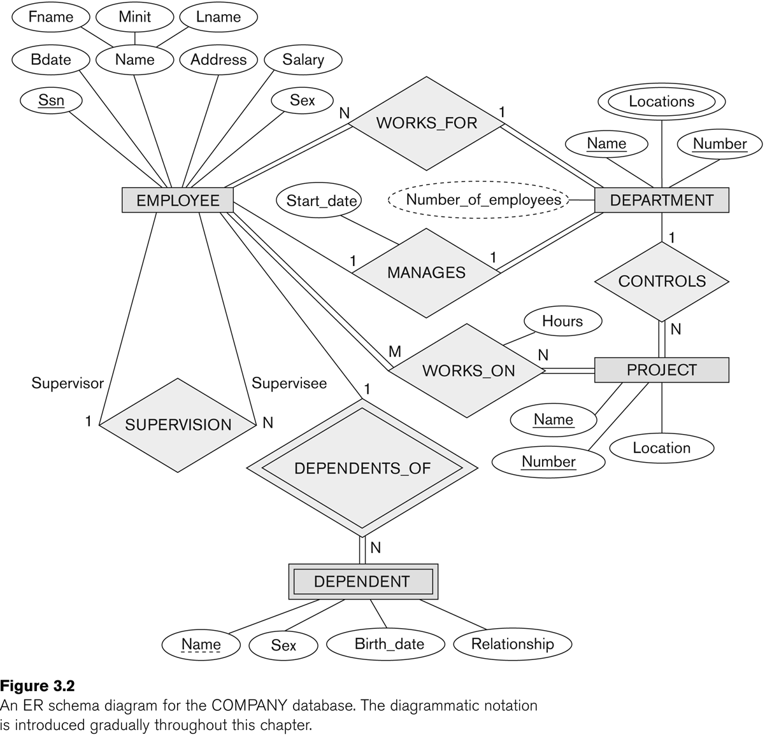
The Company ER model
This is our goal

Slide 10
ER Model Concepts
Entities
Entity is a basic concept for the ER model.
Entities are specific things or objects in the mini-world with an indipendent existence.
For example the EMPLOYEE John Smith, the Research DEPARTMENT, the ProductX PROJECT

Slide 11
ER Model Concepts
Attributes
Attributes are properties used to describe an entity.
For example an EMPLOYEE entity may have the attributes Name, SSN, Address, Sex, BirthDate
A specific entity will have a value for each of its attributes.
For example a specific employee entity may have Name='John Smith', SSN='123456789', Address ='731, Fondren, Houston, TX', Sex='M', BirthDate='09-JAN-55‘
Each attribute has a value set (or data type) associated with it – e.g. integer, string, date, enumerated type, …

Slide 12
Types of Attributes (1)
Simple
Each entity has a single atomic value for the attribute. For example, SSN or Sex.
Composite
The attribute may be composed of several components. For example:
Address(Apt#, House#, Street, City, State, ZipCode, Country), or
Name(FirstName, MiddleName, LastName).
Composition may form a hierarchy where some components are themselves composite.
Multi-valued
An entity may have multiple values for that attribute. For example, Color of a CAR or PreviousDegrees of a STUDENT.
Denoted as {Color} or {PreviousDegrees}.

Slide 13
Types of Attributes (2)
In general, composite and multi-valued attributes may be nested arbitrarily to any number of levels, although this is rare.
For example, PreviousDegrees of a STUDENT is a composite multi-valued attribute denoted by {PreviousDegrees (College, Year, Degree, Field)}
Multiple PreviousDegrees values can exist
Each has four subcomponent attributes:
College, Year, Degree, Field

Slide 14
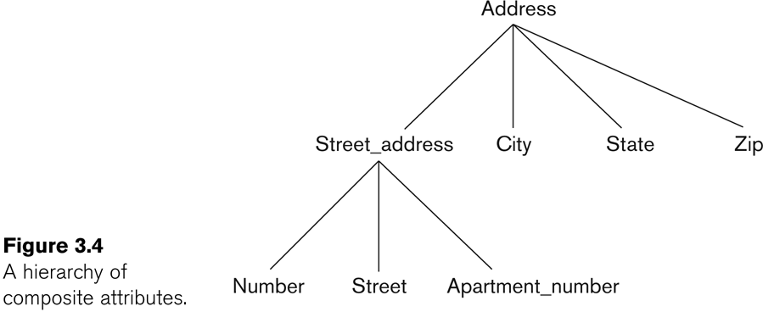
Example of a composite attribute

Slide 15
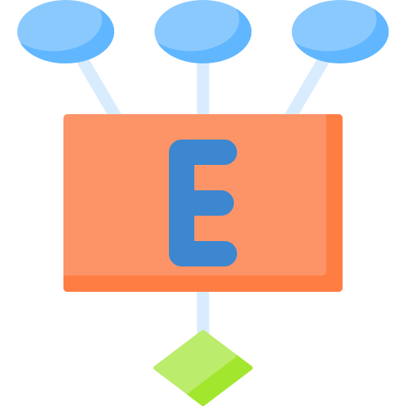

Entity Types and Key Attributes (1)
Entities with the same basic attributes are grouped or typed into an entity type.
For example, the entity type EMPLOYEE and PROJECT.
An attribute of an entity type for which each entity must have a unique value is called a key attribute of the entity type.
For example, SSN of EMPLOYEE.

Slide 16
Entity Types and Key Attributes (2)
A key attribute may be composite.
VehicleTagNumber is a key of the CAR entity type with components (Number, State).
An entity type may have more than one key.
The CAR entity type may have two keys:
VehicleIdentificationNumber (popularly called VIN)
VehicleTagNumber (Number, State), aka license plate number.
Each key is underlined (Note: this is different from the relational schema where only one “primary key is underlined).

Slide 17
Displaying an Entity type
In ER diagrams, an entity type is displayed in a rectangular box
Attributes are displayed in ovals
Each attribute is connected to its entity type
Components of a composite attribute are connected to the oval representing the composite attribute
Each key attribute is underlined
Multivalued attributes displayed in double ovals

Slide 18
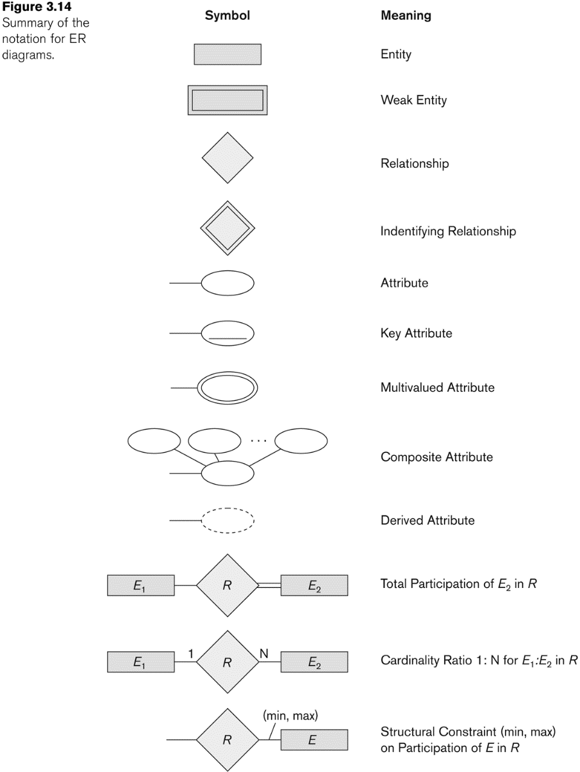
NOTATION for ER diagrams

Slide 19
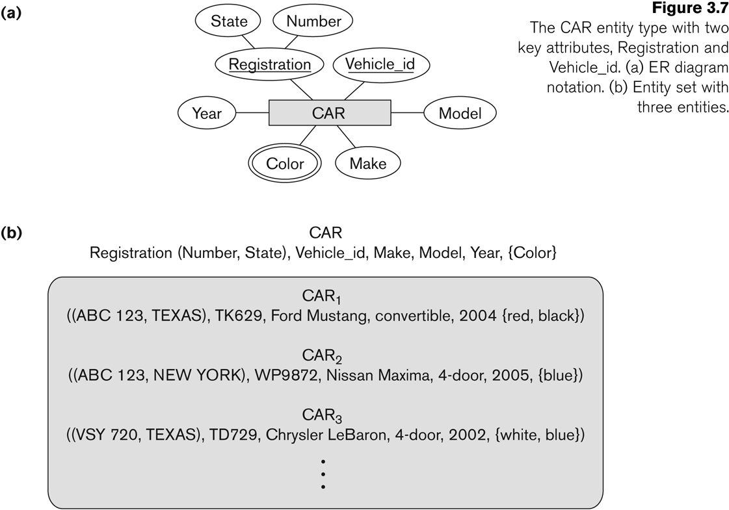
Entity Type CAR with two keys and a corresponding Entity Set
Each entity type will have a collection of entities stored in the database called the entity set or sometimes entity collection
Same name (CAR) used to refer to both the entity type and the entity set
However, entity type and entity set may be given different names
Entity set is the current state of the entities of that type that are stored in the database
Entity Type
Entity Set

Slide 20
Value Sets (Domains) of Attributes
Each simple attribute is associated with a value set
E.g., Lastname has a value which is a character string of up to 15 characters
Date has a value consisting of MM-DD-YYYY where each letter is an integer
A value set specifies the set of values associated with an attribute

Slide 21
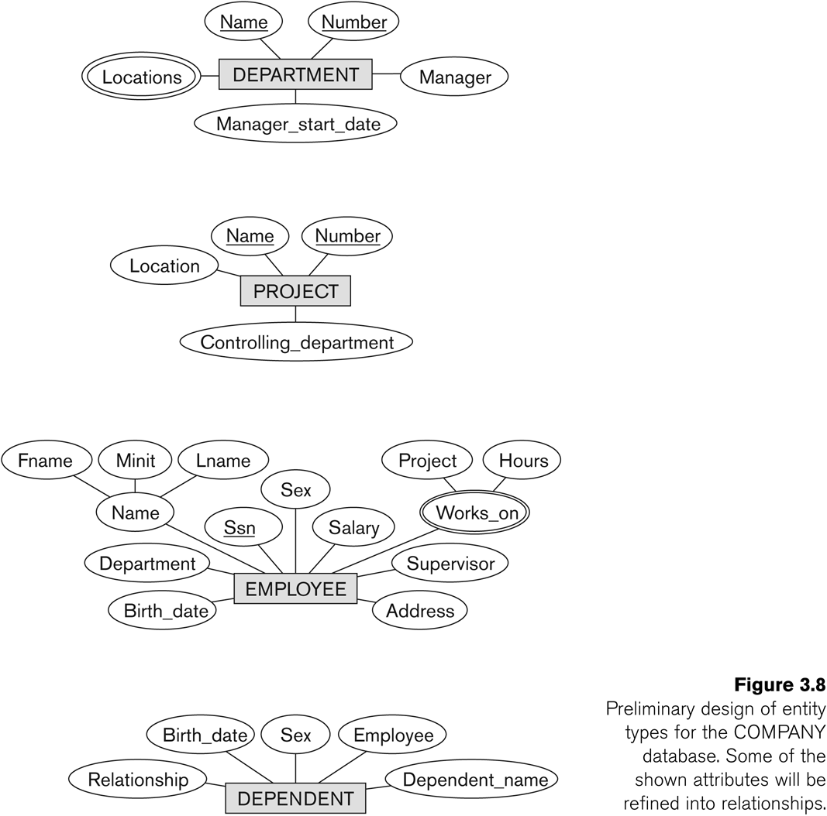
Initial Conceptual Design of Entity Types for the COMPANY Database Schema
Based on the requirements, we can identify four initial entity types in the COMPANY database:
Their initial conceptual design is shown on the following slide
The initial attributes shown are derived from the requirements description

Slide 22
Biblioteca universitaria (1)
Una biblioteca universitaria vuole realizzare un sistema informativo per gestire i propri servizi.
La biblioteca possiede diversi libri.
Ogni libro è identificato da un codice ISBN, ha un titolo, un anno di pubblicazione e un editore.
I libri sono scritti da uno o più autori.
Per ogni autore si vogliono memorizzare nome, cognome e nazionalità.
La biblioteca può avere più copie dello stesso libro.
Ogni copia ha un codice identificativo, uno stato (disponibile, in prestito, danneggiato) e una posizione nello scaffale.

Slide 23
Biblioteca universitaria (2)
Gli utenti della biblioteca possono prendere in prestito i libri.
Per ogni utente si memorizzano numero tessera, nome, cognome, email e data di iscrizione.
Quando un utente prende in prestito una copia di un libro, viene registrato un prestito con:
data di inizio prestito
data di scadenza
data di restituzione (eventuale)
La biblioteca organizza anche eventi culturali (presentazioni di libri, incontri con autori, seminari).
Per ogni evento si memorizzano titolo, data, orario, sala e numero massimo di partecipanti.
Gli utenti possono iscriversi agli eventi.

Slide 24
Refining the initial design by introducing relationships
The initial design is typically not complete
Some aspects in the requirements will be represented as relationships
ER model has three main concepts:
Entities (and their entity types and entity sets)
Attributes (simple, composite, multivalued)
Relationships (and their relationship types and relationship sets)

Slide 25
Relationships and Relationship Types (1)
A relationship relates two or more distinct entities with a specific meaning.
For example, EMPLOYEE John Smith works on the ProductX PROJECT, or EMPLOYEE Franklin Wong manages the Research DEPARTMENT.
Relationships of the same type are grouped or typed into a relationship type.
For example, the WORKS_ON relationship type in which EMPLOYEEs and PROJECTs participate, or the MANAGES relationship type in which EMPLOYEEs and DEPARTMENTs participate.
The degree of a relationship type is the number of participating entity types.
Both MANAGES and WORKS_ON are binary relationships.

Slide 26
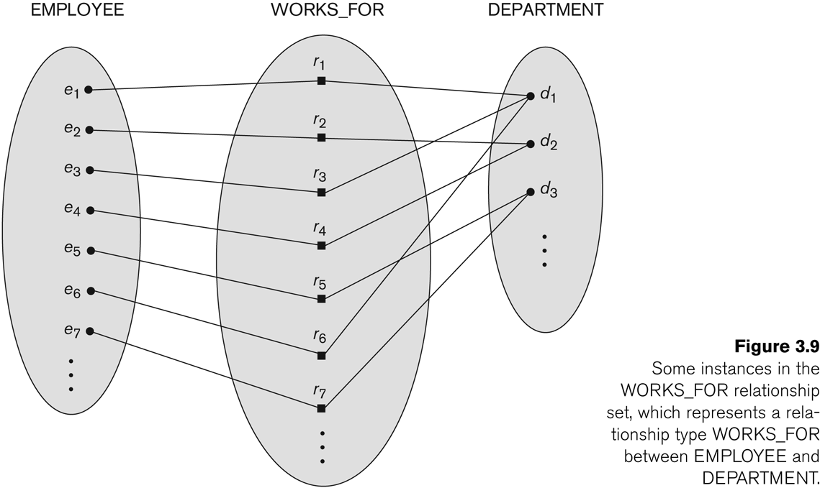
Relationship instances of the WORKS_FOR N:1 relationship between EMPLOYEE and DEPARTMENT

Slide 27
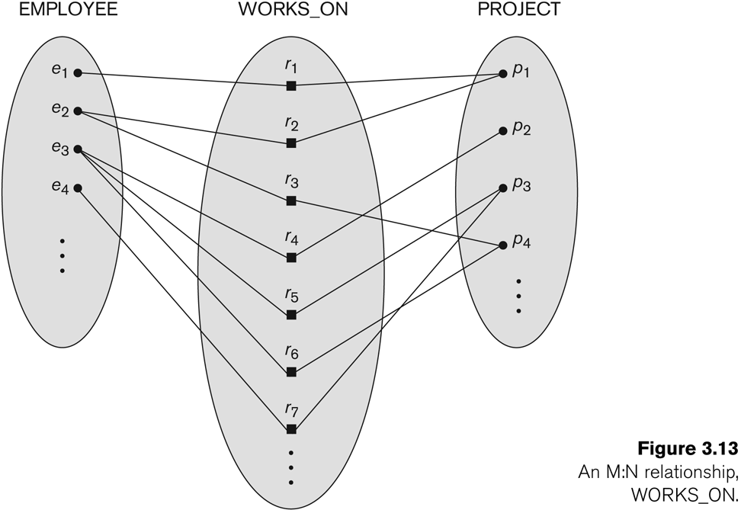
Relationship instances of the M:N WORKS_ON relationship between EMPLOYEE and PROJECT

Slide 28
Relationship type vs. relationship set (1)
Relationship Type:
Is the schema description of a relationship
Identifies the relationship name and the participating entity types
Also identifies certain relationship constraints
Relationship Set:
The current set of relationship instances represented in the database
The current state of a relationship type

Slide 29
Relationship type vs. relationship set (2)
Each instance in the set relates individual participating entities – one from each participating entity type
In ER diagrams, we represent the relationship type as follows:
Diamond-shaped box is used to display a relationship type
Connected to the participating entity types via straight lines
Note that the relationship type is not shown with an arrow.
The name should be typically be readable from left to right and top to bottom.

Slide 30
Refining the COMPANY database schema by introducing relationships
By examining the requirements, six relationship types are identified
All are binary relationships( degree 2)
Listed below with their participating entity types:
WORKS_FOR (between EMPLOYEE, DEPARTMENT)
MANAGES (also between EMPLOYEE, DEPARTMENT)
CONTROLS (between DEPARTMENT, PROJECT)
WORKS_ON (between EMPLOYEE, PROJECT)
SUPERVISION (between EMPLOYEE (as subordinate), EMPLOYEE (as supervisor))
DEPENDENTS_OF (between EMPLOYEE, DEPENDENT)

Slide 31
ER DIAGRAM – Relationship Types are: WORKS_FOR, MANAGES, WORKS_ON, CONTROLS, SUPERVISION, DEPENDENTS_OF

Slide 32
NOTATION for ER diagrams

Slide 33


Discussion on Relationship Types
RELATIONSHIP as ATTRIBUTE: In the refined design, some attributes from the initial entity types are refined into relationships:
Manager of DEPARTMENT -> MANAGES
Works_on of EMPLOYEE -> WORKS_ON
Department of EMPLOYEE -> WORKS_FOR
etc
In general, more than one relationship type can exist between the same participating entity types
MANAGES and WORKS_FOR are distinct relationship types between EMPLOYEE and DEPARTMENT
Different meanings and different relationship instances.

Slide 34
Constraints on Relationships
Cardinality Ratio (specifies maximum participation)
One-to-one (1:1)
One-to-many (1:N) or Many-to-one (N:1)
Many-to-many (M:N)
Shown by placing appropriate numbers on the relationship edges
Existence Dependency Constraint: The participation constraint specifies whether the existence of an entity depends on its being related to another entity via the relationship type (specifies minimum participation) (also called participation constraint)
zero (optional participation, not existence-dependent)
one or more (mandatory participation, existence-dependent)
Tota (set)l shown by double line, partial by single line.
M

Slide 35
Many-to-one (N:1) Relationship

Slide 36
Many-to-many (M:N) Relationship

Slide 37
Recursive Relationship Type
A relationship type between the same participating entity type in distinct roles
Also called a self-referencing relationship type.
Example: the SUPERVISION relationship
EMPLOYEE participates twice in two distinct roles:
supervisor (or boss) role
supervisee (or subordinate) role
Each relationship instance relates two distinct EMPLOYEE entities:
One employee in supervisor role
One employee in supervisee role

Slide 38
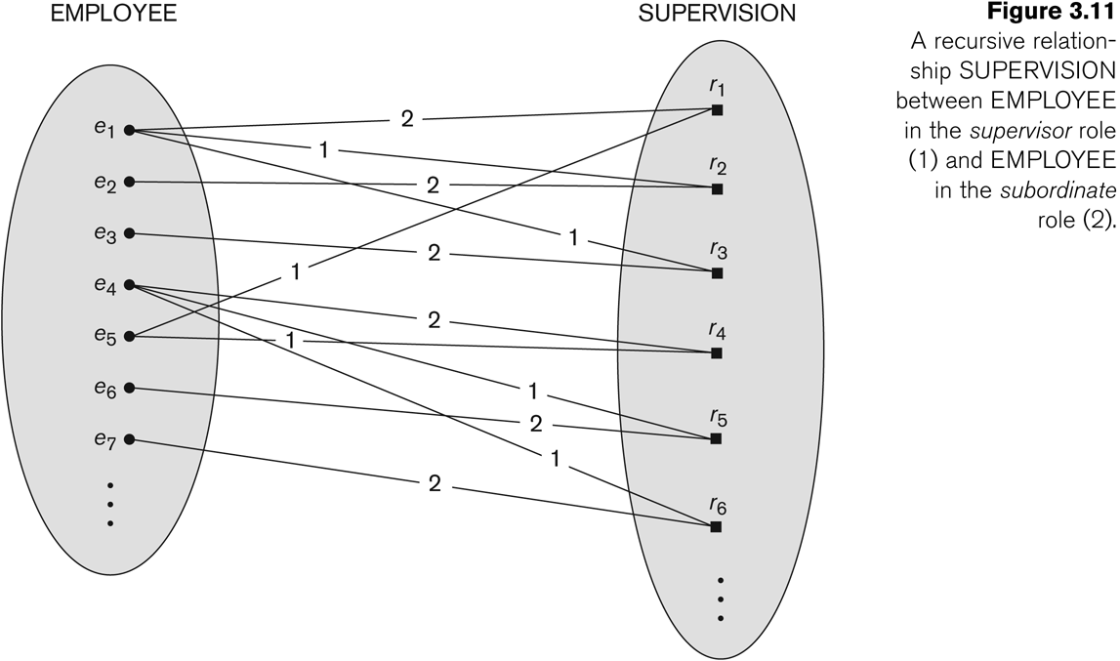
A Recursive Relationship Supervision`

Slide 39
ER DIAGRAM – Relationship Types are: WORKS_FOR, MANAGES, WORKS_ON, CONTROLS, SUPERVISION, DEPENDENTS_OF

Slide 40
NOTATION for ER diagrams

Slide 41
Weak Entity Types
An entity that does not have a key attribute and that is identification-dependent on another entity type.
A weak entity must participate in an identifying relationship type with an owner or identifying entity type
Entities are identified by the combination of:
A partial key of the weak entity type
The particular entity they are related to in the identifying relationship type
Example:
A DEPENDENT entity is identified by the dependent’s first name, and the specific EMPLOYEE with whom the dependent is related
Name of DEPENDENT is the partial key
DEPENDENT is a weak entity type
EMPLOYEE is its identifying entity type via the identifying relationship type DEPENDENT_OF

Slide 42
Attributes of Relationship types
A relationship type can have attributes:
For example, HoursPerWeek of WORKS_ON
Its value for each relationship instance describes the number of hours per week that an EMPLOYEE works on a PROJECT.
A value of HoursPerWeek depends on a particular (employee, project) combination
Most relationship attributes are used with M:N relationships
In 1:N relationships, they can be transferred to the entity type on the N-side of the relationship

Slide 43
Example Attribute of a Relationship Type: Hours of WORKS_ON

Slide 44
Alternative (min, max) notation for relationship structural constraints:
Specified on each participation of an entity type E in a relationship type R
Specifies that each entity e in E participates in at least min and at most max relationship instances in R
Default(no constraint): min=0, max=n (signifying no limit)
Must have min≤max, min≥0, max ≥1
Derived from the knowledge of mini-world constraints
Examples:
A department has exactly one manager and an employee can manage at most one department.
Specify (0,1) for participation of EMPLOYEE in MANAGES
Specify (1,1) for participation of DEPARTMENT in MANAGES
An employee can work for exactly one department but a department can have any number of employees.
Specify (1,1) for participation of EMPLOYEE in WORKS_FOR
Specify (0,n) for participation of DEPARTMENT in WORKS_FOR

Slide 45
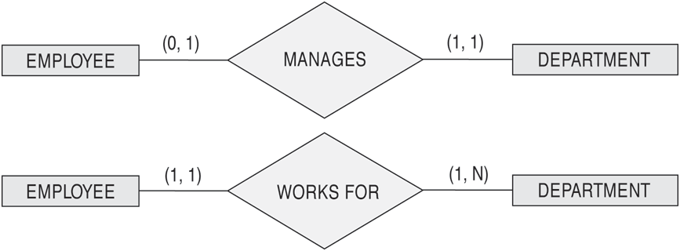
The (min,max) notation for relationship constraints
Read the min,max numbers next to the entity type and looking away from the entity type

Slide 46
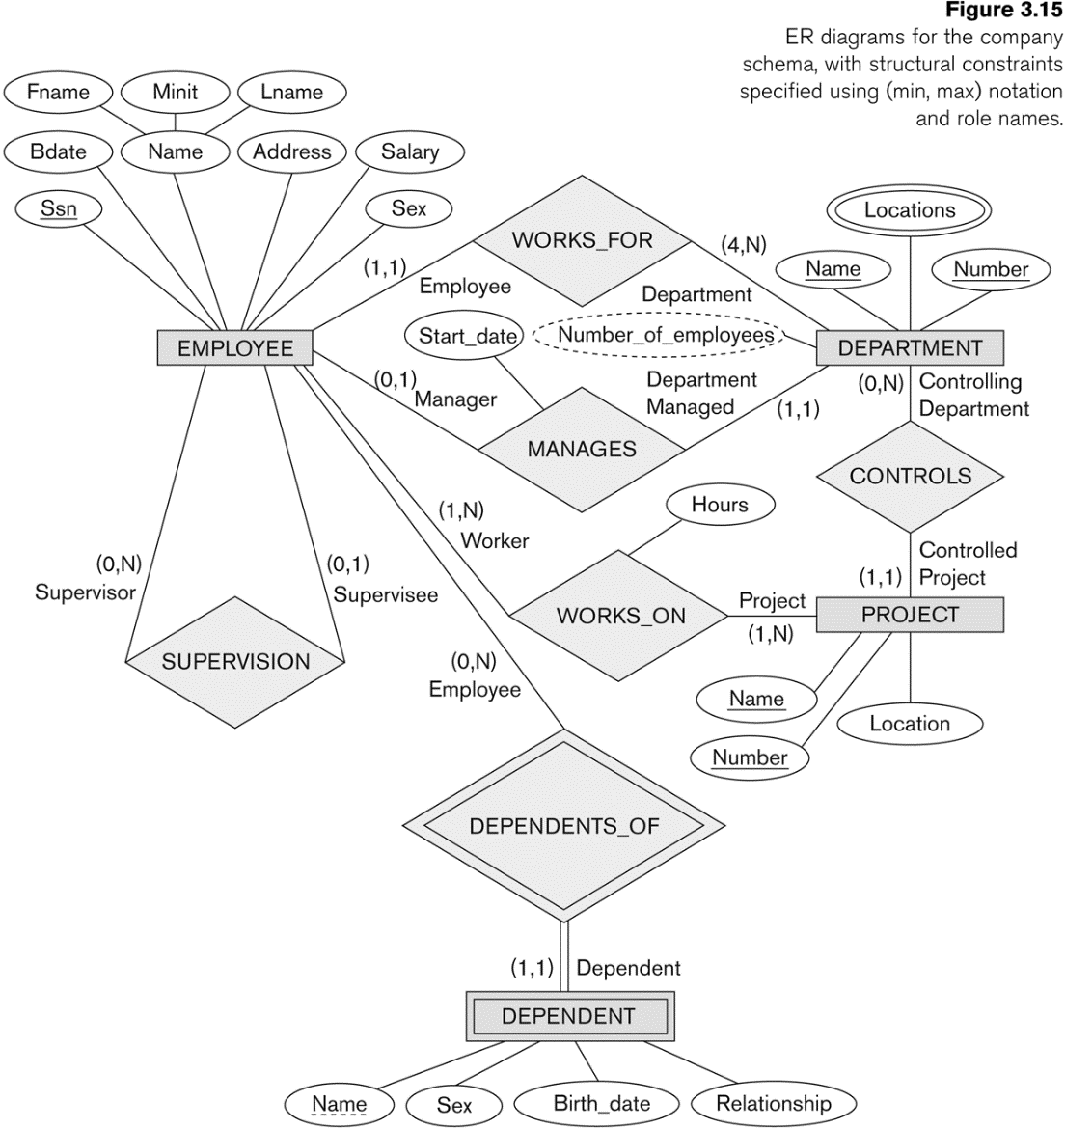
COMPANY ER Schema Diagram using (min, max) notation

Slide 47
Ex: Piattaforma universitaria di tirocini
Progettare lo schema ER di un sistema per la gestione dei tirocini universitari. Il sistema deve gestire studenti, aziende, tutor accademici, tutor aziendali, progetti di tirocinio, candidature, tirocini attivati e report settimanali. Ogni azienda propone progetti; gli studenti si candidano ai progetti; ogni studente ha un tutor accademico; ogni progetto ha un tutor aziendale; quando una candidatura viene accettata si attiva un tirocinio. Durante il tirocinio vengono prodotti report settimanali numerati progressivamente all’interno del tirocinio. Identificare entità, attributi, chiavi, relazioni, cardinalità minime e massime, eventuali vincoli di dipendenza esistenziale e almeno una weak entity.
Nota
evidenziare la weak entity;
distinguere tra partecipazione totale e parziale;
motivare almeno due existence dependency constraints;

Slide 48
Alternative diagrammatic notation
ER diagrams is one popular example for displaying database schemas
Many other notations exist in the literature and in various database design and modeling tools
UML class diagrams is representative of another way of displaying ER concepts that is used in several commercial design tools

Slide 49
UML class diagrams
Represent classes (similar to entity types) as large rounded boxes with three sections:
Top section includes entity type (class) name
Second section includes attributes
Third section includes class operations (operations are not in basic ER model)
Relationships (called associations) represented as lines connecting the classes
Other UML terminology also differs from ER terminology
Used in database design and object-oriented software design
UML has many other types of diagrams for software design

Slide 50
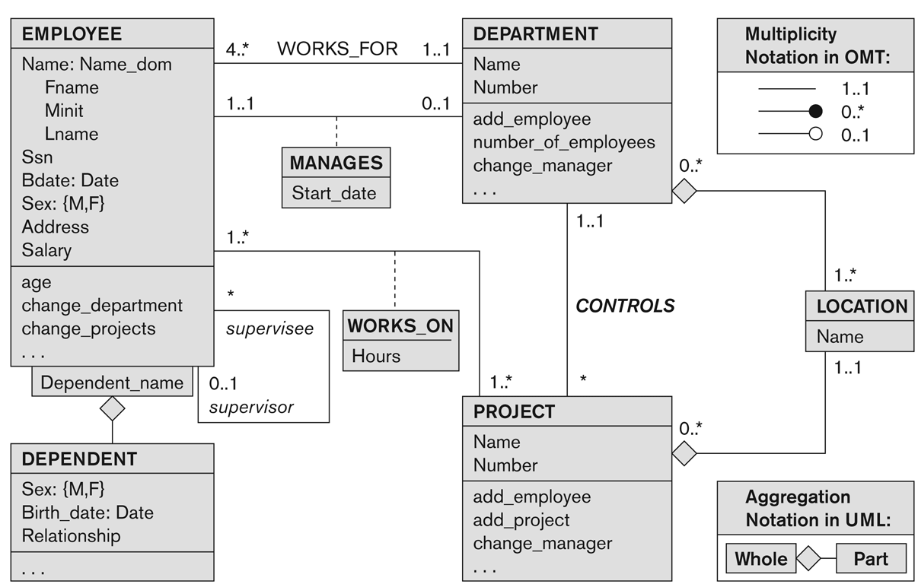



UML class diagram for COMPANY database schema

Slide 51
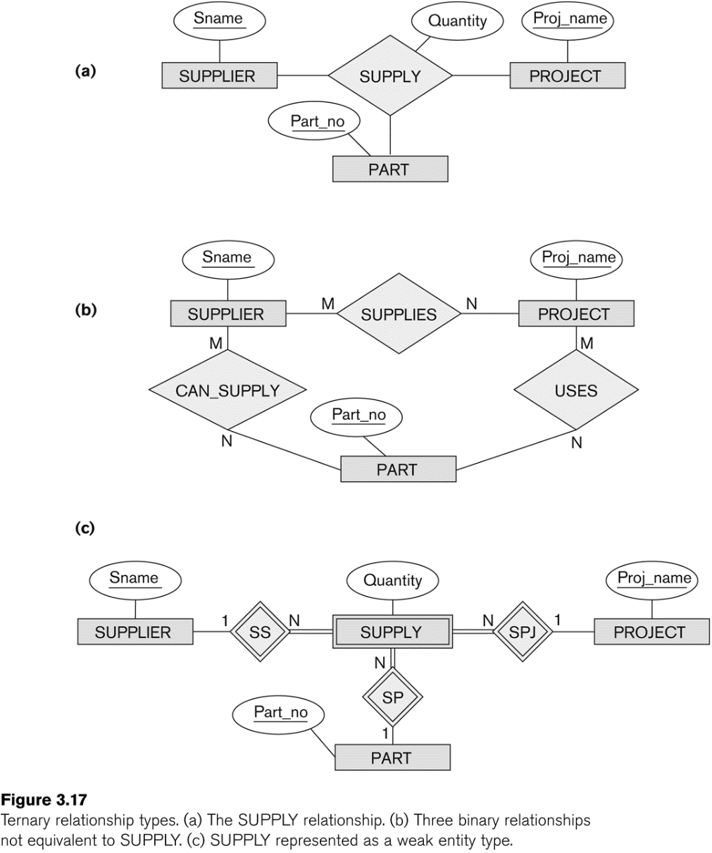

Relationships of Higher Degree
Relationship types of degree 2 are called binary
Relationship types of degree 3 are called ternary and of degree n are called n-ary
In general, an n-ary relationship is not equivalent to n binary relationships and constraint are harder to specify
In some cases, a ternary relationship can be represented as a weak entity if the data model allows a weak entity

Slide 52
Discussion of n-ary relationships (n > 2)
If a particular binary relationship can be derived from a higher-degree relationship at all times, then it is redundant
For example, the TAUGHT_DURING binary relationship in Figure 3.18 (see next slide) can be derived from the ternary relationship OFFERS (based on the meaning of the relationships)

Slide 53
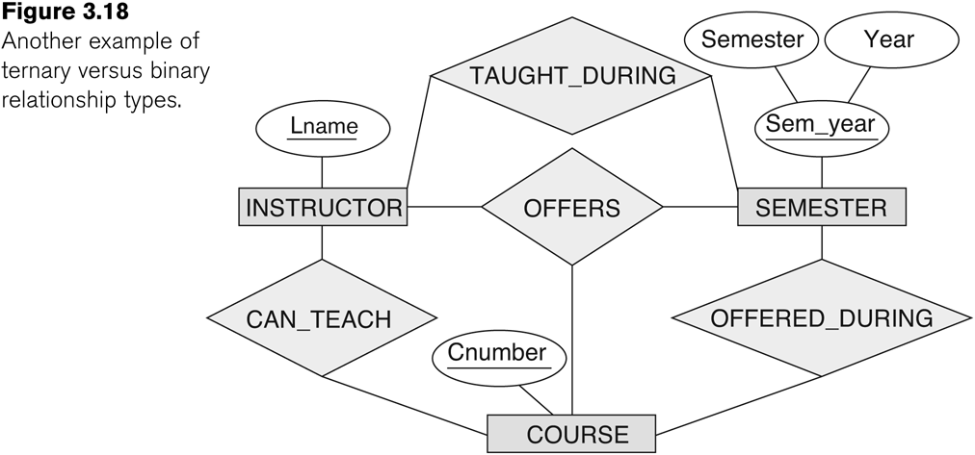
Another example of a ternary relationship

Slide 54
Displaying constraints on higher-degree relationships
The (min, max) constraints can be displayed on the edges – however, they do not fully describe the constraints
Displaying a 1, M, or N indicates additional constraints
An M or N indicates no constraint
A 1 indicates that an entity can participate in at most one relationship instance that has a particular combination of the other participating entities
In general, both (min, max) and 1, M, or N are needed to describe fully the constraints
Overall, the constraint specification is difficult and possibly ambiguous when we consider relationships of a degree higher than two.

Slide 55
Another Example: A UNIVERSITY Database
To keep track of the enrollments in classes and student grades, another database is to be designed.
It keeps track of the COLLEGEs, DEPARTMENTs within each college, the COURSEs offered by departments, and SECTIONs of courses, INSTRUCTORs who teach the sections etc.
These entity types and the relationships among these entity types are shown on the next slide in Figure 3.20.

Slide 56

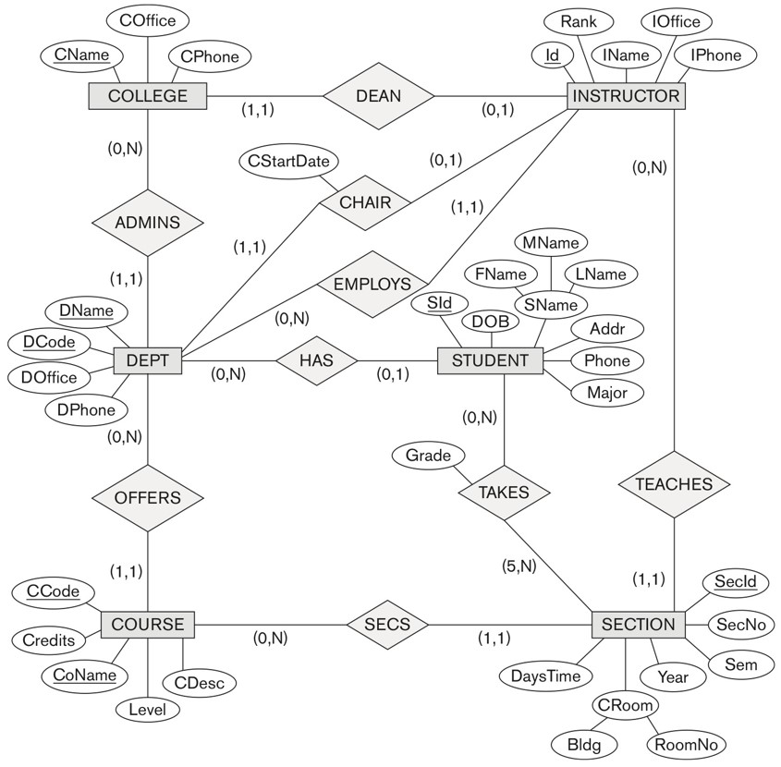
UNIVERSITY database conceptual schema

Slide 57
Extended Entity-Relationship (EER) Model (in the next chapter)
The entity relationship model in its original form did not support the specialization and generalization abstractions
Next chapter illustrates how the ER model can be extended with
Type-subtype and set-subset relationships
Specialization/Generalization Hierarchies
Notation to display them in EER diagrams

