Slide 1


Corso di laurea in:
Data Science per le scienze umane e sociali
ANALISI DEI DATI E BIG DATA
Docente: Marco Del Coco
marco.delcoco@unisalento.it

Slide 2
Introduzione al corso
Lezioni:
lunedì 09:30 – 11:30
giovedì 09:30 – 11:30
Testo:
Fondamentals of DataBase Systems 7th ed.
Elmasri - Navathe
Ricevimento:
Sia in presenza che da remote: :nviare una mail per fissare un appuntamento
marco.delcoco@unisalento.it

Slide 3
Modalità d’esame
Scritto:
Un semplice scritto per testare la conoscenza dei concetti di base
+
Un progetto pratico in cui si richiederà, a partire da una traccia assegnata, di creare un database (schema e implementazione) e effettuare alcune query dimostrative.
Progetto:

Slide 4
Programma
Modulo 2 — Fondamenti di Database Relazionali (22h)
Concetti fondamentali dei DB relazionali
Modellazione ER: entità, attributi, relazioni
Cenni su altri schemi
Linguaggio SQL
Esercizi su SQLite

Slide 5
Programma
Modulo 3 — Database Non Relazionali (NoSQL) (16h)
Concetti fondamentali dei DB non relazionali
Key Value
Document Database
Graph Database
No SQL hands on

Slide 6
Programma
Modulo 4 — Analisi Dati con Python e Pandas (8h)
Introduzione a NumPy e Pandas
Serie e DataFrame
Operazioni di base: selezione, slicing, filtri
Importazione da CSV, Excel, JSON
Gestione di file di grandi dimensioni
Interazione con Database (SQL – Neo4J etc.)
Visualizzazione dei dati

Slide 7
The 4 V
The 4 Vs define the key challenges and opportunities of managing and analyzing Big Data.
1. Volume: Refers to the massive amount of data generated every second from sources like social media, sensors, transactions, and devices.
2. Velocity: Describes the speed at which data is produced, collected, and processed. Real-time or near-real-time data flows are crucial for timely decisions.
3. Variety: Indicates the different types of data available: structured (databases), semi-structured (JSON, XML), and unstructured (images, videos, text).
4. Veracity: Represents the reliability and accuracy of the data. High data quality is essential for trustworthy analysis and decision-making.
Slide 1- <number>

Slide 8
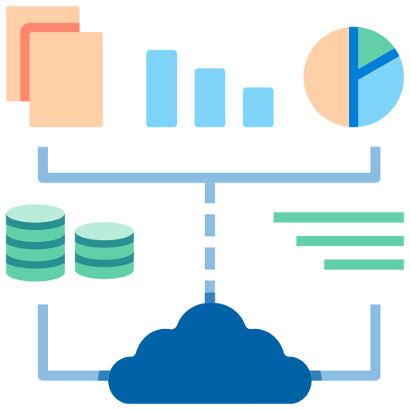
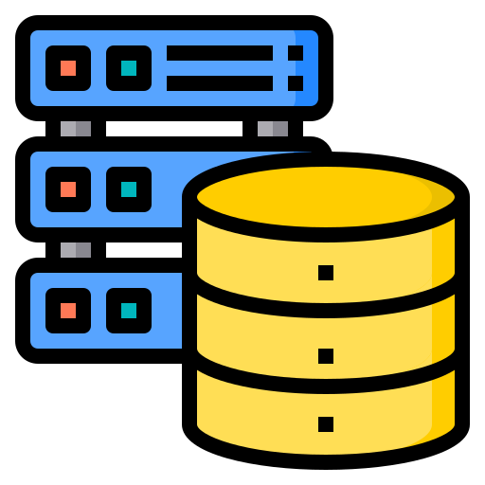
Database vs. Big Data
Database
  Structured collection of data stored in tables.
  Uses predefined schemas (rows and columns).
  Designed for consistency, accuracy, and transactions.
Big Data
  Extremely large and complex datasets.
  Includes structured, semi-structured, and unstructured data.
  Often processed with distributed systems and advanced analytics.
  Focused on discovering patterns, trends, and insights.

Slide 9
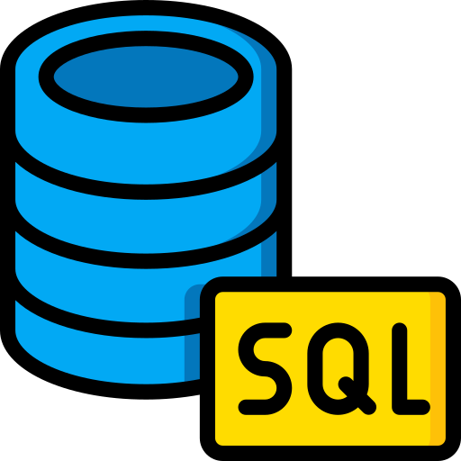


Type of Database
SQL Databases (Relational): Structured relational database using tables, schemas, and SQL queries.
NoSQL Databases: Flexible database storing unstructured or semi-structured data without fixed schemas.
Graph Databases: Database using nodes and edges to represent relationships efficiently between.

Slide 10
Type of Database
SQL Databases (Relational)
Data stored in tables with rows and columns
Uses structured schemas and relationships
Query language: SQL
Examples: MySQL, PostgreSQL, Oracle

Slide 11
Type of Database
NoSQL Databases
Flexible schemas for large or unstructured data
Types: document, key-value, column, etc.
Designed for scalability and high performance
Examples: MongoDB, Cassandra, Redis

Slide 12
Type of Database
Graph Databases
Data stored as nodes and relationships (edges)
Optimized for connected data and networks
Efficient for pathfinding and recommendations
Examples: Neo4j, Amazon Neptune

Slide 13


Data Analysis
Database
  Stores and organizes structured data.
  Enables efficient querying and data retrieval.
  Common systems: SQL databases like MySQL or PostgreSQL.
Python & Pandas
  Python: versatile programming language for data analysis.
  Pandas: powerful library for data manipulation and cleaning.
  Used for filtering, aggregating, and transforming datasets.
  What appens when data size exceed system capacity>
Data Visualization with Python
  Libraries like Matplotlib and Seaborn create charts and graphs.
  Helps explore patterns, trends, and insights visually.
  Useful for reports, dashboards, and presentations.

Slide 14
Databases and Database Users

Slide 15
Types of Databases and Database Applications
Traditional Applications:
  Numeric and Textual Databases
More Recent Applications:
  Multimedia Databases
  Geographic Information Systems (GIS)
  Biological and Genome Databases
  Data Warehouses

Slide 16
Recent Developments
New Technologies are emerging to manage vast amounts of data generated on the web:
  Big Data storage systems involving large clusters of distributed computers
  NOSQL (Not Only SQL) systems
  A large amount of data now resides on the “cloud” , huge data centers using thousands of machines.

Slide 17
Basic Definitions
Database: A collection of related data.
Data: Known facts that can be recorded and have an implicit meaning.
Mini-world: Some part of the real world about which data is stored in a database. For example, student grades and transcripts at a university.
Database Management System (DBMS): A software package/ system to facilitate the creation and maintenance of a computerized database.
Database System: The DBMS software together with the data itself. Sometimes, the applications are also included.

Slide 18
Impact of Databases and Database Technology
Businesses: Banking, Insurance, Retail, Transportation, Healthcare, Manufacturing
Service Industries: Financial, Real-estate, Legal, Electronic Commerce, Small businesses
Education : Resources for content and Delivery
More recently: Social Networks, Environmental and Scientific Applications, Medicine and Genetics
Personalized Applications: based on smart mobile devices

Slide 19

Simplified database system environment

Slide 20
Typical DBMS Functionality
Define a particular database in terms of its data types, structures, and constraints
Construct or Load the initial database contents on a secondary storage medium
Manipulating the database:
  Retrieval: Querying, generating reports
  Modification: Insertions, deletions and updates to its content
  Accessing the database through Web applications
Processing and Sharing by a set of concurrent users and application programs – yet, keeping all data valid and consistent

Slide 21
Application Activities Against a Database
Applications interact with a database by generating
  Queries: that access different parts of data and formulate the result of a request
  Transactions: that may read some data and “update” certain values or generate new data and store that in the database
Applications must not allow unauthorized users to access data
Applications must keep up with changing user requirements against the database

Slide 22
Additional DBMS Functionality
DBMS may additionally provide:
  Protection or Security measures to prevent unauthorized access
  Presentation and Visualization of data
  Maintenance of the database and associated programs over the lifetime of the database application
    Called database, software, and system maintenance

Slide 23
Example of a Database
(with a Conceptual Data Model)
Mini-world for the example:
  Part of a UNIVERSITY environment.
Some mini-world entities:
  STUDENTs
  COURSEs
  SECTIONs (of COURSEs)
  (academic) DEPARTMENTs
  INSTRUCTORs

Slide 24
Example of a Database
(with a Conceptual Data Model)
Some mini-world relationships:
  SECTIONs are of specific COURSEs
  STUDENTs take SECTIONs
  COURSEs have prerequisite COURSEs
  INSTRUCTORs teach SECTIONs
  COURSEs are offered by DEPARTMENTs
  STUDENTs major in DEPARTMENTs
Note: The above entities and relationships are typically expressed in a conceptual data model, such as the ENTITY-RELATIONSHIP data model

Slide 25

Example of a simple database

Slide 26
Main Characteristics of the Database Approach
Self-describing nature of a database system:
  A DBMS catalog stores the description of a particular database (e.g. data structures, types, and constraints)
  The description is called meta-data*.
  This allows the DBMS software to work with different database applications.
Insulation between programs and data:
  Called program-data independence.
  Allows changing data structures and storage organization without having to change the DBMS access programs.
  -----------------------------------------------------------------------------
  * Some newer systems such as a few NOSQL systems need no meta-data: they store the data definition within its structure making it self describing

Slide 27

Example of a simplified database catalog

Slide 28
Main Characteristics of the Database Approach (continued)
Data Abstraction:
  A data model is used to hide storage details and present the users with a conceptual view of the database.
  Programs refer to the data model constructs rather than data storage details
Support of multiple views of the data:
  Each user may see a different view of the database, which describes only the data of interest to that user.

Slide 29
Database Users
Users may be divided into
  Those who actually use and control the database content, and those who design, develop and maintain database applications (called “Actors on the Scene”), and
  Those who design and develop the DBMS software and related tools, and the computer systems operators (called “Workers Behind the Scene”).

Slide 30
Database Users – Actors on the Scene
  Database administrators:
    Responsible for authorizing access to the database, for coordinating and monitoring its use, acquiring software and hardware resources, controlling its use and monitoring efficiency of operations.
  Database Designers:
    Responsible to define the content, the structure, the constraints, and functions or transactions against the database. They must communicate with the end-users and understand their needs.

Slide 31
Database End Users
End-users: They use the data for queries, reports and some of them update the database content. End-users can be categorized into:
  Casual: access database occasionally when needed
  Naïve or Parametric: they make up a large section of the end-user population.
    They use previously well-defined functions in the form of “canned transactions” against the database.
    Users of Mobile Apps mostly fall in this category
    Bank-tellers or reservation clerks are parametric users who do this activity for an entire shift of operations.
    Social Media Users post and read information from websites

Slide 32
Database End Users (continued)
End users They use the data for queries, reports and some of them update the database content. End-users can be categorized into:
  Sophisticated:
    These include business analysts, scientists, engineers, others thoroughly familiar with the system capabilities.
    Many use tools in the form of software packages that work closely with the stored database.
  Stand-alone:
    Mostly maintain personal databases using ready-to-use packaged applications.
    An example is the user of a tax program that creates its own internal database.
    Another example is a user that maintains a database of personal photos and videos.

Slide 33
Database Users – Actors on the Scene (continued)
System Analysts and Application Developers
This category currently accounts for a very large proportion of the IT work force.
  System Analysts: They understand the user requirements of naïve and sophisticated users and design applications including canned transactions to meet those requirements.
  Application Programmers: Implement the specifications developed by analysts and test and debug them before deployment.
  Business Analysts: There is an increasing need for such people who can analyze vast amounts of business data and real-time data (“Big Data”) for better decision making related to planning, advertising, marketing etc.

Slide 34
Database Users – Actors behind the Scene
System Designers and Implementors: Design and implement DBMS packages in the form of modules and interfaces and test and debug them. The DBMS must interface with applications, language compilers, operating system components, etc.
Tool Developers: Design and implement software systems called tools for modeling and designing databases, performance monitoring, prototyping, test data generation, user interface creation, simulation etc. that facilitate building of applications and allow using database effectively.
Operators and Maintenance Personnel: They manage the actual running and maintenance of the database system hardware and software environment.

Slide 35
Advantages of Using the Database Approach
Controlling redundancy in data storage and in development and maintenance efforts.
  Sharing of data among multiple users.
Restricting unauthorized access to data. Only the DBA staff uses privileged commands and facilities.
Providing persistent storage for program Objects
  E.g., Object-oriented DBMSs make program objects persistent.
Providing Storage Structures (e.g. indexes) for efficient Query Processing.

Slide 36
Advantages of Using the Database Approach (continued)
Providing optimization of queries for efficient processing.
Providing backup and recovery services.
Providing multiple interfaces to different classes of users.
Representing complex relationships among data.
Enforcing integrity constraints on the database.
Drawing inferences and actions from the stored data using deductive and active rules and triggers.

Slide 37
Extending Database Capabilities
New functionality is being added to DBMSs in the following areas:
  Scientific Applications – Physics, Chemistry, Biology - Genetics
  Earth and Atmospheric Sciences and Astronomy
  XML (eXtensible Markup Language)
  Image Storage and Management
  Audio and Video Data Management
  Data Warehousing and Data Mining – a very major area for future development using new technologies
  Spatial Data Management and Location Based Services
  Time Series and Historical Data Management
The above gives rise to new research and development in incorporating new data types, complex data structures, new operations and storage and indexing schemes in database systems.

Slide 38
When not to use a DBMS
Main inhibitors (costs) of using a DBMS:
  High initial investment and possible need for additional hardware.
  Overhead for providing generality, security, concurrency control, recovery, and integrity functions.
When a DBMS may be unnecessary:
  If the database and applications are simple, well defined, and not expected to change.
  If access to data by multiple users is not required.
When a DBMS may be infeasible:
  In embedded systems where a general purpose DBMS may not fit in available storage

Slide 39
When not to use a DBMS
When no DBMS may suffice:
  If there are stringent real-time requirements that may not be met because of DBMS overhead (e.g., telephone switching systems)
  If the database system is not able to handle the complexity of data because of modeling limitations (e.g., in complex genome and protein databases)
  If the database users need special operations not supported by the DBMS (e.g., GIS and location based services).

