Slide 1
Graph Database and Neo4J

Slide 2
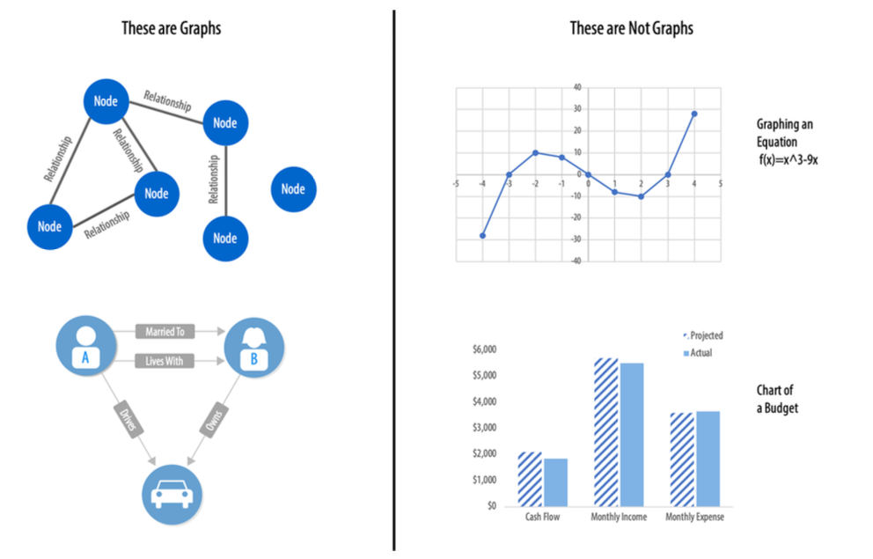
What Are Graphs?
A graph is a representation of a network, often illustrated with circles to represent entities which we call nodes, and lines to represent relationships.

Slide 3
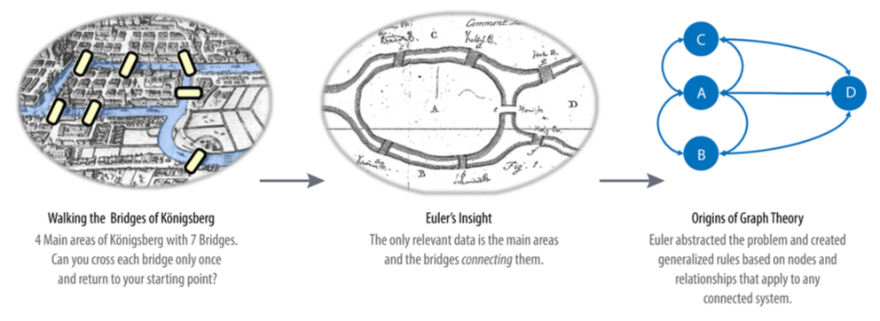
What Are Graphs?
Graphs have a history dating back to 1736, when Leonhard Euler solved the “Seven Bridges of Königsberg” problem.
The problem asked whether it was possible to visit all four areas of a city connected by seven bridges, while only crossing each bridge once. It wasn’t.
With the insight that only the connections themselves were relevant, Euler set the groundwork for graph theory and its mathematic
Figure: Euler’s progres‐
sion with one of his original sketches, from the paper “Solutio problematis ad geome‐
triam situs pertinentis”

Slide 4
What Are Graph Analytics and Algorithms?
Graph algorithms are a subset of tools for graph analytics
Graph-based approach to analyze connected data
  query the graph data,
  use basic statistics,
  visually explore the graphs,
  incorporate graphs into our machine learning tasks
Graph algorithms to refer to more global and iterative analysis

Slide 5
Graph Analytics Use Cases
Graph analytics is applied to forecast behavior and prescribe action for dynamic groups
Understanding the relationships and structure within the group
Some relevant example include:
  Investigate the route of a disease or a cascading transport failure.
  Uncover the most vulnerable, or damaging, components in a network attack.
  Identify the least costly or fastest way to route information or resources.
  Predict missing links in your data.
  Locate direct and indirect influence in a complex system.
  Discover unseen hierarchies and dependencies.
  Forecast whether groups will merge or break apart.
  Reveal communities based on behavior for personalized recommendations.
  Reduce false positives in fraud and anomaly detection.

Slide 6
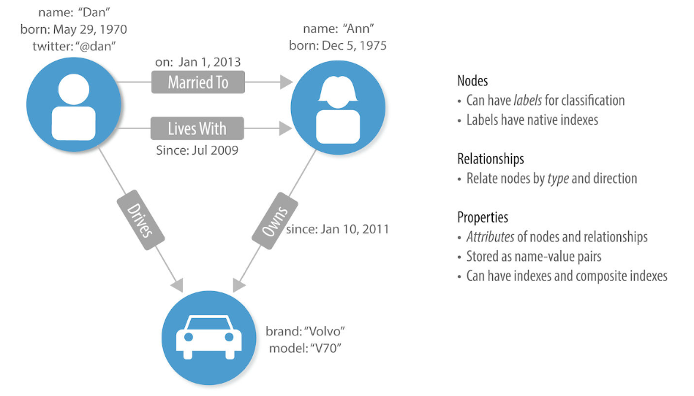
Terminology
Label marks a node as part of a group
Properties are synonymous with attributes and can contain a variety of data types
A subgraph is a graph within a larger graph
A path is a group of nodes and their connecting relationships

Slide 7
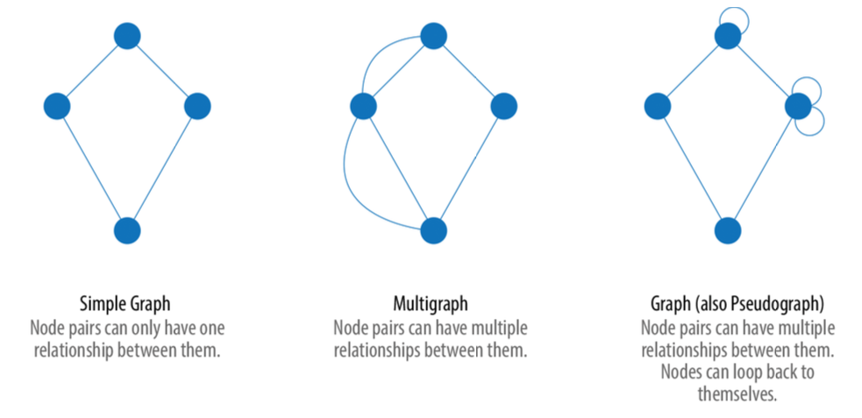
Graph Types and Structures

Slide 8
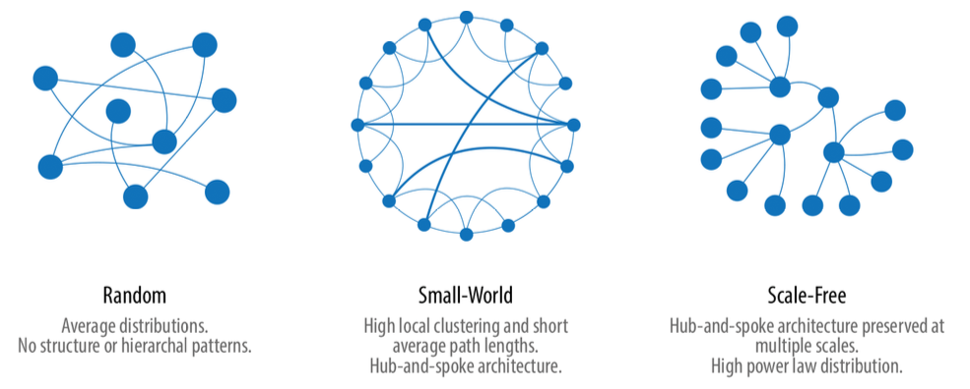
Random, Small-World, Scale-Free Structures
Random networks: In a completely average distribution of connections, a random network is formed with no hierarchies. All nodes have the same probability of being attached to any other node.
Small-world networks: extremely common in social networks; it shows localized connections and some hub-and-spoke pattern (“Six Degrees”)
Scale-free networks: is produced when there are power-law distributions and a hub-and-spoke architecture is preserved regardless of scale, such as in the World Wide Web

Slide 9
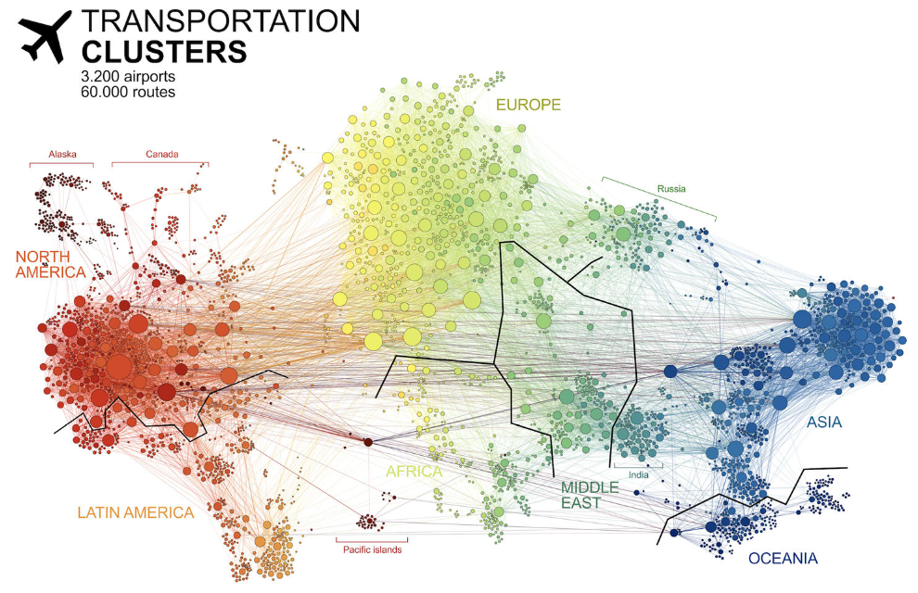
“Connected World: Untangling the Air Traffic Net‐ work”

Slide 10
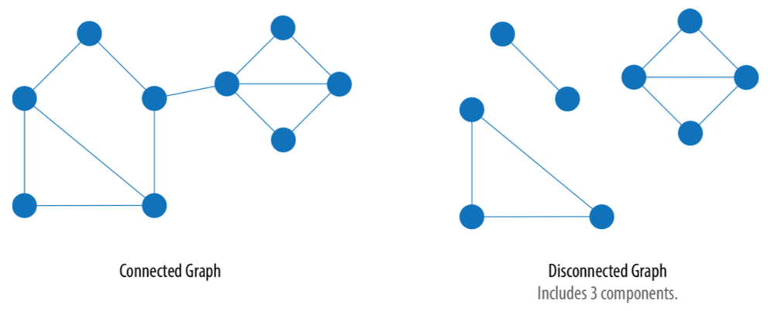
Connected Versus Disconnected Graphs

Slide 11
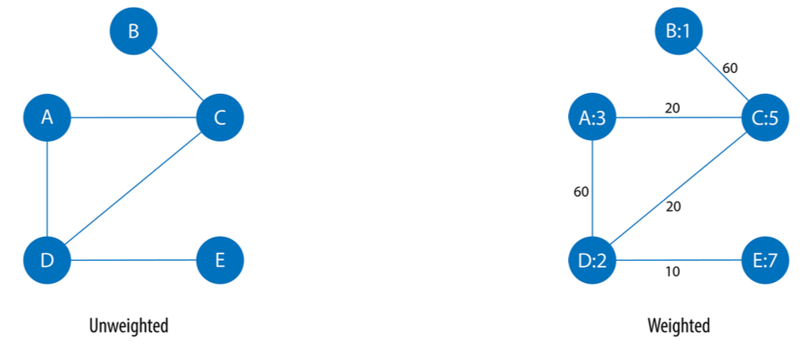
Unweighted Graphs Versus Weighted Graphs

Slide 12
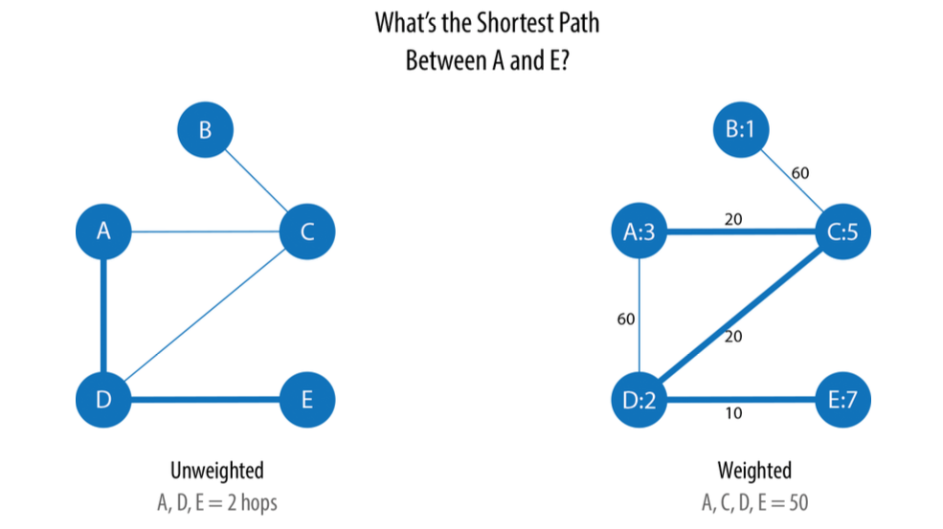
Unweighted Graphs Versus Weighted Graphs: influence on shortest path

Slide 13
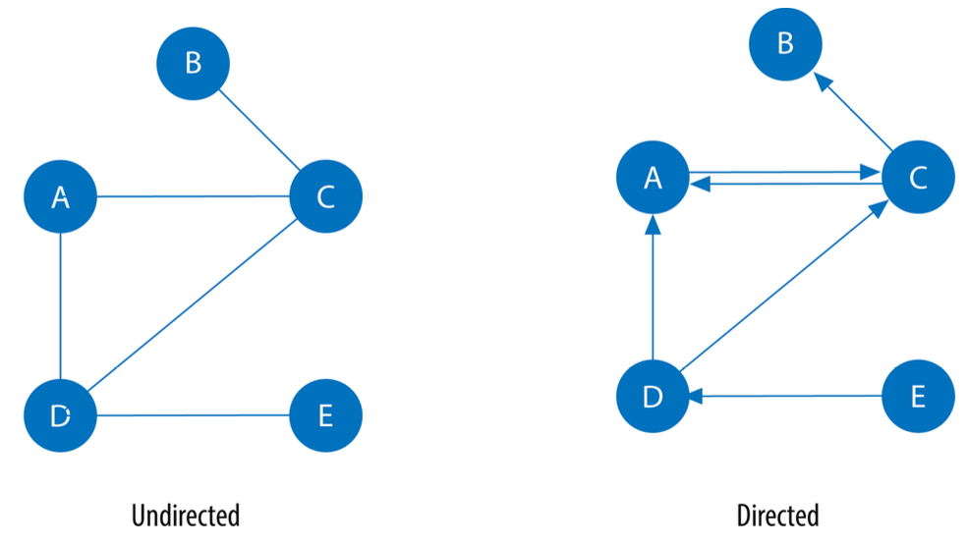
Undirected Graphs Versus Directed Graphs

Slide 14
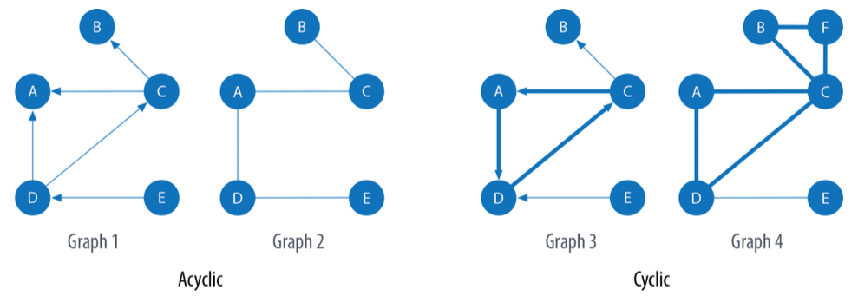
Acyclic Graphs Versus Cyclic Graphs

Slide 15
Types of Graph Algorithms
Pathfinding: Paths are fundamental to graph analytics and algorithms and finding shortest paths is probably the most frequent task performed with graph algorithms
Centrality: is all about understanding which nodes are more important in a network (the ability to quickly spread information versus bridging distinct groups)
Community Detection: Connectedness is a core concept of graph theory that enables a sophisticated network analysis such as finding communities.

Slide 16
Che cos’è un Graph Database
Nodi
Relazioni
🔵
↔️
Rappresentano entità come persone, prodotti, articoli, stazioni o documenti.
Collegano i nodi in modo esplicito e possono avere tipo, direzione e proprietà.
Label e proprietà
🏷️
🔎
Pattern matching
Neo4j usa il property graph model: nodi e archi possono avere attributi descrittivi.
Le query descrivono percorsi e pattern, non soltanto tabelle e join.

Slide 17
Comparison between Graph and Relational
Aspetto
Relazionale
Grafo
Struttura
Tabelle, chiavi primarie, chiavi esterne, join
Nodi, relazioni, label, proprietà
Domande tipiche
“Quali righe corrispondono a questo criterio?”
“Quali entità sono collegate e tramite quale percorso?”
Esempio
users, groups, memberships, follows
(:User)-[:FOLLOWS]->(:User), (:User)-[:MEMBER_OF]->(:Group)

Slide 18
When Graph are the best option
Social network: Amici di amici, follower, community e suggerimenti di contatto.
Recommendation: Users, products, categories, and purchase or interest relationships.
Fraud Detection: Suspicious chains involving accounts, devices, transactions, and identities.
Relational databases remain suitable for structured data and traditional transactions, but graph databases become preferable when the main value lies in connections, paths, and multi-hop queries.

