Slide 1
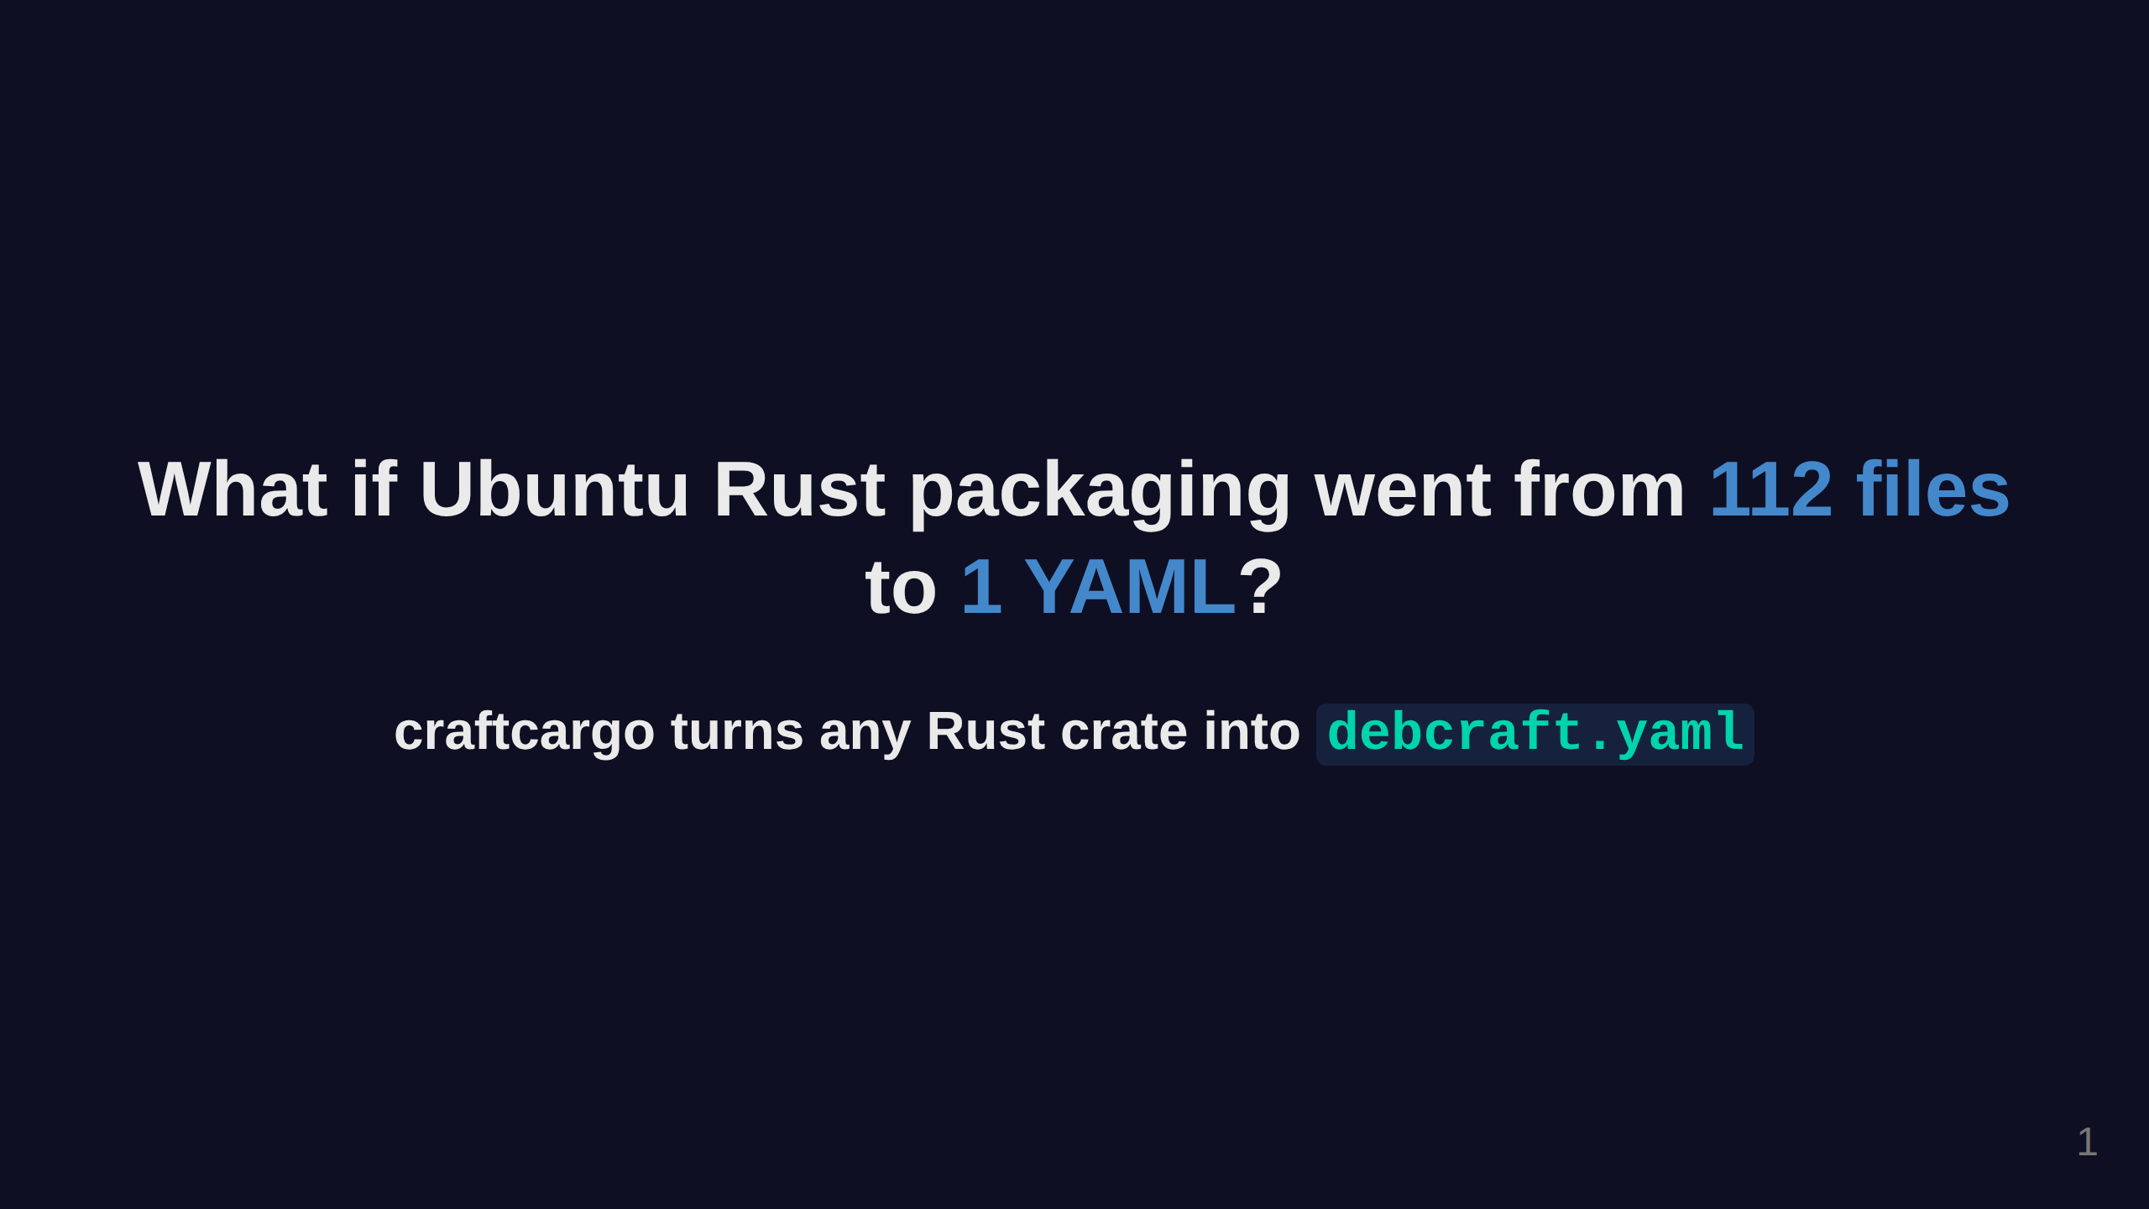
Notes:
IMAGE NEEDED: Abstract dark background with faint Rust gear logos / crate boxes floating

Slide 2
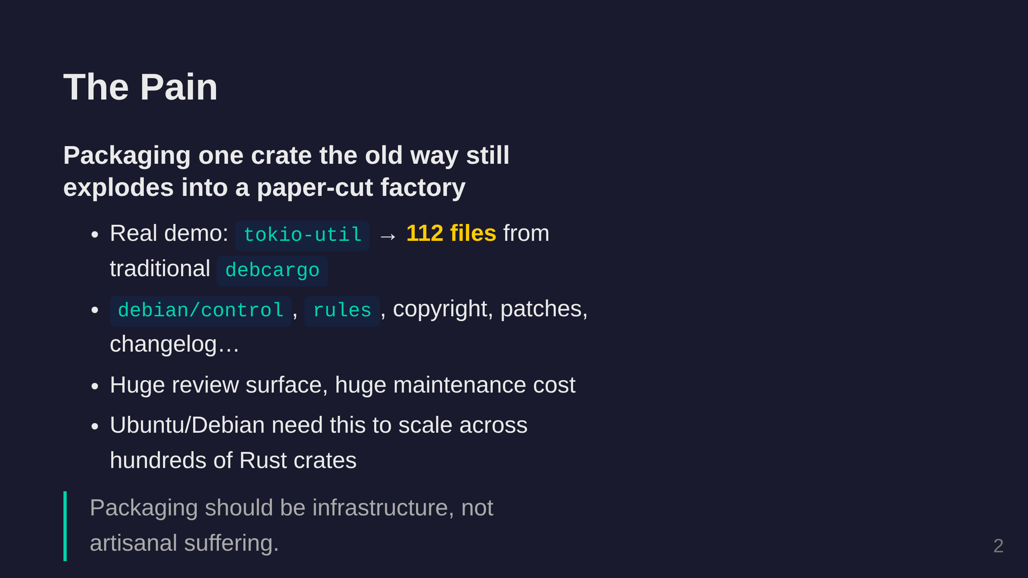
Notes:
IMAGE NEEDED: Illustration of a single crate box exploding into 112 scattered documents/files

Slide 3
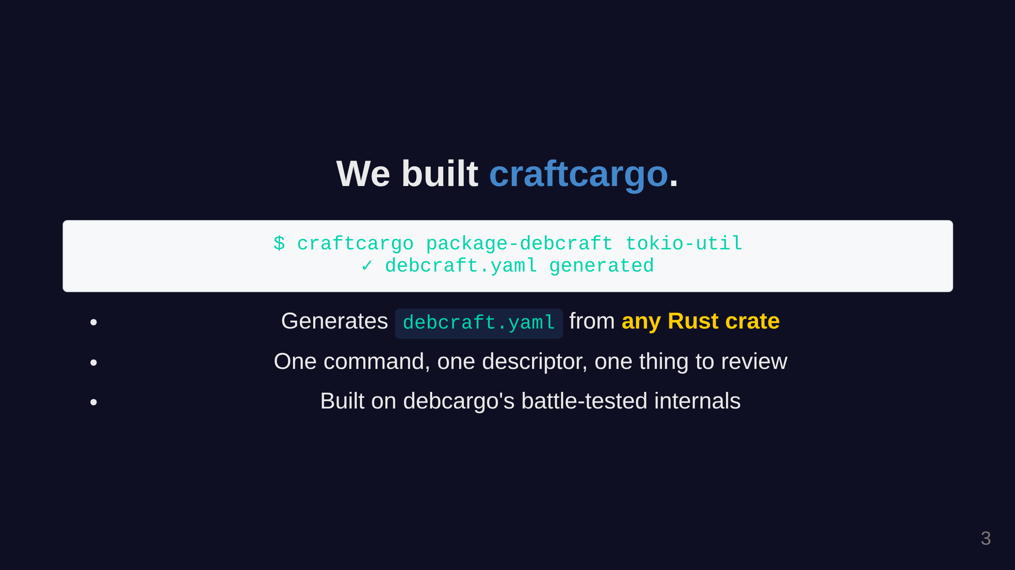
Notes:
IMAGE NEEDED: Glowing terminal/command prompt on dark background, minimal and clean

Slide 4
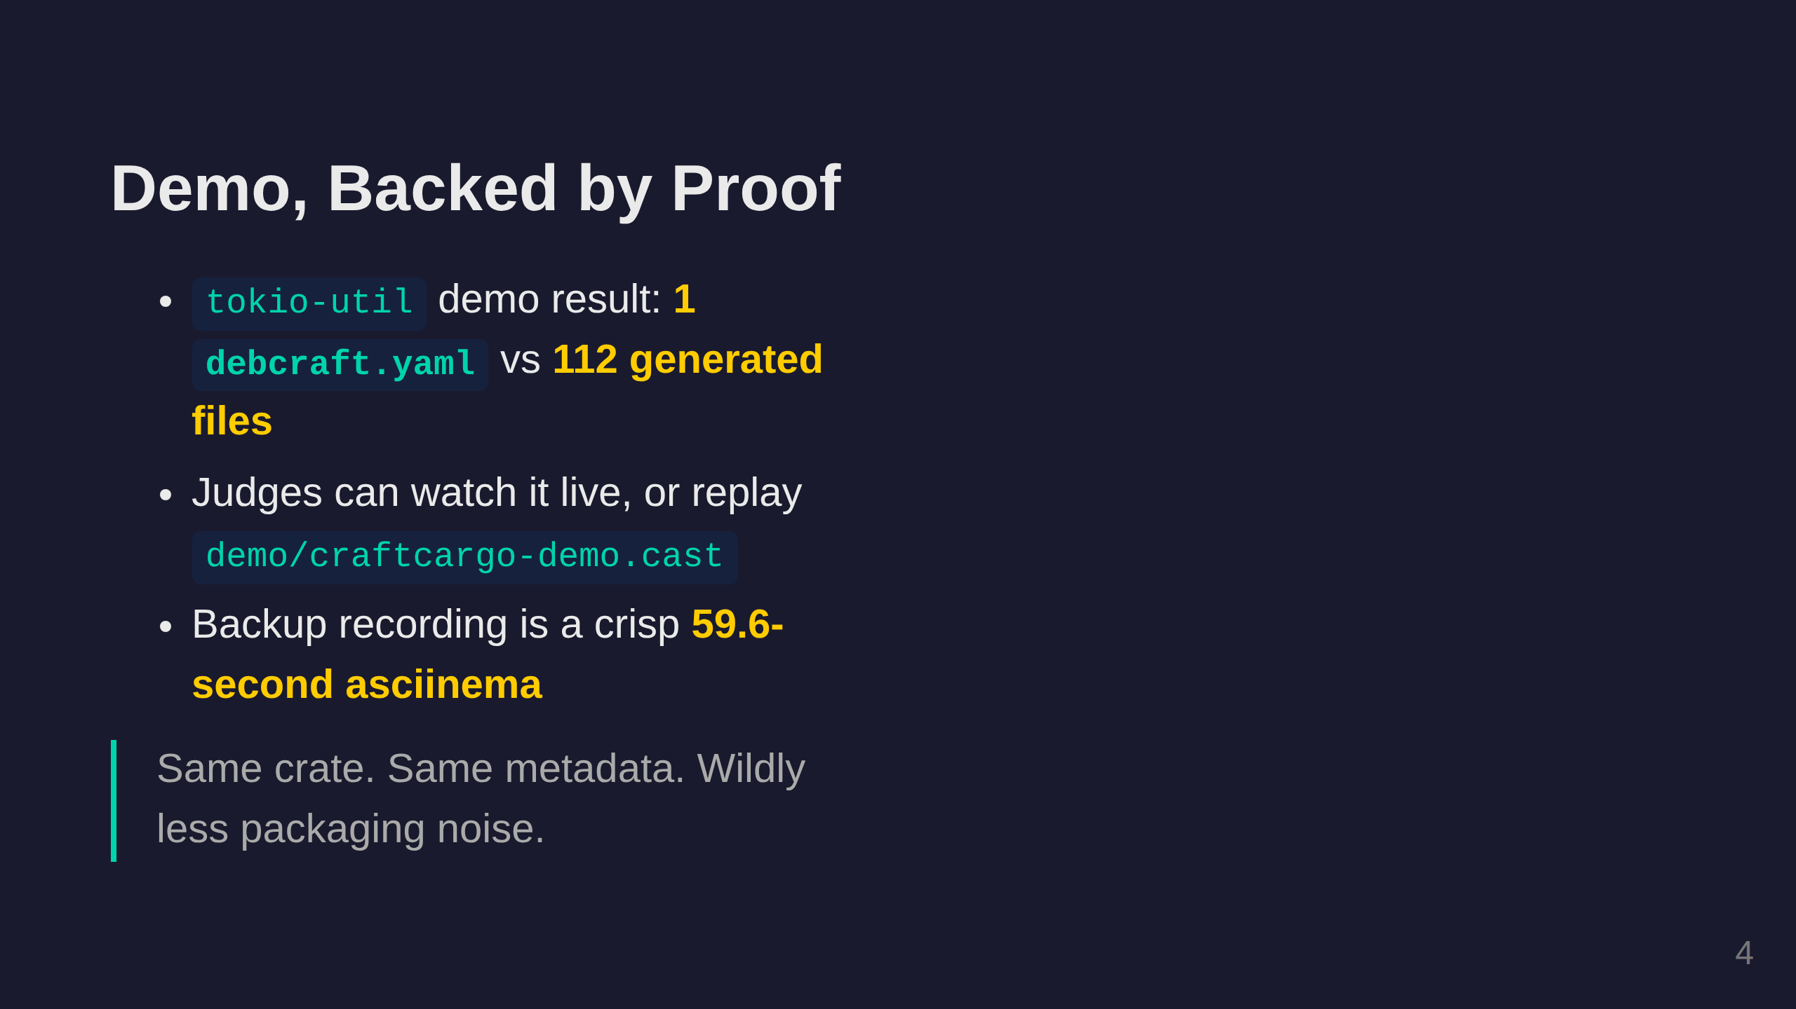
Notes:
IMAGE NEEDED: Screenshot of the actual demo running in terminal - capture after building Generate with: cd demo && ./run-demo.sh -n, then screenshot the YAML output

Slide 5
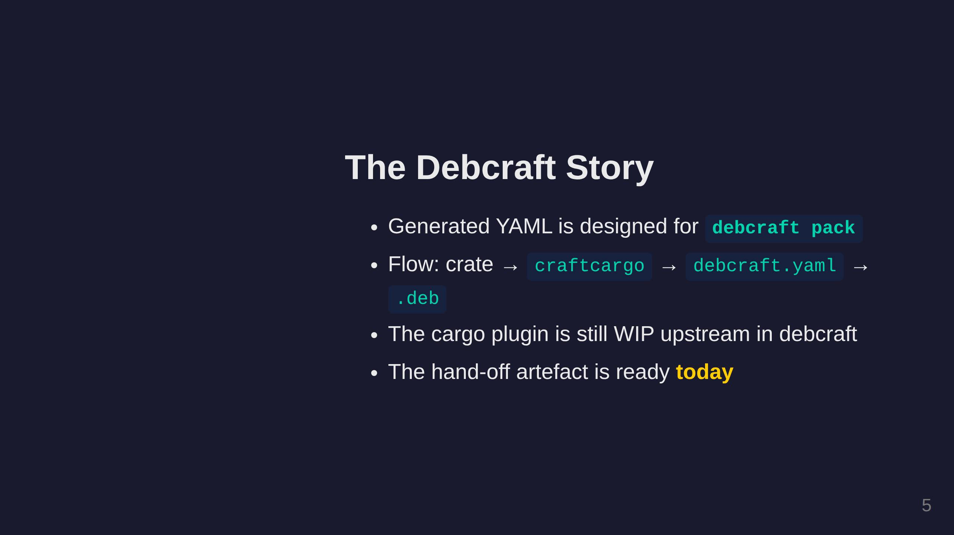
Notes:
IMAGE NEEDED: Architecture diagram (use Excalidraw or Mermaid): [crates.io registry] → [craftcargo] → [debcraft.yaml] → [debcraft pack] → [.deb package] Hand-drawn style looks great for hackathons

Slide 6
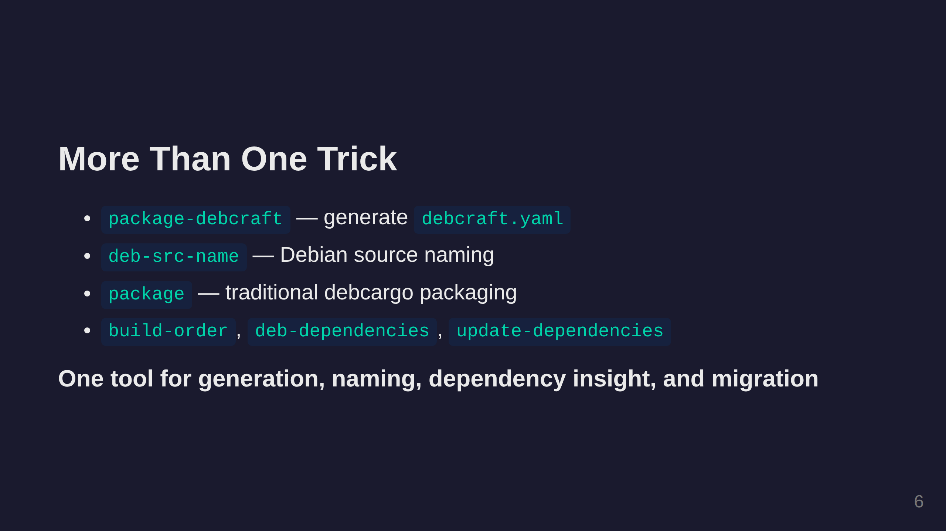
Notes:
IMAGE NEEDED: Subtle background of an upward-trending graph or green arrows

Slide 7
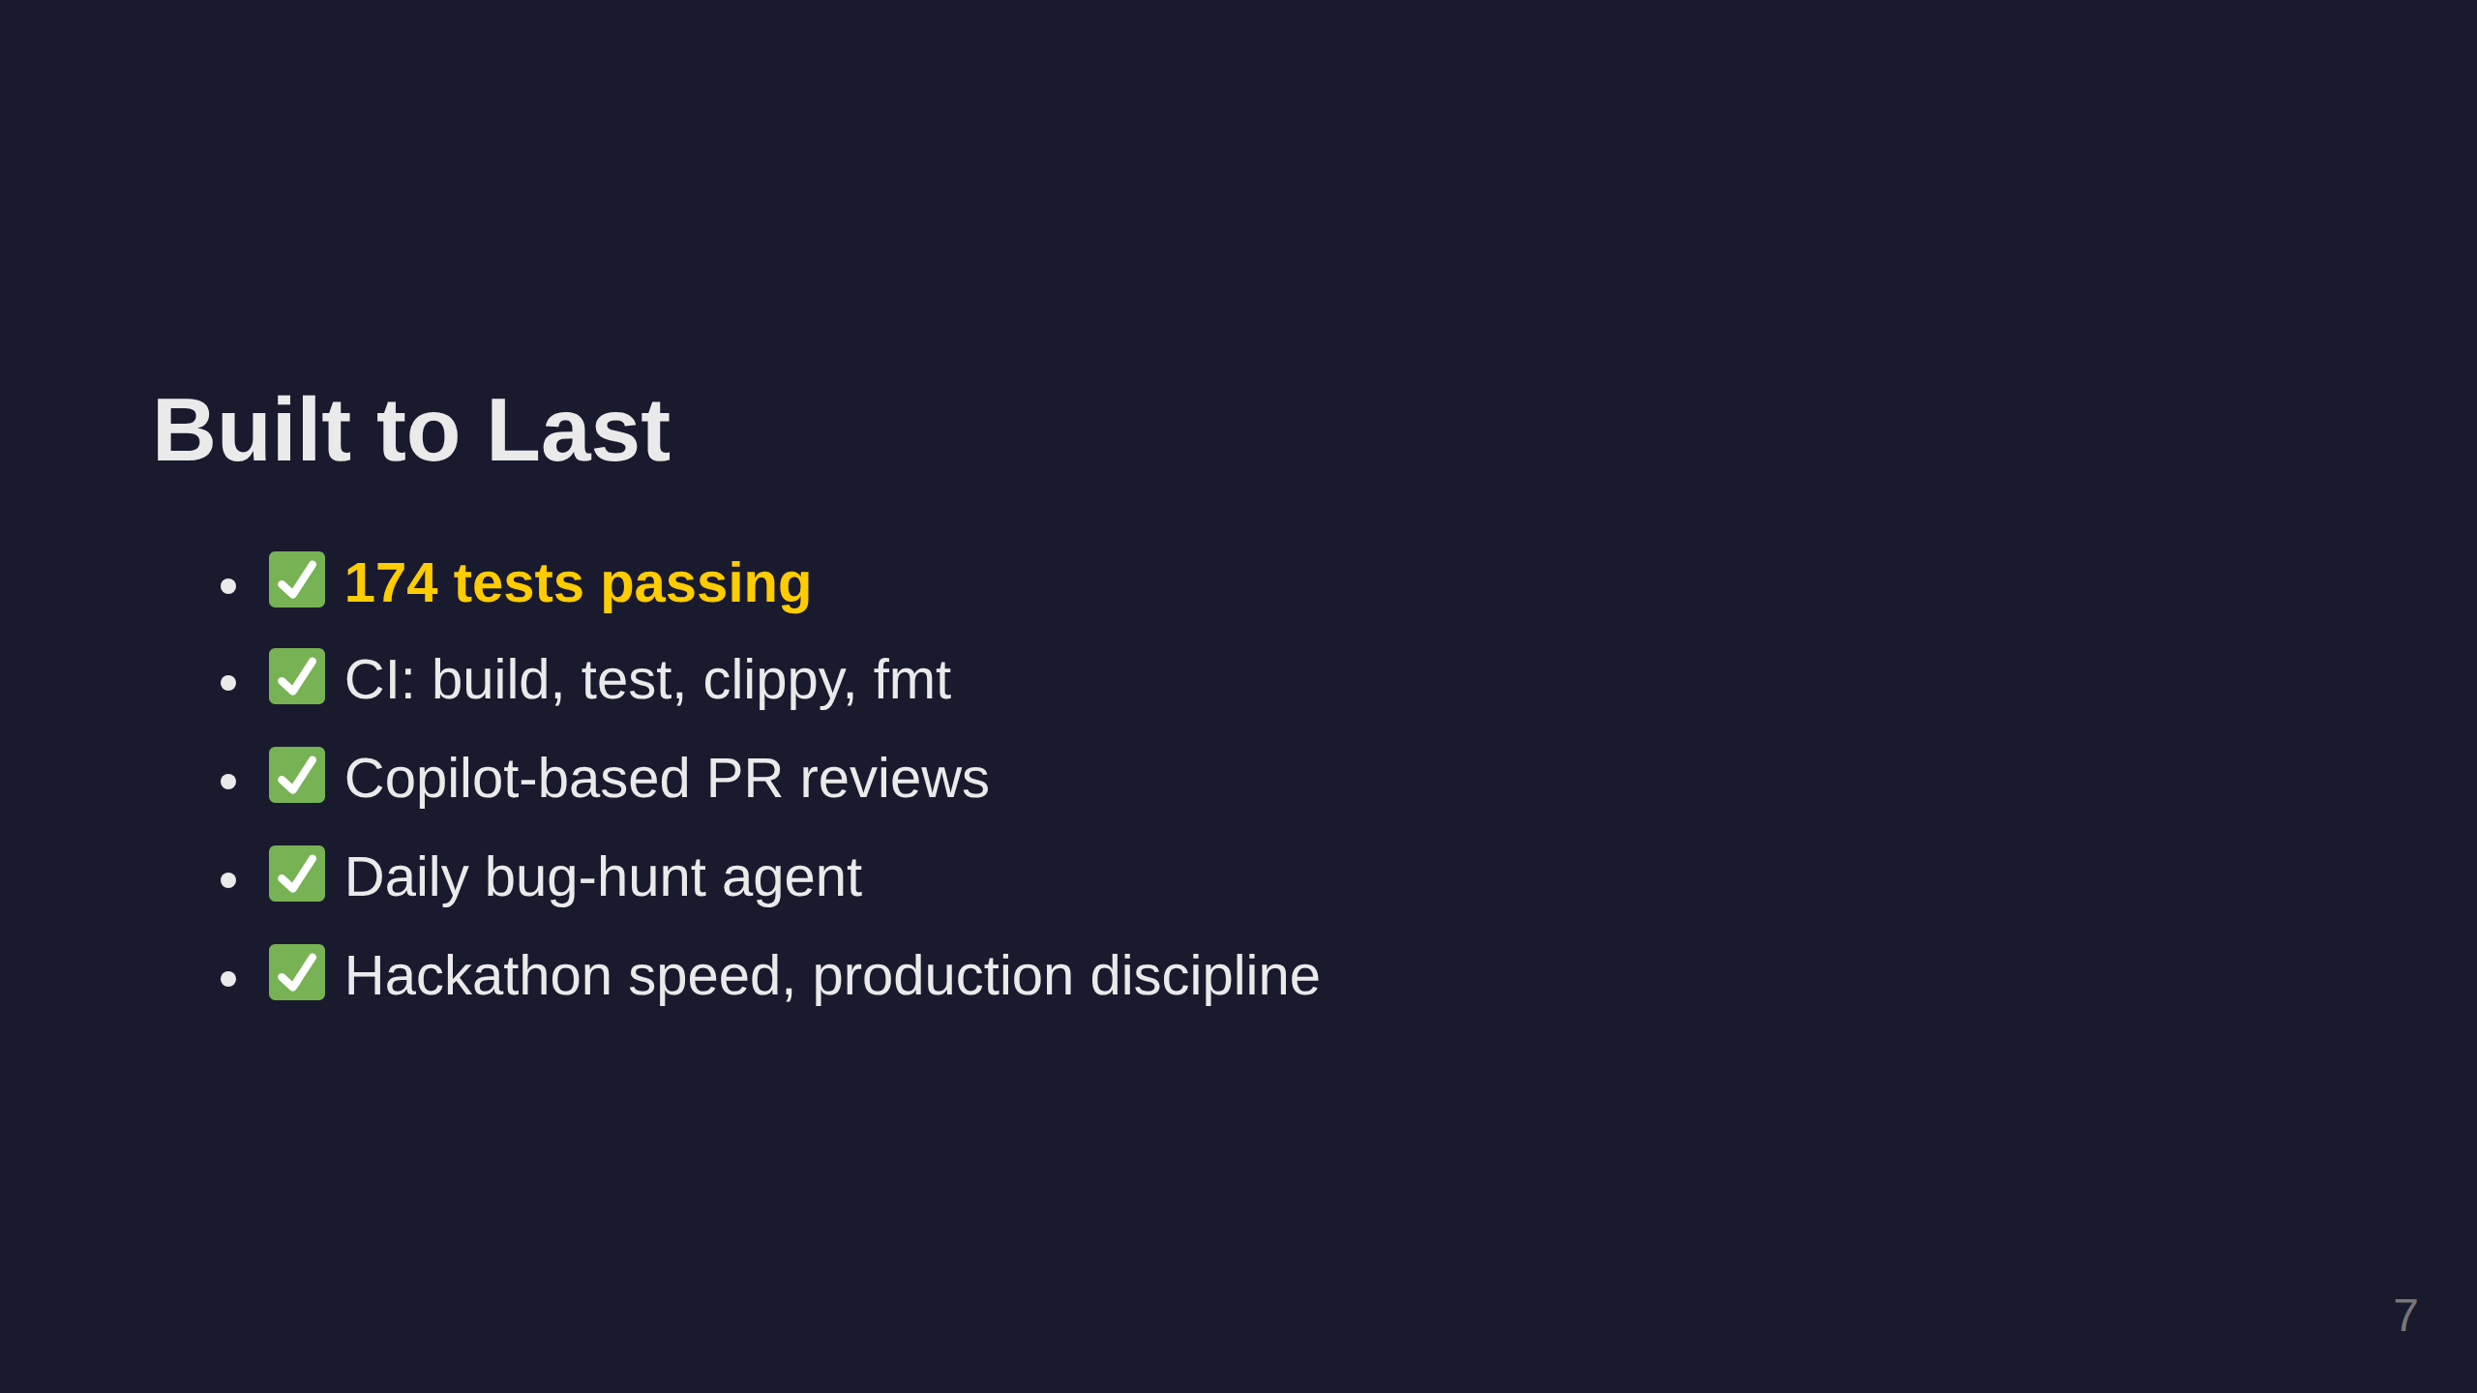
Notes:
IMAGE NEEDED: Screenshot of green CI badges / GitHub Actions passing checks OR: a collage of ✅ checkmarks and test output

Slide 8
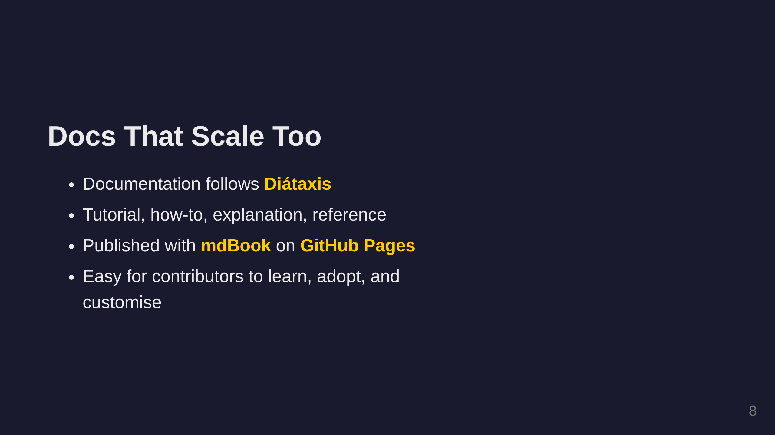
Notes:
IMAGE NEEDED: Funnel/pipeline diagram (Excalidraw style): Top: hundreds of crate boxes pouring in Middle: craftcargo machine/funnel Bottom: neat row of .deb packages coming out Style: colourful, hand-drawn, energetic

Slide 9
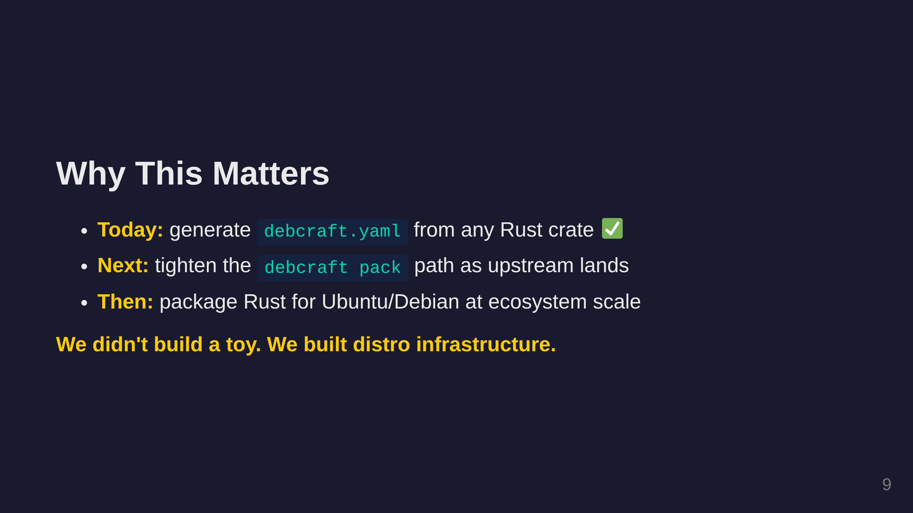
Notes:
IMAGE NEEDED: Faint Ubuntu circle-of-friends logo or globe/earth image

Slide 10
