Slide 1
Data Deduplication Based on Hadoop
Authors: Mehul Savaliya,
Keval Shah,
Kushal Trivedi,
Asst. Prof. Sanjay Vidhani,
Asst. Prof. Era Johri
Affiliation: K.J. Somaiya College of Engineering, Information Technology, India

Slide 2
Introduction
Due to excessive load of data from various sources, cloud storage faces difficulty due to duplication of data.
It occurs on social media platforms like Facebook, Instagram, Twitter etc. when multiple users upload the same content.
To overcome this problem, Deduplication techniques are required.
Existing Deduplication techniques are not efficient and lack performance when Big data comes into picture.
Our approach is to make efficient and scalable Deduplication technique by improvising over the existing methods.

Slide 3
Flaws in Previous Systems
Hash computation was slow when Big Data comes into picture.
High lookup time to identify duplicates.
Data preprocessing time for accessing data was more.

Slide 4
Steps for Implementation
File Aggregation
Chunking
Hash Computation
HBase
File Access

Slide 5
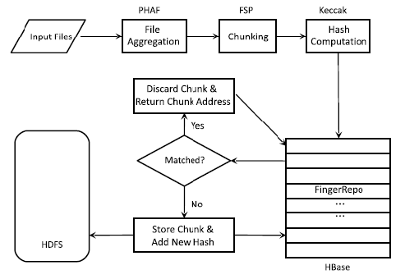
Flowchart

Slide 6
Result
INPUT 1 : 4 KB Text File
INPUT 2 : 40 KB Image File
INPUT 3 : 40 MB GIT Repository
Comparision of SHA-2 and SHA-3
Algorithm | Time cost for input 1 | Time cost for input 2 | Time cost for input 3
SHA-3 | 0.63ms | 3.23ms | 41ms
SHA-2 | 5.18ms | 9.02ms | 67ms

Slide 7
References
Dongzhan Zhang, Chengfa Liao, Wenjing Yan, Ran Tao and Wei Zhe, "Data Deduplication based on Hadoop", 2017 Fifth International Conference on Advanced Cloud and Big Data
Lars Kolb, Andreas Thor, Erhard Rahm, "Dedoop: Efficient Deduplication with Hadoop", The Proceedings of the VLDB Endowment (PVLDB), 2012
Ruay-Shiung Chang, Chih-Shan Liao, Kuo-Zheng Fan, and Chia-MingWu, "Dynamic Deduplication Decision in a Hadoop Distributed File System", Hindawi Publishing Corporation International Journal of Distributed Sensor Networks Volume 2014
Apache Hadoop MapReduce.https://hadoop.apache.org/docs/stable/hadoop-mapreduce-client/hadoop-mapreduce-client-core/MapReduceTutorial.html

