Slide 1
pSeUDO: Spoofing a Time Machine in Linux
By ben epstein

Slide 2
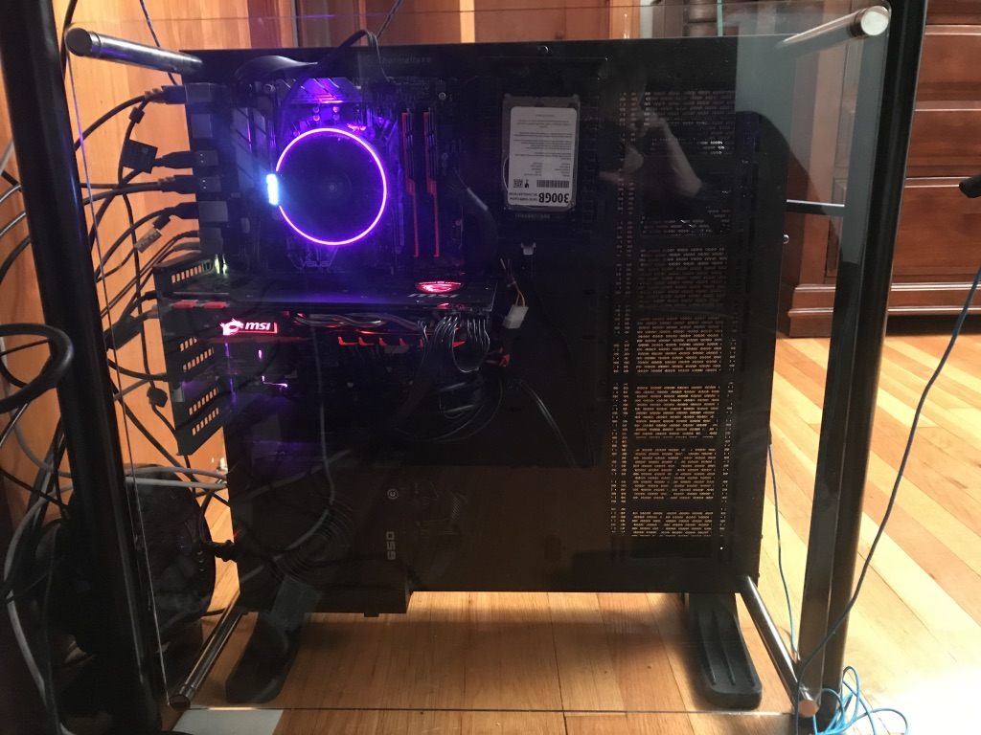
Tools Used
X(ubuntu) 16.04.3 LTS
Sublime Text
iTerm
Dropbox
Github
Vagrant
Bash for Windows

Slide 3
Dependencies
ssh: remote login, initial setup
Avahi: file server
Netatalk: Apple service spoof
Ufw: assumed to be default firewall

Slide 4
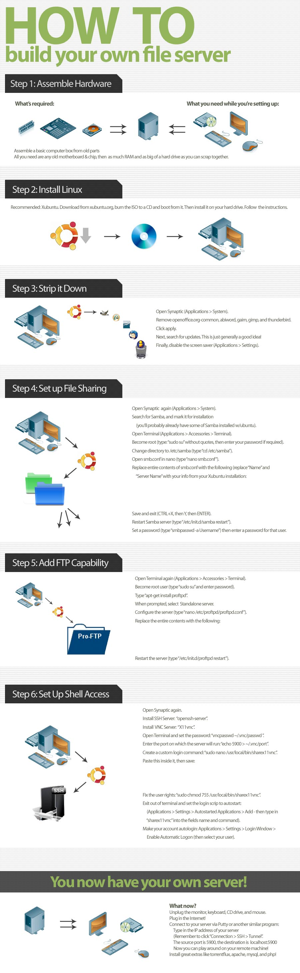
User Flow – Server Side
pSeUDO-lnx.sh
Acquires admin authorization
Installs dependencies
Asks for settings
Sets up a new user
Copies configuration files to correct locations
Opens firewall for AFP, TCP 548
Asks user to reboot
After reboot, the user is prompted to begin setup on the Client side after being shown the IP address and port number that was just configured

Slide 5
User Flow – Client Side
pSeUDO-osx.sh
Acquires admin authorization
Asks for IP and Port number from earlier
Enables “unsupported” Time Machine volumes
Pings the IP to check for connectivity, if not, ask for a new IP/Port
If OK, tries the default login info (timemachine:timemachine) included with the script, and asks for new login info if that fails
Prompts user to open Time Machine settings and select the newly added share.
Done!

Slide 6
Complications
Testing, testing testing:
Needed to test on a brand new Linux installation every time:
Vagrant init, vagrant up, vagrant ssh, *test code*, *code fails*, exit, vagrant destory, do it again!
Time to do all of this: ~1-2 minutes
Time to change code: 5-20 seconds
Apple: “Need more information? Too bad”
Hamachi Optional Install:
Installs via a downloaded .deb package, not apt-get
Still trying to get this working

Slide 7
Bugs/Issues
Slow. SLOW. SLLLOOOOOWWWWWWW.
(Especially over VPN e.g. Hamachi)
User adding problems:
Two commands: useradd and adduser – different syntax / options
Requires a hashed password, which takes extra time/compute cycles
Compatibility/Testing:
I only have one MacOS machine and two Linux boxes. Testing for all scenarios is just impossible for me to do.
AFP is not secure enough for enterprise or even small-med business use

Slide 8
To The Future
Add client script to brew, create repository for server side
Share around the GitHub
If anyone wants to try it out, let me know!

