Slide 1
Open Rapid Control Prototyping, Education and Design Tools
Dion Beqiri
Contact: beqirdio@gmail.com
Supervisor: Ing. Pavel Píša, Ph.D.
Department of Control Engineering
Bachelor’s Thesis
June 2022

Slide 2
Goals
Understanding and extending the pysimCoder project
Vector signals feature
Adding support for GNU/Linux targets:
  MZ_APO Zynq based educational kit
  RaspberryPi board (extension)
Adding support for ESP32-C3 (RISC-V) board running NuttX RTOS
Controlling some peripheral using combination of NuttX and pysimCoder

Slide 3
PysimCoder
Graphical editor for design of control systems
Can generate real-time RPC code for various targets
Similar in style to Simulink, Xcos, etc…
Advantages:
  Lighter, faster, compatible with any OS
  Open source and freely available
  Uses Python for most of its functions
Disadvantages:
  Less development, missing features, and poor (code) stability

Slide 4
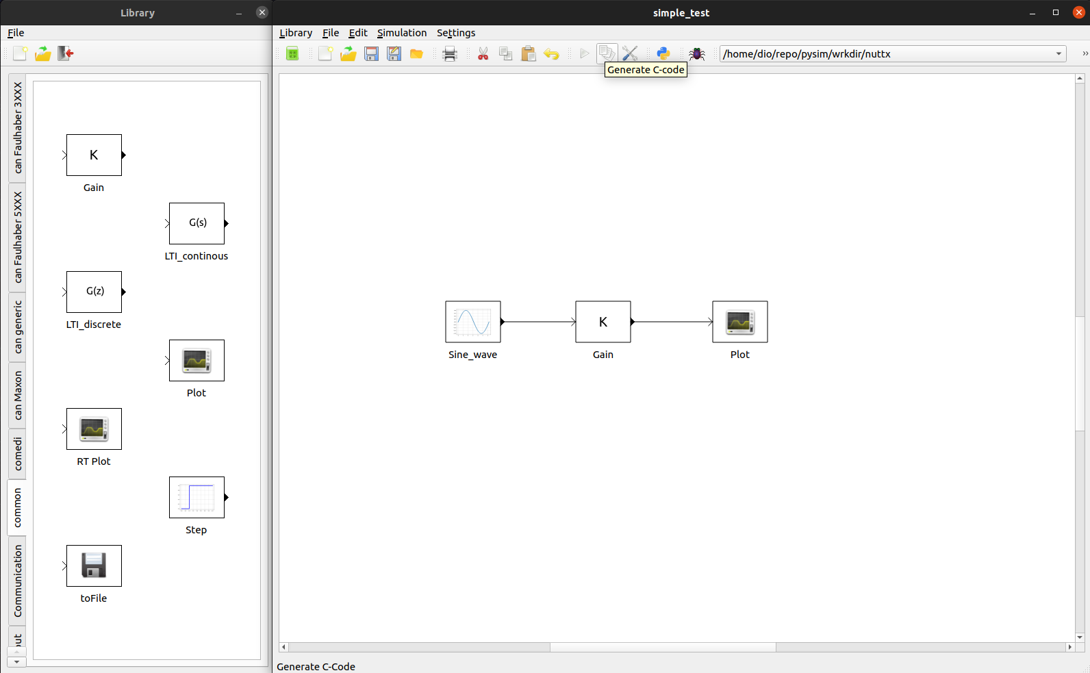
PysimCoder

Slide 5
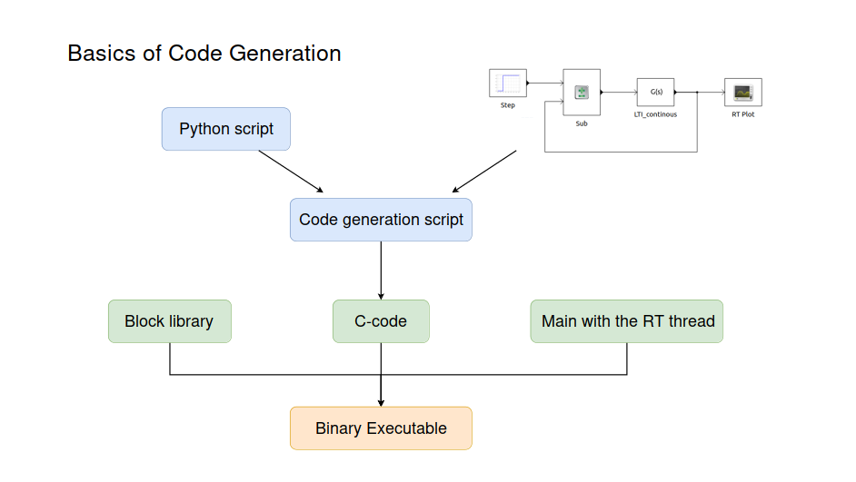
PysimCoder

Slide 6
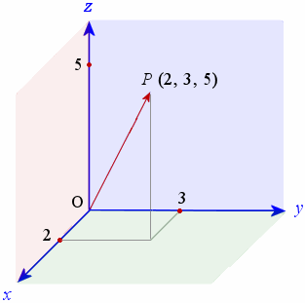
Vectors
Importance of vectors in mathematics and control systems engineering
Existing support for vector dimensions
Enabling vector signals in pysimCoder
Static setting of dimensions
Automatic setting of dimensions

Slide 7
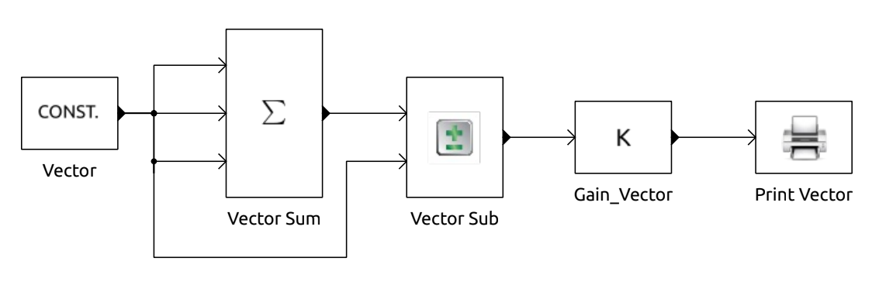
Vectors
New blocks for vector experimentation
Mostly mathematical blocks
Some blocks know their dimensions, others don’t
Static dimensions → only human error is possible

Slide 8
Vectors
Algorithm for setting dimensions without user input
Assumption that blocks are ordered sequentially
Propagation path of dimensions:
  Source blocks (know dimensions internally)
  Middle blocks (get dimensions externally)
  Destination blocks (externally also)
Middle blocks contain variable for I/O dimension ratio

Slide 9
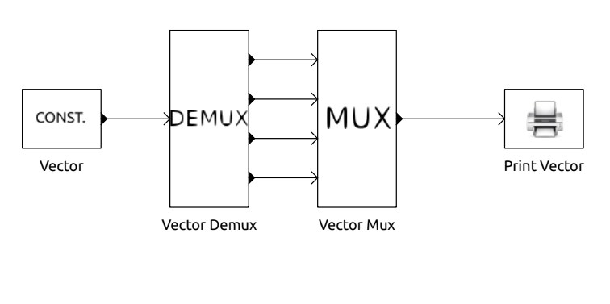
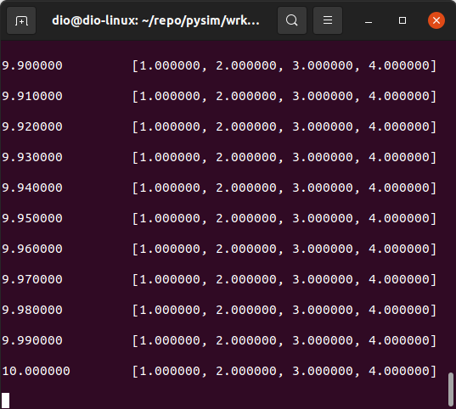
Vectors
Multiplexer combines scalar values into a vector signal
Demultiplexer is inverse
Link between vector-able and normal blocks
Testing on each other for verification

Slide 10



GNU / Linux
Popular operating system
Supports real-time extensions
Open source and freely available
Increased usage in embedded systems
pysimCoder supports various Linux targets
MZ_APO educational kit runs on real-time Linux (Debian distribution)
RaspberryPi board (Raspbian distr.)

Slide 11
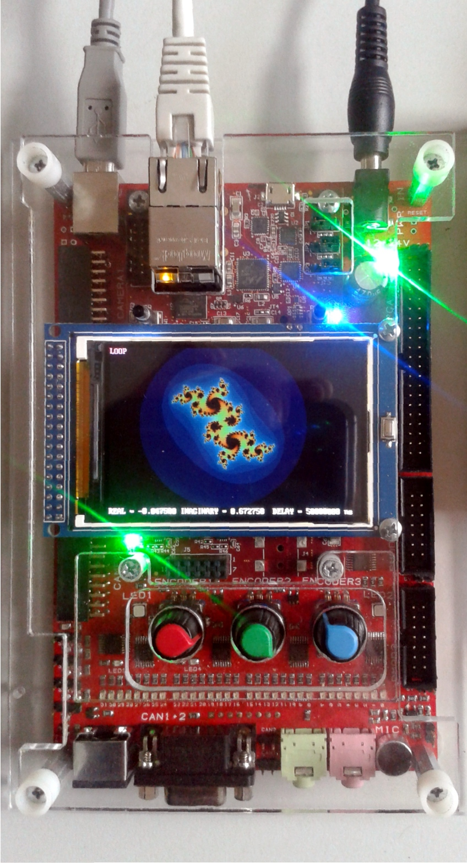
MZ_APO educational kit
Existing implementation of MZ_APO Simulink blocks:
  Rotary knob incremental encoders
  DC motor
Adaptation into pysimCoder blocks
  .xblk, .py, and .c files
Construction of Makefile specific to Zynq based Linux targets
DC motor follower with real-time PID tuning (using incremental encoders) demonstration

Slide 12
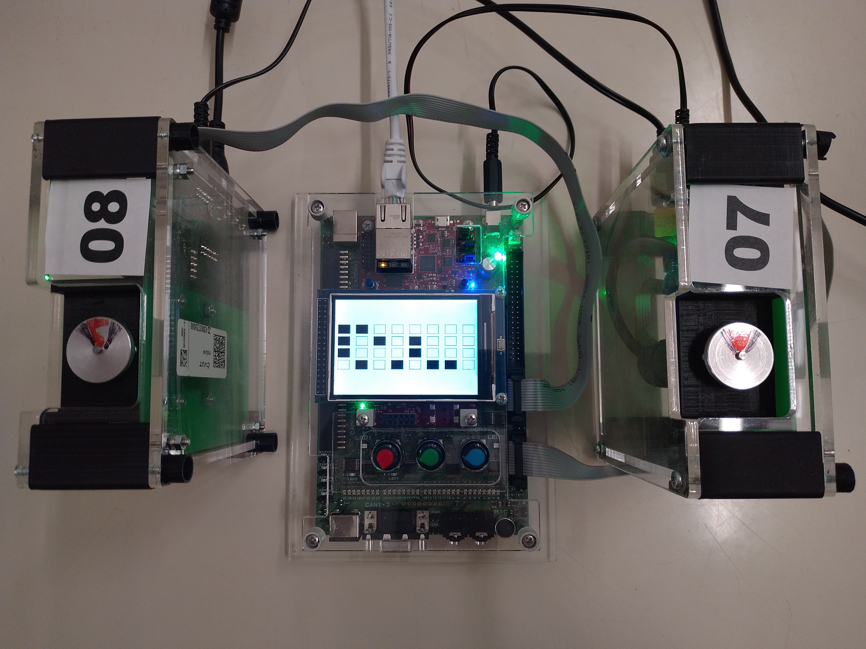
MZ_APO educational kit

Slide 13
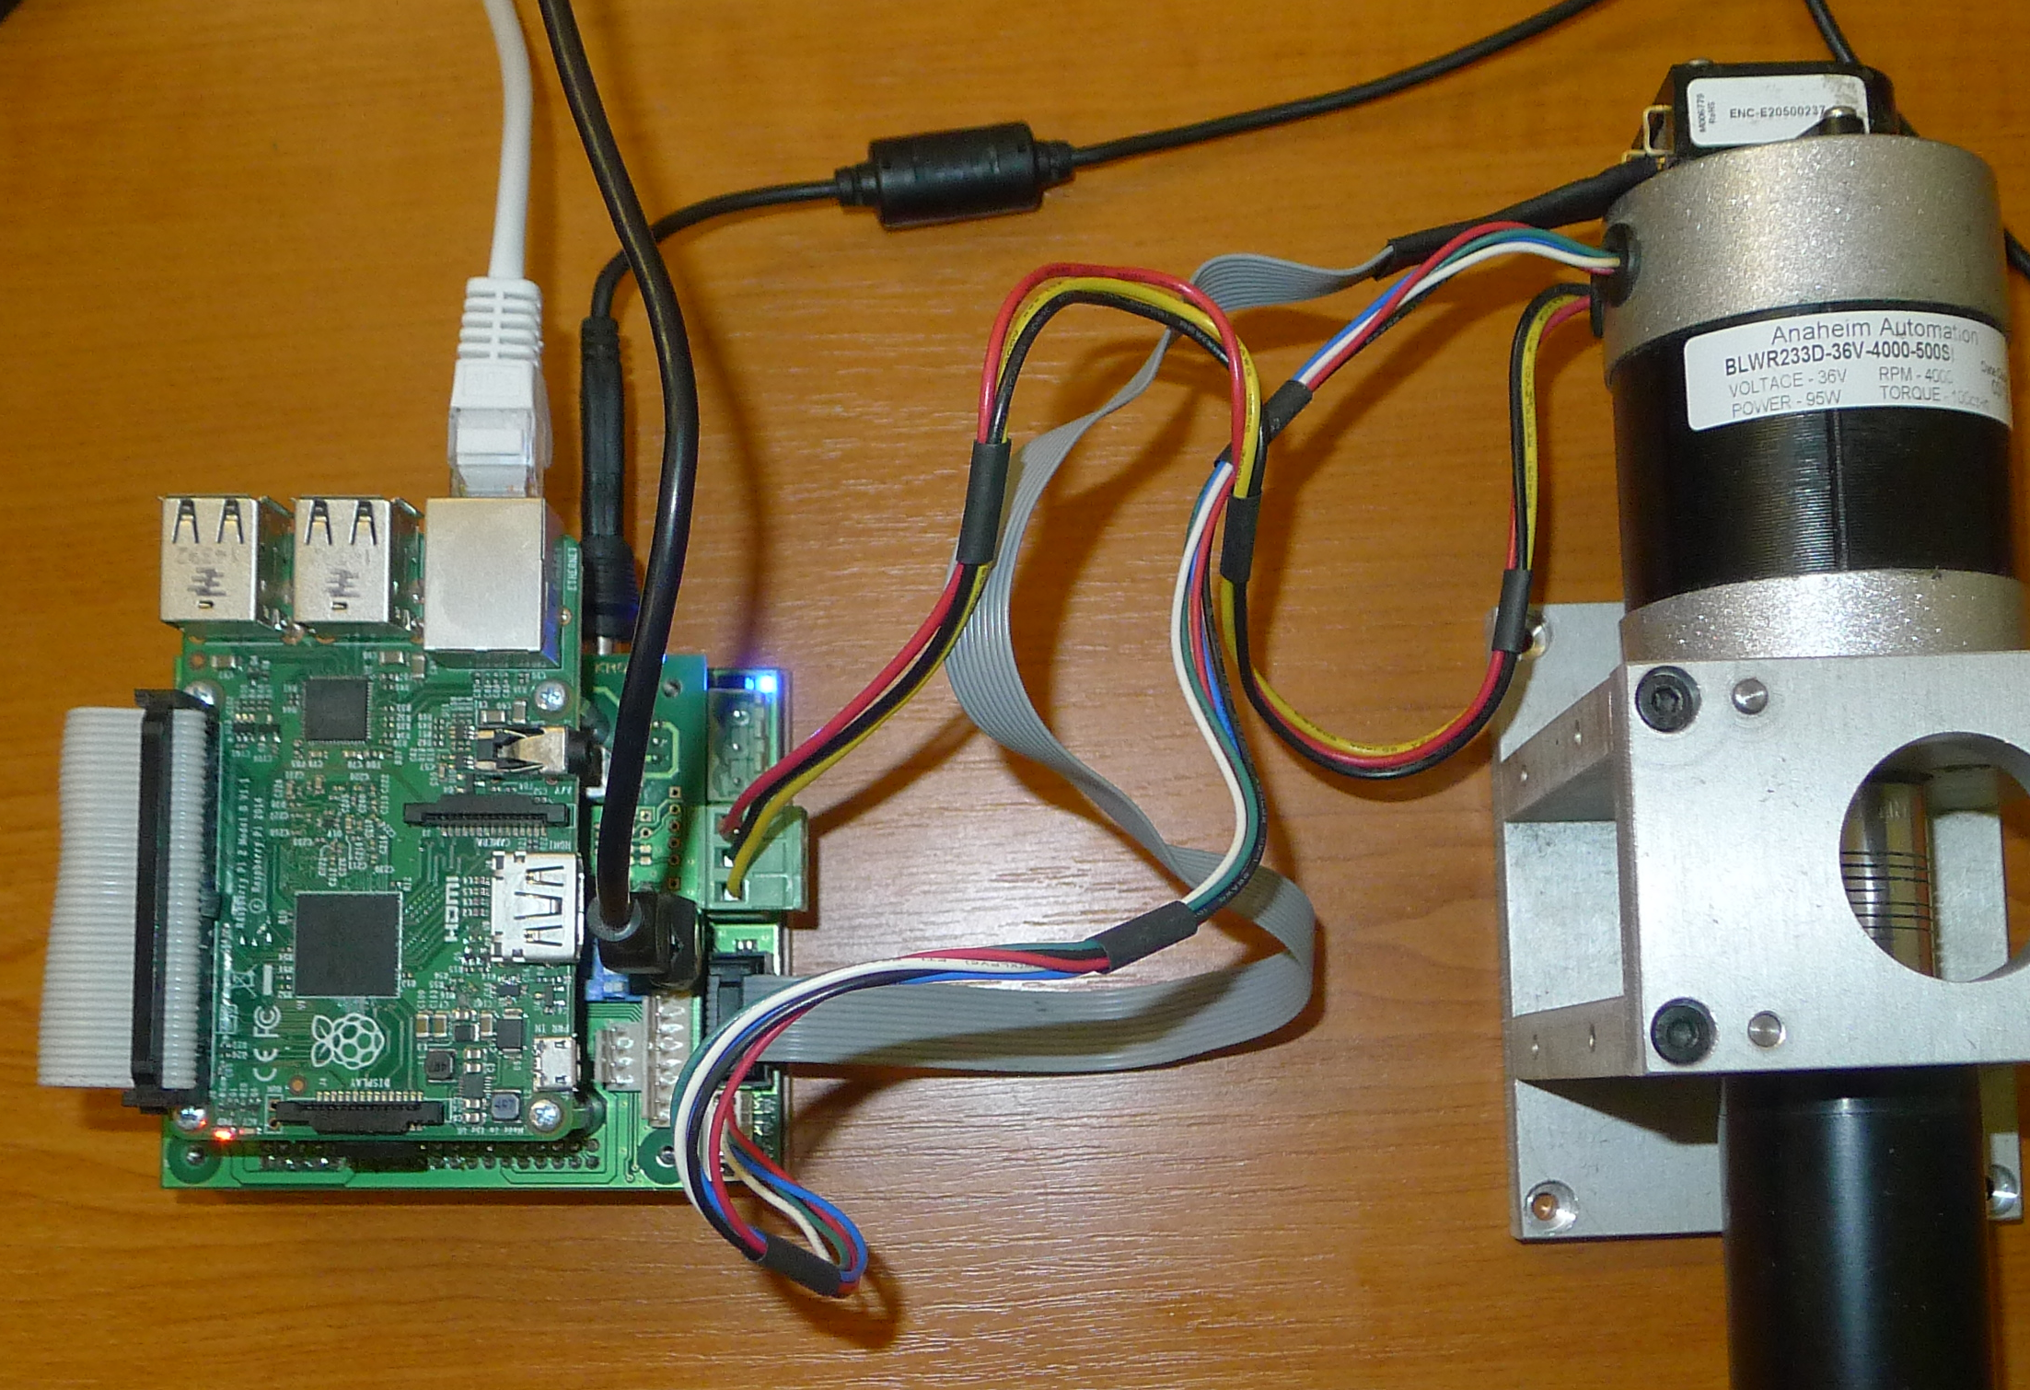
Raspberry Pi (PMSM control)
RaspberryPi Model 2B (v1.1)
Already supported in pysimCoder
Existing Simulink project for controlling 3-Phase Permanent Magnet Synchronous Motor
Possible adaptation to pysimCoder block and diagram

Slide 14
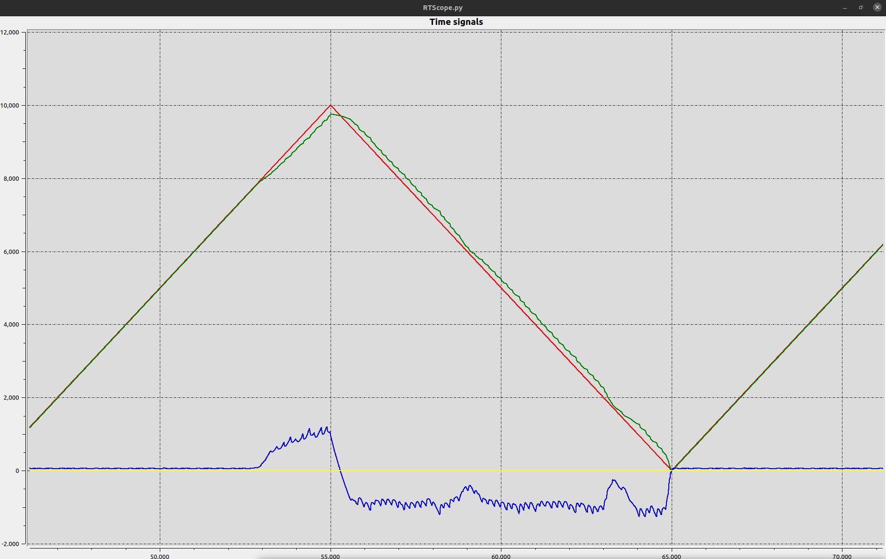
Raspberry Pi (PMSM control)

Slide 15
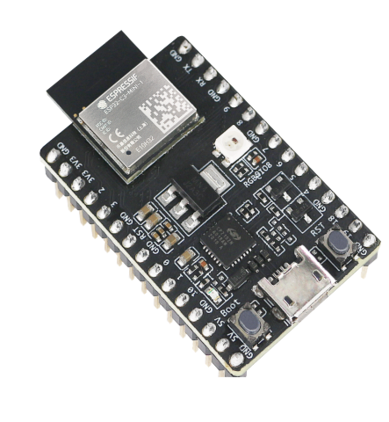
NuttX and ESP32C3
NuttX: Real Time Operating System
ESP32C3-DevKitM-1
Testing NuttX blocks on ESP32C3 board
Replacing RaspberryPi with ESP32C3 for 3-Phase PMSM motion control
Main changes for NuttX implementation

Slide 16
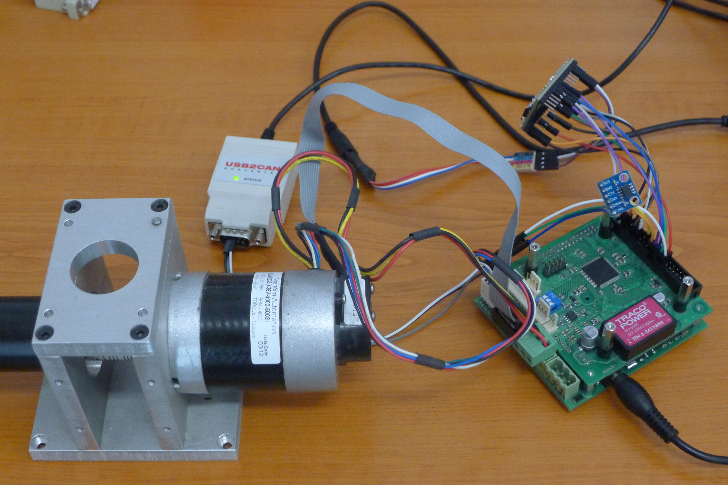
NuttX and ESP32C3

Slide 17
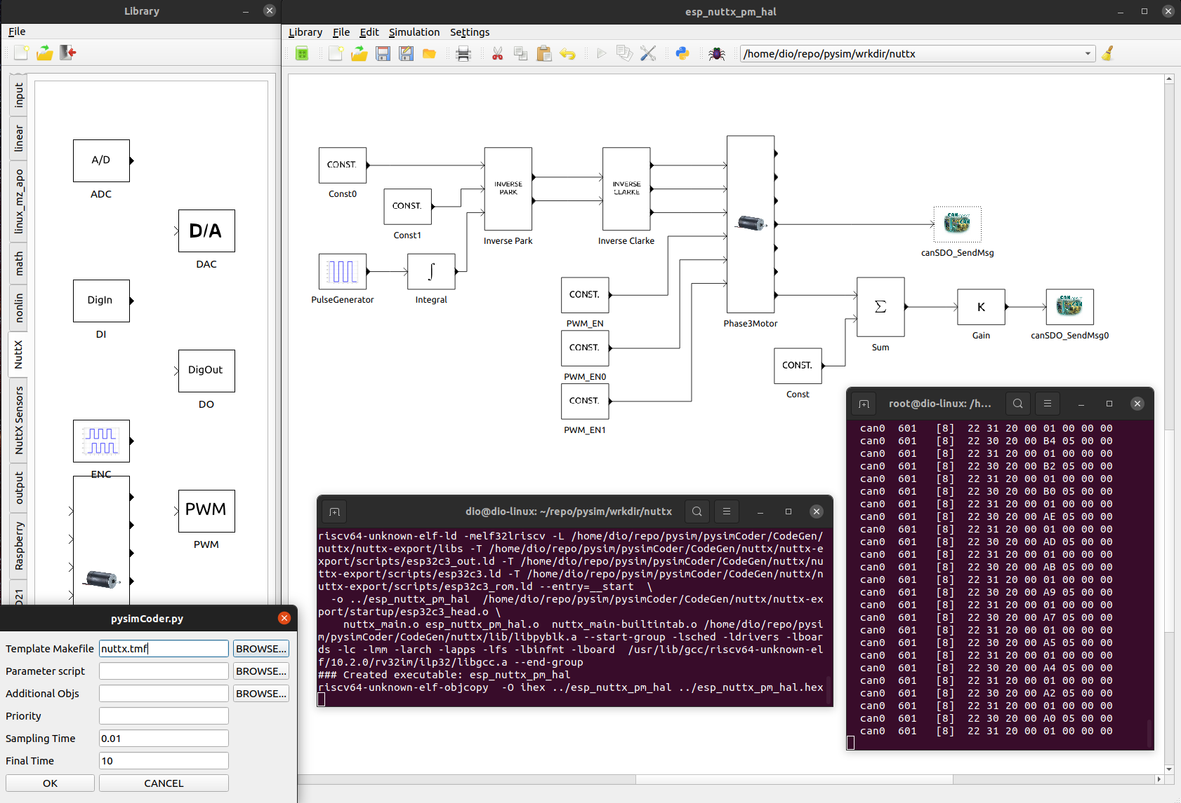
NuttX and ESP32C3

Slide 18
Conclusions
Vectors:
  Testing on more complex diagrams
  Optimization of dimension setting algorithm
  Placement of algorithm on editor level
GNU/Linux:
  More MZ_APO hardware blocks
  New RPi block only for specific hardware
NuttX + ESP32C3:
  PMSM motion control without PID due to unattainable sampling frequencies

Slide 19
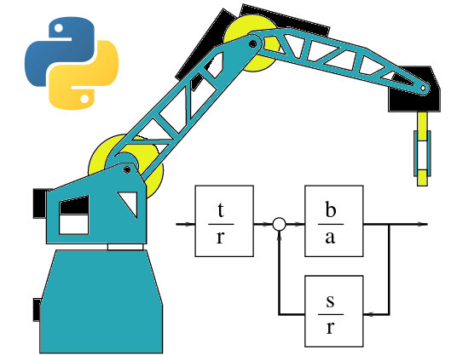
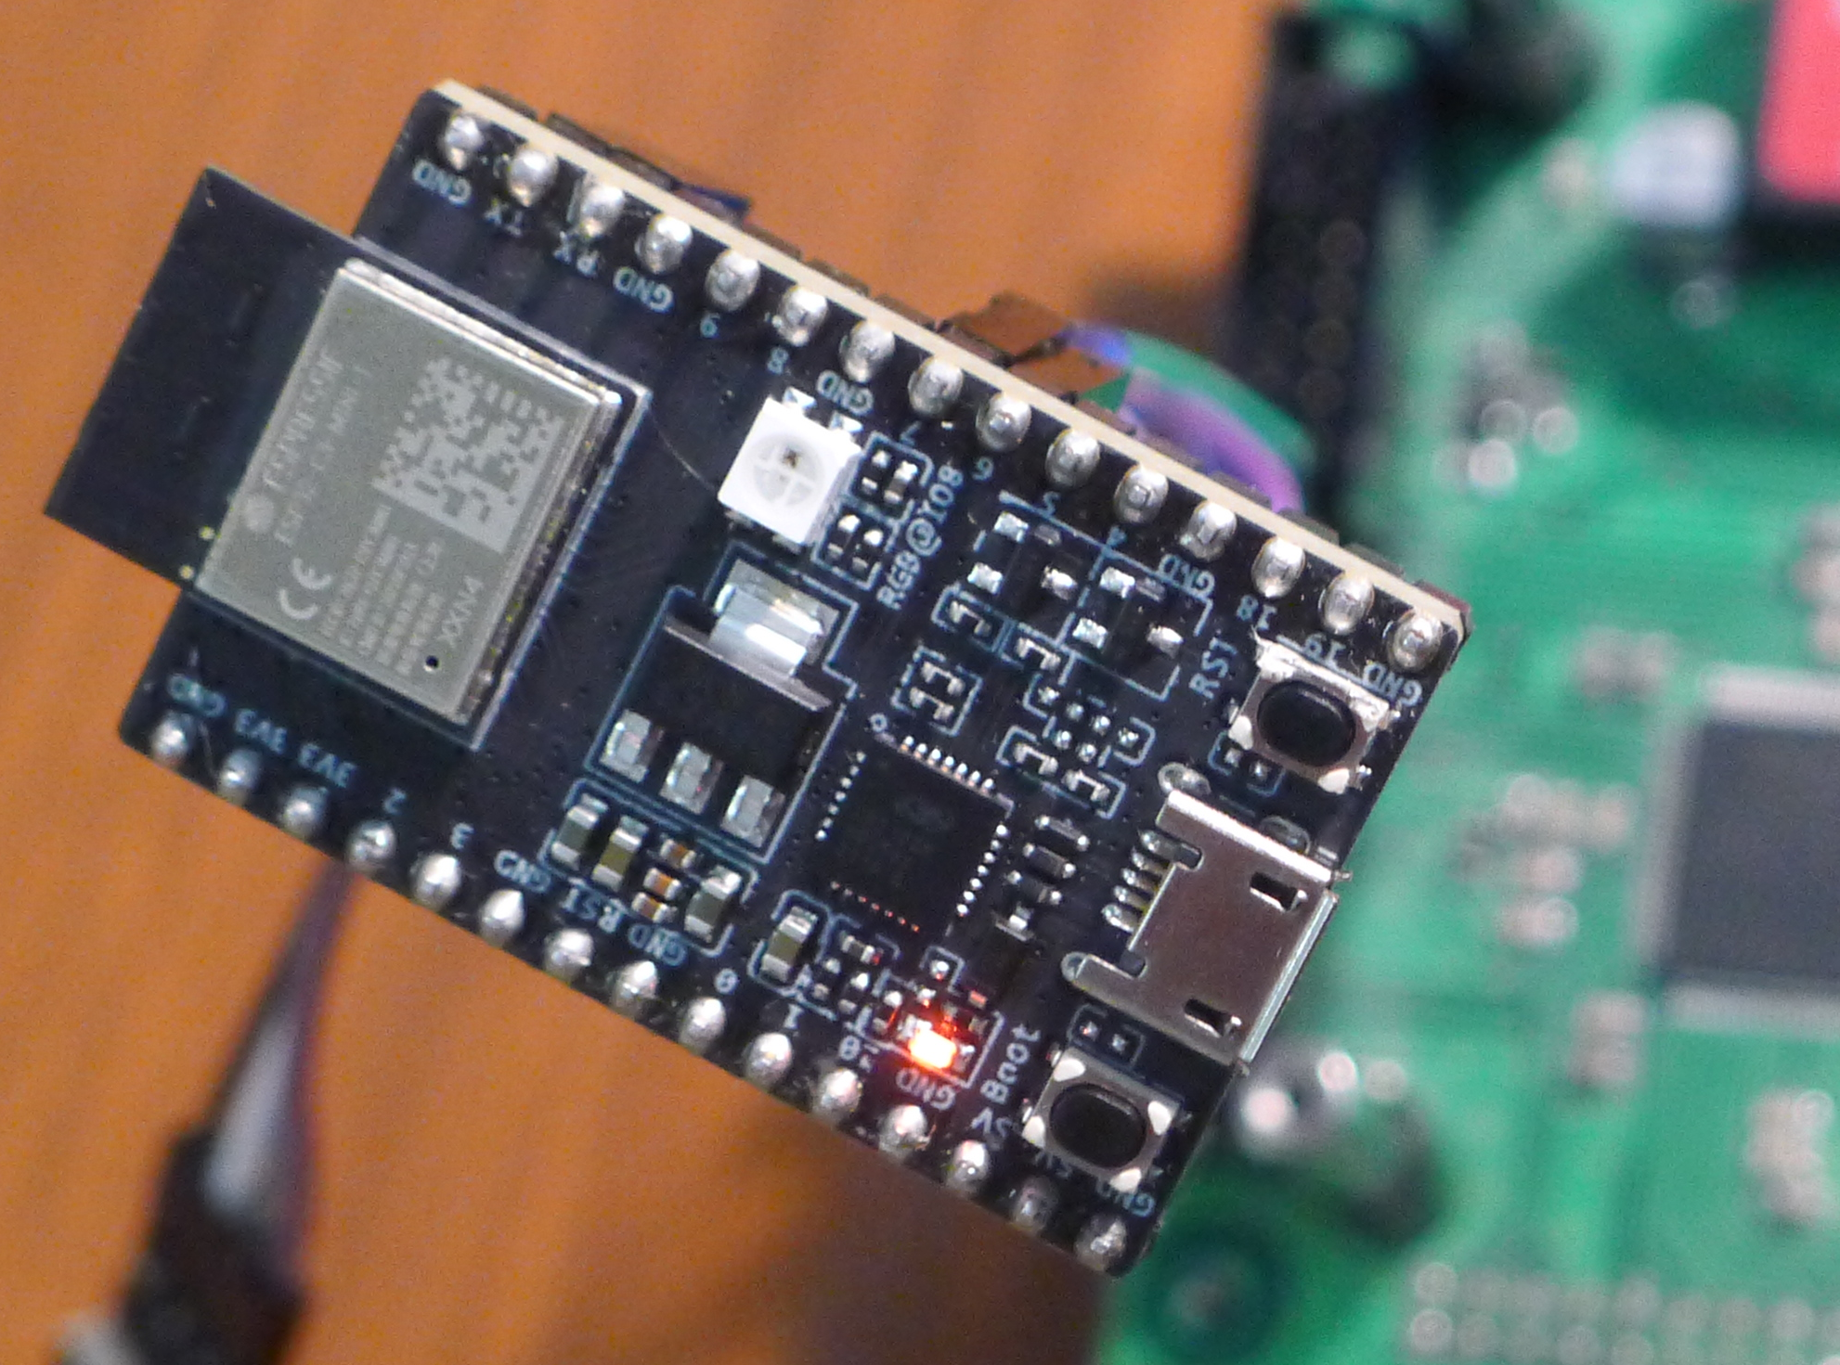
Final Remarks
Learned a lot both in hardware and software
Got to use various types of controllers and peripherals
Meaningful contributions to an open-source project
Learned to appreciate Linux OS (for development and real-time purposes)

