Slide 1
Web Mining Semester Project Presentation
Extraction of Goals from Premier League Match Reports using Natural Language Processing Techniques
Jochen Hülß and Matthias Rabus
05/23/2013

Slide 2

Agenda
BBC Match Report Crawling
Preprocessing Steps
Classification & Validation
Example Application

Slide 3
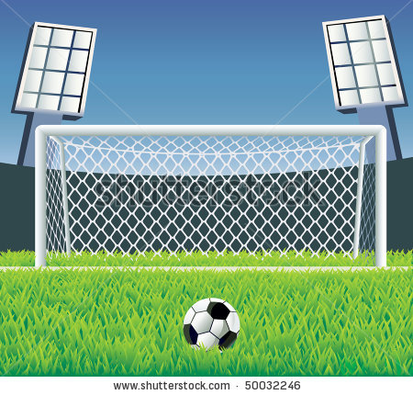
Project Goal
Conclude semi-automated training data from seeds
Supervised Classification of sentences with model accuracy > 75%

Slide 4
Example Match Report
Crawler Entry Page
http://www.bbc.co.uk/sport/football/premier-league/results
Match Report: ManU – Aston Villa
Header with result bar
Article
Info boxes
HTML tree structured
Parsed for article with XPATH
//h:div[@class='article']/h:p/text() |
//h:div[@class='article']/h:p/*/text()

Slide 5
Preprocessing: NLP & Manual Patterns
Cleaning text from RapidMiner annotations
Apply POS and NER
Manually find goals and construct patterns
Examples
Van Persie opened the scoring.
NNP NNP VBD DT VBG
PERSON PERSON 0 0 0
[PERSON | ORGA] opened DT scoring

Slide 6
Preprocessing: Manual Patterns
Examples
Van Persie opened the scoring.
NNP NNP VBD DT VBG
PERSON PERSON 0 0 0
[…] firing high into the roof of the net.
VBG JJ IN DT NN IN DT NN
0 0 0 0 0 0 0 0
[PERSON | ORGA] opened DT scoring
VB * IN * net

Slide 7
Preprocessing: JAPE Grammar Rules
GATE = Gui + Text + Processing Resources
JAPE rules are processing resources
[PERSON | ORGA] opened DT scoring
Rule: Goal2
( ({Person.rule == PersonFinal}|{Lookup.majorType == country_adj}|{Location.locType == city}| {Organization.rule == LocOrg})
{Token.string =~ open}
({Token.category == DT}|{Token.category == IN})?
{Token.string =~ scor})
:goalSequence -->
:goalSequence.Goal = {kind=Goal, rule=Goal2}

Slide 8
Data Set Properties
342 Reports
9,211 sentences
758 positive seeds
8,453 without goals
14 rules

Slide 9
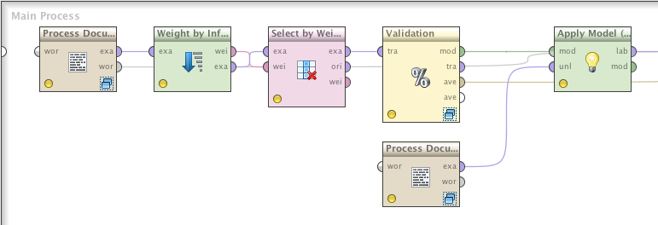
Classification & Validation
Different classifiers:
Naive Bayes: 64.58% accuracy
SVM: 70.59% accuracy
50-NN: 75.00% accuracy
Weighted 50-NN: 80.88% accuracy
Notes:
Naive bayes:
Too many unknown attributes in test set -> harder too classify
SVM:
High amount of attributes (>3000) => scattered plot => harder too find decision boundaries
K-NN:
Higher score because NN model is based on distance comparison (possible for unknown attributes)
W K-NN:
Fewer attributes => higher influence of single attributes

Slide 10
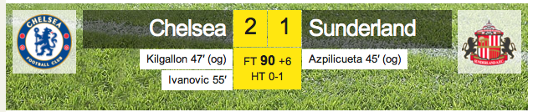
Example: Chelsea - Sunderland
Apply model on unlabeled match report
24 sentences
8 containing a goal

Slide 11
Example: Chelsea – Sunderland (cont.)
50-NN Basic best accuracy, 50-NN Weighted highest precision.

Slide 12
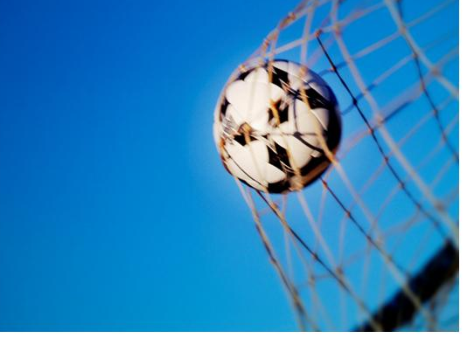
Conclusion
Successful classification
Good accuracy
Semi-automatic pattern detection

