Slide 1
Extraction of Goals from Premier League Match Reports using Natural Language Processing Techniques
Web Mining Semester Project by
Jochen Hülß and Matthias Rabus

Slide 2
Agenda

Slide 3
Example match report
Overview:
http://www.bbc.co.uk/sport/football/premier-league/results

Slide 4
Preprocessing NLP

Slide 5
Preprocessing Manual Patterns

Slide 6
Preprocessing JAPE Grammar Rules

Slide 7
Data Set Properties
Matze!

Slide 8
Classification & Validation
Matze!

Slide 9
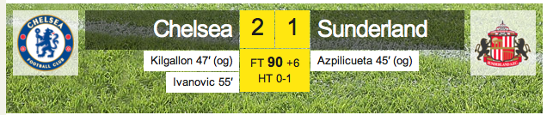
Example: Chelsea - Sunderland

Slide 10
Conclusion
Matze!

