Slide 1
SHOW ME RELATED WORK (GR8)
Beraat Buz 150160002 Yusuf Akdoğan 150160001 Tuğba Durman 150160119 Meryem Güven 150160801 Muhammed Enes Tırnakçı 150160038

Slide 2
CONTENTS
1) Introduction
2) Use-case Diagrams
3) Group Member Roles
4) Technologies We Used
5) Customer Meetings
6) Project in The Charter vs Final Product
7) Tests Results

Slide 3
INTRODUCTION
Goal
Helping research community
Showing relations between papers
Scope
Many services offer help, e.g. GoogleScholar, ResearchGate
Visualize relations among papers as graphs
Each node is a paper
Directed edge between two nodes if one paper cites another, On click show the way citation
A click on a node in the graph should show the pdf
Mark an edge as strong or weak

Slide 4
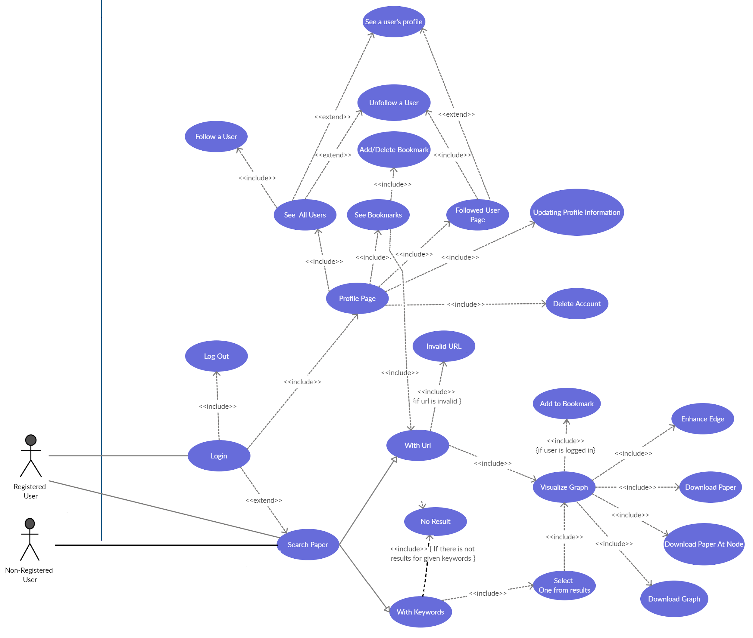
Use Case Diagram PART-1

Slide 5
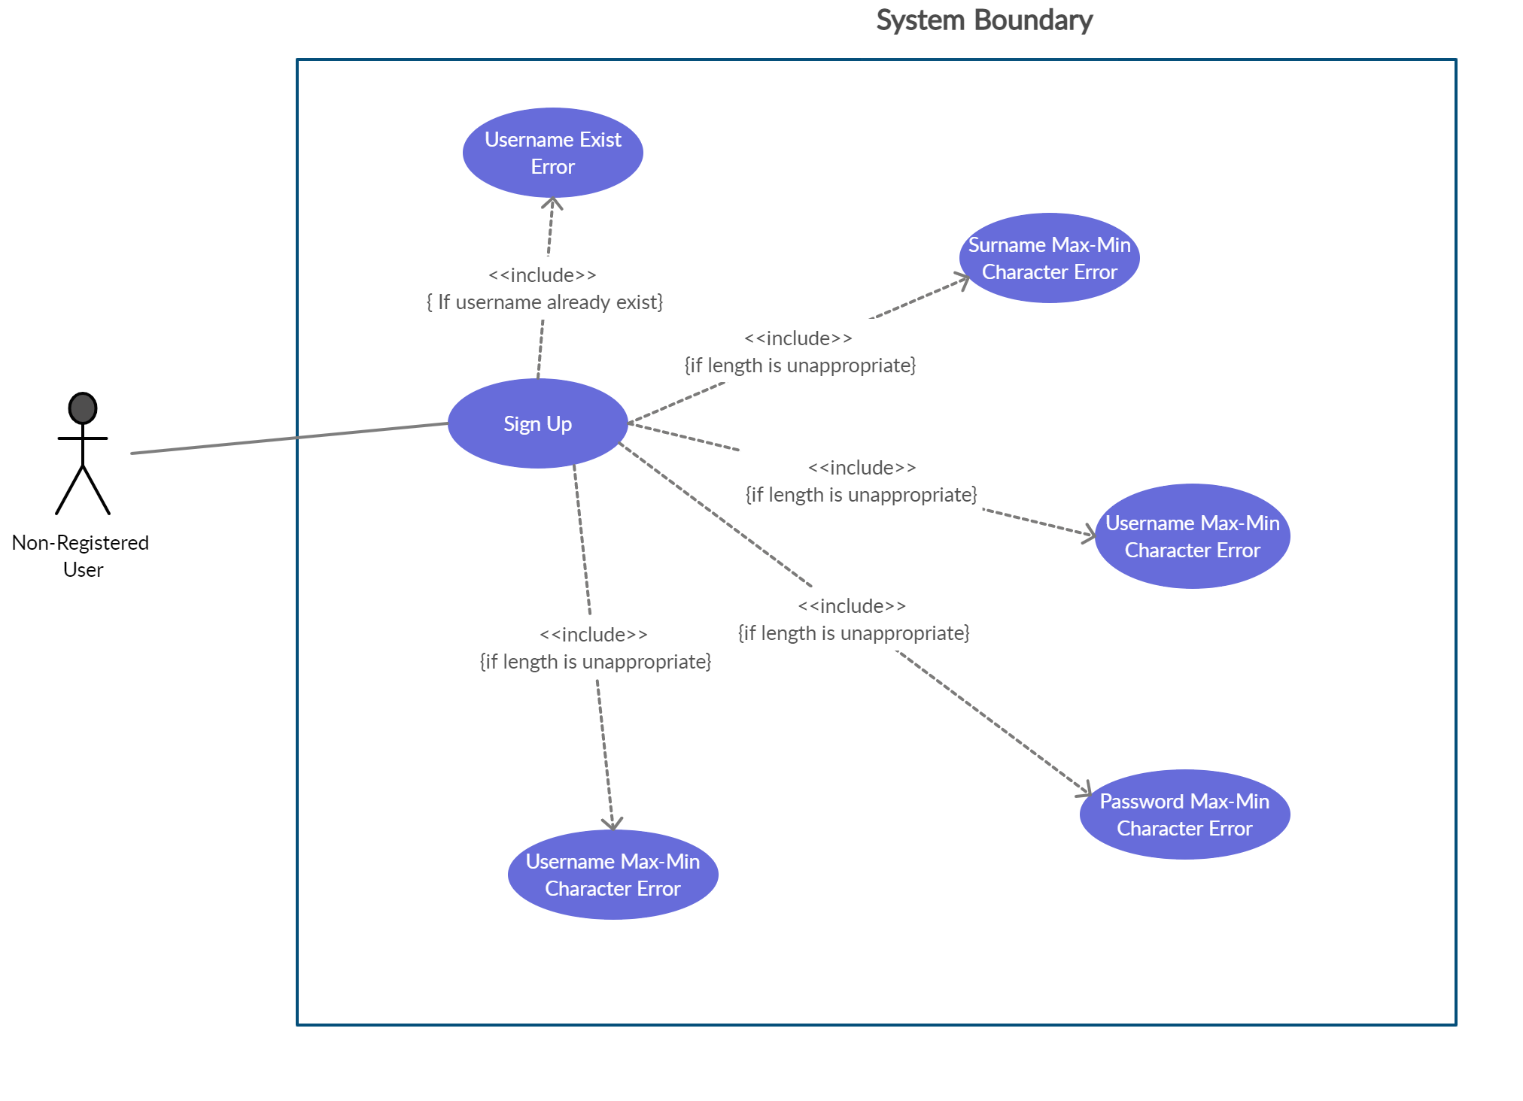
Use Case Diagram PART-2

Slide 6
Member | Roles | Responsibilities
Yusuf Akdoğan | Parsing | Paper Parsing using Paper URL, Keyword and Author Name
Tuğba Durman | User Authentication, Recommended Paper | Creating Sign-up, Login pages and database operations
Muhammed Enes Tırnakçı | User Profile Functions, Search Options, Delete Account | General Back-End, Main Search Page and Results Front-End, Graph Download Options
Meryem Güven | Bookmark, User Information | Bookmark CRUD, User Information CRUD and their Front, Back-End
Beraat Buz | Graph Visualization | Creating edge, nodes and modals on click. Pairing graph and parsed paper

Slide 7
The Technologies Used In The Project
Usage | Technology
Web Application Framework | Flask
Database Management System | PostgreSQL
User Password Encryption | Passlib library
Project tracking and management tools | JIRA
Documentation tools | Confluence
Source code version control systems | Bitbucket
Testing tools | Selenium, Jmeter, Pytest

Slide 8
Customer
Our Customer was Bilge Süheyla Akkoca Gazioğlu.
We meet 5 times, First meeting was on Wednesday, but it changed to Saturday. We attended all meetings.
We showed our process and we asked questions about areas we stuck. Also we take notes about customer’s demands.
The customer wanted 2 changes which are the page where users see their followers and search tool using author name to create author’s selected paper’s graph. We completed this asks before the last meeting. And we showed these changes to customer.

Slide 9
Security issues
Things We Done stated in Project Charter | Things We Done Extra
Visualize relations among papers as graphs | Search Modes -> URL, Keyword, Author Name and Author publications, Recommended Paper
Each node is a paper | User Authentication/Deletion and Profile Page (About, All Users, Followers, Followed, Bookmark, Delete Account)
Directed edge between two nodes if one paper cites another, On click show the way citation | Bookmark Management For Paper URLs
A click on a node in the graph should show the pdf | User Follow/Unfollow Option
Mark an edge as strong or weak | Graph download as screenshot, Exporting Searched Paper, References and Citations as CSV and JSON

Slide 10
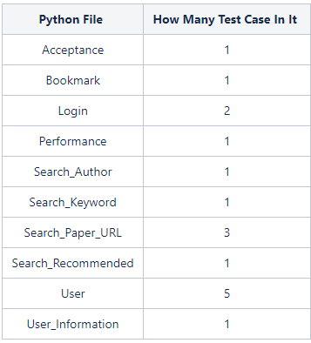
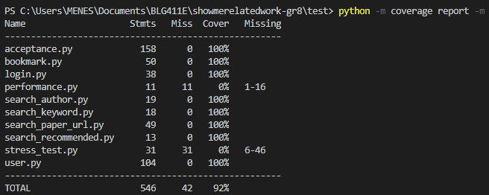
Tests
Security issues
We tested our website with Selenium, Jmeter, Pytest
In Jmeter, we gave these values to do load test:
Number of Threads (users) : 100
Ramp-Up Period (in seconds) : 100
Loop Count : 10
In our acceptance test, we test all functions of website in one unit test.
We also done load/stress tests with Selenium DesiredCapabilities functions by opening processes in threads.
We done 17 unit tests.
All of tests were successful.

Slide 11
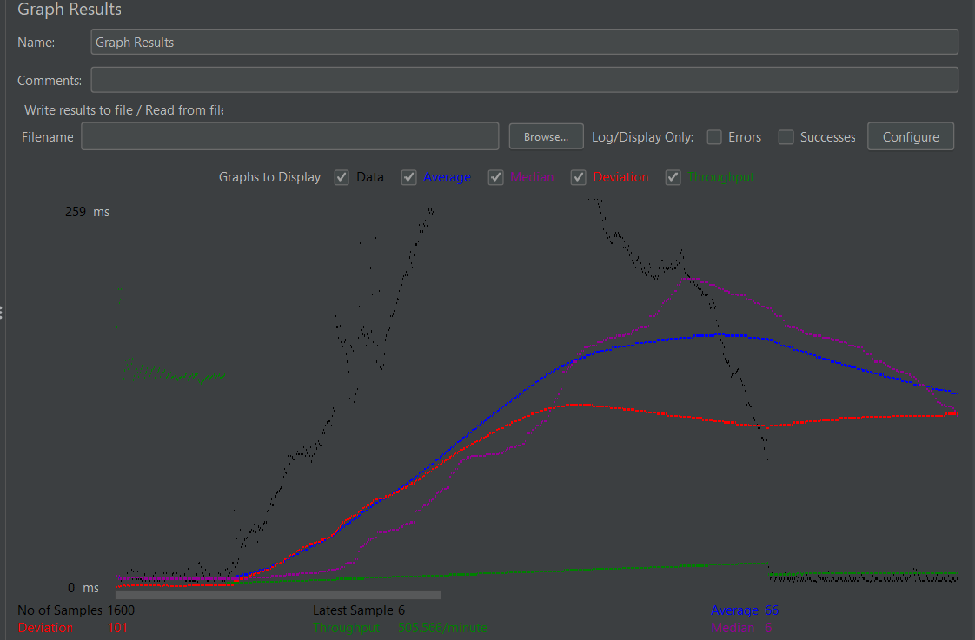
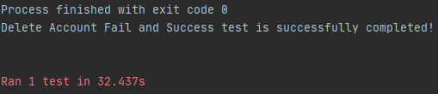
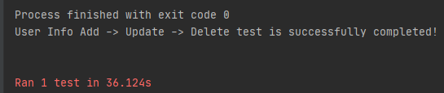
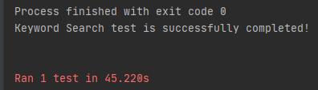
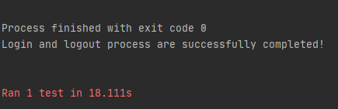
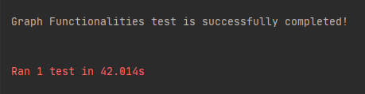
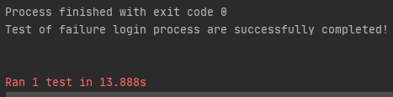
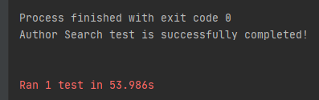
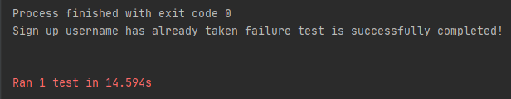
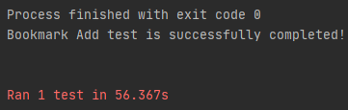
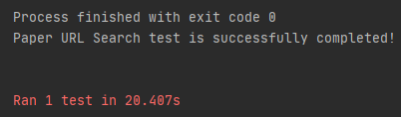
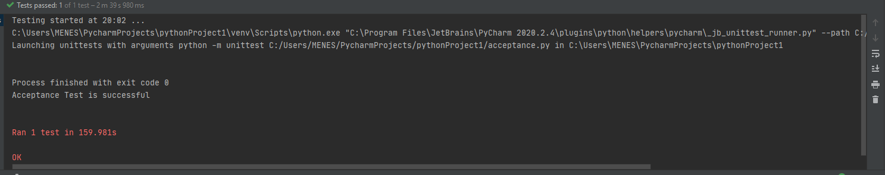
Security issues

Slide 12
THANK YOU FOR LISTENING

