Slide 1
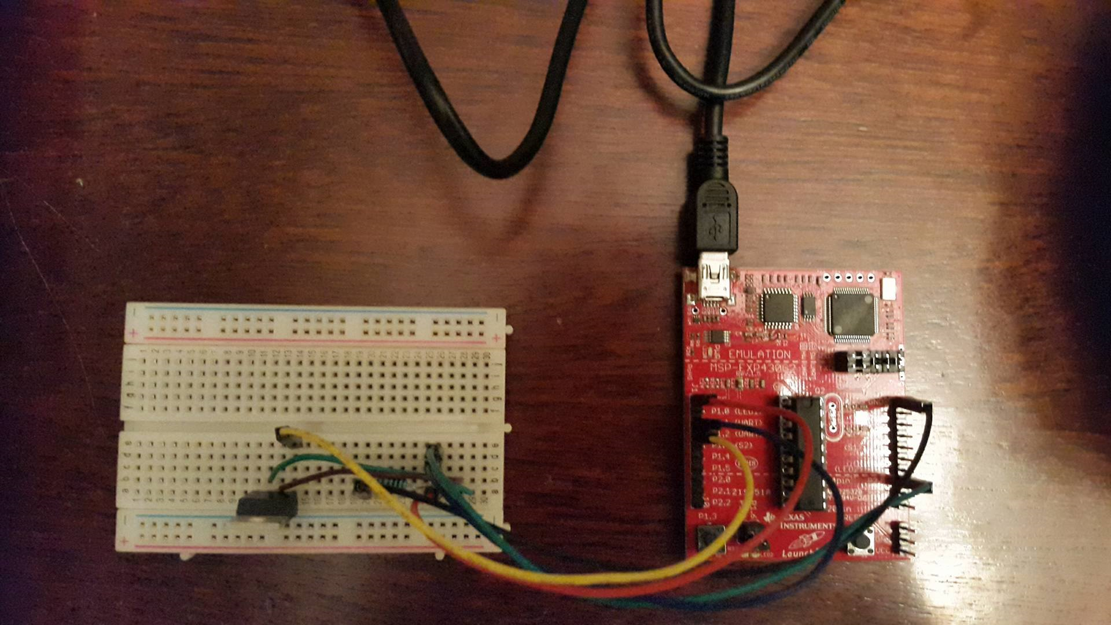
Temperature
The voltage taken from the circuit through microcontroller will be converted to a temperature value which will be displayed on a computer screen.
The computer will send the data back to the circuit to adjust the temperature.
The program will check the temperature regularly (e.g. 10 seconds).
The temperature will be controlled either automatically or manually through a user interface.

