Slide 1
Visualization of Center-Star Alignment
Berat Bicer, 21503050

Slide 2
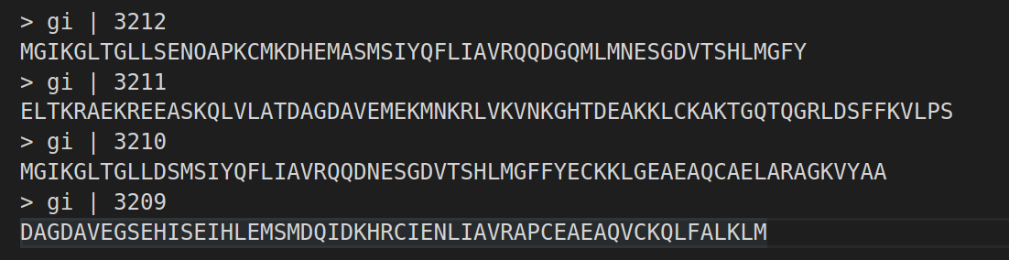
Input Sequences
FASTA formated input, 4 sequences.

Slide 3
Center-Star Alignment
Compute pairwise aligment scores with Needleman-Wunsch using 1:-1:-5 match score:mismatch penalty:gap penalty
[0, 1] → -92
[0, 2] → -57
[0, 3] → -53
[1, 2], → -62
[1, 3] → -96
[2, 3] -> -75

Slide 4
Center-Star Alignment
Compute star scores, sum of pairwise alignment scores for each sequence, select the sequence with highest score as center star.
0 → -202
1 → -250
2 → -194
3 → -224
Center star is sequence 2.

Slide 5
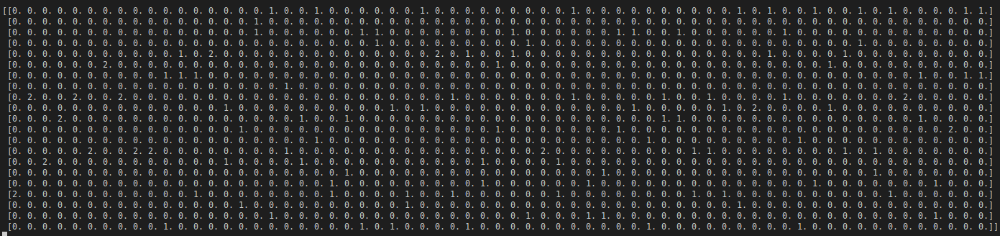
Center-Star Alignment
Using the best pairwise alignment of center star, construct an initial profile.
Current Alignments:
0 → MGIKGLTGLL___SENOAPKCMKDHEMASMSIYQFLIAVRQQDGQMLMNESGDVTSHLMG_FY__
2 → MGIKGLTGLLDSMSIYQFLIAVRQQDNESGDVTSHLMGFFYECKKLGEAEAQCAELARAGKVYAA
Current Profile:

Slide 6
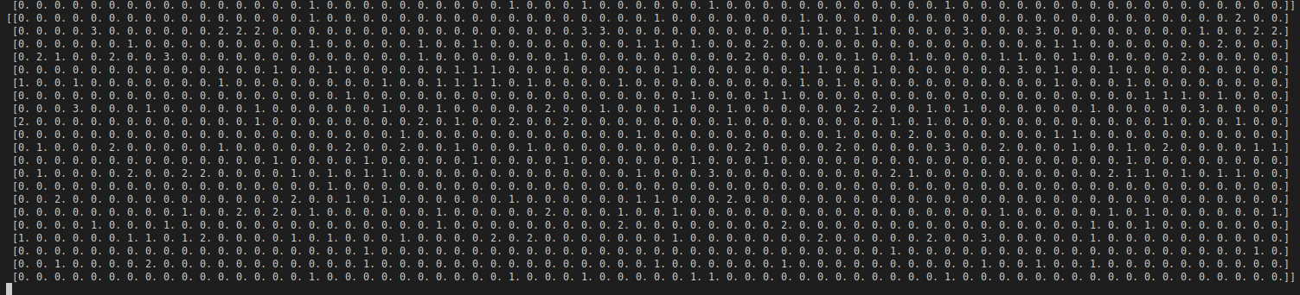
Center-Star Alignment
Find the next alignment candidate based on pairwise alignment score with center star, update the profile.
Next Alignment:
0 →MGIK_GLTGLL_ _ _SENOAPKCMKDHEMASM_ _SIYQFLIAVRQQDGQMLMN_ESG_DVTSHLMG_FY_ _
2 →MGIK_GLTGLLDSMSIYQFLIAVRQQDNESG_ _DVTSHLMGFFYECKKLGEA_EAQ_CAELARAGKVYAA
1 →ELTKRAEKREEASKQLVLATDAGDAVEMEKMNKRLVKVNKGHTDEAKKLCKAKTGQTQGRLDSFFKVLPS
3 →DAGD_AVEGSE_ _ _HISEIHLEMSMDQIDKH_ _RCIENLIAVR_ _A_ _PCEA_EAQ_VCKQLFALKLM_ _
Current Profile:

