Slide 1
Phase Disaggregation for LLM Inference
Splitwise & DistServe
ECE 5545: Machine Learning Hardware & Systems
Berat Celik & Jiayang (Ethan) Chen
Spring 2026

Slide 2
How LLM Inference Works
Phase 1: Prefill
Processes all input tokens in parallel
One forward pass through the model
Produces the first output token
Generates the KV-cache (stored context)
Compute-bound
Phase 2: Decoding
Generates tokens one at a time
Each step reads the full KV-cache
Repeats until end of sequence
Sequential, autoregressive
Memory-bandwidth-bound
"Is tomato a fruit?"
Prefill: process 5 tokens at once, output "Yes" Decode: generate "," "it" "is" "." one by one
KV-Cache: key/value tensors stored during prefill, read at every decode step. This is what gets transferred when phases are on different machines.
2

Slide 3
Two Phases, Very Different Profiles
 | Prefill | Decoding
Bottleneck | Compute-bound | Memory bandwidth-bound
Tokens per step | All input tokens (parallel) | One token (sequential)
GPU utilization | High | Low without batching
Power draw | Near TDP | Well below TDP
Latency metric | TTFT (time to first token) | TPOT / TBT (time per token)
Batching | Limited benefit (already saturated) | Significant benefit
Preferred parallelism | Tensor (intra-op) | Pipeline (inter-op)
This asymmetry is what motivates both papers.
3

Slide 4
Key Metrics
Metric | Definition | Why it matters
TTFT | Time to first token | User-perceived responsiveness
TBT / TPOT | Time between output tokens | Streaming reading speed
E2E Latency | TTFT + TPOT x output length | Total request time
Throughput | Requests per second | System capacity
Goodput | Throughput while meeting SLO targets | Cost efficiency
SLO Attainment | % of requests within latency bounds | Service quality
Example SLO: "90% of requests must have TTFT < 0.25s and TPOT < 0.1s"
4

Slide 5
The Problem with Colocation
Prefill/Decode Interference
One prefill in a decode batch:
3x latency hit (input=128)
5x latency hit (input=1024)
Goes both directions
Parallelism Coupling
Prefill wants tensor parallelism
Decoding wants pipeline parallelism
Colocated: must pick one
One phase always loses
Over-Provisioning
Must provision for worst case
Colocated: 1.6 req/s (OPT-13B)
Disaggregated: 3.3 req/s
2.1x wasted capacity
Solution: put prefill and decoding on separate hardware.
5

Slide 6
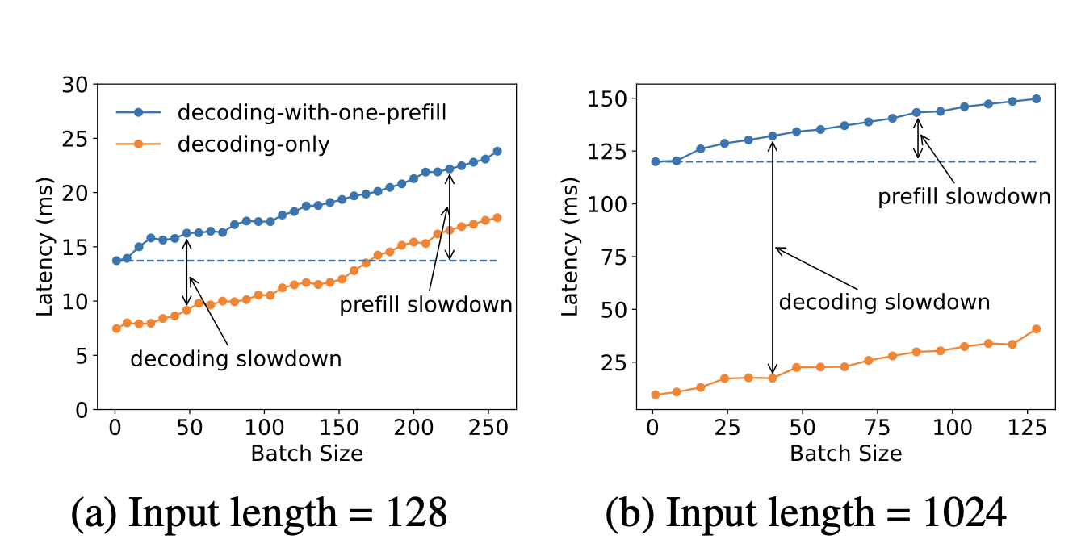
Prefill-Decode Interference
Source: Zhong et al., OSDI 2024, Figure 2
6

Slide 7
Splitwise
Efficient Generative LLM Inference Using Phase Splitting
Patel et al. | University of Washington + Microsoft | ISCA 2024
7

Slide 8
Insights from Azure Production Traces
Real traces from two Microsoft Azure LLM services (coding + conversation, Nov 2023)
Insight I
Workloads vary widely
Coding: 1500 prompt tokens, 13 output
Conversation: 1020 prompt, 129 output
Insight II
Token generation underutilizes GPUs
60-70% of time spent with 20 or fewer
active tokens in the batch
Insight III
Most wall-clock time is in decoding
Even large prompts (1500 tokens) take
roughly the same time as 6 output tokens
Insight IV
Prompt batching saturates quickly
Throughput plateaus after ~2048 tokens
Token batching keeps scaling
Splitwise Figure 3-4, Table IV
8

Slide 9
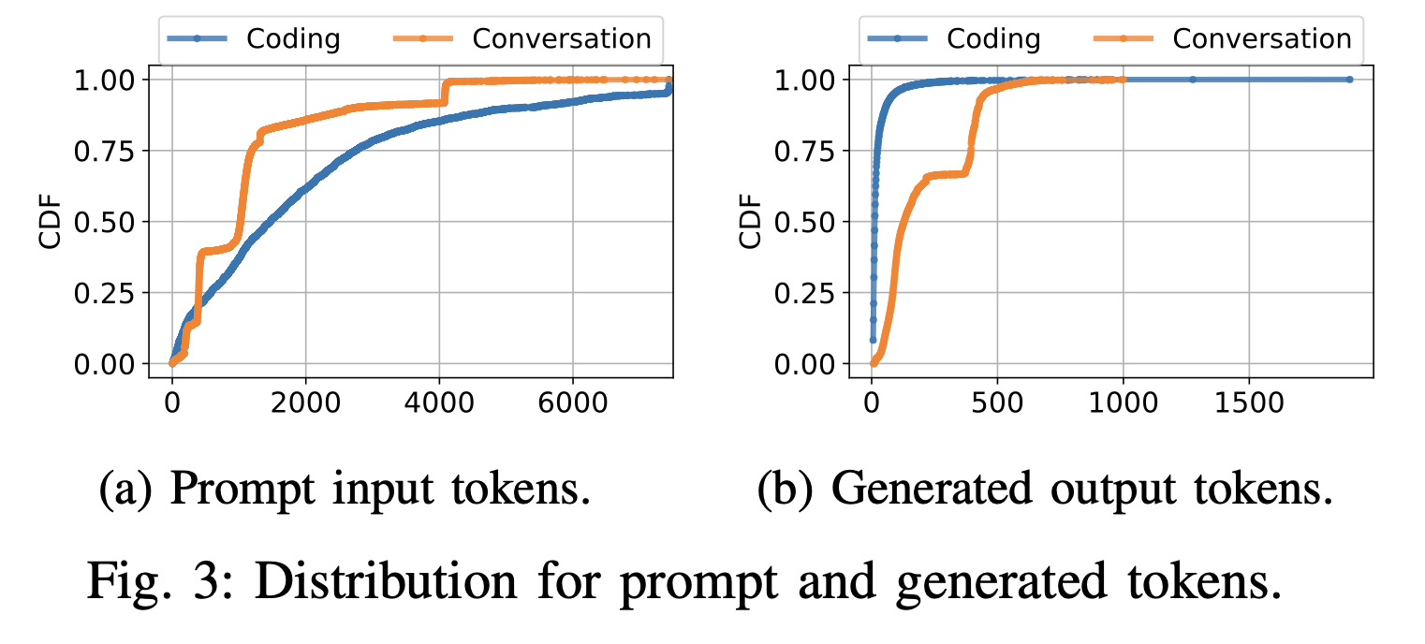
Azure Production Trace Distributions
Source: Patel et al., ISCA 2024, Figure 3
9

Slide 10
The Hardware Insight
 | A100 | H100 | Ratio
TTFT (coding) | 185 ms | 95 ms | 0.51x
TBT (coding) | 52 ms | 31 ms | 0.70x
Cost per request | $0.42 | $0.52 | 1.24x
Energy | 1.37 Whr | 1.37 Whr | 1x
H100 has 3.43x more compute than A100
Prefill benefits (TTFT: 0.51x). Token generation barely does (TBT: 0.70x).
Token generation can run on cheaper hardware without much performance loss.
Power-capping token machines to 70% has virtually no latency impact.
10

Slide 11
Splitwise Architecture
Cluster-Level Scheduler (JSQ routing)
Prompt Pool
Compute-optimized GPUs (H100)
Dedicated to prefill
FCFS, batch up to 2048 tokens
Token Pool
Cost-efficient GPUs (A100)
Dedicated to generation
Continuous batching
KV-cache transfer >>
Mixed Pool
Flexible machines that handle overflow from either pool
11

Slide 12
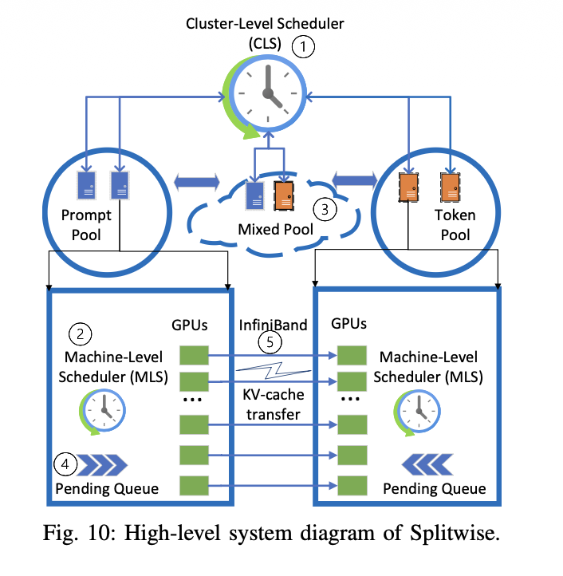
Splitwise System Architecture
Source: Patel et al., ISCA 2024, Figure 10
12

Slide 13
KV-Cache Transfer
Serialized (naive)
Wait for full prefill to finish
Transfer entire KV-cache at once
64% overhead on second token
Per-layer (optimized)
Send each layer's cache as it computes
Transfer overlaps with computation
16% overhead on second token
Transfer overhead: 0.8% of end-to-end latency
Constant 5-8ms regardless of prompt size (MSCCL++ zero-copy over InfiniBand)
Both papers confirm: KV-cache transfer is not the bottleneck.
13

Slide 14
Cluster Configurations
Configuration | Prompt GPUs | Token GPUs | Tradeoff
Splitwise-AA | DGX-A100 | DGX-A100 | Lowest cost
Splitwise-HH | DGX-H100 | DGX-H100 | Best performance
Splitwise-HA | DGX-H100 | DGX-A100 | Best cost-performance
Splitwise-HHcap | DGX-H100 | H100 at 70% power | Power savings
14

Slide 15
Splitwise Results
Same power & cost budget
2.15x more throughput vs Baseline-A100
Same cost
1.4x more throughput at 20% lower cost vs Baseline-H100
Same throughput target
25% lower power (HHcap) or 25% lower cost (AA)
Headline: up to 1.4x throughput at 20% lower cost, or 2.35x throughput at same budget
Robust to workload changes (7% drop with mismatched workload) and model changes.
15

Slide 16
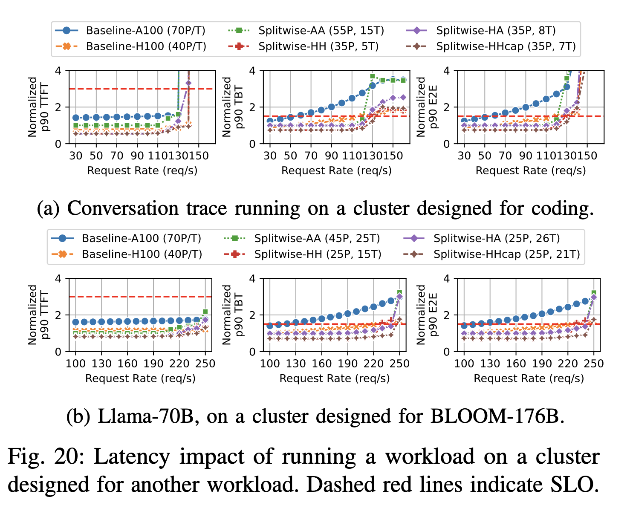
Splitwise Throughput-Latency Results
Source: Patel et al., ISCA 2024, Figure 16
16

Slide 17
Splitwise Summary
Characterized real Azure production workloads, found 7 key insights
Designed three-pool architecture (prompt, token, mixed)
Optimized KV-cache transfer: 0.8% of end-to-end latency
Explored four heterogeneous cluster configurations
Result: cheaper GPUs for token generation work just as well
Limitations: needs cluster provisioning, less useful with few GPUs, basic fault tolerance
17

Slide 18
DistServe
Disaggregating Prefill and Decoding for Goodput-Optimized LLM Serving
Zhong et al. | Peking University + StepFun + UC San Diego | OSDI 2024
18

Slide 19
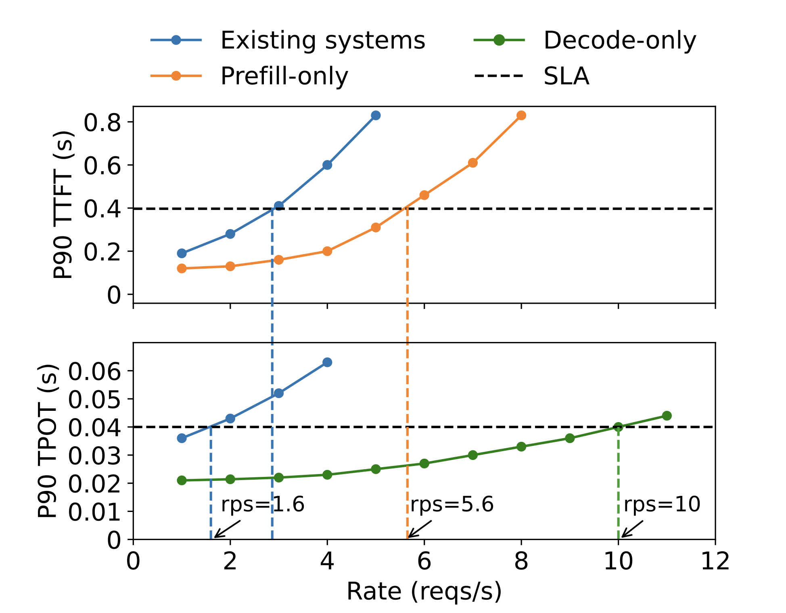
Goodput / How DistServe Works
Goodput = max request rate while meeting Service Level Objective (SLO)
1 A100, 13B LLM, 512 prompt and 64 output tokens to simulate an article summary task.
19

Slide 20
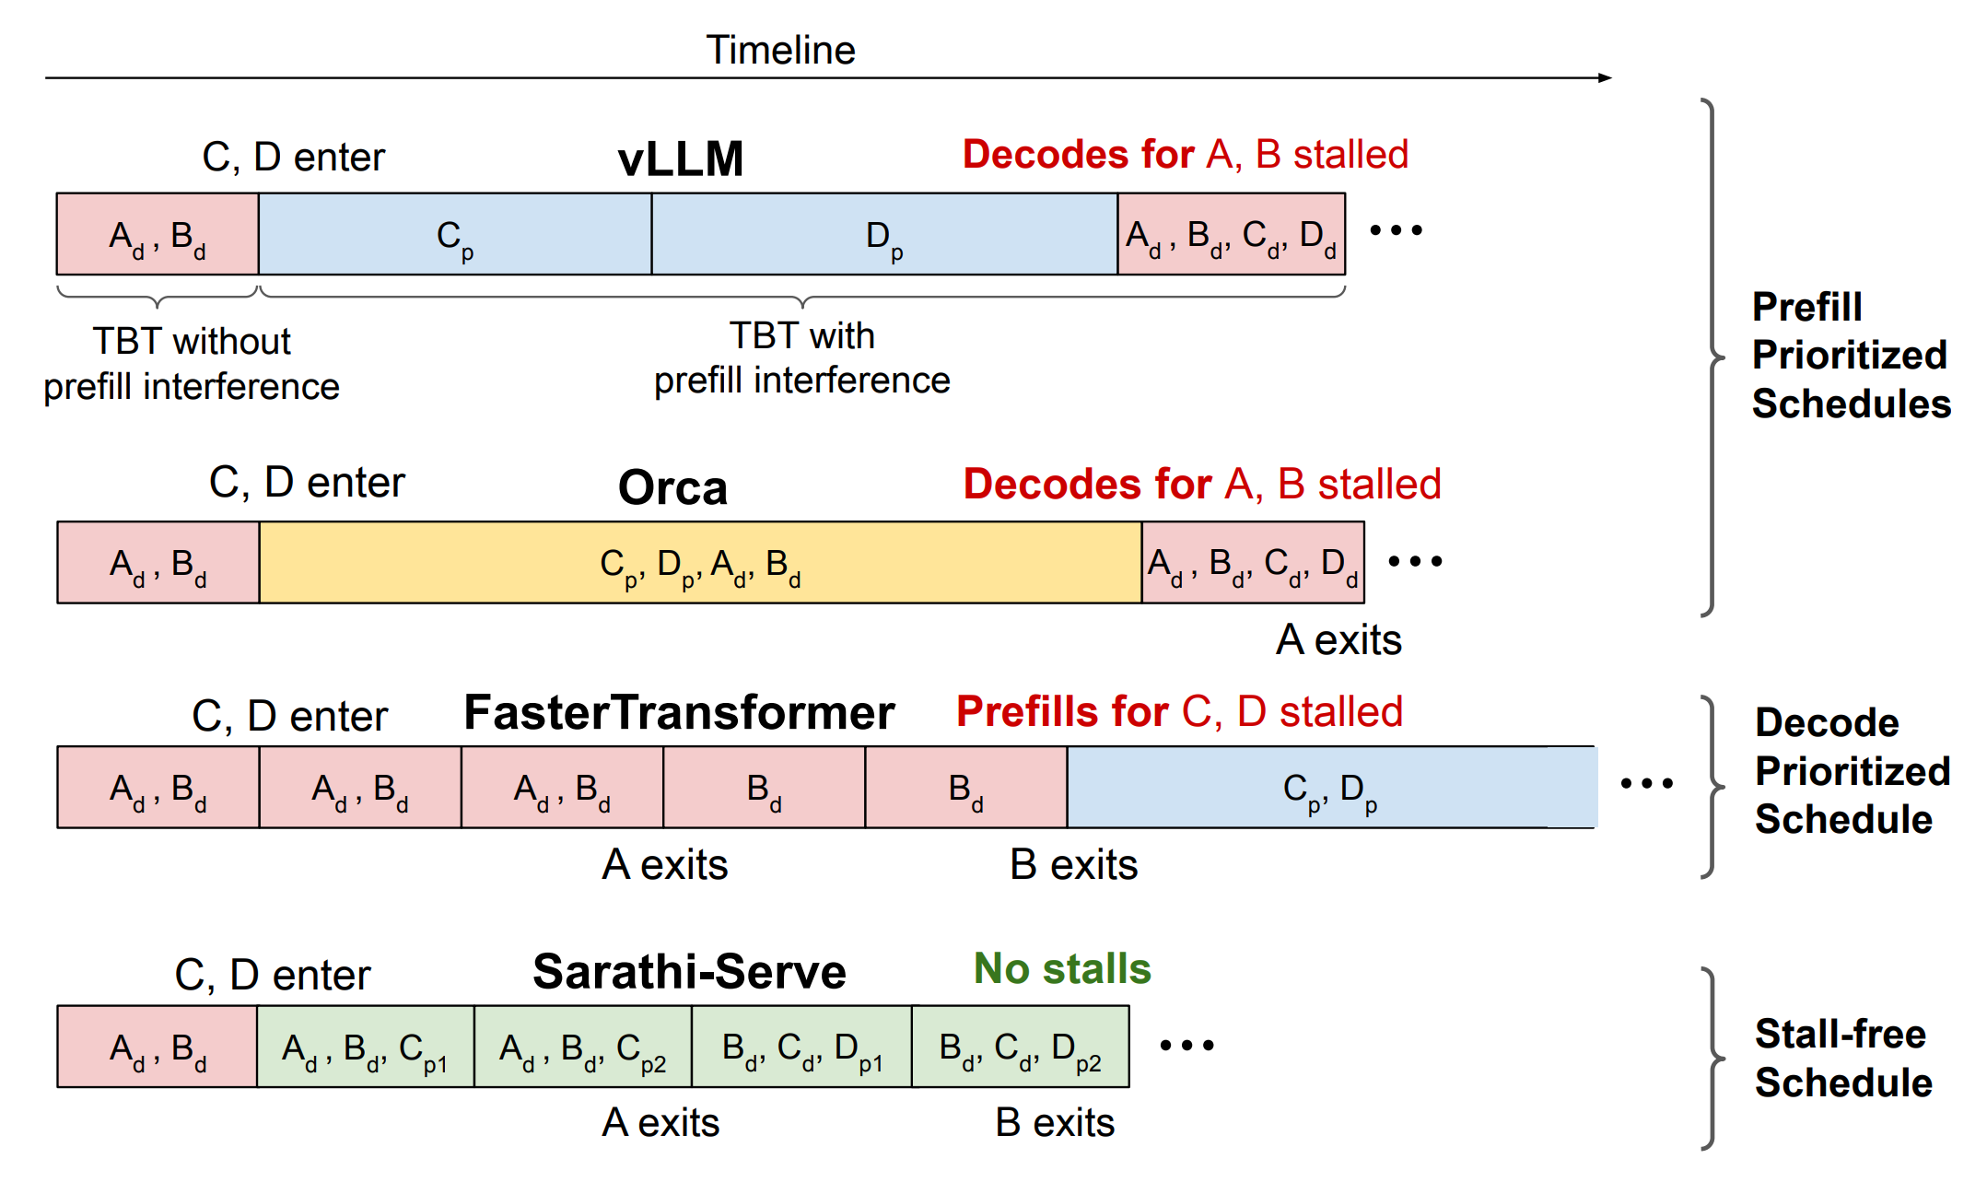
Why Not Chunked Prefill?
Mixed Chunk / Chunked Prefill: Sarathi Serve
20

Slide 21
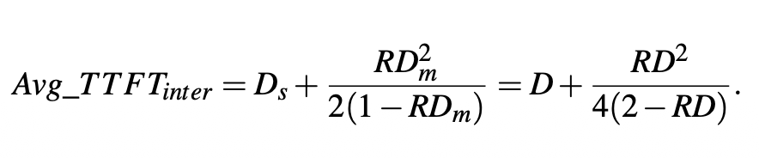
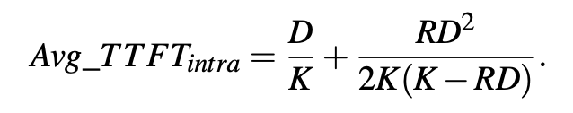
Formal Analysis / Parallelism Tradeoff
Prefill Instances
Modeled as M/D/1 queue
Avg TTFT = execution time + queuing delay
Low request rates:
Tensor parallelism better (cuts execution time)
High request rates:
Pipeline parallelism better (handles queuing)
Decoding Instances
Single job is bandwidth-bound
Batching is essential for utilization
Disaggregation helps:
Multiple prefill instances feed one decoder
Naturally larger batches, better GPU use
Large batches approach compute-bound
21

Slide 22
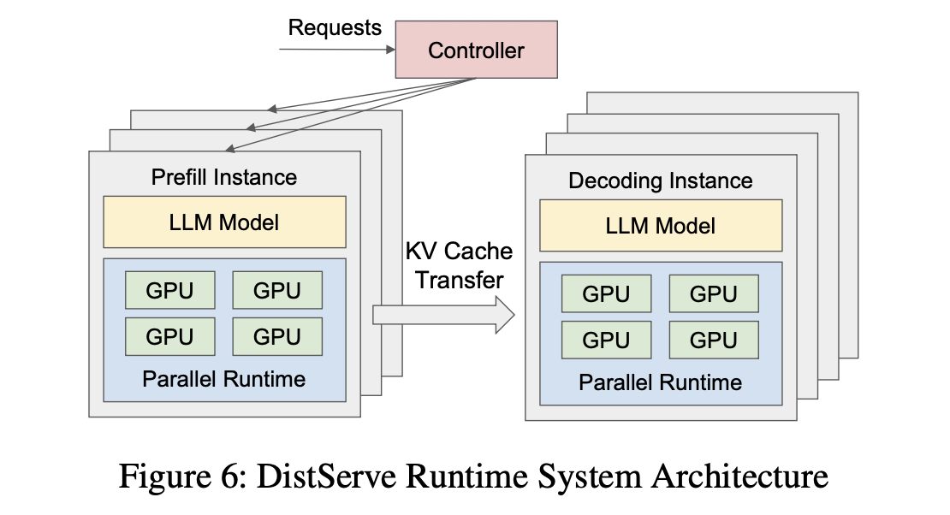
DistServe System Architecture
Source: Zhong et al., OSDI 2024, Figure 6
22

Slide 23
Placement Algorithms
Input: model, workload, SLOs. Output: optimal parallelism + instance counts.
Algorithm 1: for high speed cross-node network
Enumerate parallelism configs
Simulate goodput for each
Pick best config per phase
Replicate to meet target rate
Runs in under 1.3 minutes
Algorithm 2: For limited bandwidth network
Prefill + decode on same node
Use NVLINK for KV transfer
Co-optimize within node budget
Group layers into segments
Simulator accuracy: under 2% error compared to real hardware runs
23

Slide 24
DistServe Results
32 NVIDIA A100-80GB GPUs across 4 nodes | OPT models (13B, 66B, 175B) | vs vLLM and DeepSpeed-MII
Workload | Rate vs vLLM | SLO vs vLLM | Rate vs DeepSpeed-MII
Chatbot (ShareGPT) | 2.0x to 4.6x higher | 1.8x to 3.2x tighter | 1.6x to 7.4x higher
Code Completion | 5.7x higher | 1.4x tighter | 1.6x higher
Summarization | 4.3x higher | 12.6x tighter | 1.8x higher
Parallelism strategies chosen (different per phase):
Model | Prefill (TP, PP) | Decode (TP, PP)
OPT-13B | (2, 1) | (1, 1)
OPT-66B | (4, 1) | (2, 2)
OPT-175B | (3, 3) | (4, 3)
24

Slide 25
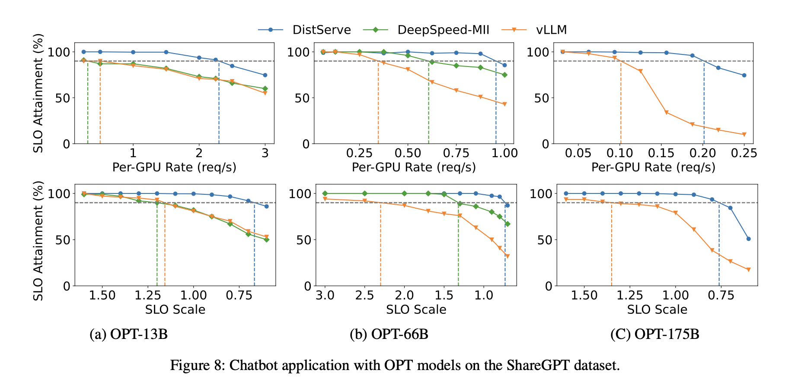
DistServe Evaluation: Chatbot and Workloads
Source: Zhong et al., OSDI 2024, Figure 8
25

Slide 26
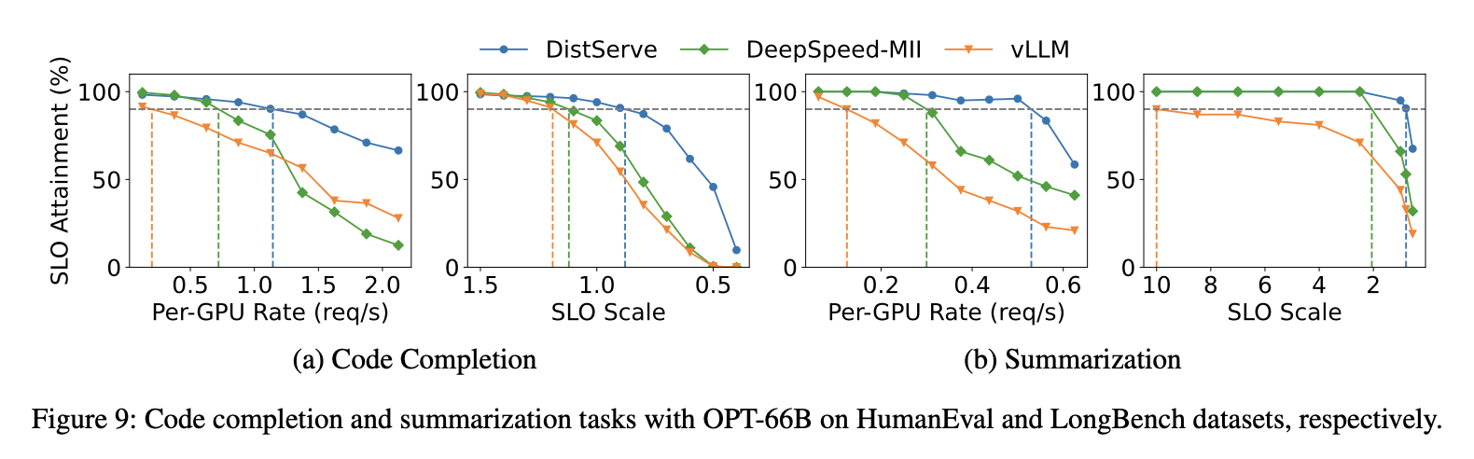
DistServe Evaluation: Code and Summarization
Source: Zhong et al., OSDI 2024, Figure 9
26

Slide 27
Splitwise vs DistServe
 | Splitwise | DistServe
Focus | Heterogeneous hardware | Goodput optimization
Cluster | Mixed GPU types | Homogeneous
Core idea | Right hardware per phase | Right parallelism per phase
Audience | Cloud providers | Service operators
KV transfer | Per-layer overlapped | Pull-based on-demand
Analysis | Production traces | Queueing theory
Venue | ISCA 2024 | OSDI 2024
Complementary approaches. Best system would combine both.
27

Slide 28
References
[1] P. Patel, E. Choukse, C. Zhang, A. Shah, I. Goiri, S. Maleki, R. Bianchini.
"Splitwise: Efficient Generative LLM Inference Using Phase Splitting."
ISCA 2024. arXiv:2311.18677
[2] Y. Zhong, S. Liu, J. Chen, J. Hu, Y. Zhu, X. Liu, X. Jin, H. Zhang.
"DistServe: Disaggregating Prefill and Decoding for Goodput-optimized
Large Language Model Serving." OSDI 2024. arXiv:2401.09670
[3] A. Agrawal et al. Sarathi: Efficient LLM Inference by Piggybacking Decodes
with Chunked Prefills. arXiv:2308.16369, 2023.
[4] W. Kwon et al. Efficient Memory Management for Large Language Model Serving
with PagedAttention (vLLM). SOSP 2023.
[5] Y. Sheng et al. FlexGen: High-Throughput Generative Inference of Large Language
Models with a Single GPU. ICML 2023.
28

Slide 29
Thank You
Questions?
Splitwise: arXiv:2311.18677 (ISCA 2024)
DistServe: arXiv:2401.09670 (OSDI 2024)
Berat Celik & Jiayang (Ethan) Chen
ECE 5545 | Spring 2026
29

