Slide 1
SEN2212 · DATA STRUCTURES & ALGORITHMS II
Bank Queue
Management System
A single-window bank client manager built on two hand-coded data structures — a binary search tree for the customer registry and a FIFO queue for the waiting line.
Berat Karataş
ID 2203016
Emirhan Sönmez
ID 2364656
Melisa Okay
ID 1905885
Group 35 Lab Section 904 Project Report

Slide 2




1
The Problem
Managing the order of customers at a bank counter
People arrive at different times. A clerk working from memory or sticky notes loses track of who came first and calls the wrong person.
Register once Each customer is recorded a single time, keyed by ID.
One rule:
First come,
first served.
Hand out tickets People join the line in the order they arrive.
Call in order The counter calls customers strictly first-come, first-served.
The Bank Queue Management System enforces this automatically, in one desktop window.
Bank Queue Management System · Group 35
2

Slide 3





2
Environment & Approach
Standard-library Java, with the data structures written by hand
LANGUAGE
INTERFACE
PERSISTENCE
CORE STRUCTURES
Java, JavaSE-21
Java Swing
Flat text file
Hand-coded
Developed in the Eclipse IDE.
Nimbus look-and-feel; one window.
Musteriler.txt — id,name,surname rows.
No TreeMap / ArrayDeque — built from nodes up.
Why build them by hand? The project's goal is to understand the cost of every operation — so the tree and the queue are written from their nodes up, not pulled from the collections library.
Bank Queue Management System · Group 35
3

Slide 4


3
Two Structures, Two Questions
Each core job maps onto one classic data structure
Customer Registry
Waiting Line
“Is this ID registered, and who is it?”
“Who is served next?”
Binary Search Tree
Keyed by customer ID; lookup is the most frequent operation.
Ordered keys, no duplicates stored.
Search & insert in O(log n) on average.
FIFO Queue (linked list)
A line is, by definition, first-in first-out.
front / rear pointers; nodes chained in arrival order.
enqueue & dequeue in O(1) — constant time.
Bank Queue Management System · Group 35
4

Slide 5


4
CustomerBST — the registry
Recursive insert & search, keyed by ID
Why a tree? By keeping IDs ordered and halving the search space at each step, a BST finds or rejects an ID in O(log n) comparisons — versus O(n) for scanning a list.
private Node insertRec(Node node, Customer c) {
if (node == null) { size++; return new Node(c); }
int cmp = c.getId().compareTo(node.customer.getId());
if (cmp < 0) node.left = insertRec(node.left, c);
else if (cmp > 0) node.right = insertRec(node.right, c);
return node; // cmp == 0 -> duplicate, ignored
}
private Node searchRec(Node node, String id) {
if (node == null) return null;
int cmp = id.compareTo(node.customer.getId());
if (cmp == 0) return node;
return cmp < 0 ? searchRec(node.left, id)
: searchRec(node.right, id);
}
IDs are fixed-width student numbers, so String.compareTo orders them like numbers.
A duplicate ID stops insertion — the tree never stores the same customer twice.
Both methods are recursive, mirroring the shape of the tree.
Caveat: O(log n) is the average. Inserting already-sorted IDs degrades the tree toward O(n) — the fix is a balanced tree (see Future Work).
Bank Queue Management System · Group 35
5

Slide 6



5
CustomerQueue — the waiting line
Singly-linked list with front & rear pointers
Why a linked queue? enqueue links onto the rear and dequeue unlinks the front — both O(1) no matter how long the line grows. An array would make “call next” an O(n) shift of everyone behind.
public void enqueue(Customer c) {
QueueNode n = new QueueNode(c);
if (rear == null) front = rear = n; // empty line
else { rear.next = n; rear = n; }
size++;
}
public Customer dequeue() {
if (front == null) return null;
Customer c = front.customer;
front = front.next;
if (front == null) rear = null; // line now empty
size--;
return c;
}
Three small helpers the interface needs:
contains — stops one person taking two tickets — O(n)
peek — reports who is next without removing them
snapshot — copies the line so the screen can redraw it
Bank Queue Management System · Group 35
6

Slide 7
6
Cost of Each Operation
What we gain by choosing each structure deliberately
Operation | Structure | Method | Time complexity
Register / find a customer | BST | insert / search | O(log n) avg · O(n) worst
Take a ticket (join line) | Queue | enqueue | O(1)
Call next customer | Queue | dequeue | O(1)
Already in line? | Queue | contains | O(n)
Redraw waiting list | Queue | snapshot | O(n)
Count registered | BST | getSize | O(1)
READING THE COST
O(1)
constant — instant, any line length
O(log n)
scales gently — the BST advantage
O(n)
linear — fine at this scale
The hot paths — find, join, call — are the cheap ones.
Bank Queue Management System · Group 35
7

Slide 8
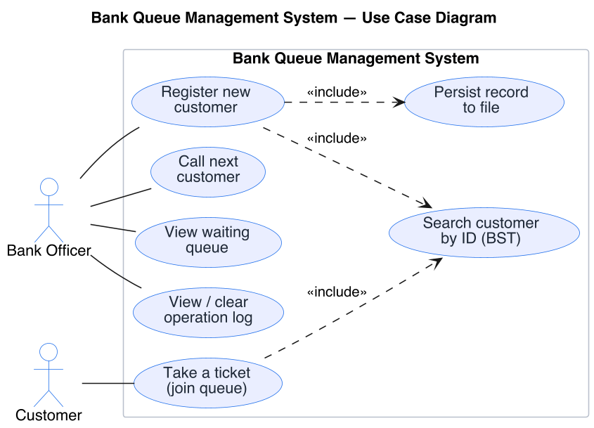



7
Use Case Diagram
The system from the outside — who does what
Bank Officer Drives the admin actions — register, call next, view the queue and the log.
Customer Passive — added by “take a ticket”, summoned by “call next”.
«include» Registering and taking a ticket both search the BST; registering also persists to file.
Bank Queue Management System · Group 35
8

Slide 9
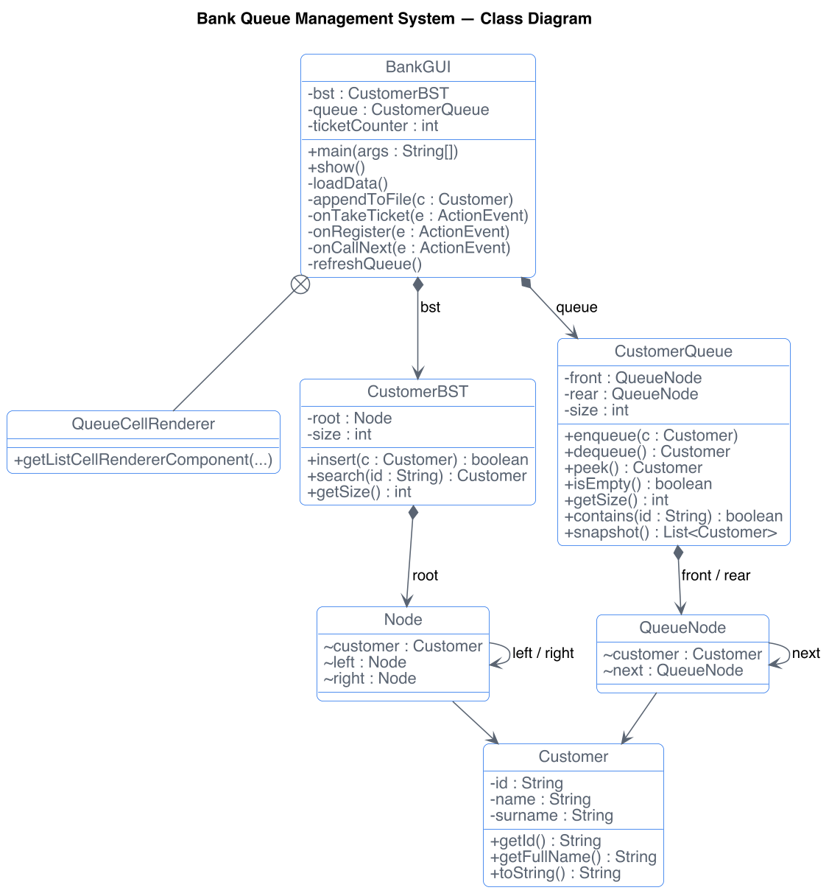


8
Class Diagram
Ownership flows downward — nothing points back up
Three layers BankGUI owns one CustomerBST and one CustomerQueue (plus the nested QueueCellRenderer).
Each structure owns its nodes The tree a root Node with left / right; the queue a chain of QueueNodes, front → rear.
Customer is shared The plain id / name / surname record both structures store; every node points to one.
Testable in isolation: the structures know nothing about the GUI, so the tree and queue were exercised from a plain main() before the window existed.
Bank Queue Management System · Group 35
9

Slide 10
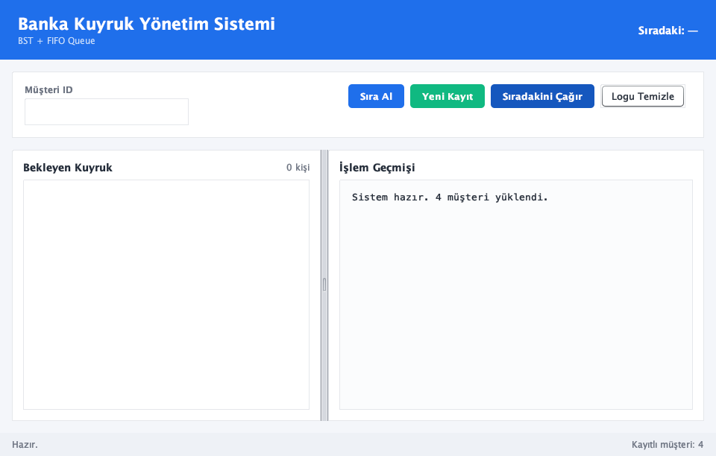
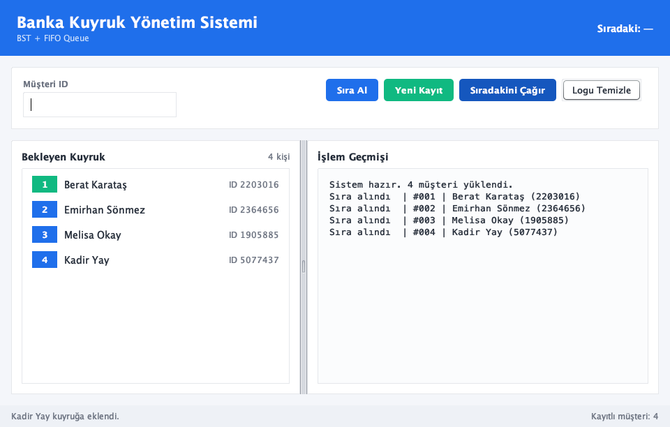
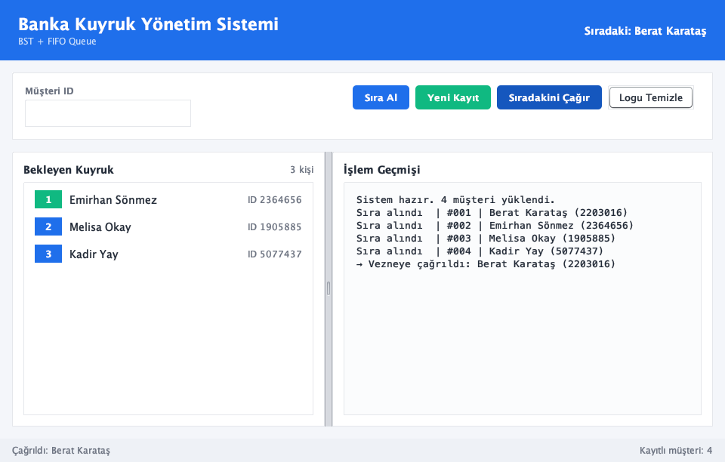
9
Live Walkthrough
One session: load the registry, build the line, serve in order
1
Launch & load
2
Build the line
3
Serve in order
Reads Musteriler.txt into the BST — “4 müşteri yüklendi.” The waiting line starts empty.
“Sıra Al” checks each ID against the tree, then enqueues. The front is highlighted green.
“Sıradakini Çağır” dequeues the front (Berat); the line shifts up — strict FIFO.
Bank Queue Management System · Group 35
10

Slide 11

10
Design Choices
We considered the alternatives — and rejected them on purpose
Registry: BST, not a HashMap
Line: Queue, not a Stack
Binary search tree keeps IDs ordered (room for range / sorted listings) and lets us own the algorithm.
FIFO queue serves the earliest arrival first — exactly what a fair line does.
Hash map would be O(1) but unordered — and shrinks the whole registry to a single library call.
Stack (LIFO) would serve the most recent arrival first — the opposite of fair.
Bank Queue Management System · Group 35
11

Slide 12



11
Work Partitioning
Group 35 · three members, three layers
Emirhan Sönmez
Melisa Okay
Berat Karataş
ID 2364656
ID 1905885
ID 2203016
Analysis & Design
Data Structures
Interface & Persistence
03–06 May 2026
07–11 May 2026
12–15 May 2026
Defined the problem and use cases; designed the class structure and chose the BST + queue split.
Implemented CustomerBST (recursive insert / search) and CustomerQueue (linked front / rear, enqueue / dequeue / contains / snapshot).
Built the Swing interface (queue list, action panel, log) and the Musteriler.txt load / append layer.
Bank Queue Management System · Group 35
12

Slide 13




12
Conclusion & Future Work
Find a customer quickly, serve customers fairly — the system does both because each task rests on a suitable structure. The BST answers “is this ID registered?” in O(log n); the FIFO queue answers “who is next?” in O(1), always in arrival order.
FUTURE WORK
Balance the tree
Allow leaving the line
Move to a database
An AVL or red-black variant turns average O(log n) into a guaranteed bound.
Let customers who give up waiting exit the queue, not only join and be called.
Replace the flat file once the customer base outgrows a single text file.
The data structure you choose determines what your program does well — so choosing it deliberately is a large part of the design.
Bank Queue Management System · Group 35
13

Slide 14


References
1
Cormen, T. H., Leiserson, C. E., Rivest, R. L., & Stein, C. (2009). Introduction to Algorithms (3rd ed.). MIT Press.
2
Weiss, M. A. (2012). Data Structures and Algorithm Analysis in Java (3rd ed.). Pearson.
3
Goodrich, M. T., Tamassia, R., & Goldwasser, M. H. (2014). Data Structures and Algorithms in Java (6th ed.). Wiley.
Thank you
4
Sedgewick, R., & Wayne, K. (2011). Algorithms (4th ed.). Addison-Wesley.
Bank Queue
Management System
5
Oracle. (2024). The Java Tutorials – Creating a GUI With Swing.
6
Oracle. (2024). Java Platform, Standard Edition API Specification (java.io, javax.swing).
Group 35 · SEN2212
Lab Section 904
Bank Queue Management System · Group 35
14

