Slide 1

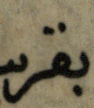



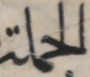
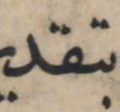




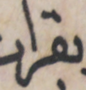

Word Spotting Using Convolutional Siamese Network
Berat Kurar Barakat, Reem Alasam, Jihad El-Sana
Department of Computer Science
Ben-Gurion University of the Negev
Training with contrastive loss
Siamese Network
CNN
F(x₁)
W
L₂
CNN
F(x₂)
Random Model
Discriminative Model
Notes:
Can we spot OOV words with a discriminative model but without word embedding?
We tackled this question on historical document images using convolutional siamese neural networks. A siamese network employs two identical convolutional networks that are trained to extract the features of two input word images such that Euclidean distance of the two feature vectors is close if the inputs are same and far if the inputs are different.
We demonstrated that this method can spot OOV words as well as words with varying writing styles and backgrounds.

