Slide 1
DIP 2019 Practical session

Slide 2
Docker
Jupyter
OpenCV
Keras
Tensorflow on GPU
CNN
Autoencoder

Slide 3
What is a docker?
Docker is a tool that makes easier to run programs by using containers.
A container is an instance of a docker image.
A docker image is a standalone and executable package of software.
Docker image contains everything needed to run a program: code, libraries and settings.

Slide 4
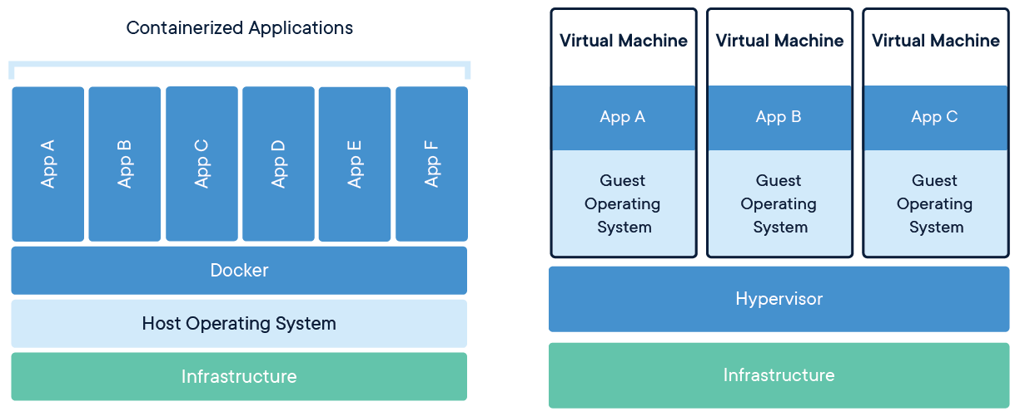
Docker versus VM
Docker
VM
Notes:
Multiple docker containers can run on the same OS.
Hence containers take up less space than VMs
On the other hand every VM is a full copy of OS and all VMs run on a single machine.

Slide 5
Some docker commands
See list of existing images:
docker images
Create a container from an image: nvidia-docker run -v /DATA/berat/dip_cont:/root/dip_cont --name dip_cont -it dl-image bash
See list of existing containers:
docker ps --all

Slide 6
Some docker commands
Stop a running container:
docker stop dip_cont
Make an image of the container:
docker commit dip_cont dip_image
Delete an image:
docker rmi dip_image
Delete a container:
docker rm dip_cont

Slide 7

Python notebook
Jupyter python notebook is an interactive computational environment
Combines code execution with explanatory data in the form of text, plot and images.
Help scientists to demonstrate their work easily.

Slide 8
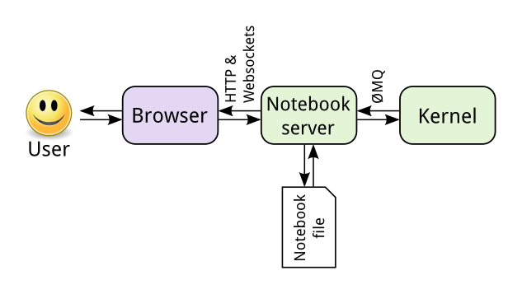
Jupyter notebook structure
Jupyter notebook is based on server-client structure.
Server executes the code chunks.
User receives the results from server via an internet browser.

Slide 9
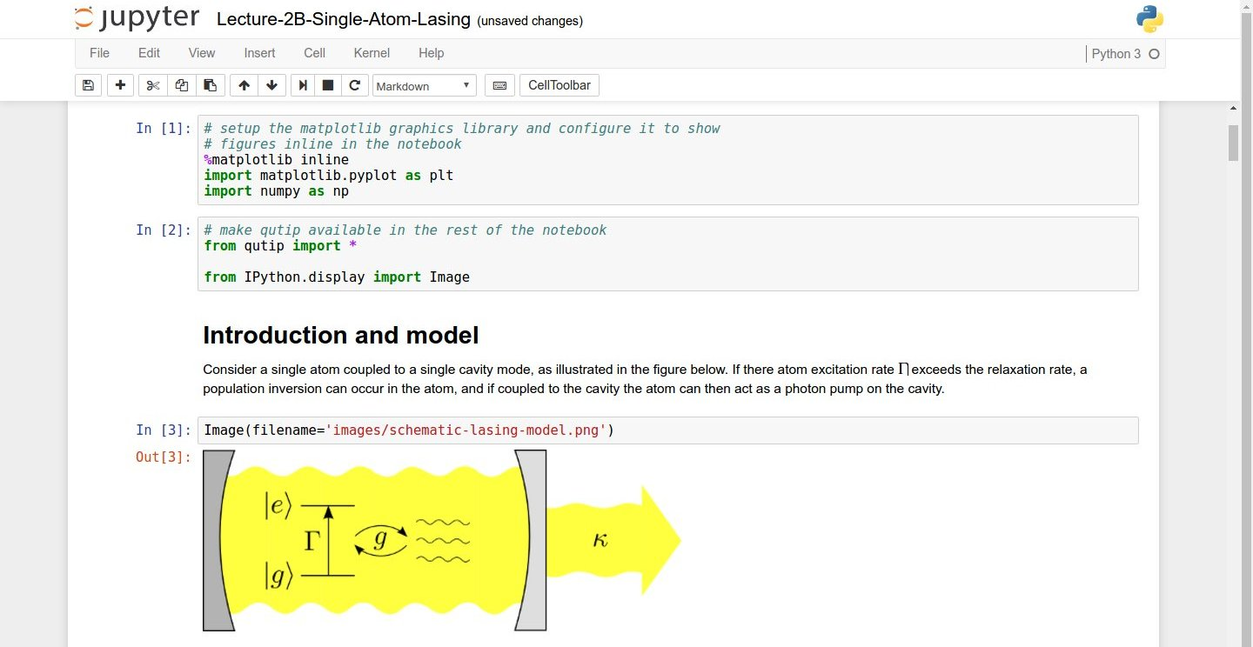
Python notebook user interface

Slide 10
Jupyter commands in server side
Create a docker container with a port to Jupyter server:
nvidia-docker run -p 8080:8080 -v /DATA/berat/dip_cont:/root/dip_cont --name dip_cont -it dl-image bash
Change privileges on the mounted folder:
chown 1013:1013 dip_cont
Start Jupyter server from inside docker:
cd dip_cont
jupyter notebook --no-browser --port=8080

Slide 11
Jupyter commands in user side
Open port between server and localhost:
ssh csdlsrv1 -L 8080:localhost:8080
In an internet browser:
http://localhost:8080
In server, start docker:
nvidia-docker start dip_cont -ai
There is a problem!

Slide 12
Jupyter commands in user side
In server, start docker:
nvidia-docker start dip_cont -ai
There is a problem!
Jupyter server is running and we can’t use bash.
Stop Jupyter server (ctrl+c)
Stop and exit docker (ctrl+d)
Start docker without bash (nvidia-docker start dip_cont)
Start jupyter server without bash
nvidia-docker exec dip_cont jupyter-server –no-browser –port=8080
Start docker again with bash (nvidia-docker start dip_cont –ai)

Slide 13
Basic image processing using opencv
Install opencv (open source for computer vision)
pip install opencv-python
Install numpy (array library for scientific computing)
pip install numpy
pip uninstall python-dateutil
pip install python-dateutil
Refer to the following jupyter notebook:
image_processing.ipynb

Slide 14
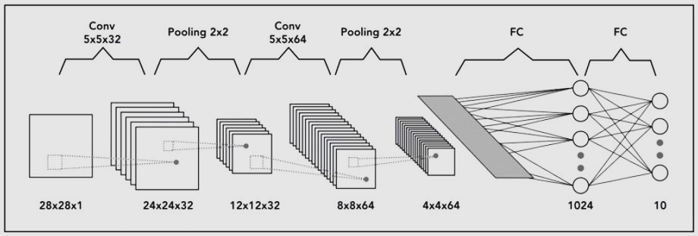
Convolutional neural network (CNN)

Slide 15
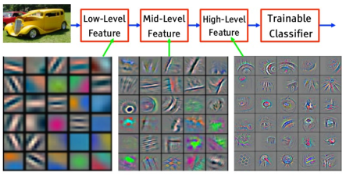
CNN extracts features automatically

Slide 16
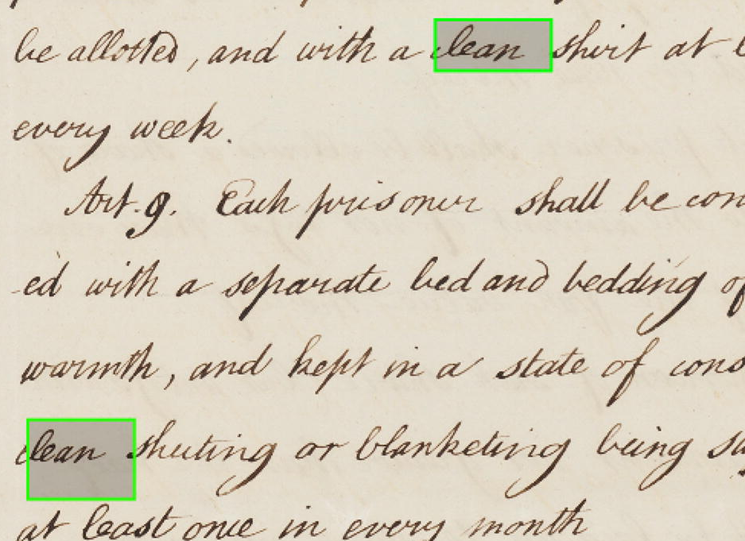
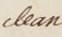
Word spotting
Where is this word in the document?

Slide 17
Word spotting using off-the-shelf CNN features
Where is this word in the document?
CNN
features
CNN
features
CNN
features

Slide 18
Keras
Keras is a high level API that can run on top of:
Tensorflow
Theano
We will run it on top of tensorflow.

Slide 19
Keras on tensorflow
nvidia-docker run -v /DATA/berat/dip_cont:/root/dip_cont --name dip_cont -it dl-image bash
pip install --upgrade pip
pip install opencv-python
pip uninstall keras pip install keras==2.1.2
pip uninstall python-dateutil
pip install python-dateutil
vi ~/.keras/keras.json
Notes:
pip uninstall keras pip install keras==2.1.2
pip uninstall python-dateutil
pip install python-dateutil
vi ~/.keras/keras.json

Slide 20
Tensorflow on GPU
pip uninstall tensorflow
pip install tensorflow-gpu==1.2
Run python on a specific GPU
import os os.environ["CUDA_VISIBLE_DEVICES"]="2"
Use nvidia-smi to see idle GPUs

Slide 21
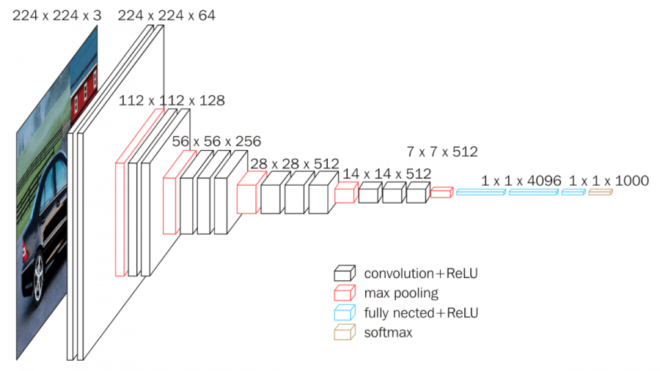
VGG net

Slide 22
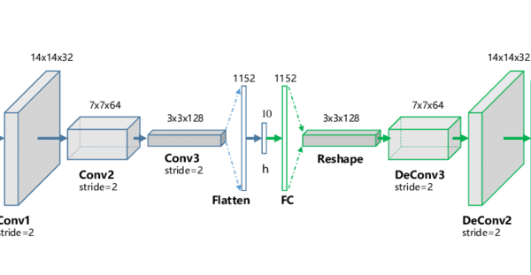
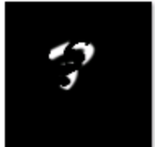
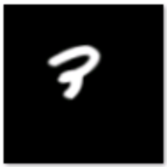
Autoencoder

Slide 23
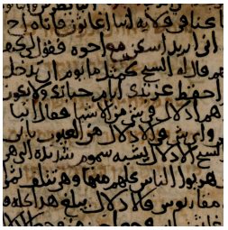
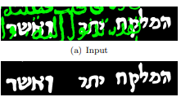
Restoring Hebrew characters using autoencoder

