Slide 1
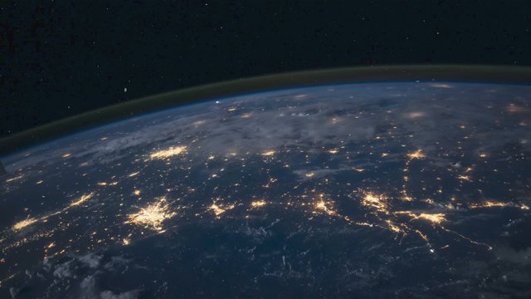
Computer Networking in 100 Seconds - 00:00

Slide 2
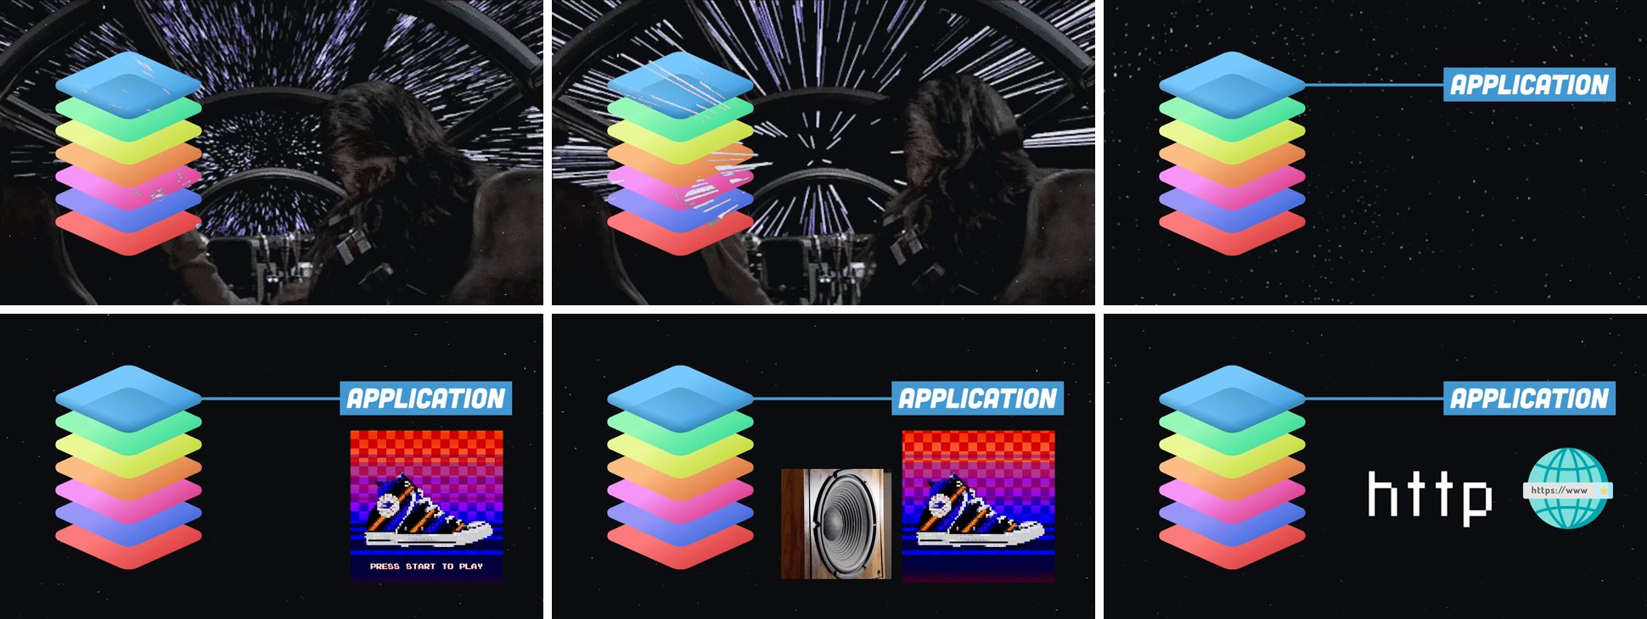

Slide 3

Computer Networking in 100 Seconds - 00:33

Slide 4

Computer Networking in 100 Seconds - 00:36

Slide 5

Computer Networking in 100 Seconds - 00:40

Slide 6

Computer Networking in 100 Seconds - 00:41

Slide 7

Computer Networking in 100 Seconds - 00:46

Slide 8
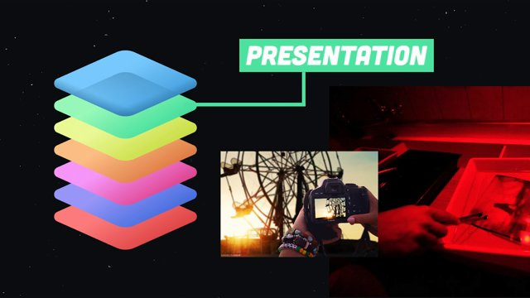
Computer Networking in 100 Seconds - 00:48

Slide 9

Computer Networking in 100 Seconds - 00:49

Slide 10

Computer Networking in 100 Seconds - 00:51

Slide 11

Computer Networking in 100 Seconds - 00:52

Slide 12
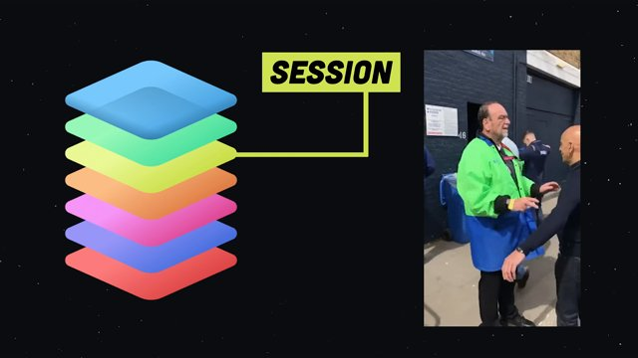
Computer Networking in 100 Seconds - 00:53

Slide 13
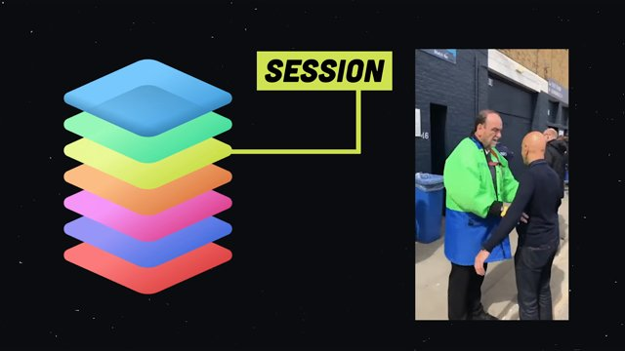
Computer Networking in 100 Seconds - 00:54

Slide 14

Computer Networking in 100 Seconds - 00:55

Slide 15

Computer Networking in 100 Seconds - 00:56

Slide 16
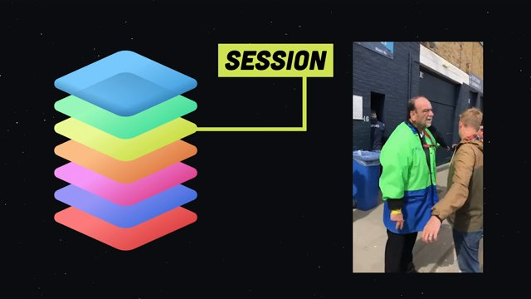
Computer Networking in 100 Seconds - 00:57

Slide 17

Computer Networking in 100 Seconds - 00:58

Slide 18
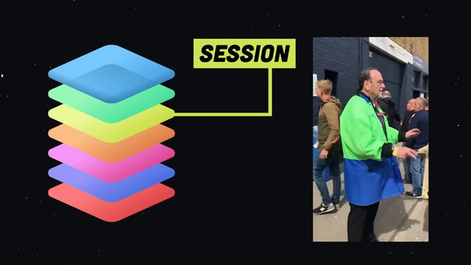
Computer Networking in 100 Seconds - 00:59

Slide 19

Computer Networking in 100 Seconds - 01:00

Slide 20
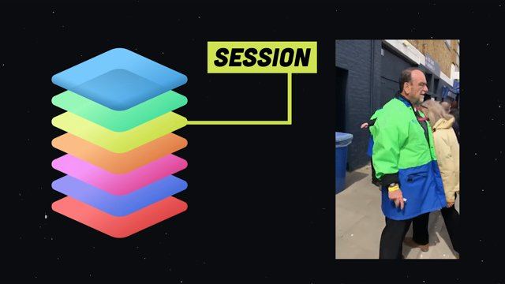
Computer Networking in 100 Seconds - 01:01

Slide 21
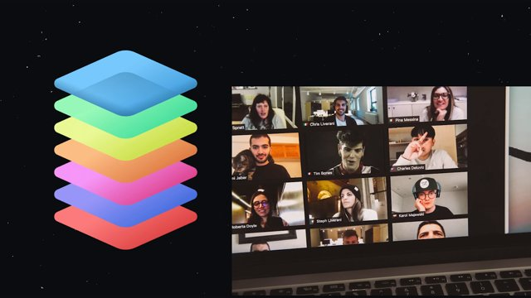
Computer Networking in 100 Seconds - 01:02

Slide 22

Computer Networking in 100 Seconds - 01:03

Slide 23

Computer Networking in 100 Seconds - 01:04

Slide 24

Computer Networking in 100 Seconds - 01:05

Slide 25

Computer Networking in 100 Seconds - 01:10

Slide 26

Computer Networking in 100 Seconds - 01:12

Slide 27
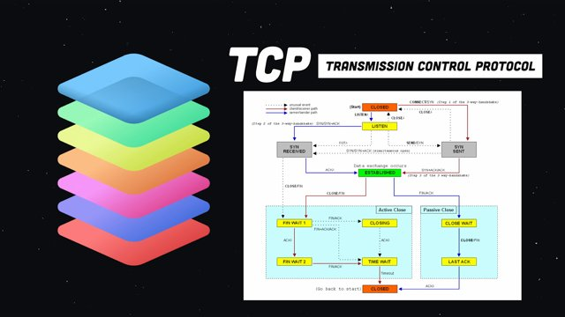
Computer Networking in 100 Seconds - 01:15

Slide 28

Computer Networking in 100 Seconds - 01:21

Slide 29
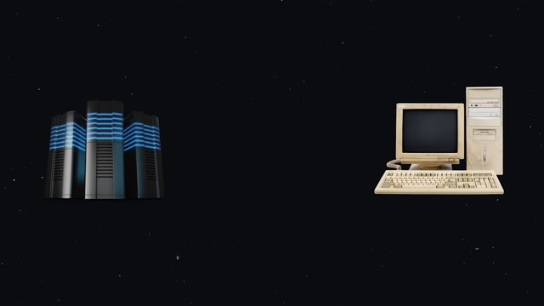
Computer Networking in 100 Seconds - 01:22

Slide 30

Computer Networking in 100 Seconds - 01:30

Slide 31
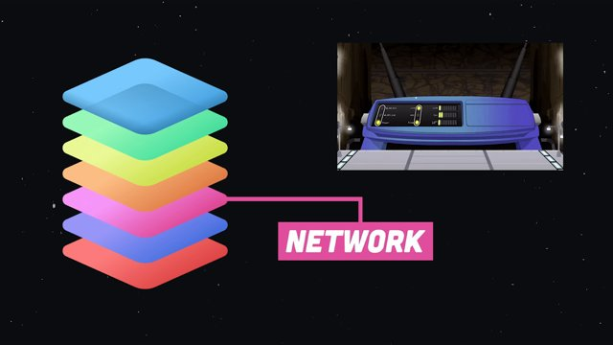
Computer Networking in 100 Seconds - 01:31

Slide 32
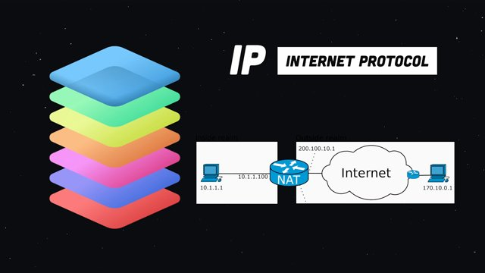
Computer Networking in 100 Seconds - 01:35

Slide 33
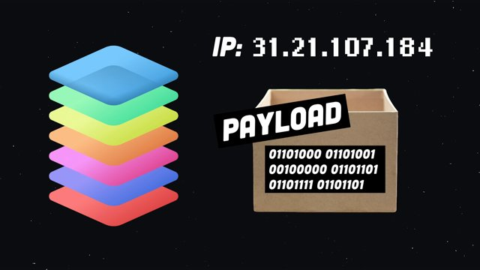
Computer Networking in 100 Seconds - 01:41

Slide 34
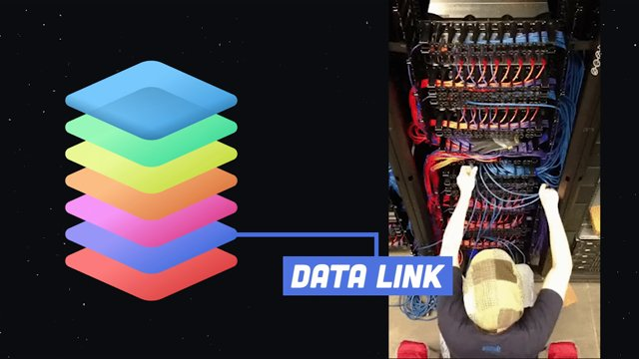
Computer Networking in 100 Seconds - 01:53

Slide 35
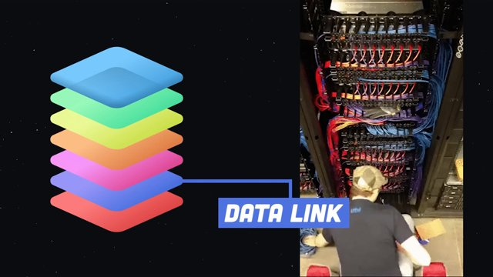
Computer Networking in 100 Seconds - 01:54

Slide 36
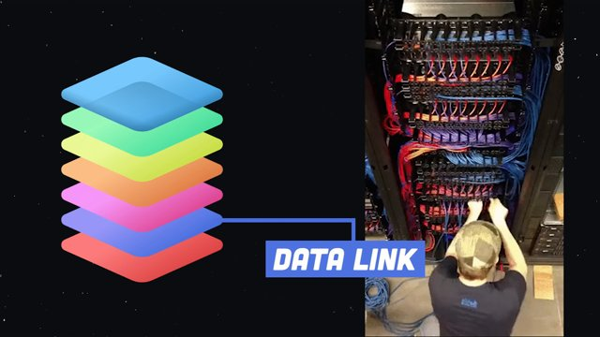
Computer Networking in 100 Seconds - 01:55

Slide 37
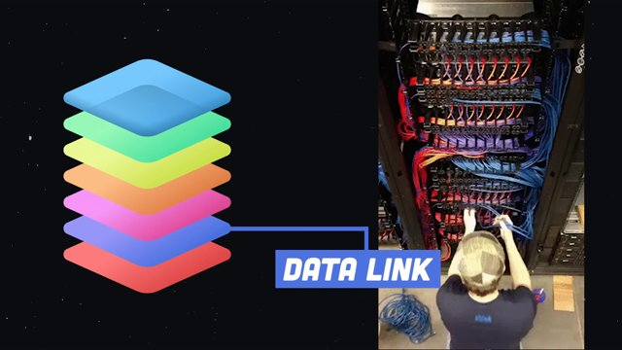
Computer Networking in 100 Seconds - 01:56

Slide 38
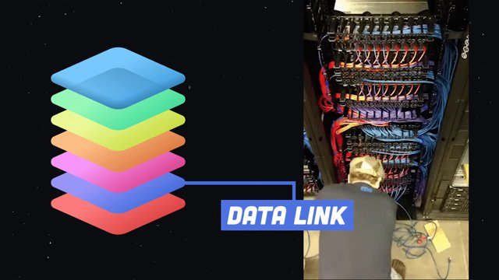
Computer Networking in 100 Seconds - 01:57

Slide 39
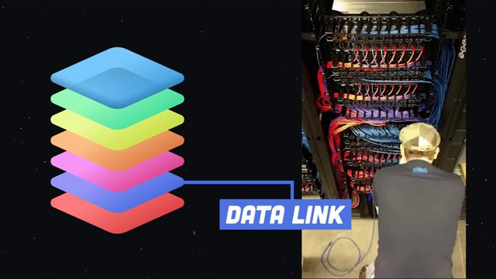
Computer Networking in 100 Seconds - 01:58

Slide 40
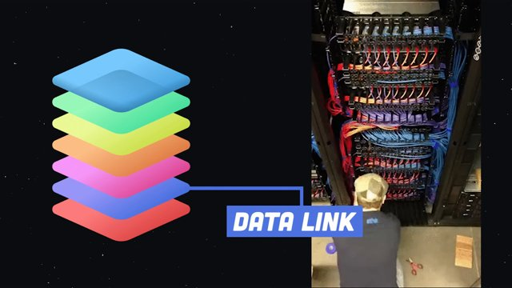
Computer Networking in 100 Seconds - 01:59

Slide 41
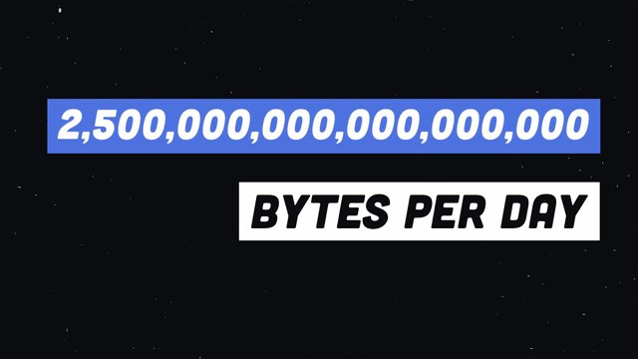
Computer Networking in 100 Seconds - 02:00

Slide 42

Computer Networking in 100 Seconds - 02:06

Slide 43

Computer Networking in 100 Seconds - 02:07

Slide 44

Computer Networking in 100 Seconds - 02:08

Slide 45

Computer Networking in 100 Seconds - 02:09

Slide 46

Computer Networking in 100 Seconds - 02:10

Slide 47

Computer Networking in 100 Seconds - 02:11

Slide 48

Computer Networking in 100 Seconds - 02:12

Slide 49

Computer Networking in 100 Seconds - 02:14

Slide 50

Computer Networking in 100 Seconds - 02:15

Slide 51

Computer Networking in 100 Seconds - 02:16

Slide 52

Computer Networking in 100 Seconds - 02:17

Slide 53

Computer Networking in 100 Seconds - 02:18

