Slide 1
Video URL: Bilinmiyor
Video - 00:00:000

Slide 2

Video - 00:00:000

Slide 3
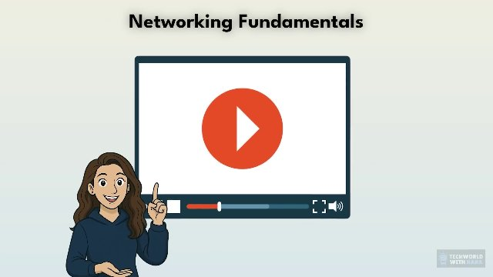
Video - 00:01:000

Slide 4
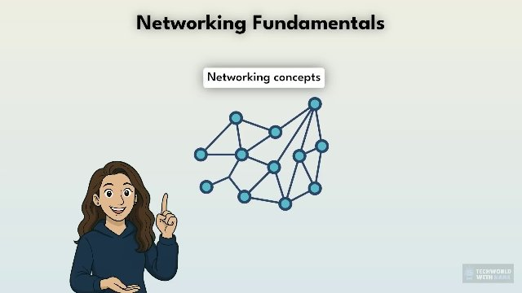
Video - 00:03:000

Slide 5
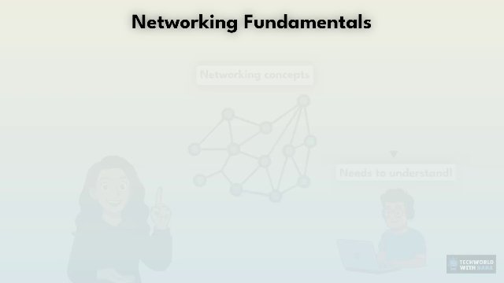
Video - 00:08:000

Slide 6
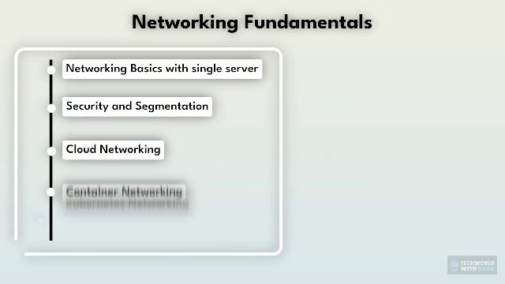
Video - 00:09:000

Slide 7
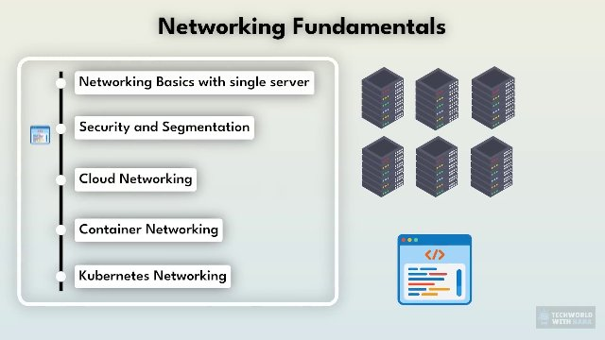
Video - 00:14:000

Slide 8
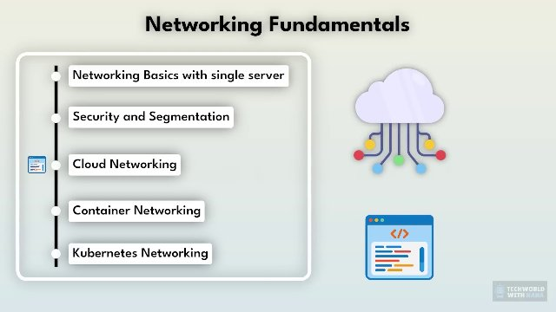
Video - 00:15:000

Slide 9
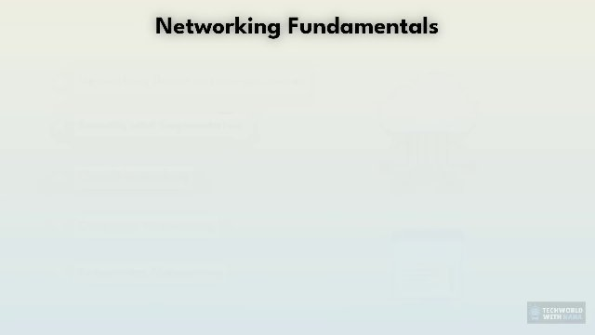
Video - 00:19:000

Slide 10
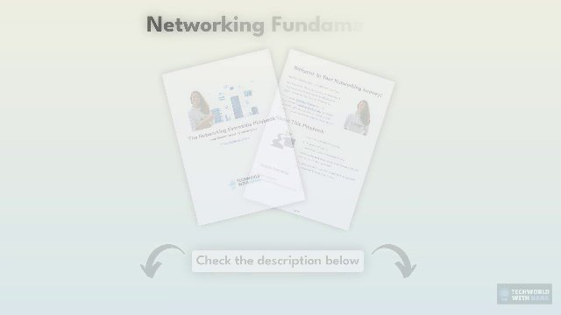
Video - 00:46:000

Slide 11

Video - 00:47:000

Slide 12

Video - 00:49:000

Slide 13
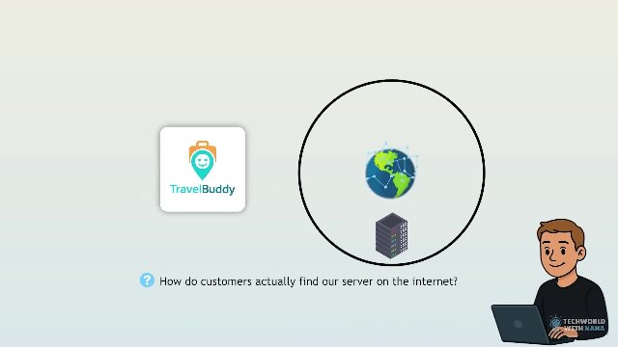
Video - 01:00:000

Slide 14

Video - 01:03:000

Slide 15
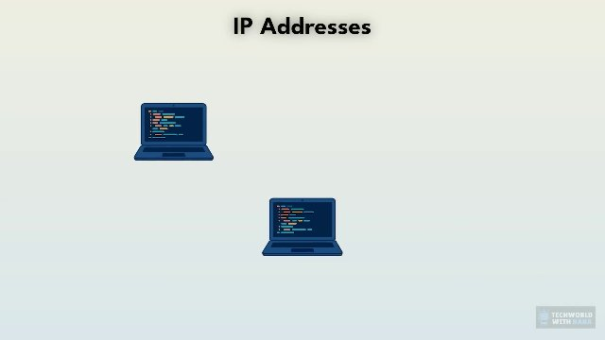
Video - 01:04:000

Slide 16
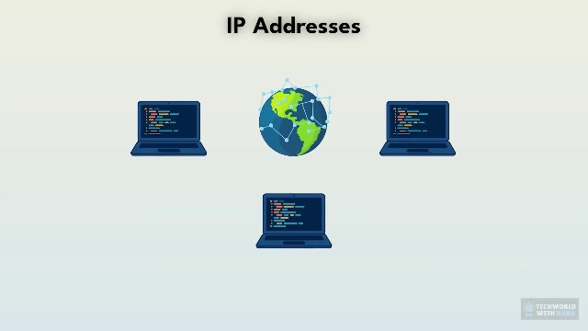
Video - 01:05:000

Slide 17
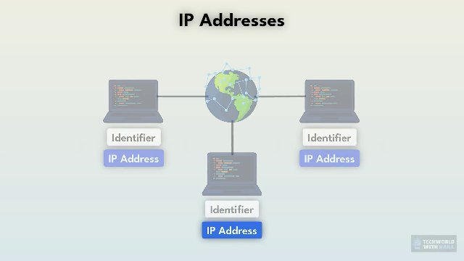
Video - 01:13:000

Slide 18
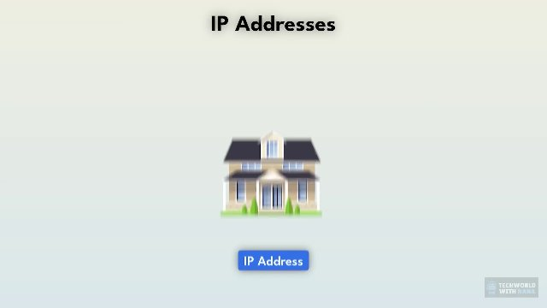
Video - 01:14:000

Slide 19
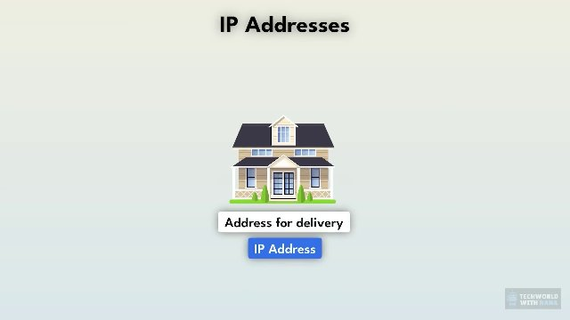
Video - 01:15:000

Slide 20
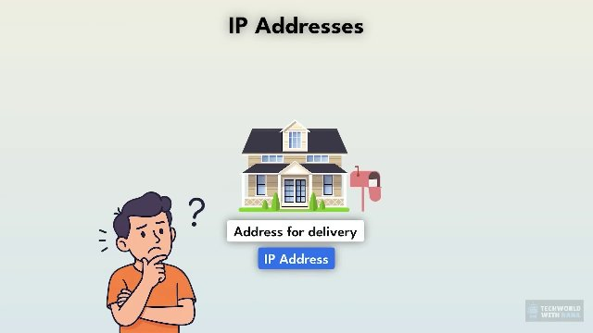
Video - 01:18:000

Slide 21
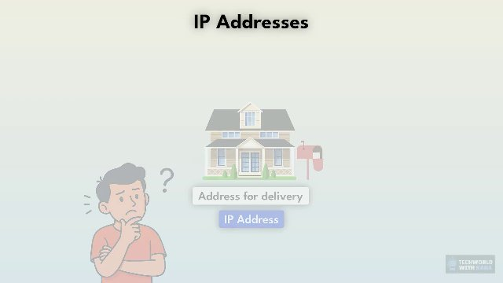
Video - 01:19:000

Slide 22
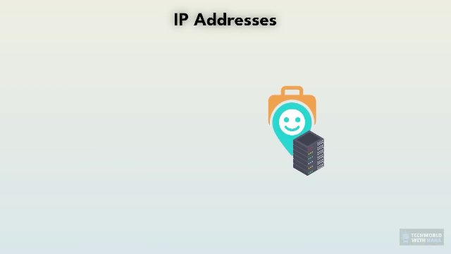
Video - 01:20:000

Slide 23
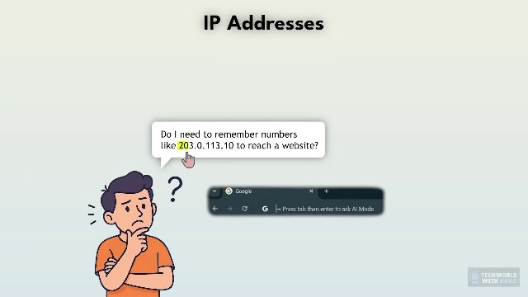
Video - 01:36:000

Slide 24
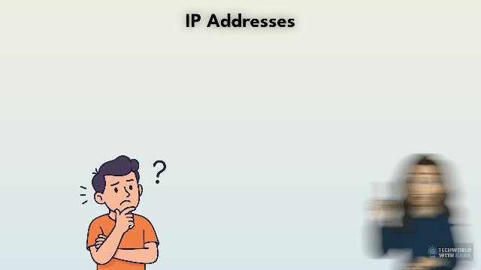
Video - 01:43:000

Slide 25
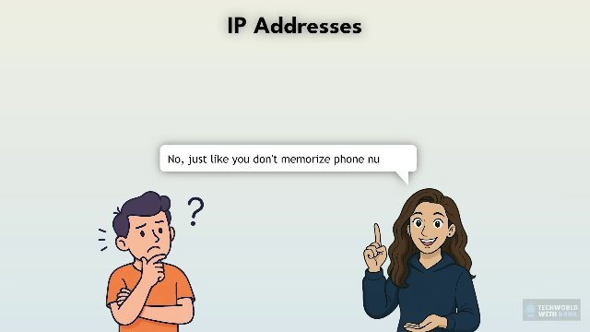
Video - 01:44:000

Slide 26
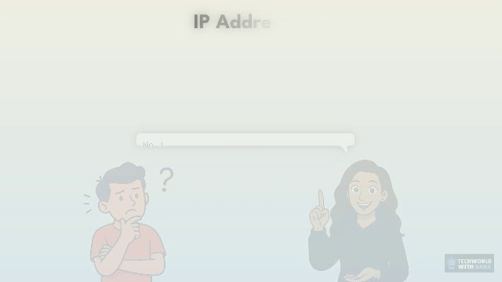
Video - 01:49:000

Slide 27
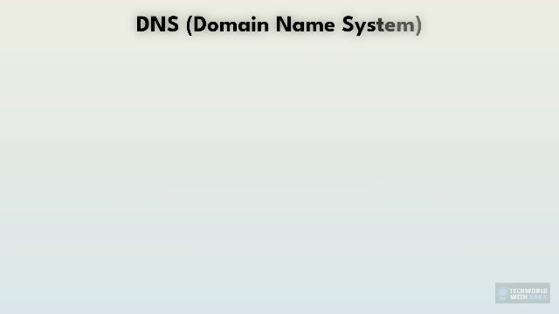
Video - 01:50:000

Slide 28
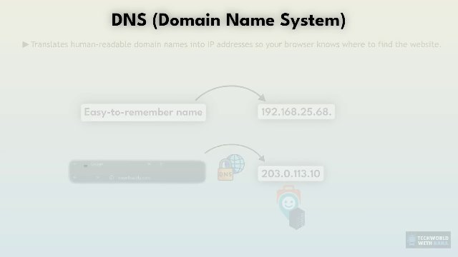
Video - 02:06:000

Slide 29
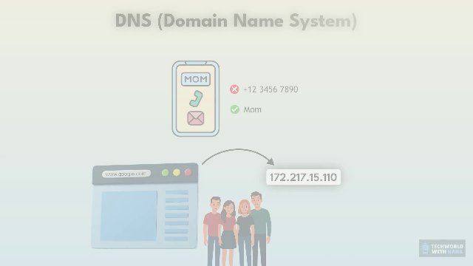
Video - 02:29:000

Slide 30

Video - 02:30:000

Slide 31

Video - 02:32:000

Slide 32

Video - 02:33:000

Slide 33
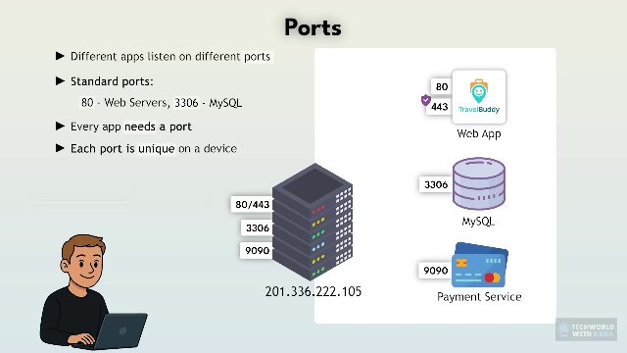
Video - 03:39:000

Slide 34
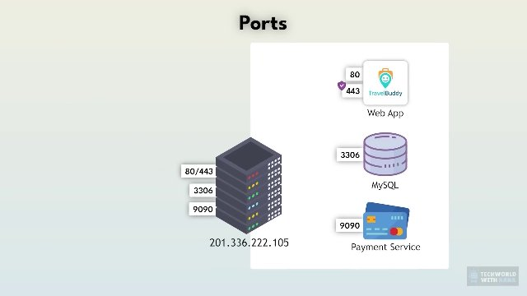
Video - 03:50:000

Slide 35
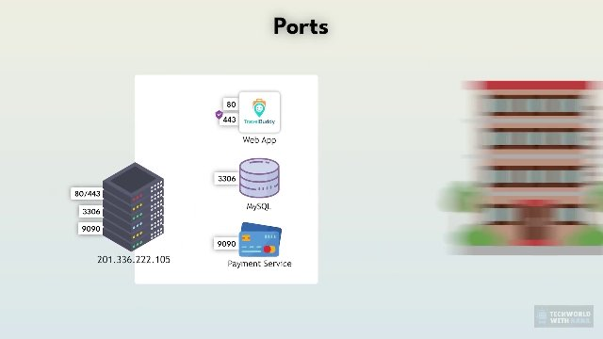
Video - 03:51:000

Slide 36
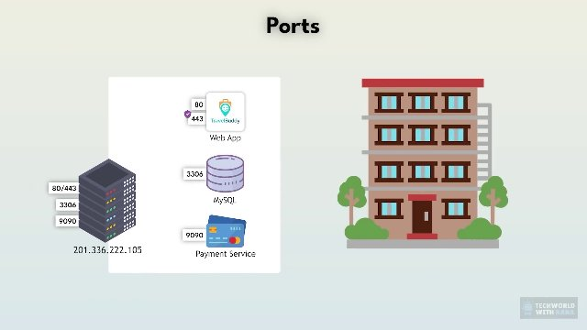
Video - 03:52:000

Slide 37
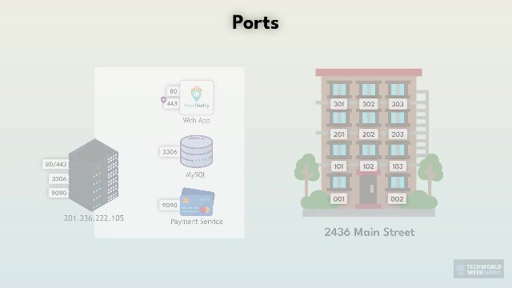
Video - 04:08:000

Slide 38

Video - 04:09:000

Slide 39
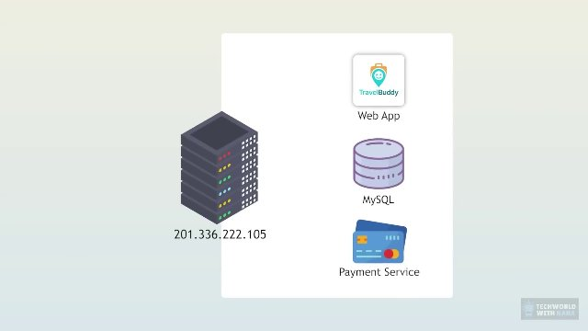
Video - 04:11:000

Slide 40
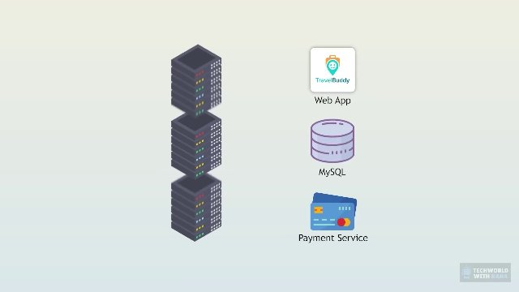
Video - 04:34:000

Slide 41
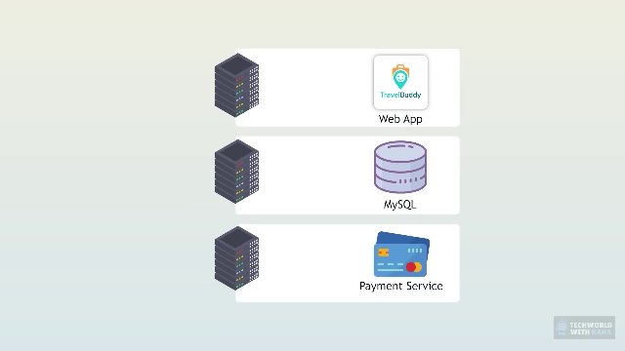
Video - 04:35:000

Slide 42
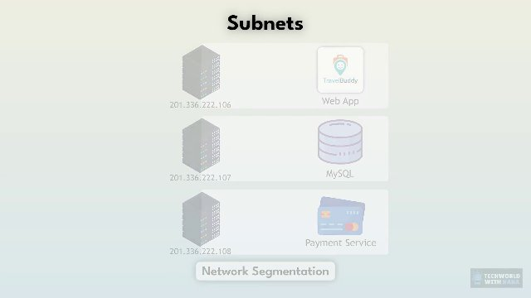
Video - 04:43:000

Slide 43
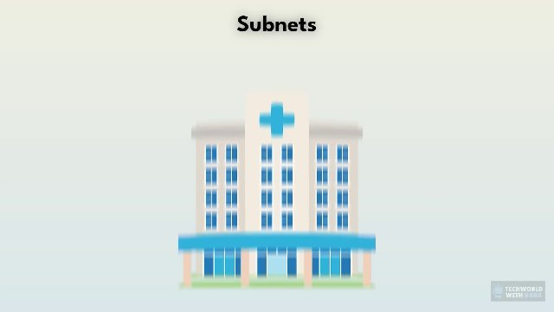
Video - 04:44:000

Slide 44

Video - 04:45:000

Slide 45
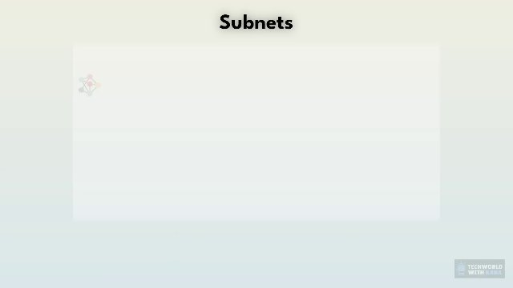
Video - 04:59:000

Slide 46
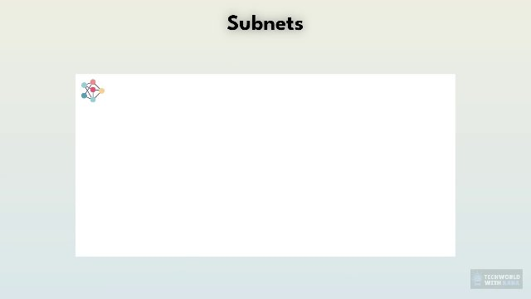
Video - 05:00:000

Slide 47
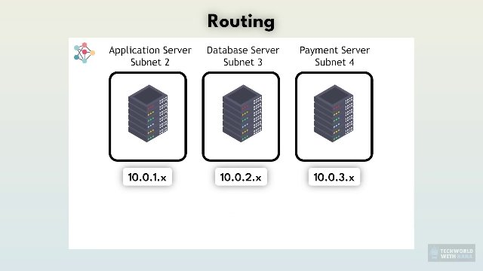
Video - 05:38:000

Slide 48
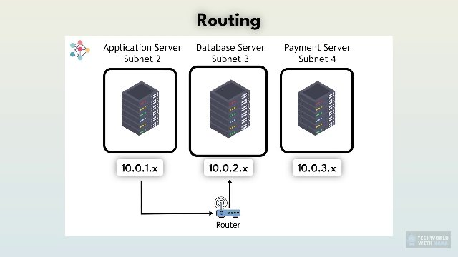
Video - 05:48:000

Slide 49
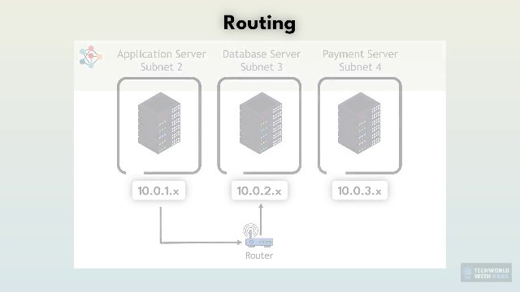
Video - 05:51:000

Slide 50
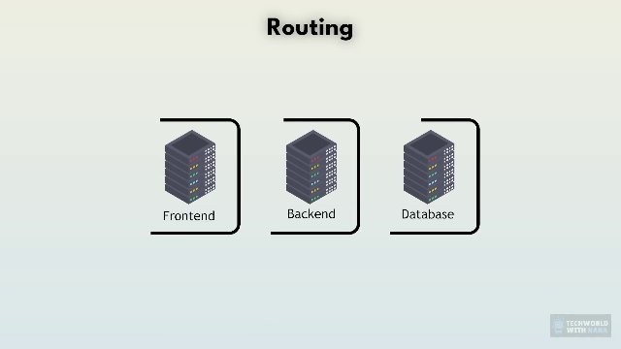
Video - 05:52:000

Slide 51
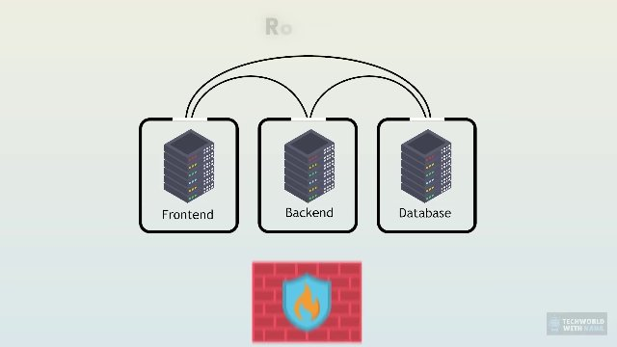
Video - 06:11:000

Slide 52
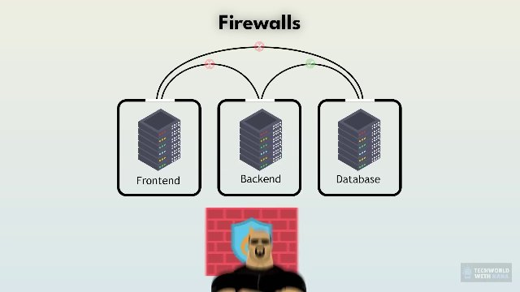
Video - 06:23:000

Slide 53
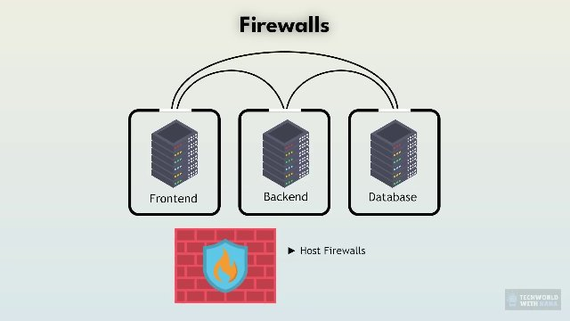
Video - 06:24:000

Slide 54
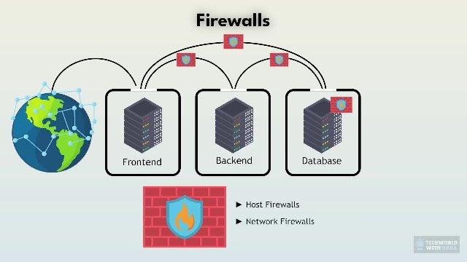
Video - 06:50:000

Slide 55
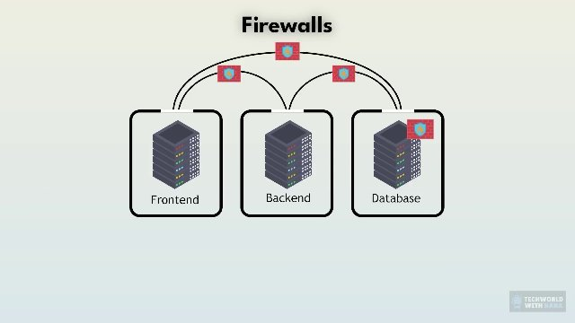
Video - 07:10:000

Slide 56
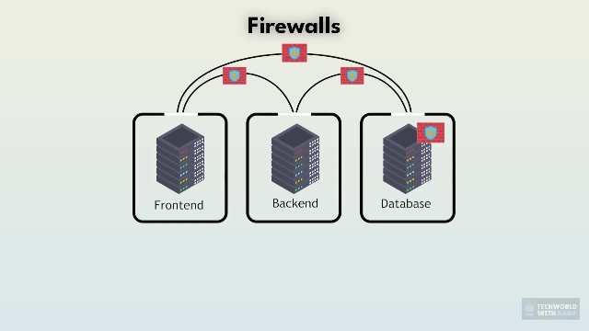
Video - 07:23:000

Slide 57
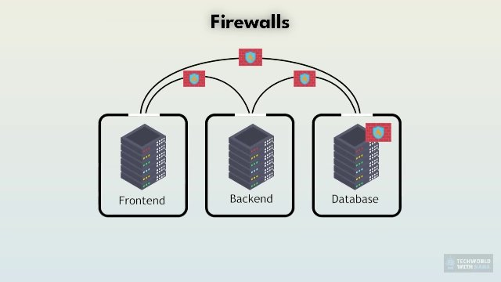
Video - 07:24:000

Slide 58
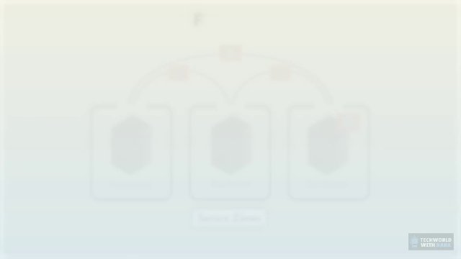
Video - 07:32:000

Slide 59

Video - 07:33:000

Slide 60

Video - 07:34:000

Slide 61

Video - 07:35:000

Slide 62

Video - 07:38:000

Slide 63
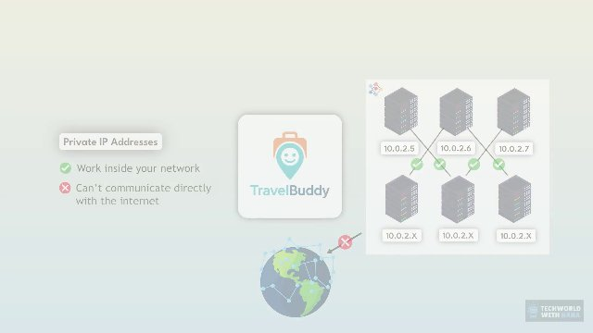
Video - 08:01:000

Slide 64

Video - 08:02:000

Slide 65

Video - 08:13:000

Slide 66
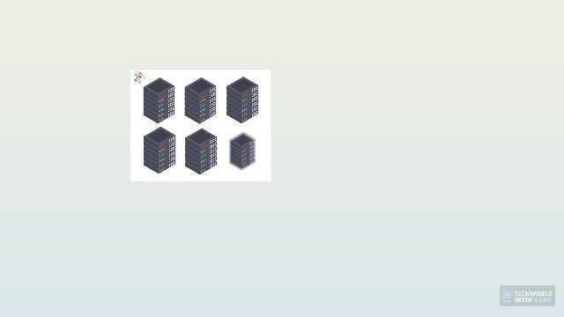
Video - 08:15:000

Slide 67

Video - 08:17:000

Slide 68

Video - 08:51:000

Slide 69

Video - 08:53:000

Slide 70

Video - 08:54:000

Slide 71

Video - 09:01:000

Slide 72

Video - 09:02:000

Slide 73

Video - 09:31:000

Slide 74

Video - 09:49:000

Slide 75

Video - 10:10:000

Slide 76

Video - 10:11:000

Slide 77

Video - 10:13:000

Slide 78

Video - 10:26:000

Slide 79

Video - 10:27:000

Slide 80

Video - 10:32:000

Slide 81

Video - 10:58:000

Slide 82

Video - 10:59:000

Slide 83

Video - 11:02:000

Slide 84

Video - 11:07:000

Slide 85

Video - 11:08:000

Slide 86

Video - 11:19:000

Slide 87

Video - 11:20:000

Slide 88

Video - 11:38:000

Slide 89

Video - 12:17:000

Slide 90

Video - 12:18:000

Slide 91

Video - 12:24:000

Slide 92

Video - 12:32:000

Slide 93

Video - 12:33:000

Slide 94

Video - 12:38:000

Slide 95

Video - 12:39:000

Slide 96

Video - 12:40:000

Slide 97

Video - 12:48:000

Slide 98

Video - 12:49:000

Slide 99

Video - 12:50:000

Slide 100

Video - 12:51:000

Slide 101

Video - 12:52:000

Slide 102

Video - 12:58:000

Slide 103

Video - 12:59:000

Slide 104

Video - 13:04:000

Slide 105

Video - 13:05:000

Slide 106

Video - 13:09:000

Slide 107

Video - 13:10:000

Slide 108

Video - 13:11:000

Slide 109

Video - 13:18:000

Slide 110

Video - 13:19:000

Slide 111

Video - 13:20:000

Slide 112

Video - 13:21:000

Slide 113

Video - 13:22:000

Slide 114

Video - 13:23:000

Slide 115

Video - 13:24:000

Slide 116

Video - 13:25:000

Slide 117

Video - 13:26:000

Slide 118

Video - 13:27:000

Slide 119

Video - 13:28:000

Slide 120

Video - 13:29:000

Slide 121

Video - 13:38:000

Slide 122

Video - 13:51:000

Slide 123

Video - 13:52:000

Slide 124

Video - 13:56:000

Slide 125

Video - 14:01:000

Slide 126

Video - 14:06:000

Slide 127

Video - 14:07:000

Slide 128

Video - 14:09:000

Slide 129

Video - 14:10:000

Slide 130

Video - 14:11:000

Slide 131

Video - 14:13:000

Slide 132

Video - 14:25:000

Slide 133

Video - 14:44:000

Slide 134

Video - 14:52:000

Slide 135

Video - 14:56:000

Slide 136

Video - 14:57:000

Slide 137

Video - 15:14:000

Slide 138

Video - 15:15:000

Slide 139

Video - 15:31:000

Slide 140

Video - 15:32:000

Slide 141

Video - 16:14:000

Slide 142

Video - 16:41:000

Slide 143

Video - 16:44:000

Slide 144

Video - 17:11:000

Slide 145

Video - 17:15:000

Slide 146

Video - 17:30:000

Slide 147

Video - 17:31:000

Slide 148

Video - 17:32:000

Slide 149

Video - 17:35:000

Slide 150

Video - 18:07:000

Slide 151

Video - 18:08:000

Slide 152

Video - 18:09:000

Slide 153

Video - 18:15:000

Slide 154

Video - 18:35:000

Slide 155

Video - 18:42:000

Slide 156

Video - 18:43:000

Slide 157

Video - 20:10:000

Slide 158

Video - 20:11:000

Slide 159

Video - 20:22:000

Slide 160

Video - 20:23:000

Slide 161

Video - 20:31:000

Slide 162

Video - 20:38:000

Slide 163

Video - 20:39:000

Slide 164

Video - 20:46:000

Slide 165

Video - 20:47:000

Slide 166

Video - 20:54:000

Slide 167

Video - 20:58:000

Slide 168

Video - 21:19:000

Slide 169

Video - 21:20:000

Slide 170

Video - 21:22:000

Slide 171

Video - 21:44:000

Slide 172

Video - 21:45:000

Slide 173

Video - 21:56:000

Slide 174

Video - 22:37:000

Slide 175

Video - 22:49:000

Slide 176

Video - 22:58:000

Slide 177

Video - 22:59:000

Slide 178

Video - 23:00:000

Slide 179

Video - 23:01:000

Slide 180

Video - 23:17:000

Slide 181

Video - 23:18:000

Slide 182

Video - 23:19:000

