Slide 1
Video URL: https://www.youtube.com/watch?v=tAuRQs_d9F8
8 Design Patterns EVERY Developer Should Know - 00:00:000

Slide 2
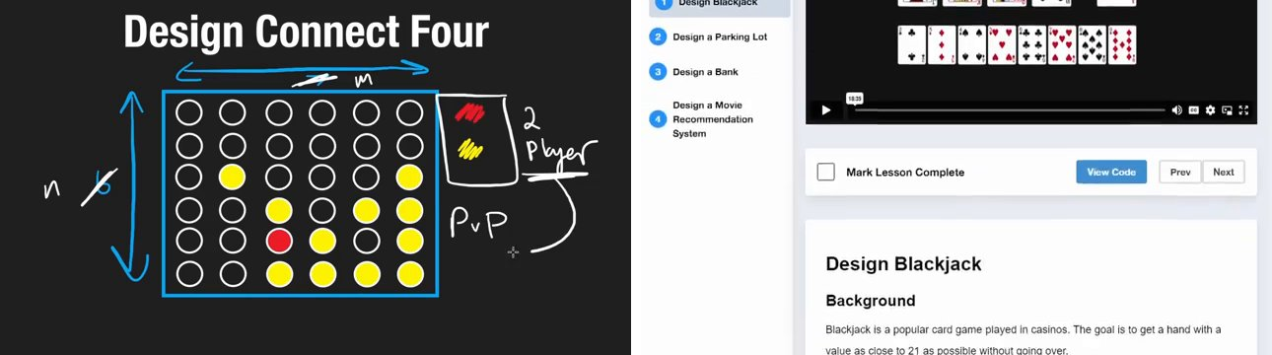

Slide 3
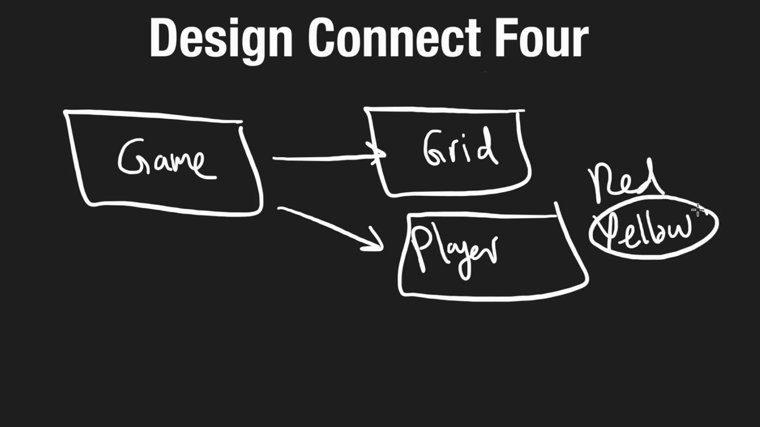
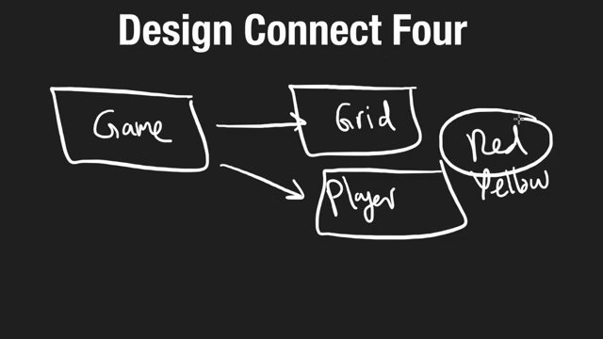
8 Design Patterns EVERY Developer Should Know - 09:45:000

