Slide 1
Video URL: Bilinmiyor
Video - 00:00:000

Slide 2
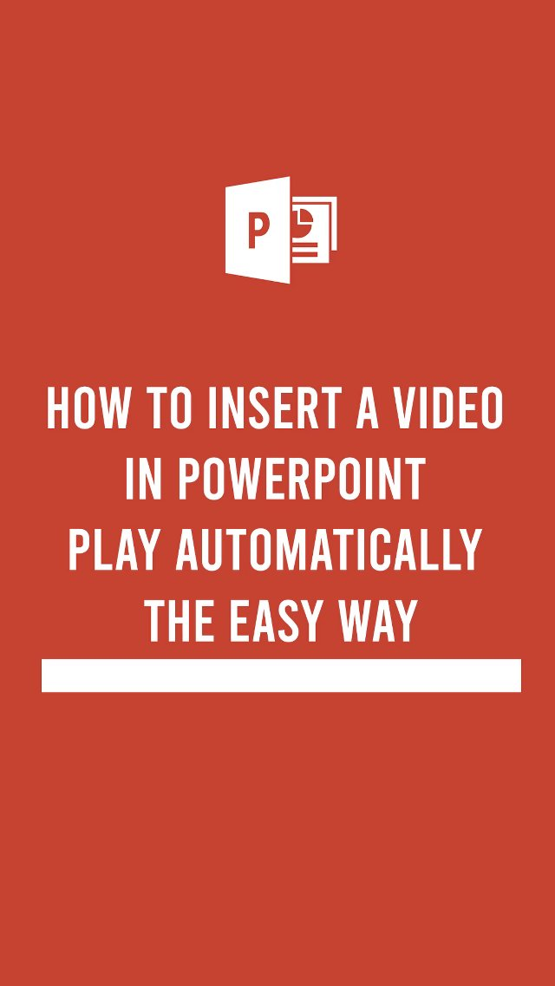
Video - 00:00:000

Slide 3
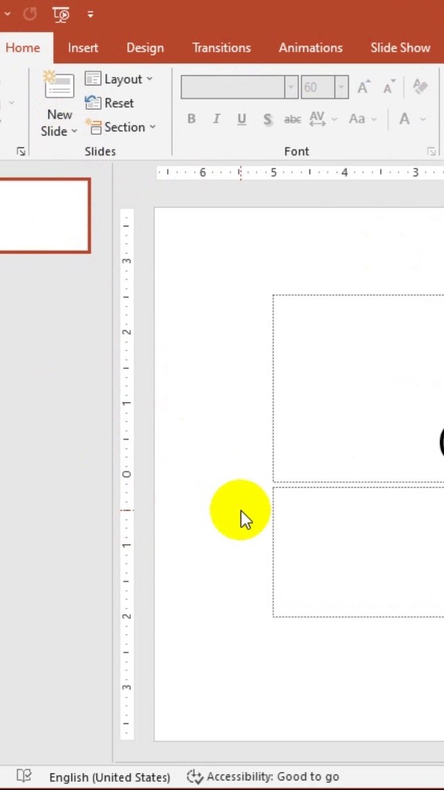
Video - 00:04:000

Slide 4
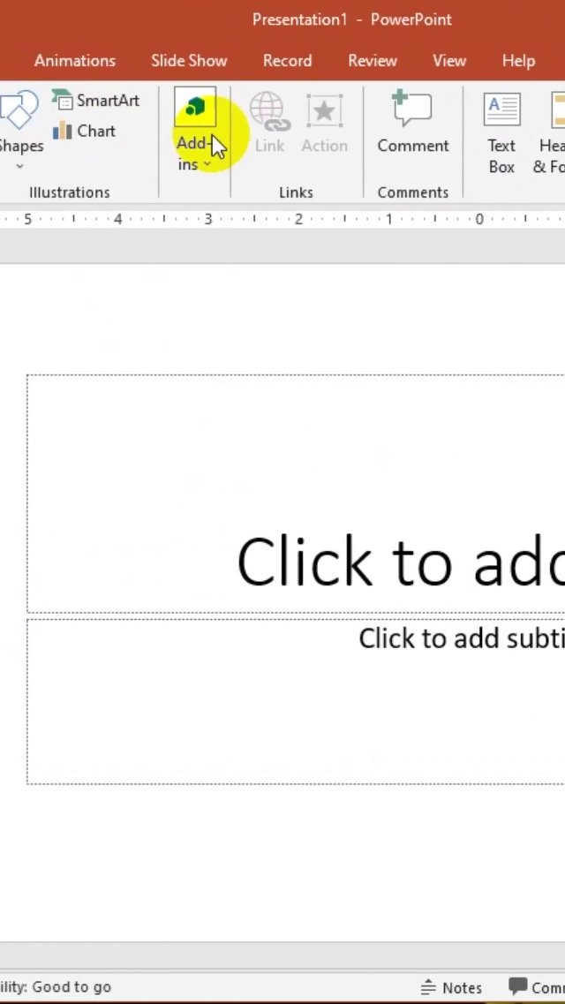
Video - 00:08:000

Slide 5
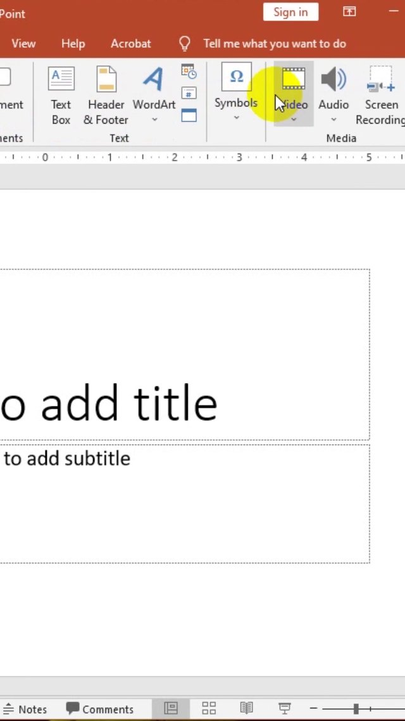
Video - 00:09:000

Slide 6
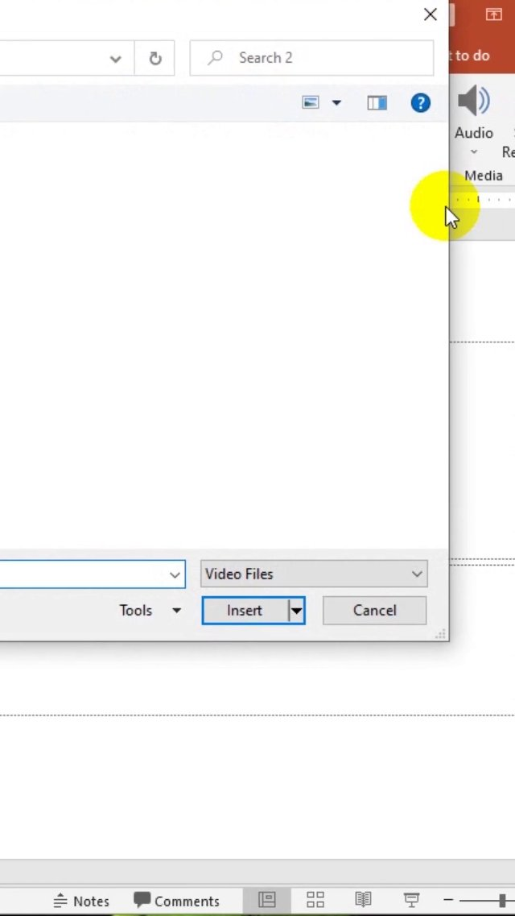
Video - 00:11:000

Slide 7
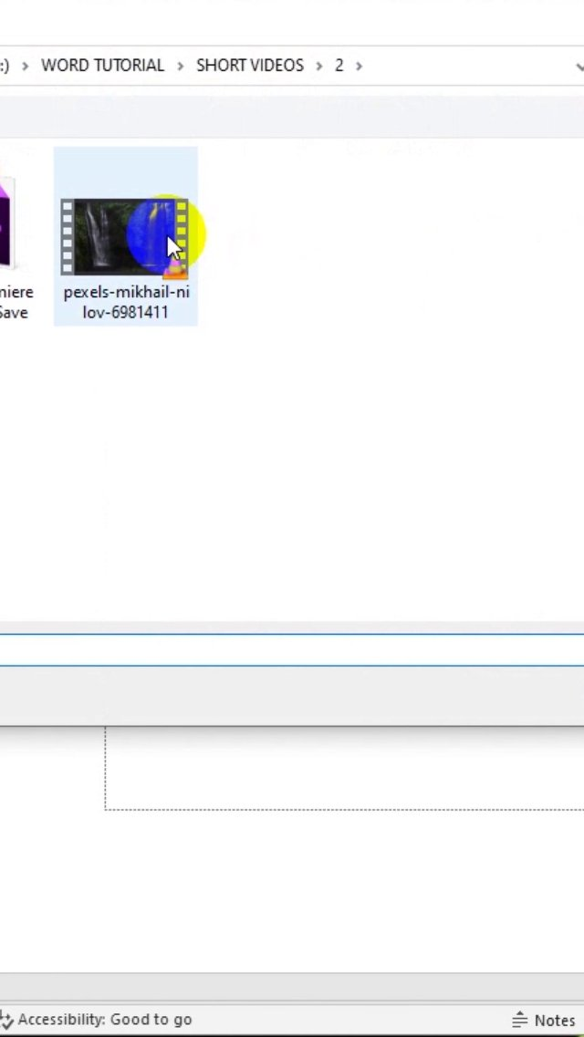
Video - 00:12:000

Slide 8
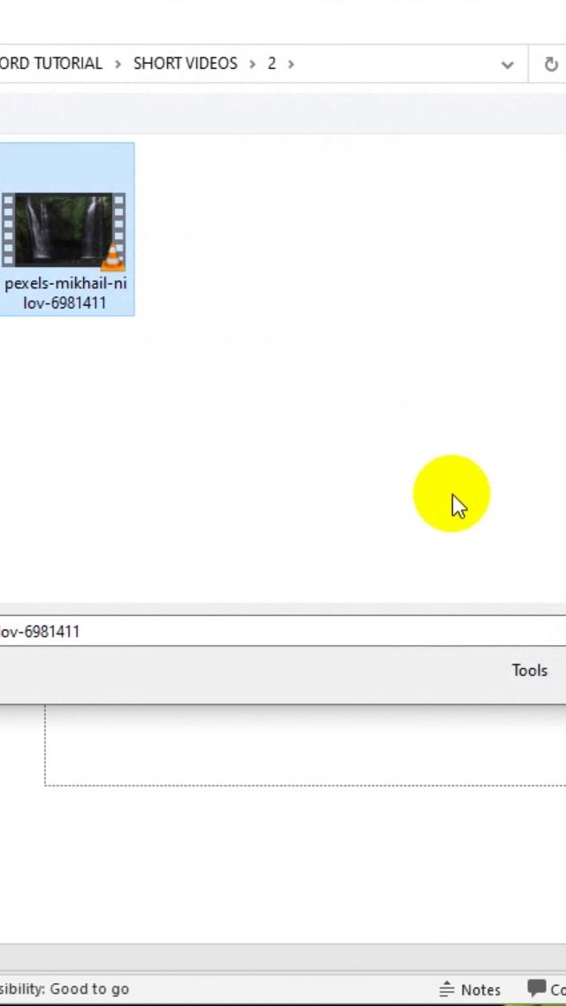
Video - 00:13:000

Slide 9
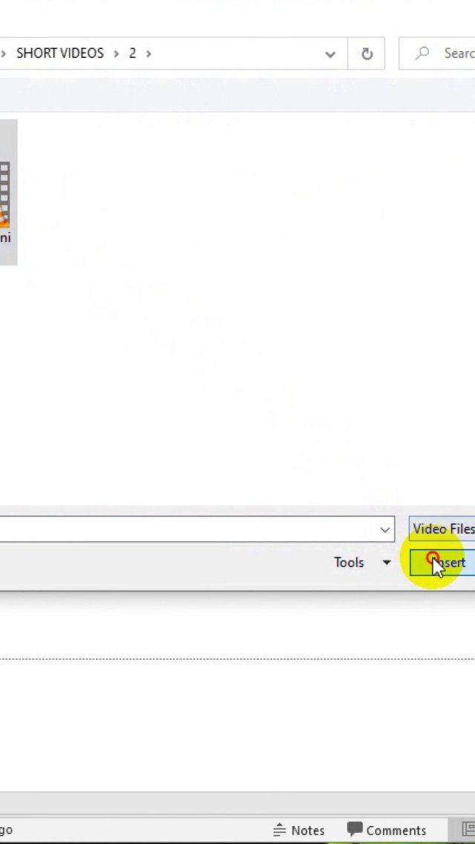
Video - 00:14:000

Slide 10
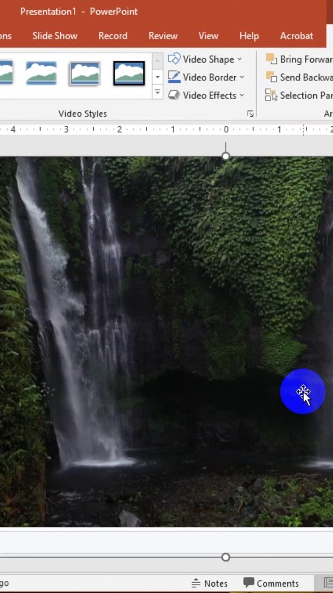
Video - 00:15:000

Slide 11
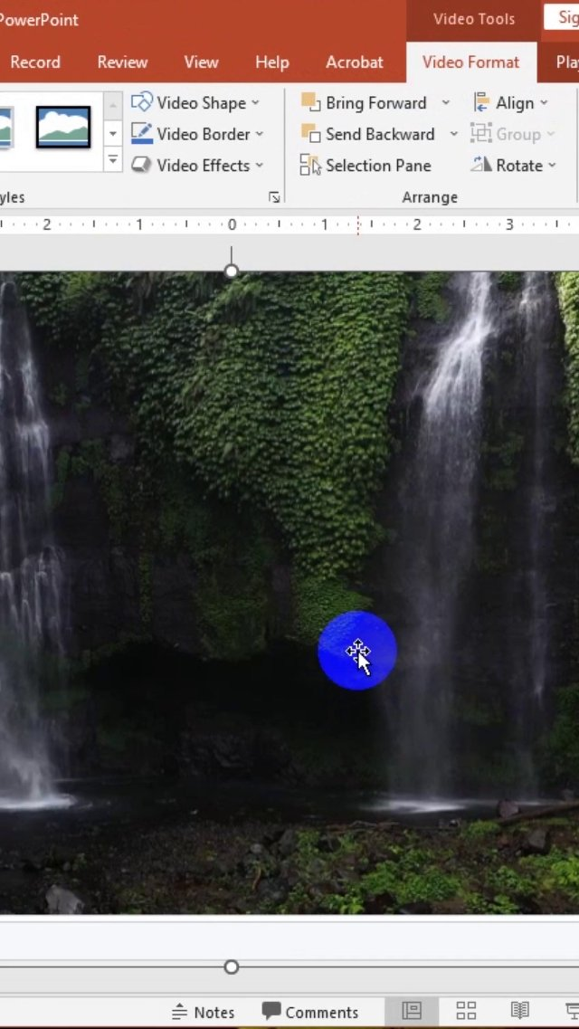
Video - 00:16:000

Slide 12
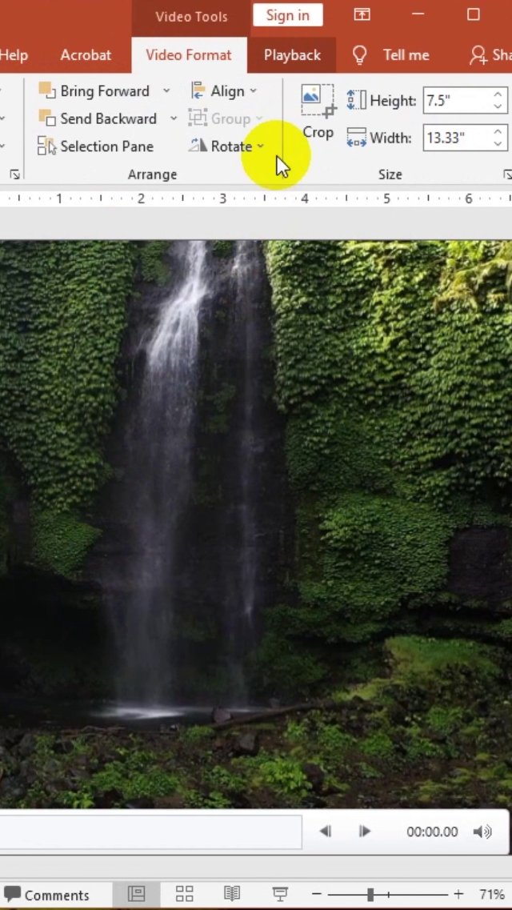
Video - 00:17:000

Slide 13
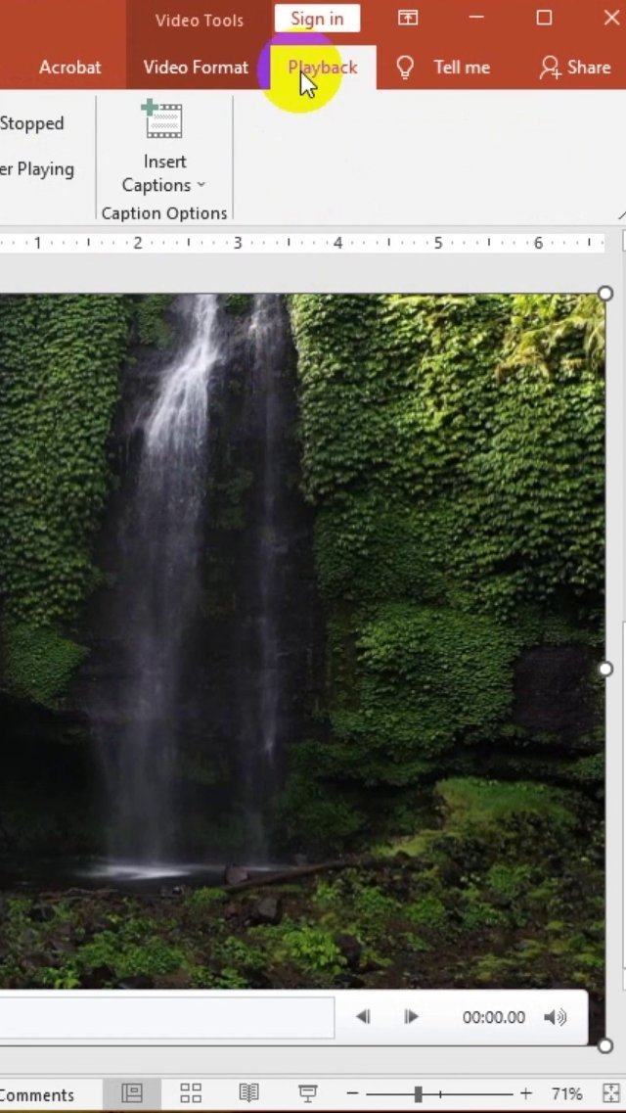
Video - 00:18:000

Slide 14
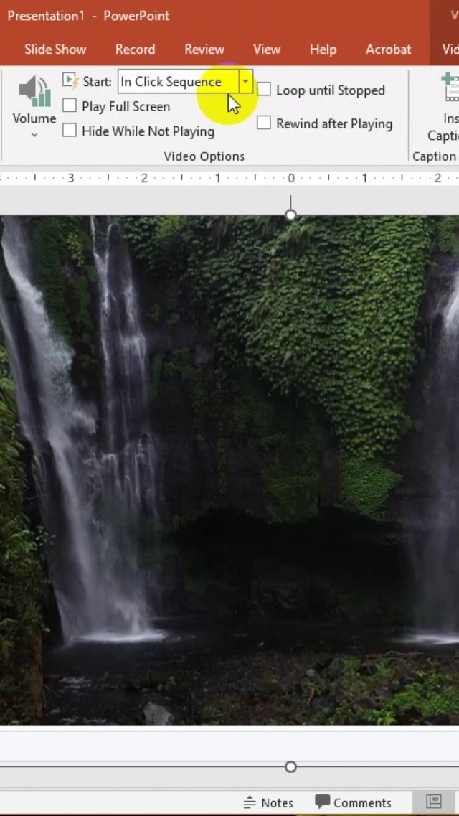
Video - 00:19:000

Slide 15
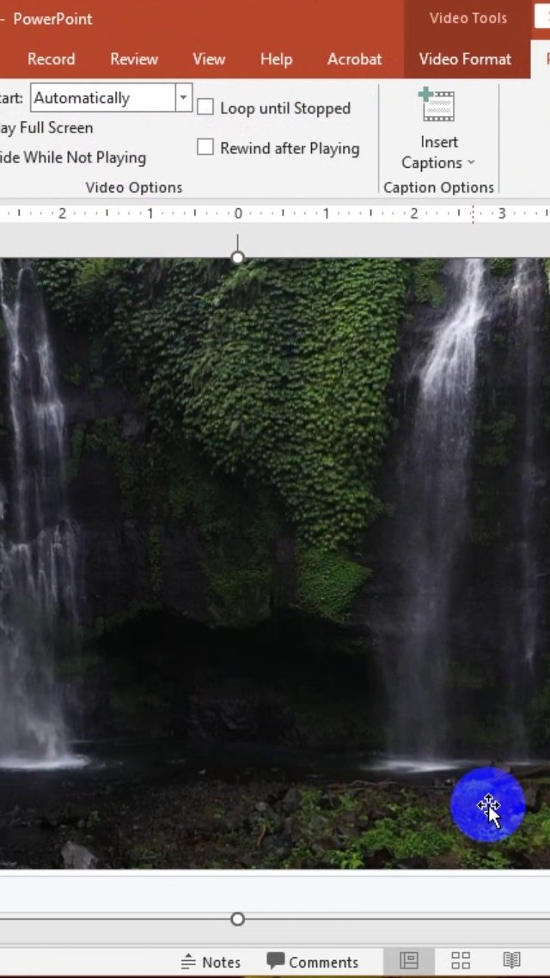
Video - 00:24:000

Slide 16
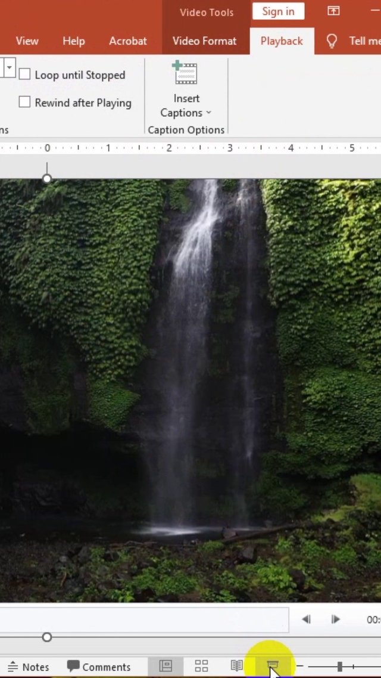
Video - 00:25:000

Slide 17

Video - 00:27:000

Slide 18

Video - 00:28:000

Slide 19

Video - 00:29:000

Slide 20

Video - 00:30:000

Slide 21
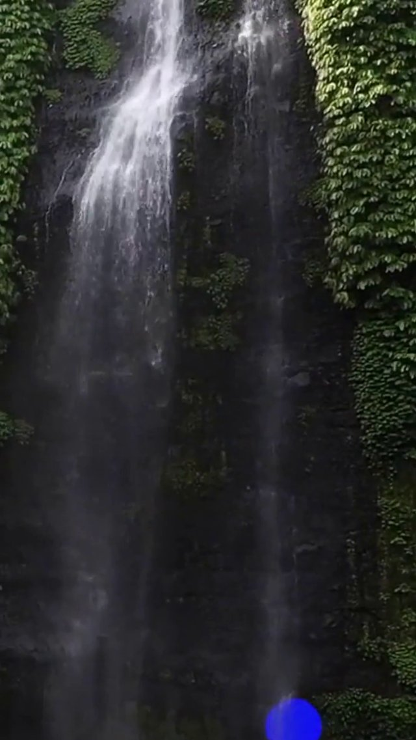
Video - 00:31:000

Slide 22
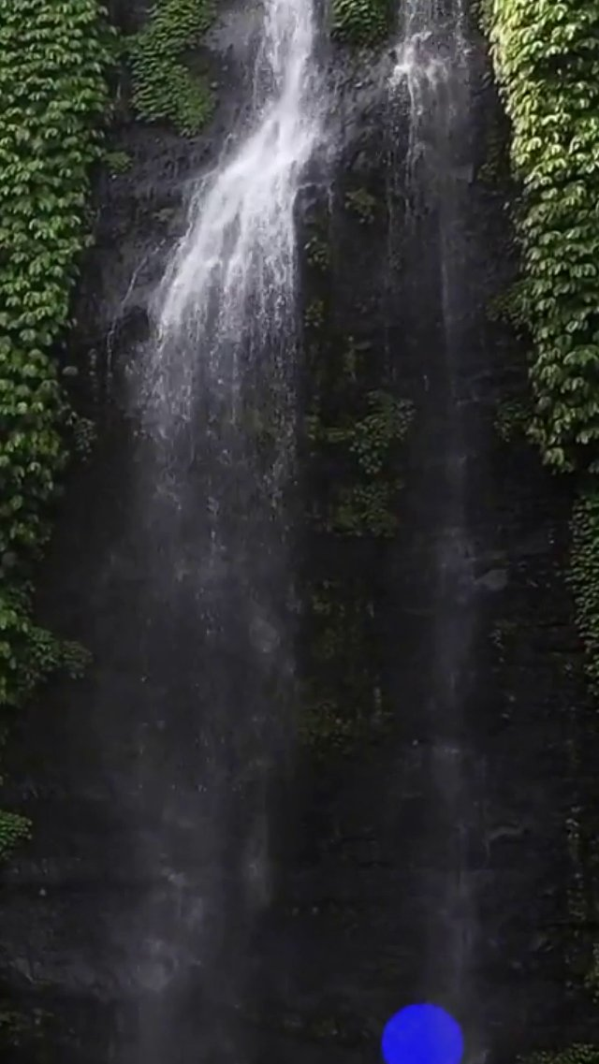
Video - 00:32:000

Slide 23
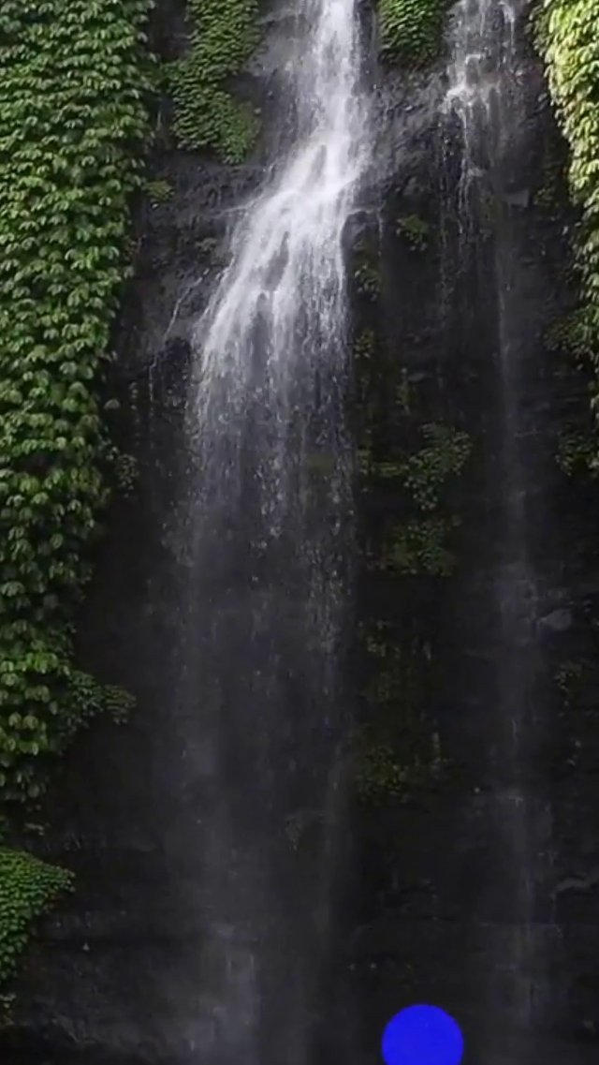
Video - 00:33:000

Slide 24

Video - 00:34:000

