Slide 1

Docker in 100 Seconds - 00:00

Slide 2

Docker in 100 Seconds - 00:01

Slide 4
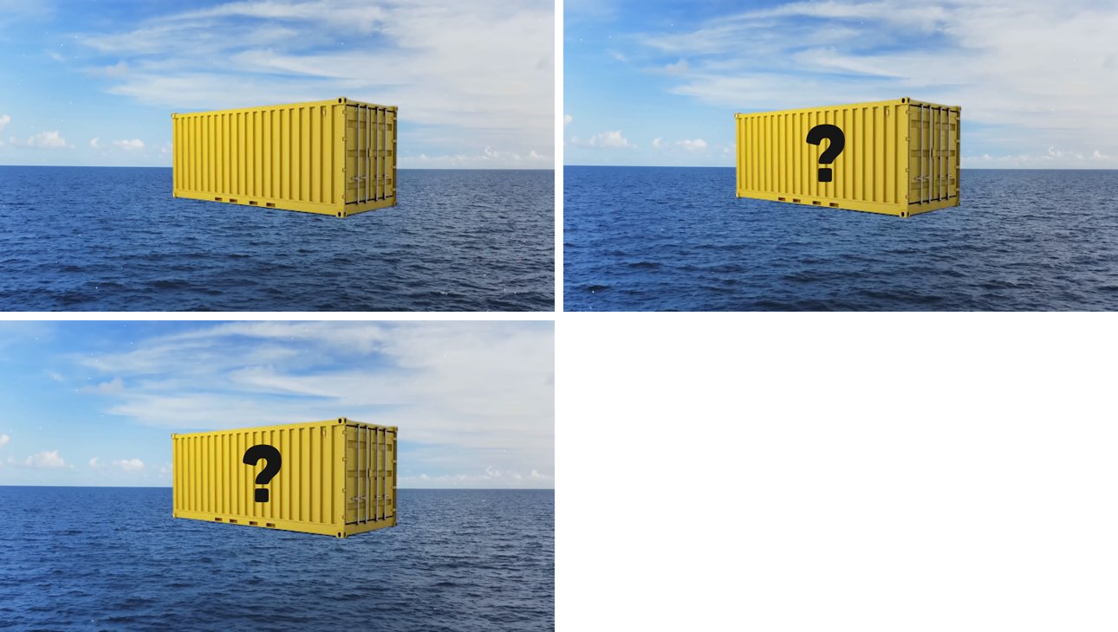

Slide 5

Docker in 100 Seconds - 00:10

Slide 6

Docker in 100 Seconds - 00:11

Slide 7

Docker in 100 Seconds - 00:12

Slide 8
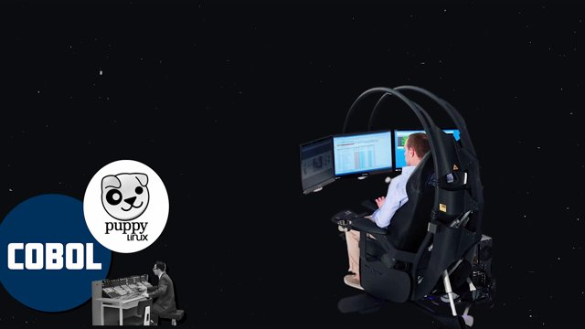
Docker in 100 Seconds - 00:13

Slide 9
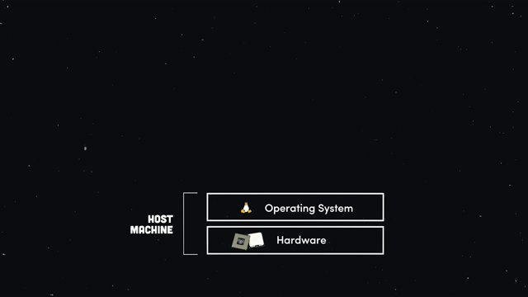
Docker in 100 Seconds - 00:17

Slide 10
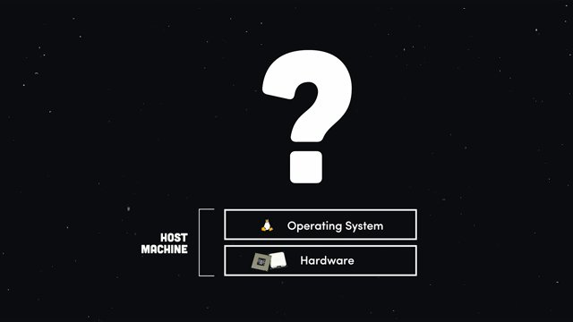
Docker in 100 Seconds - 00:18

Slide 11
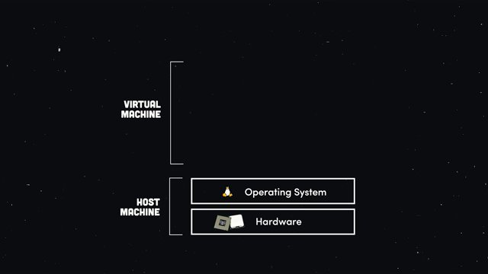
Docker in 100 Seconds - 00:20

Slide 12
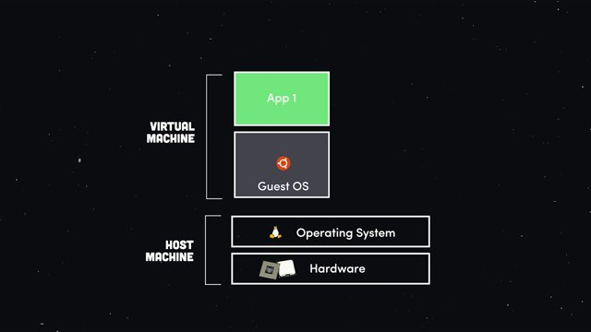
Docker in 100 Seconds - 00:21

Slide 13
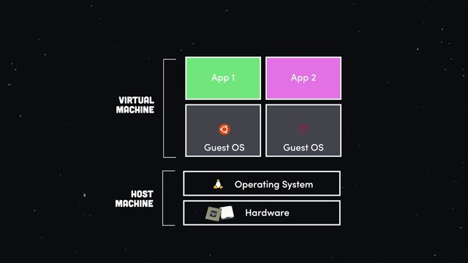
Docker in 100 Seconds - 00:23

Slide 14
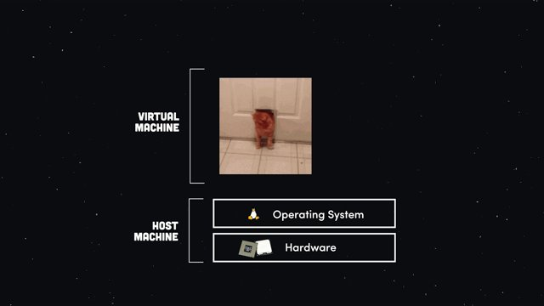
Docker in 100 Seconds - 00:29

Slide 15
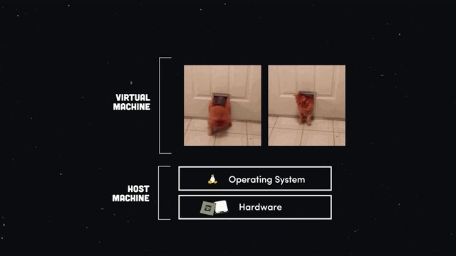
Docker in 100 Seconds - 00:31

Slide 16
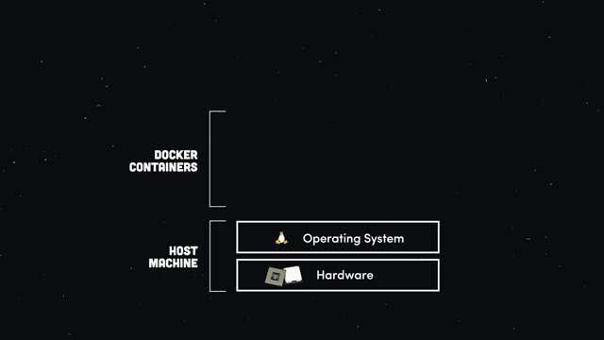
Docker in 100 Seconds - 00:34

Slide 17
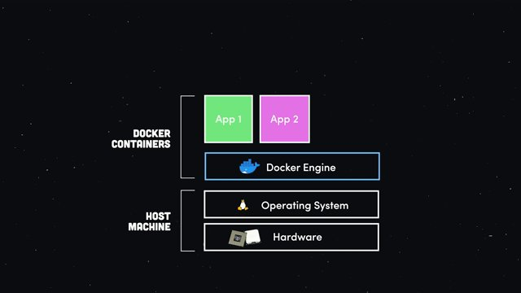
Docker in 100 Seconds - 00:38

Slide 18
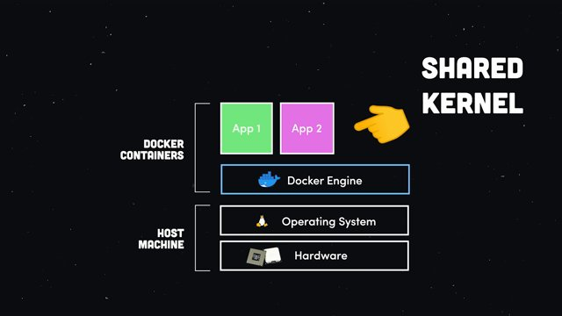
Docker in 100 Seconds - 00:41

Slide 19
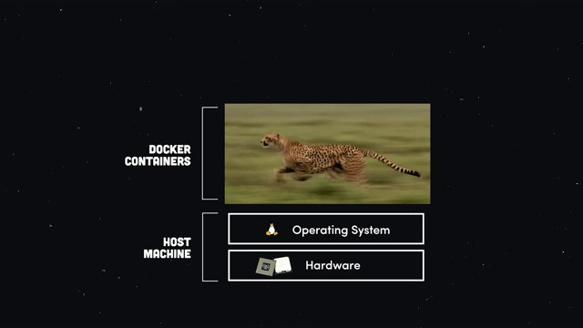
Docker in 100 Seconds - 00:46

Slide 20

Docker in 100 Seconds - 00:48

Slide 21

Docker in 100 Seconds - 00:49

Slide 22

Docker in 100 Seconds - 00:51

Slide 23
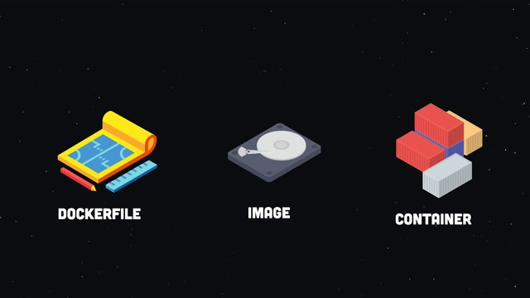
Docker in 100 Seconds - 00:53

Slide 24

Docker in 100 Seconds - 00:55

Slide 25

Docker in 100 Seconds - 00:56

Slide 26
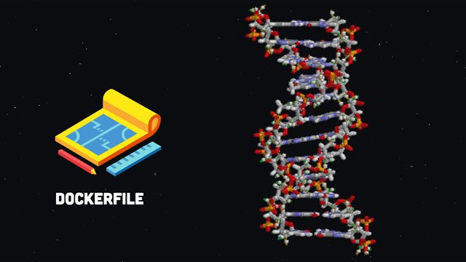
Docker in 100 Seconds - 00:57

Slide 27
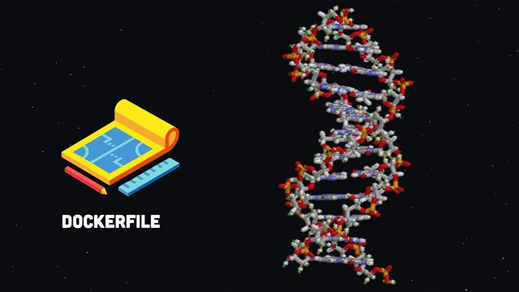
Docker in 100 Seconds - 00:58

Slide 28

Docker in 100 Seconds - 00:59

Slide 29
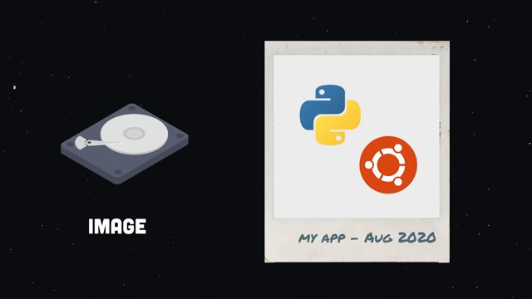
Docker in 100 Seconds - 01:00

Slide 30
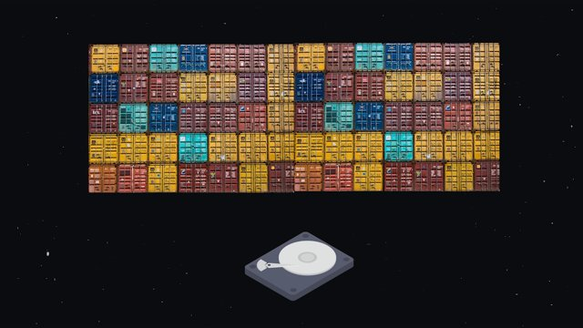
Docker in 100 Seconds - 01:05

Slide 31
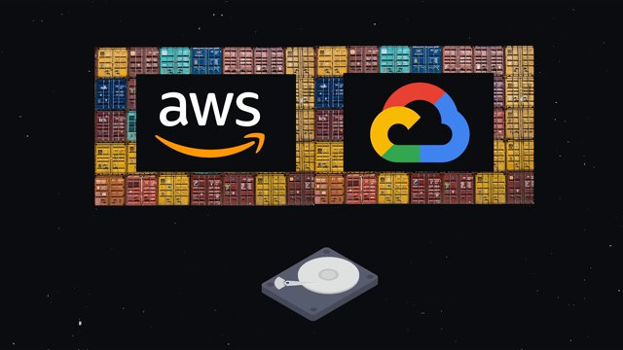
Docker in 100 Seconds - 01:06

Slide 32
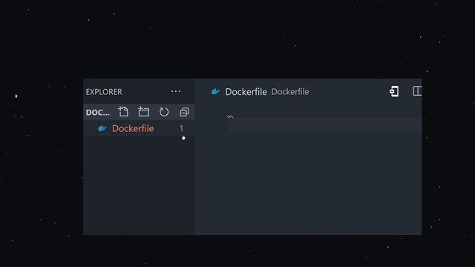
Docker in 100 Seconds - 01:11

Slide 33
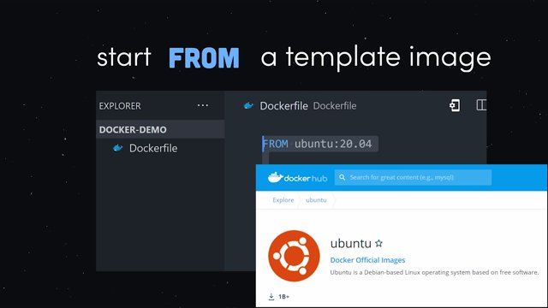
Docker in 100 Seconds - 01:16

Slide 34
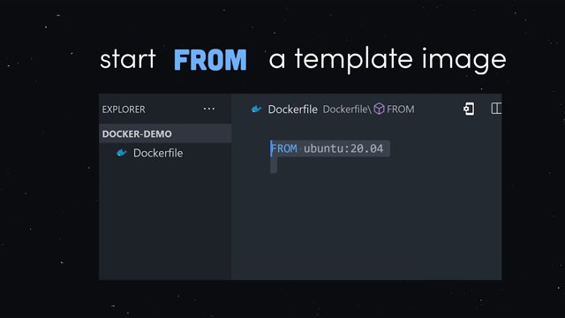
Docker in 100 Seconds - 01:21

Slide 35
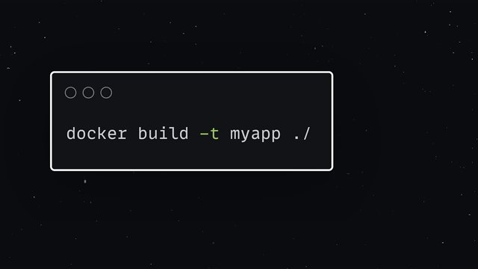
Docker in 100 Seconds - 01:34

Slide 36
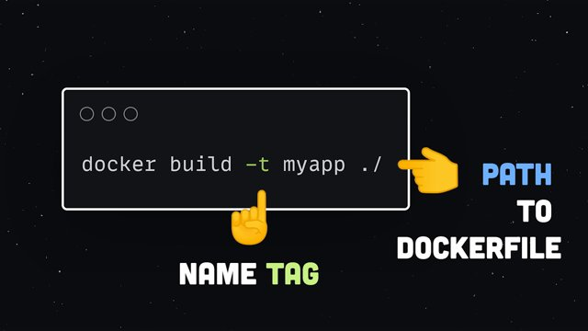
Docker in 100 Seconds - 01:36

Slide 37
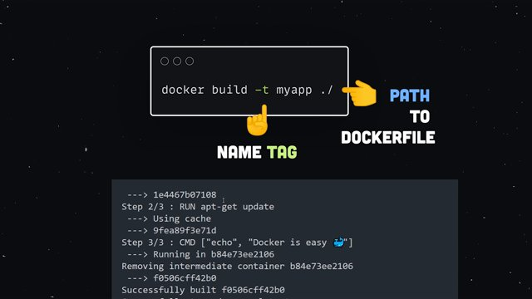
Docker in 100 Seconds - 01:37

Slide 38
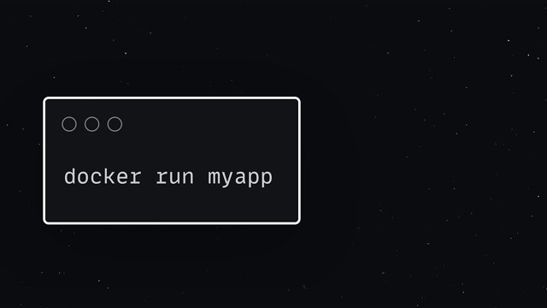
Docker in 100 Seconds - 01:42

Slide 39
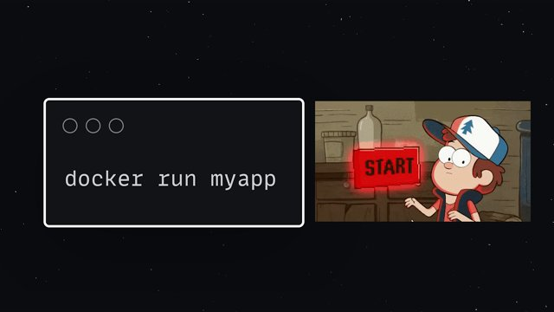
Docker in 100 Seconds - 01:43

Slide 40
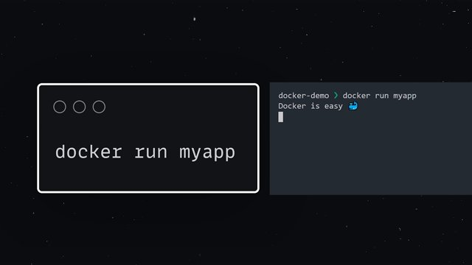
Docker in 100 Seconds - 01:45

Slide 41
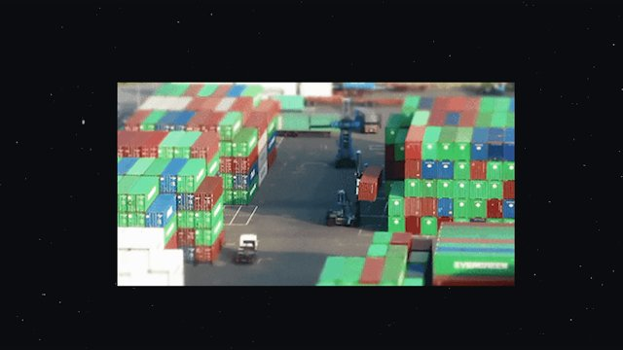
Docker in 100 Seconds - 01:48

Slide 42

Docker in 100 Seconds - 01:52

Slide 43
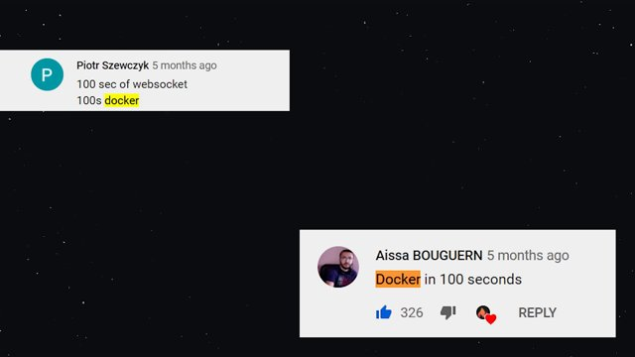
Docker in 100 Seconds - 01:53

Slide 44
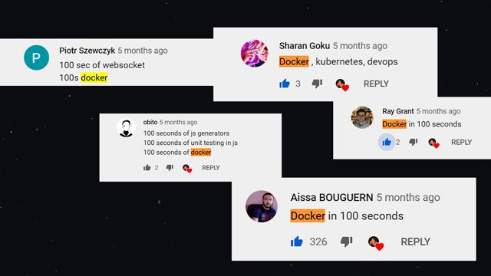
Docker in 100 Seconds - 01:54

Slide 45
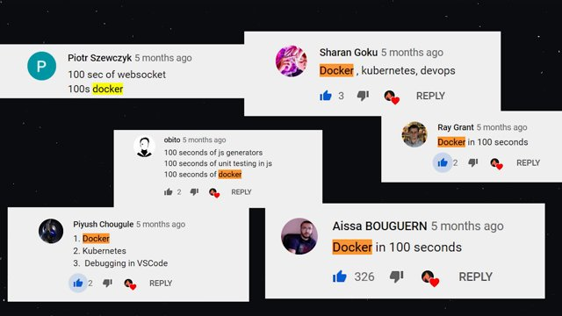
Docker in 100 Seconds - 01:55

Slide 46

Docker in 100 Seconds - 01:56

Slide 47
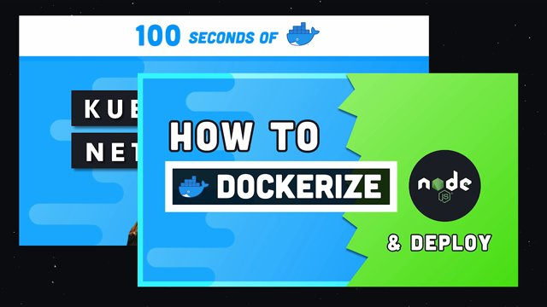
Docker in 100 Seconds - 01:57

Slide 48

Docker in 100 Seconds - 02:00

Slide 49

Docker in 100 Seconds - 02:01

Slide 50

Docker in 100 Seconds - 02:03

Slide 51

Docker in 100 Seconds - 02:04

