Slide 1
2buggAI
Team 34
Nikola Cvetkovic · Krystian Kedzior · Berceste Yagmur Aslan Özugur
Innovation Lab 2 · Summer Term 2026
FH Technikum Wien

Slide 2
Project Goals
A CLI tool that automatically debugs real-world GitHub repositories
Supports C, C++, Java, and Python multi-file projects, automatic dependency detection and its installation
Compiles the project, runs the right debugger, collects full debug output
Sends source code and compile errors, runtime errors, debugger output to OpenAI API to AI explain the bug and apply the fixed code directly into the source code

Slide 3
Implementations
Multi-language support: C, C++, Java, and Python
Build system support: gcc/g++ for C and C++, Maven and Gradle for Java, pip with virtual environments for Python
Debugger integration: GDB and Valgrind for C/C++, JDB for Java, PDB for Python
Automatic dependency installation (Python): Virtual environment per project, requirements.txt parsing, import scanning, package name mapping via pip
Automatic dependency installation (Java): Correct JDK version detection and installation via sudo apt, automatic Gradle version download via wget

Slide 4
Implementations
Error classification: Errors matched against a known checklist, sorted by type and difficulty (easy → medium → hard)
AI fix loop: Detected error + source code sent to OpenAI API, fix applied directly into the source file with automatic .bak backup, retries up to 5 times per error to handle cases where the first fix introduces new issues
Partial analysis fallback: If compilation fails, the tool continues with static AI analysis instead of stopping completely
Automatic checklist expansion: New error categories discovered by the AI are added directly into the checklist file, so the tool learns from each run
Interactive program detection: Programs requiring user input are automatically detected and skipped for execution, falling back to AI-based static analysis

Slide 5
Architecture
Input Layer: Developer runs the tool via CLI, providing a path to a repository, a short fix description, and optional flags
Output Layer: Results are displayed in the terminal as a structured debug report including detected errors, AI explanation, suggested fix, and the fix applied directly into the source file with a .bak backup. Optionally the full report including source code, compile output, error list, and AI analysis is saved as a JSON file.
Processing Layer: Our tool automatically handles everything: file collection, language and build system detection, dependency installation, compilation, debugging, error classification, and AI analysis.

Slide 6
Testing Overview & What Worked
~60 open-source GitHub repositories tested: C, C++, Java, and Python (https://github.com/bercesteyagmur/2buggAI/blob/main/Documentations/2buggAI_Test_Results_Analysis.pdf)
What Worked
Language & build system detection | reliable across all 4 languages
Java version & Gradle compatibility detection | Correct JDK installed automatically per detection
Python import-based detection | worked even without requirements.txt
Error classification & checklist expansion | improved with every run
AI static analysis fallback | AI static analysis continued even when compilation failed because of build system errors or missing dependencies
AI fix loop | AI fix loop detected errors, generated fixes, and applied them directly into the source code

Slide 7
Continuous Development & Limitations
Every test run revealed new edge cases and the tool was continuously improved sprint by sprint
Example Limitations:
1. Maven version conflicts: Build failures caused by incompatible maven-compiler-plugin versions could not be resolved automatically
2. Python dependency conflicts: When packages in requirements.txt are mutually incompatible (e.g. Django 3.1.13 requires asgiref ≥ 3.4, but asgiref 3.2.3 was pinned), pip cannot resolve them and the project cannot run
3. Platform-specific code: Projects using windows.h or conio.h fail on Linux; this is an environment issue, not a code bug, so the tool skips fix attempts
4. External services: Repositories requiring hardware, APIs, or databases not available in the test environment could not be executed or debugged

Slide 8
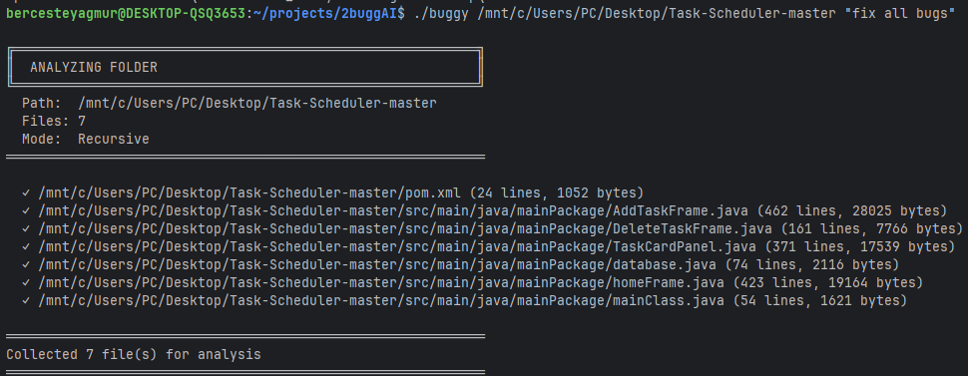
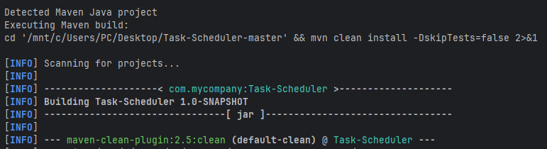
Example Run of 2buggAI
The tool scans the project folder and collects all 7 files for testing, including pom.xml and the Java source files.
2. The tool detects a Maven project and runs mvn clean install to build it automatically.

Slide 9
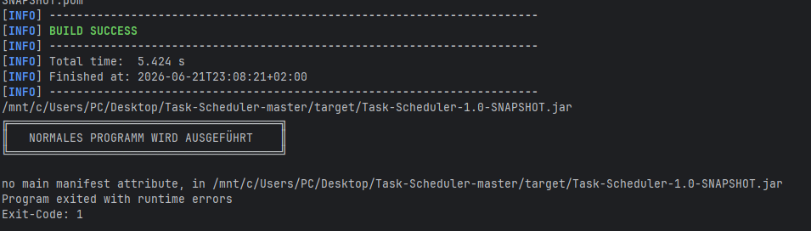
Example Run of 2buggAI
3. The Maven build finishes with BUILD SUCCESS, and the JAR file is created. But when the tool tries to run the program, it fails with "no main manifest attribute" and Exit-Code: 1 because the pom.xml is missing the main class configuration.

Slide 10
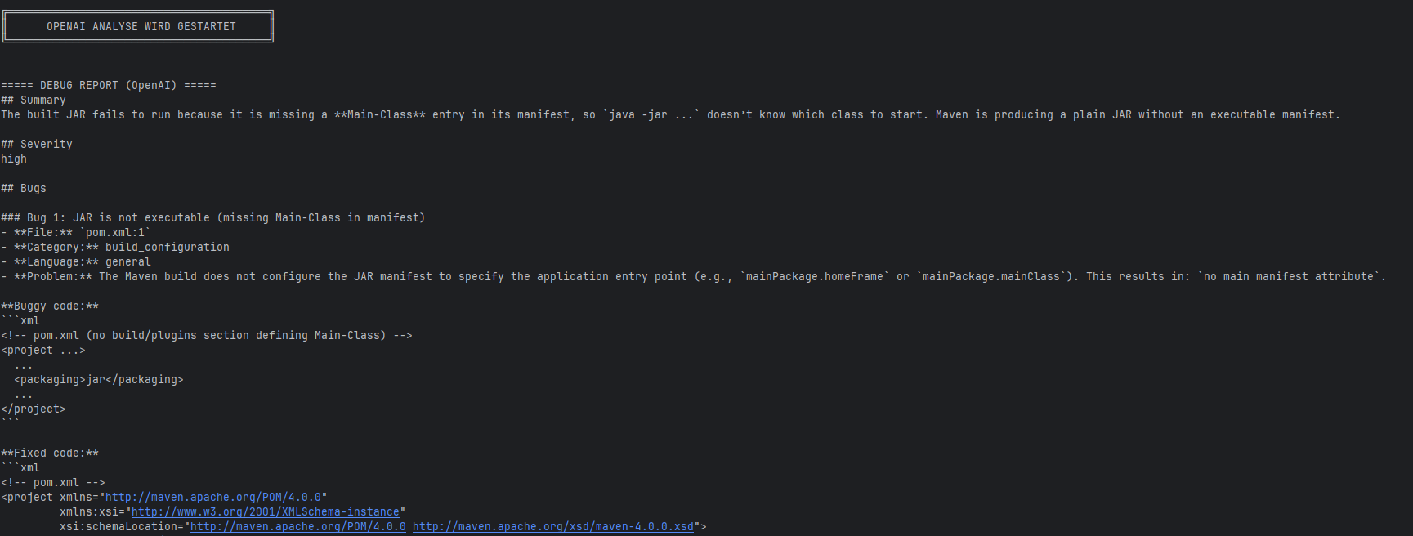
Example Run of 2buggAI
4. Even though the program could not run, OpenAI analysis still starts and generates a debug report. It explains that the JAR fails to run because the manifest is missing a "Main-Class" entry, so Java doesn't know which class to start and then AI provides the buggy code and the fixed code, and also adds the fix directly into the project (you can see this in the next slides).

Slide 11
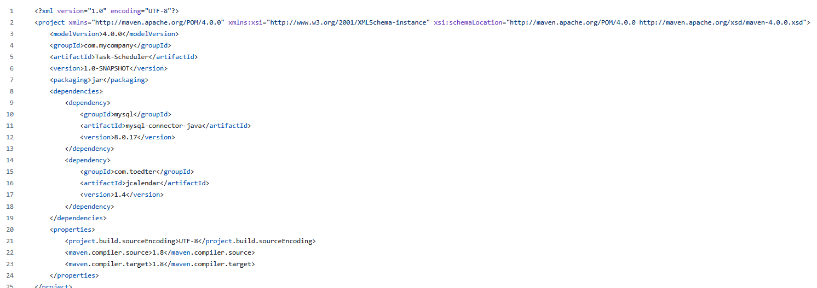
Before Running Tool This is the original pom.xml file of the tested project, taken from its GitHub repository (https://github.com/jvondermarck/dinosaur-exploder), before our tool checked it. It has the dependencies and basic settings, but no plugin to build a runnable JAR file. Because of this, the JAR file has no "Main-Class" information, so the program cannot start with java -jar.

Slide 12
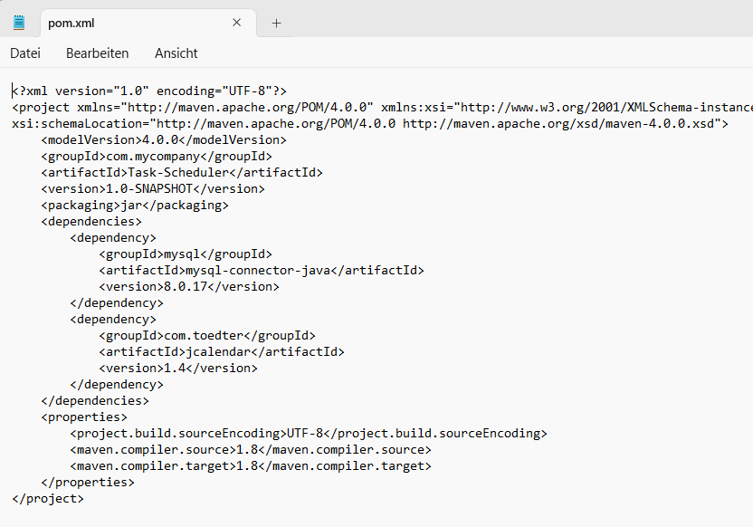
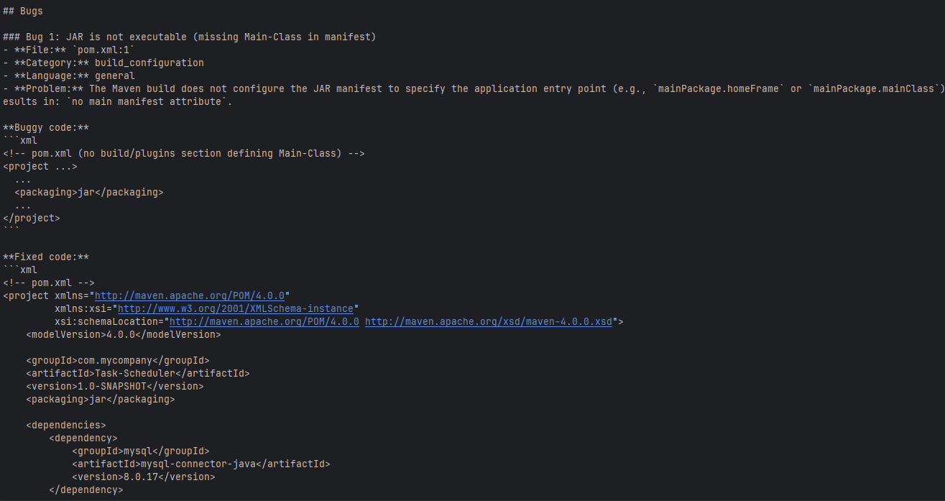
After Running Tool Program Output (Left): The tool ran the project, but it did not start correctly. The JAR file did not have a "Main-Class" defined in its manifest, so Java did not know which class to run.
Fixed Implementation (Right): The AI implemented the fixed code directly in the source code by adding a maven-jar-plugin block to the pom.xml file, with the main class specified inside it. Now Maven knows the correct entry point, and the JAR file can be run with java -jar.

