Slide 1
ChessMate

Slide 2
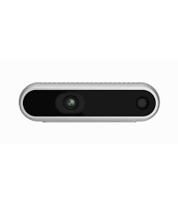

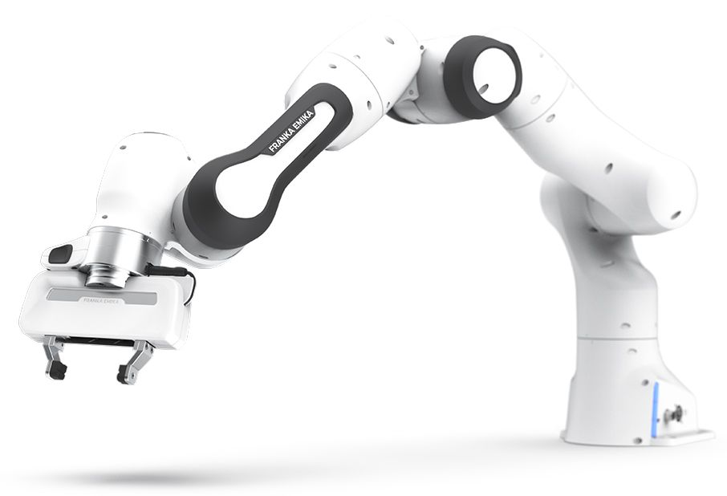

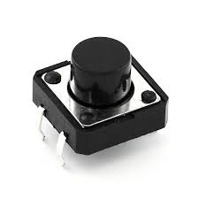
Camera calibration
Center pixel
Pixel to world coordinates
Chessboard all squares’ centers
YOLO piece detection
Base pixels of detected pieces
Square location of the pieces
Length of squares
Player move detection
Capture zone detection
Game_controller
Fixing minor errors
Capturing pieces and recovering pieces
Castling move
Pick and place
HRI
Button?

Slide 3
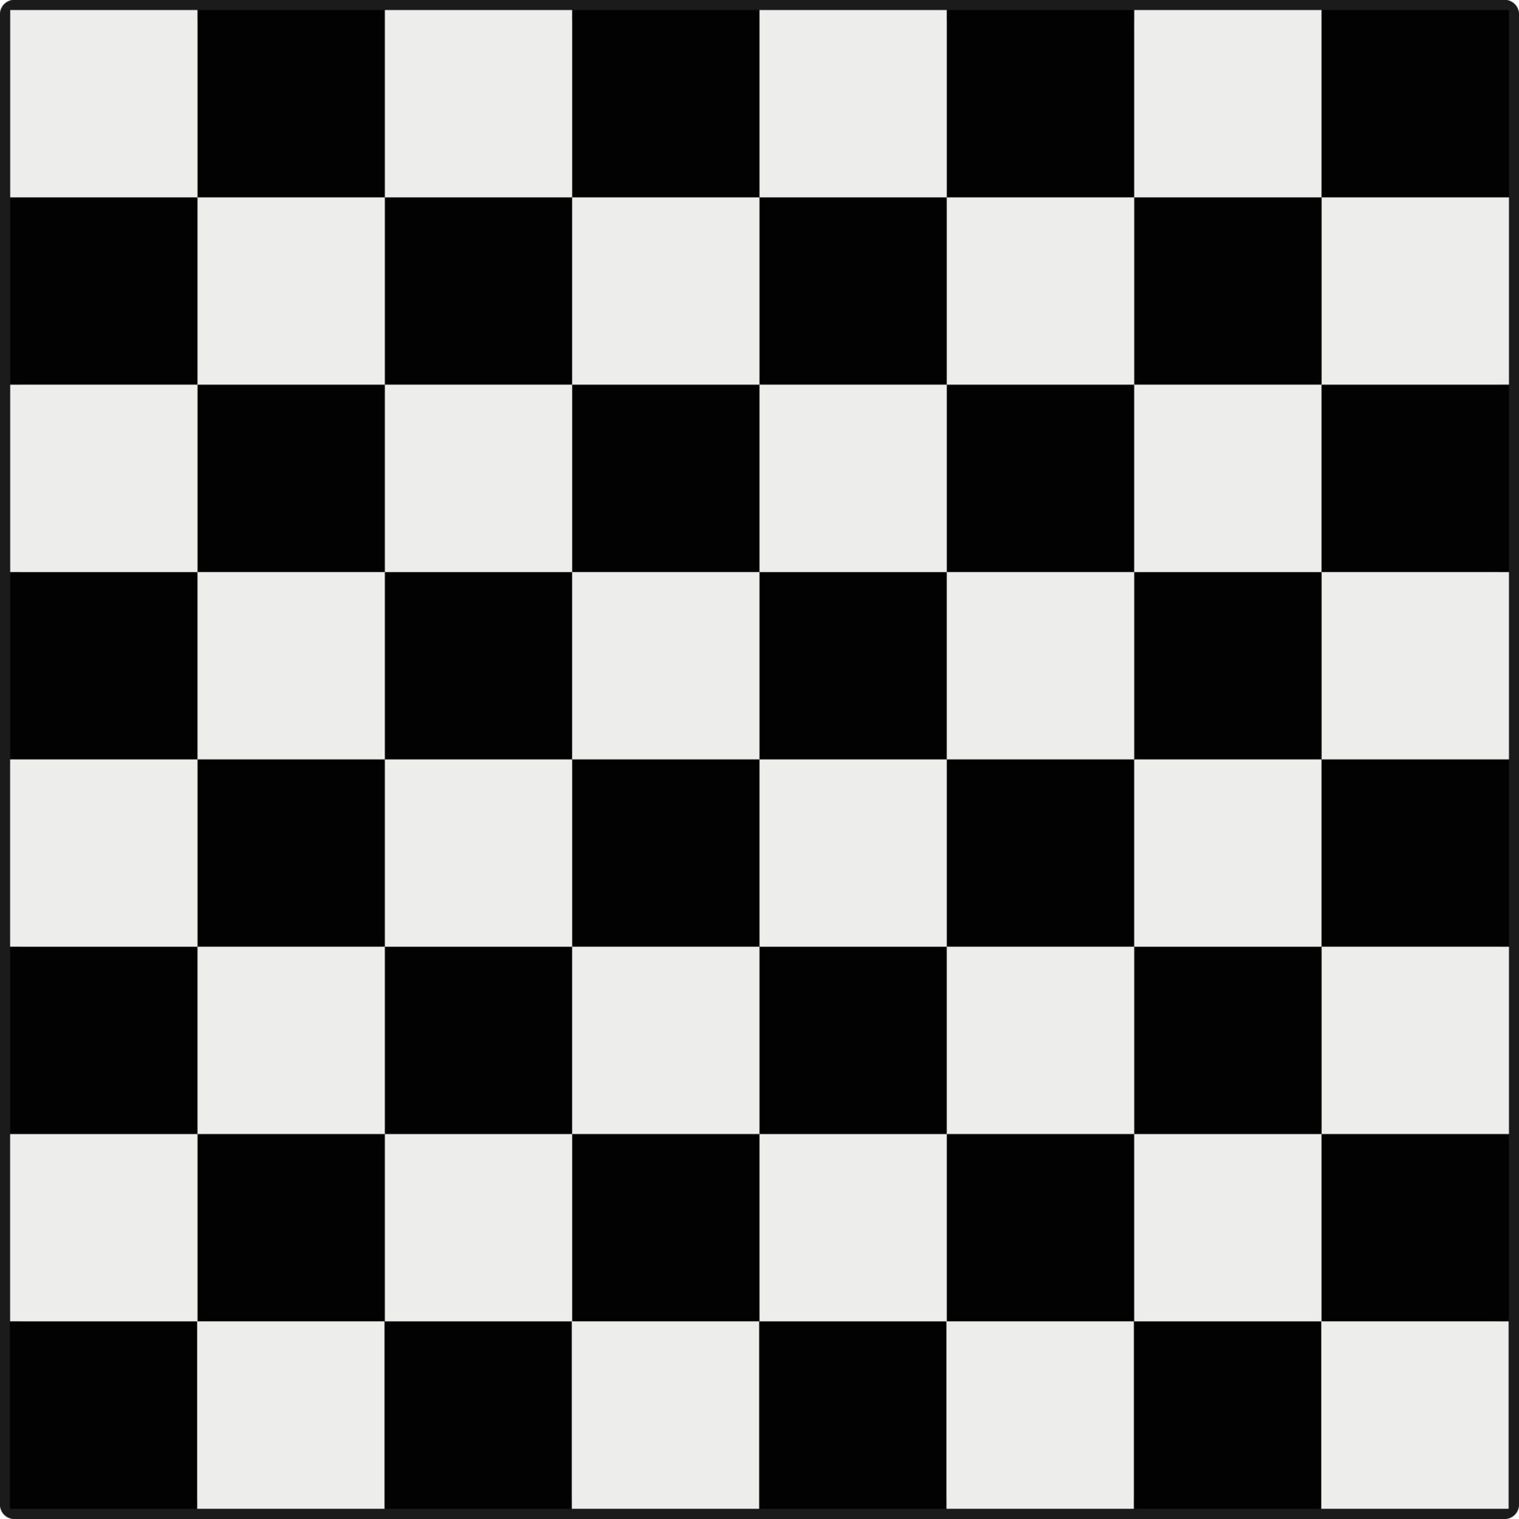
Input
Square size
Board dimensions
Top left inner corner of the board
Camera calibration
Object points
findChessboardCorners
calibrateCamera
Output
Intrinsic matrix: focal, principal
Extrinsic matrix

Slide 4
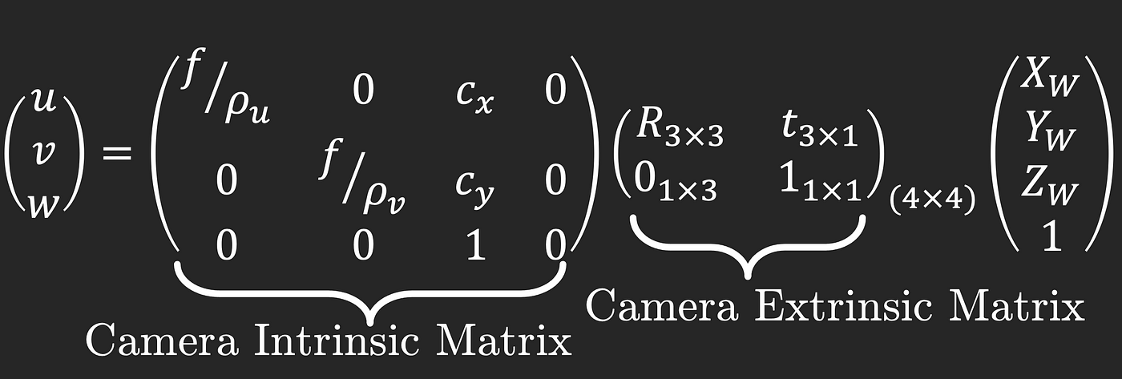
Given this
Find this

Slide 5



Next steps
(x,y,z)
Chess_table = {
“A1”: [“brook”, (0,0,0)],
“B1”: [“bknight”, (0,0,0)],
…}
+
+
=
euclidean

