Slide 1
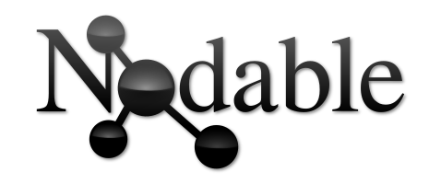
Past, present and future.
Bérenger Dalle-Cort - 2018/06/05

Slide 2
Summary
Where did this idea comes from ?
What is Nodable now ?
What is my road map for Nodable ?
Realtime demo.

Slide 3
Where did this idea comes from ?
November 2017
First idea
June 2018
now
time

Slide 4
Where did this idea comes from ?
I wanted to code for fun.
I’m in fond of graph theory.
I like to represent things graphically.
I was 3D Artist for 9 years (Maya software).

Slide 5
What is Nodable now ?
November 2017
First idea
June 2018
now
time

Slide 6
What is Nodable now ?
- Text to graph editor.
Text Editor
Graph Editor

Slide 7
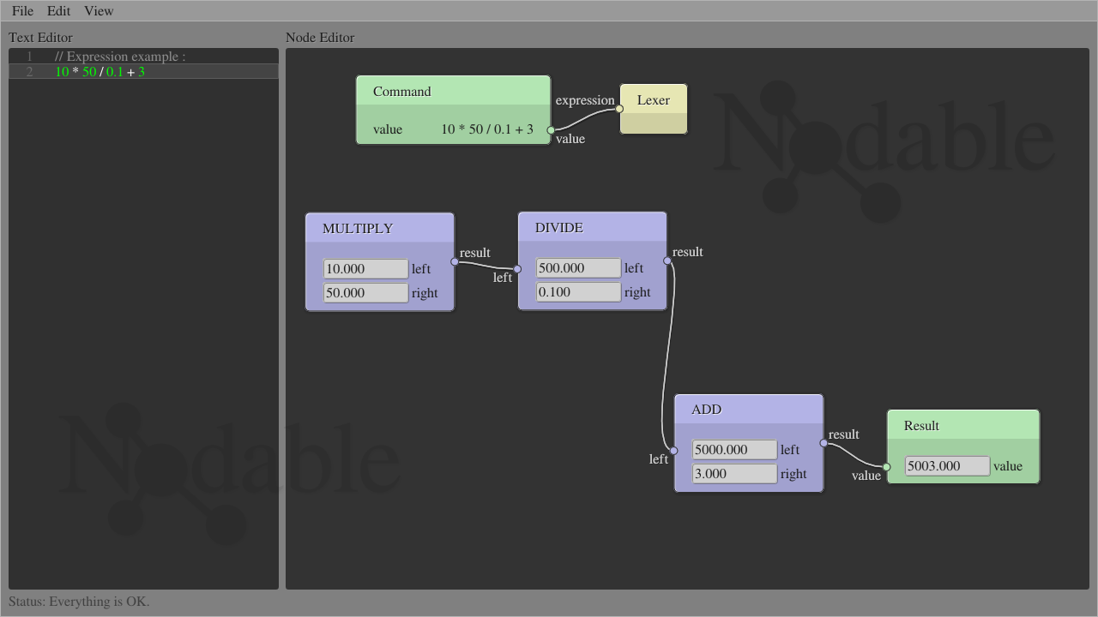
What is Nodable now ?

Slide 8
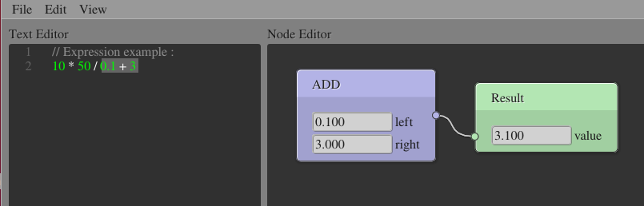
What is Nodable now ?
- Visualize graph portions.

Slide 9
The future of Nodable
November 2017
First idea
June 2018
now
time

Slide 10
The future of Nodable
Seamless « Graph to Text » edition.
Text Editor
Graph Editor

Slide 11
The future of Nodable
Parser improvements :
  - Conditionnal structures (if, else if, else).
  - Iterative structures (for, while).
Step by step execution.

Slide 12
Demo
Now a little demo of the tool.

Slide 13
Thanks !
My web site : www.dalle-cort.fr
Source code : github.com/berdal84/Nodable

