Slide 1
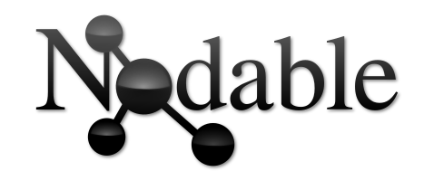
Bidirectionnal edition & GUI improvements
Bérenger Dalle-Cort - 2018/06/12

Slide 2
Previously
- Text-to-graph editor only
Text Editor
Graph Editor

Slide 3
What is Nodable now ?
- Bidirectionnal !
Text Editor
Graph Editor

Slide 4
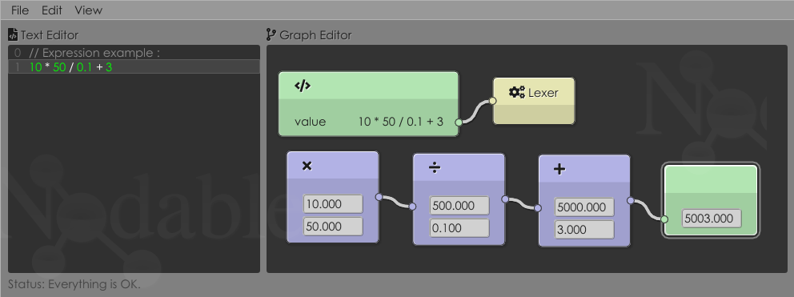
What is Nodable now ?
- GUI improvements (font, nodes, icons, etc.)

Slide 5
Demo
Now a short demo of the lastest version.

Slide 6
Thanks !
My web site : www.dalle-cort.fr
Source code : github.com/berdal84/Nodable

