Slide 1

New features in April 2020
Bérenger Dalle-Cort - 2020/04/05

Slide 2
Summary
A brief reminder of the Nodable concept.
A short history
What's new ?
Demo of the software
What's next ?

Slide 3
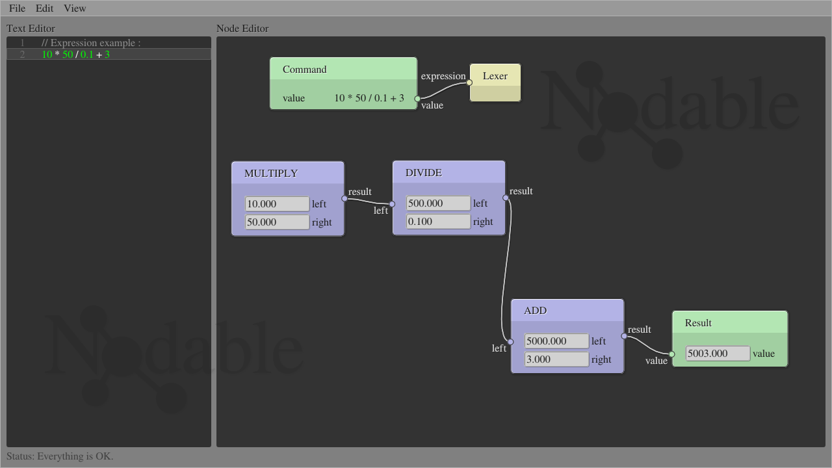
Nodable concept

Slide 4
History
Nov 2017
First idea
June 2018
Previous talk
April 2020
Now
time

Slide 5
What's new ?
- Multi files edition
- Undo/Redo (text-based)
- Parenthesis parsing

Slide 6
Demo
A short demo of the tool.

Slide 7
The future of Nodable
- Conditionnal structures (if/else)
- Functions (declare, call)
The previous steps imply to choose a base language.

Slide 8
Thanks !
My web site : www.dalle-cort.fr
Source code : github.com/berdal84/Nodable

