Slide 1
Core Insight
Turning NetAct KPI exports into decisions
Platform overview · For the Core team, leadership and business stakeholders

Slide 2
WHY WE BUILT IT
KPI reporting was manual, slow and inconsistent
Hours, not minutes
Two people, two answers
Problems found late
Each NetAct export was opened by hand, filtered, charted and pasted into a deck — repeated per KPI, per week.
The same export could be summarised differently depending on who prepared it and what they chose to highlight.
A dip at 03:00 or a slow upward creep is easy to miss by eye, so issues surfaced after they had already cost something.
The data was never the problem. Getting a consistent answer out of it was.
Core Insight · 1

Slide 3
WHAT IT IS
One place where an export becomes a reviewed report
You upload the Excel file exactly as NetAct produces it. Core Insight checks the file is what it claims to be, computes the KPI, analyses the result statistically, and writes the summary — with charts and exports ready to share.
Upload
Validate
Analyse
Report
Share
›
›
›
›
NetAct file,
unchanged
Structure and
columns checked
Baselines, trends,
quality
Charts and a
written summary
PowerPoint,
Teams, download
No new tool for the engineers to learn, and no reformatting of the export beforehand.
Core Insight · 2

Slide 4
MEASURED, NOT ESTIMATED
A three-day export, end to end
Figures below are from an actual run on a real NetAct CMG export, on the live deployment.
3,456
288
4
~5 sec
rows ingested
periods analysed
charts generated
upload to report
raw CMG measurements
15-minute resolution
rendered server-side
including the written summary
The same file, prepared by hand, was a morning of work — and produced a summary that depended on who wrote it.
Core Insight · 3

Slide 5
WHAT THE ANALYSIS LOOKS FOR
Five questions, answered on every upload
1
Is anything unusual?
4
Are we running out of room?
Spikes and dips judged against what that hour of day normally looks like — so a busy evening is not an alarm, but a quiet 03:00 is.
Busy-period load against the target, with a projected date if growth is genuine.
2
Has something changed for good?
5
Can we trust this export?
A step change that persists, which usually means a configuration change or rerouted traffic rather than demand.
Collection gaps, duplicates and stuck counters, scored out of 100 before any conclusion is drawn.
3
Where is this heading?
A trend with a confidence measure, and a forecast only when the trend is real.
Core Insight · 4

Slide 6
FOR THE SCEPTICS IN THE ROOM
Why the findings are worth acting on
Compared like with like
Every point is judged against its own hour-of-day baseline, not a flat average. Busy hours stop looking like incidents.
Two bars, not one
A point must be both statistically unusual and materially different. A 9% wobble in a quiet bucket is not raised as major.
Honest about weak signals
Where a trend explains little of the variation it is reported as flat and no forecast is produced, instead of drawing a confident line through noise.
Silence is a result
A clean period is reported as clean. The platform does not manufacture findings to look useful.
Core Insight · 5

Slide 7
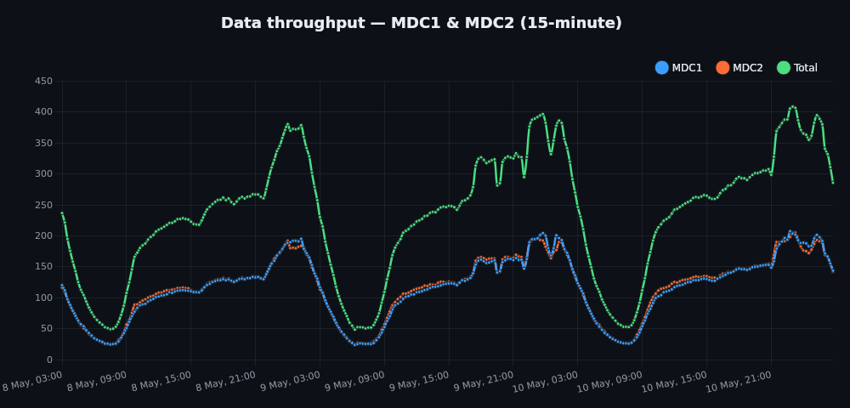
REAL OUTPUT
What a finished report shows
Written summary
"Data throughput across 3 days at 15-minute resolution (288 periods). Typical level 247 Gbps, busy-period peak 383 Gbps. No anomalies, trend, or data-quality issues detected in this period."
Data quality 100 / 100
100% of expected data points present.
Busiest hour 23:00, quietest 07:00.
Nothing flagged — a verified clean period,
not an unchecked one.
Core Insight · 6

Slide 8
WHAT IT IS WORTH
For the business
Reporting time collapses
One version of the truth
A task measured in hours becomes one measured in seconds, repeatable by anyone on the team.
The same file always produces the same summary, with the numbers behind every statement.
Problems surface earlier
Decisions are auditable
Dips, step changes and slow growth are caught while they are still cheap to fix.
Every report keeps its data, its charts and its reasoning, so a conclusion can be checked months later.
None of this asks the team to change how they export data.
Core Insight · 7

Slide 9
WHAT IT IS WORTH
For the Core team
New KPIs without a rewrite
Each KPI is a self-contained module — validation, transformation, metrics and charts — added without touching the others.
Exports that are already formatted
PowerPoint decks, chart images and JSON, generated from the report rather than rebuilt by hand.
Delivery where people already are
Reports can be pushed to Microsoft Teams instead of waiting to be opened.
Open to other tools, safely
A read-only interface lets AI assistants and scripts query reports and findings — query only, never write.
Core Insight · 8

Slide 10
WHERE IT GOES NEXT
Live today, and what follows
Live now
In build
Being considered
•
Two KPI workflows plus CMM workbooks
•
Read-only interface for AI assistants
•
Scheduled and automated reporting
•
Seasonal anomaly detection and forecasting
•
KPI definitions held in the database
•
Alerting on findings, not just reports
•
Server-rendered charts, stored durably
•
Assisted KPI creation, reviewed before import
•
Cross-KPI correlation
•
PowerPoint, JSON and image exports
•
Deployed and reachable by the team
Core Insight · 9

Slide 11
See it for yourself
The platform is running now. Bring a NetAct export and we can process it in the session.
bituinsight.vercel.app
Ask for an account — access is granted per person.
Questions — and what you would want it to answer next.

