Slide 1


DIRE DAWA UNIVERSITY · STUDENT CLINIC CENTER
DDU Clinic
One secure platform for the entire campus clinic
Reception, doctors, lab, pharmacy, wards, referrals, billing and records — connected, verifiable and built to last.
Bereket Zelalem
Dire Dawa University alumnus
Notes:
Welcome. This is DDU Clinic — one secure platform for the entire campus clinic. I'm Bereket Zelalem, a Dire Dawa University alumnus, and I'm bringing this home to my own university.

Slide 2

WHY THIS, WHY ME
This began as my graduation
project. I'm bringing it home.
I studied here. Dire Dawa University shaped me — so when it came time to build my final-year graduation project, I built something my own campus could truly use.
What started as a student project grew into a complete, working platform for the student clinic that cared for me and thousands like me.
Dire Dawa University
Now I want to give it back — not as a demo, but as a real system for the university that gave me my start. This is alumni giving back, in the most practical way I know.
Where it started. Where it belongs.
“From the alumni,
back to the university.
DDU Clinic
2
Notes:
This is the heart of the story. I'm a DDU alumnus. This began as my final-year graduation project, and it grew into a real platform for the very clinic that looked after me. I'm bringing it home — from the alumni, back to the university.

Slide 3





THE PROBLEM
5,000–10,000
A clinic for thousands,
running on paper.
students & staff depend on one
campus clinic — every term
Lost & scattered records
Long queues, slow care
Paper files and disconnected tools — a student's history is never in one place when it's needed.
No shared queue or status; patients wait while staff hunt for files and re-ask the same questions.
Sick-leave can't be trusted
No oversight, no data
Handwritten certificates are easy to forge and impossible for faculty to verify.
Leadership has no live view of demand, throughput, stock or outcomes to plan around.
DDU Clinic
3
Notes:
The campus clinic serves five to ten thousand students and staff on paper and fragmented tools. Records get lost, queues are long, sick-leave certificates can't be verified, and leadership has no data to plan with.

Slide 4




THE SOLUTION
One connected platform,
the whole journey.
Every step of care lives in a single secure system — so information follows the patient instead of getting stuck at a desk.
One record per student
The full care journey
A single connected chart — visits, results, prescriptions and documents in one place.
Reception → doctor → lab → pharmacy → wards → referrals → billing, end to end.
Secure by design
Verifiable documents
Role-based access, strong sign-in and a full audit trail on every action.
Certificates and letters anyone can check as genuine in seconds.
DDU Clinic
4
Notes:
The answer is one connected platform covering the whole journey — reception to records. Information follows the patient. It's secure by design and every document it issues can be verified.

Slide 5









HOW CARE FLOWS
A guided path for every visit.
The platform always knows the right next step — and shows each team exactly what they can do, and nothing they can't.
1
2
3
4
5
6
7
8
Reception
Triage
Doctor
Lab
Pharmacy
Wards
Referrals
Records
Register
& intake
Vitals
& priority
Consult
& decide
Tests
& results
Dispense
medicines
Admit
& care
Refer out
safely
One lasting
chart
Lab results loop back to the doctor, not out the door. Nothing is skipped, nothing is lost — the workflow enforces safe, complete care.
DDU Clinic
5
Notes:
Every visit follows a guided path from reception to a lasting record. The system always knows the correct next step and routes hand-offs automatically — for example, lab results come back to the ordering doctor rather than ending the visit.

Slide 6








ONE PLATFORM, EVERY DESK
Modules at a glance.
CLINICAL CARE
Reception
Triage
Consults
Laboratory
Pharmacy
Wards
Referrals
Appointments
OPERATIONS
Billing
Human Resources
Store & Assets
Reports & Analytics
SELF-SERVICE & PLATFORM
Student Portal
Saba AI assistant
Feature toggles
Audit & security
DDU Clinic
6
Notes:
Everything a campus clinic does is here: reception, triage, consultations, lab, pharmacy, wards, referrals and appointments for care; billing, HR, store and reports for operations; plus the student portal, the Saba AI assistant, configurable modules and built-in security.

Slide 7



BUILT TO LAST
Three ideas that keep it
reliable — and yours.
A workflow engine
Backend-driven screens
Toggles & white-label
Guided every step
See only what you may do
Configure per institution
Care follows a defined path, so the system always offers the right next action and never an invalid one. Safer for patients, simpler for staff.
The server decides what each person can do; the screen shows exactly that — no more, no less. Permissions can never drift from the buttons.
Turn modules on or off and rebrand the whole system — colours, name and logo — without touching code. One platform, many campuses.
DDU Clinic
7
Notes:
Under the hood, three ideas keep it dependable. A workflow engine means the right next step is always offered. Backend-driven screens mean people only ever see what they're allowed to do. And feature toggles with white-label branding mean it configures to any institution without code changes.

Slide 8




SECURITY & TRUST
Protected access, on every action.
Role-based access
2-factor & passkeys
Eight staff roles see only their own areas — reception, doctor, lab, pharmacy, wards, HR and more.
Optional two-factor sign-in, modern passkeys and single-use recovery codes for staff accounts.
Full audit trail
On-leave auto lockout
Every state change and action is recorded — a complete, tamper-evident history of who did what.
When a staff member goes on approved leave, their login is automatically disabled until they return.
DDU Clinic
8
Notes:
Security is built in, not bolted on. Access is role-based; sign-in supports two-factor and passkeys; every action is audited; and staff on approved leave are automatically locked out until they return — process and security working together.

Slide 9
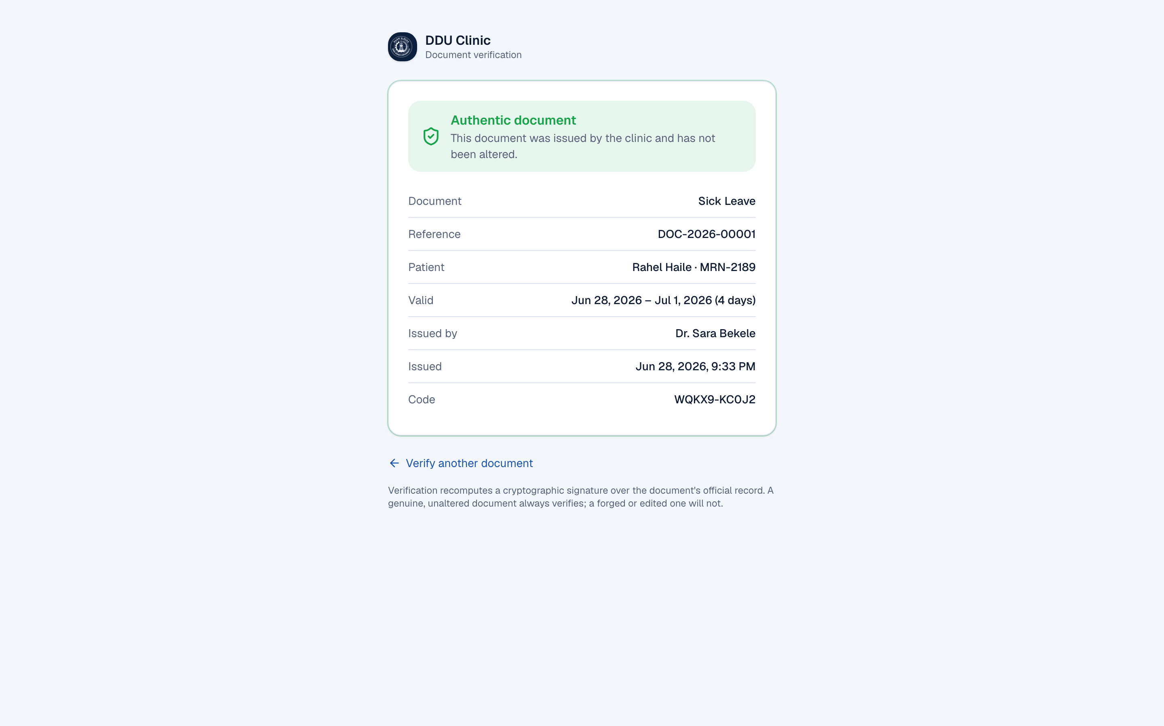



A STANDOUT DIFFERENTIATOR
Documents anyone can trust.
Every certificate, referral and visit summary carries a QR code and a short verify code. Anyone — faculty, an employer, a hospital — can confirm it's genuine.
Scan or type the code
Open /verify on any phone — no login, no account, no app to install.
Tamper-evident by maths
A cryptographic signature is re-checked live; an edited copy simply won't verify.
Four clear outcomes
Valid, altered, revoked or not-found — an instant, unambiguous answer.
Public verification page · /verify
DDU Clinic
9
Notes:
This is a real differentiator. Every document the clinic issues is tamper-evident: it carries a QR and a short code, and anyone can check it at the public verify page with no login. A genuine document always verifies; a forged or edited one never will.

Slide 10


MEET SABA
A careful AI copilot — read-only
by design.
For doctors
For students
History-aware support — differentials, tests to consider and red-flags to watch, framed as decision support for the visit on screen.
A caring guide — gentle self-care advice based on the student's own visits, and a nudge to come in or seek help when it matters.
Strictly read-only
Access-controlled
Stays on task
Explains and looks up — never changes, orders or approves anything.
Shows each person only what they're allowed to see — nothing else.
Answers clinic questions only; politely declines everything off-topic.
Runs on affordable or free AI — Groq today, swappable to OpenAI or an on-campus Ollama server so no data need leave the clinic.
DDU Clinic
10
Notes:
Saba is our AI copilot with two faces: history-aware support for doctors and a caring guide for students. Crucially it is strictly read-only and access-controlled — it can look things up and explain, but never change anything, and it only shows each user what they're allowed to see. It runs on affordable or even free AI, including a fully on-premise option.

Slide 11



WHAT IT PRODUCES
Signed, printable, verifiable.
Formal documents on university letterhead — each one signed, sealed with a QR code, and re-printable exactly as issued.
Sick-leave
certificates
Prescriptions
Lab reports
Referral letters
Discharge
summaries
Visit
summaries
Every document carries a verify seal. A QR code and short code let faculty, employers or hospitals confirm authenticity at /verify — instantly, with no login.
DDU Clinic
11
Notes:
The platform produces all the documents a clinic needs — sick-leave certificates, prescriptions, lab reports, referral letters, discharge and visit summaries — on university letterhead, each signed and carrying a verifiable QR seal.

Slide 12
IMPACT FOR DDU
What changes on day one.
1
100%
8
24/7
record per student
verifiable documents
roles, one system
live oversight
Every visit, result and prescription in a single connected chart.
Every certificate and letter can be confirmed genuine in seconds.
Reception to management working from the same live information.
Real-time view of demand, queues, stock and outcomes for leadership.
Faster care, less paper, one trusted source of truth — and the data to keep improving.
DDU Clinic
12
Notes:
The impact is immediate: one record per student, fully verifiable documents, eight roles working from one system, and round-the-clock oversight for leadership. Faster care, far less paper, and a single trusted source of truth — with data to keep improving. These figures illustrate the model the platform enables.

Slide 13



CLOUD-NATIVE & LOW-COST
Runs anywhere. Scales cheaply.
Serverless in the cloud
Or on a campus server
Runs on modern serverless hosting — capacity flexes with demand, so you pay for what you use.
Prefer to keep everything on-site? The same system can run on a university server. Your choice.
Nothing to install
Scales to 10k+ students
It's a website. Staff and students just open a link on any phone, tablet or computer.
Built to serve the whole campus affordably — and other university clinics after that.
DDU Clinic
13
Notes:
It's cloud-native and low-cost. It can run serverless in the cloud, paying only for what's used, or on a campus server if the university prefers. There's nothing to install — it's just a website — and it scales affordably to ten thousand students and beyond.

Slide 14
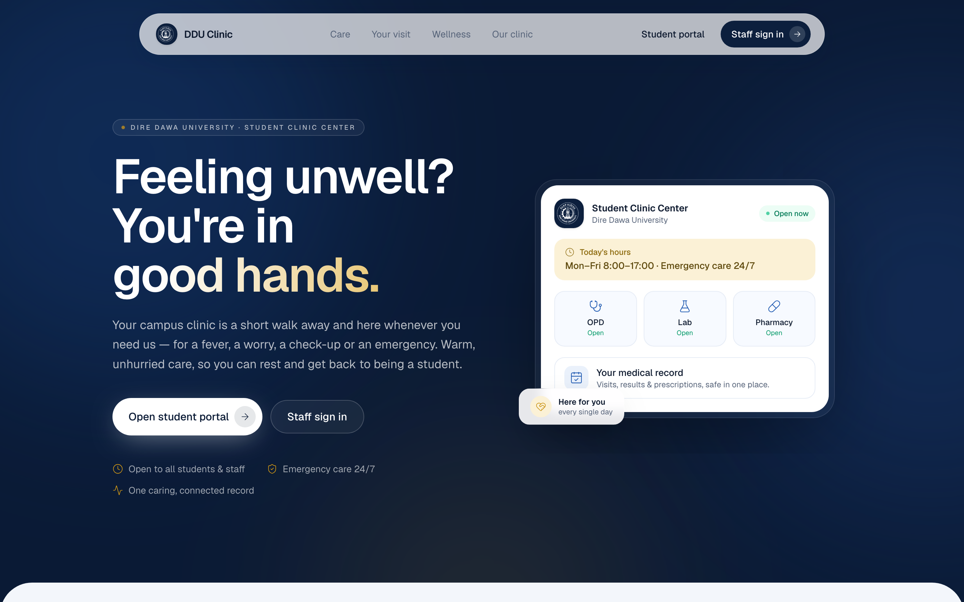

NOT A CONCEPT
It's already built,
and already live.
This is a complete, working platform with a live demo you can use today — not slideware and not a prototype. Every screen, workflow and document in this deck exists and runs right now.
End-to-end workflows running
Realistic demo data loaded
Live student-facing landing page
Signed, verifiable documents live
DDU Clinic
14
Notes:
Importantly, this is not a concept. It is already built and deployed, with a working demo you can try today. Everything shown in this deck exists and runs right now, on realistic data.

Slide 15


WHERE IT GOES NEXT
Same platform, more places to reach it.
The core is done. What's next simply extends its reach — so the clinic needs less costly hardware, and students carry their clinic in their pocket.
Mobile & tablet apps
Student clinic app
The same clinical flows on phones and tablets — so the clinic doesn't need a costly desktop at every desk.
A simple standalone app for students to check their visit status, documents and appointments on the go.
The bigger picture: the clinic is one piece of a wider campus digital-lifestyle vision — a separate future initiative for another day.
DDU Clinic
15
Notes:
Looking ahead, the roadmap is light and practical: mobile and tablet apps for the same flows, so the clinic avoids buying expensive desktops everywhere, and a standalone student app for clinic status. This also fits a bigger campus digital-lifestyle vision — but that's a separate future initiative.

Slide 16
THE ASK
Let's deploy DDU Clinic
across the university.
I'm ready to partner with the university to put this into the hands of the clinic and the students it serves — as an alumnus, giving back something real.
1
2
3
A short pilot
Roll out campus-wide
Grow together
Run it live for the student clinic with real workflows and a small team.
Extend to every desk and the full student body, department by department.
Add mobile apps and connect to campus systems as the partnership matures.
Next step: a 30-minute walkthrough of the live system, at your convenience.
DDU Clinic
16
Notes:
My ask is simple: partner with me to deploy DDU Clinic across the university. Start with a short pilot in the student clinic, roll it out campus-wide, and grow together from there. The next step is just a thirty-minute walkthrough of the live system whenever suits you.

Slide 17



Thank you.
From the alumni, back to the university.
Bereket Zelalem
Dire Dawa University alumnus
DDU Clinic platform
Notes:
Thank you. From the alumni, back to the university. I'd love to take this forward together.

