Slide 1

Final Project-4 : Airflow
Büşra Berfim Karakurt

Slide 2
İçerik
Architecture
Airflow
data-generator to MinIO
MinIO to Apache Spark
Apache Spark
Apache Spark to MinIO
Bronze-Layer
Silver-Layer

Slide 3






Architecture
data-generator

Slide 4
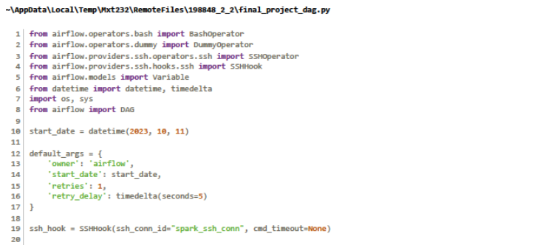
Airflow

Slide 5
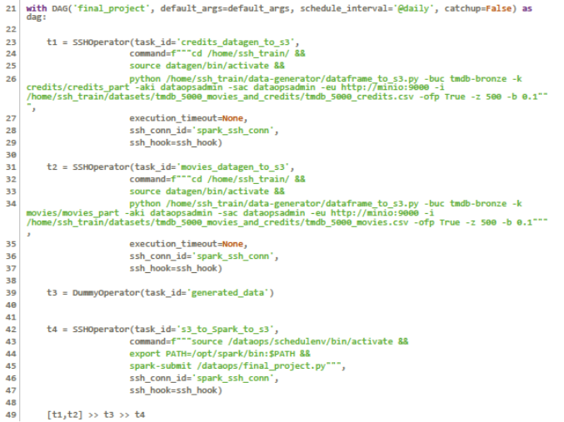
Airflow

Slide 6
data-generator to MinIO
[t1,t2]
spark_client container’ında :
git clone https://github.com/erkansirin78/data-generator.git
python dataframe_to_s3.py --help

Slide 7
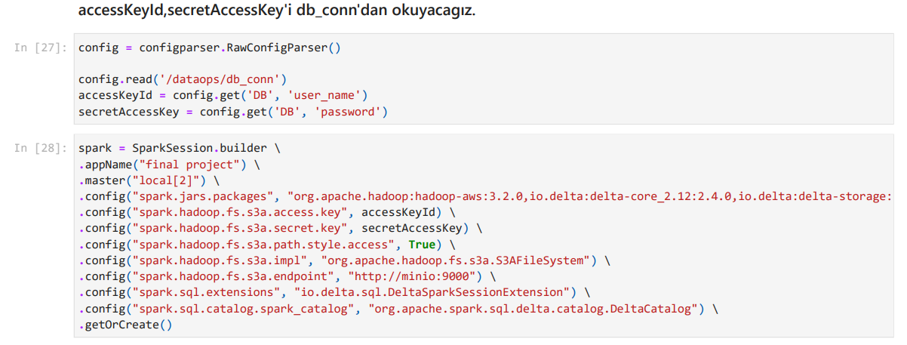
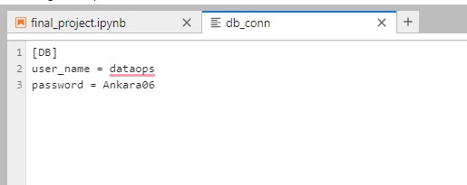
MinIO to Apache Spark

Slide 8
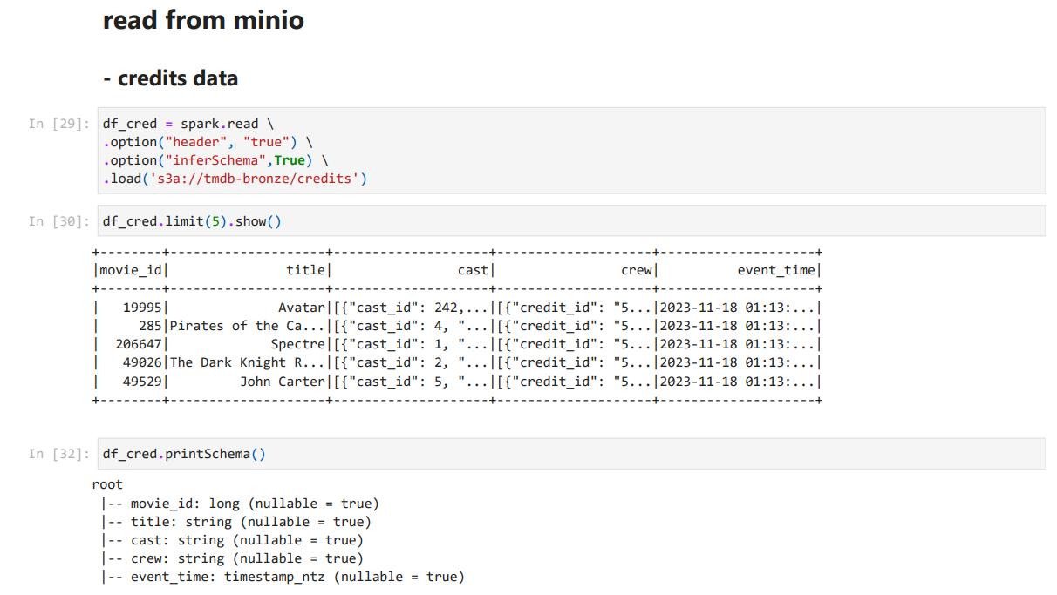
MinIO to Apache Spark

Slide 9
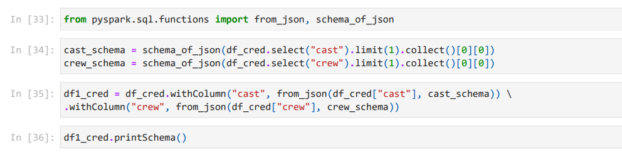
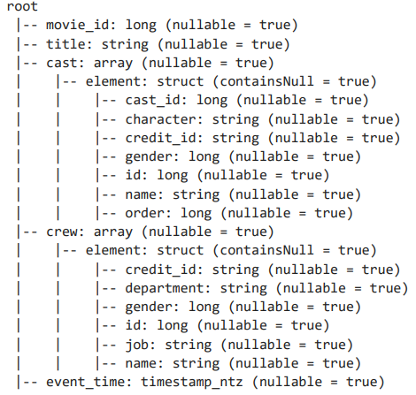
Apache Spark
cast ve crew sütunları → json structured
string → ArrayType(StructType())→ StructType()

Slide 10
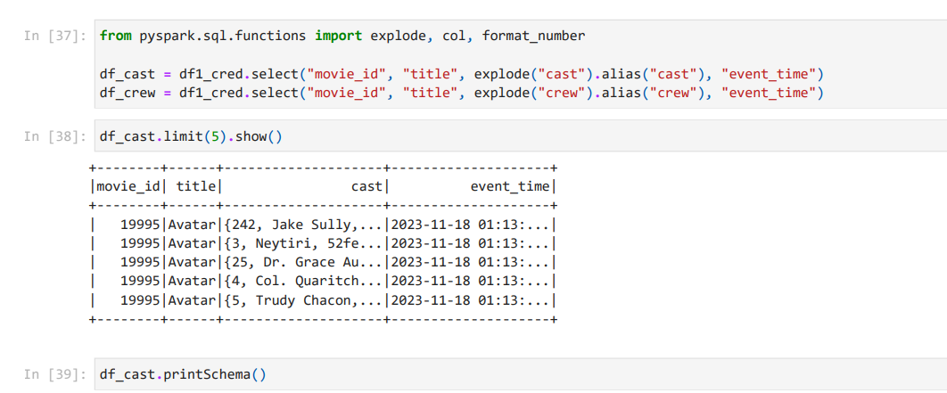
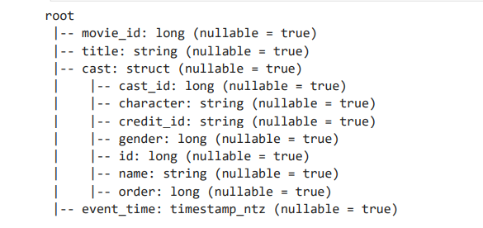
Apache Spark
cast ve crew sütunları → json structured
string → ArrayType(StructType())→ StructType()

Slide 11
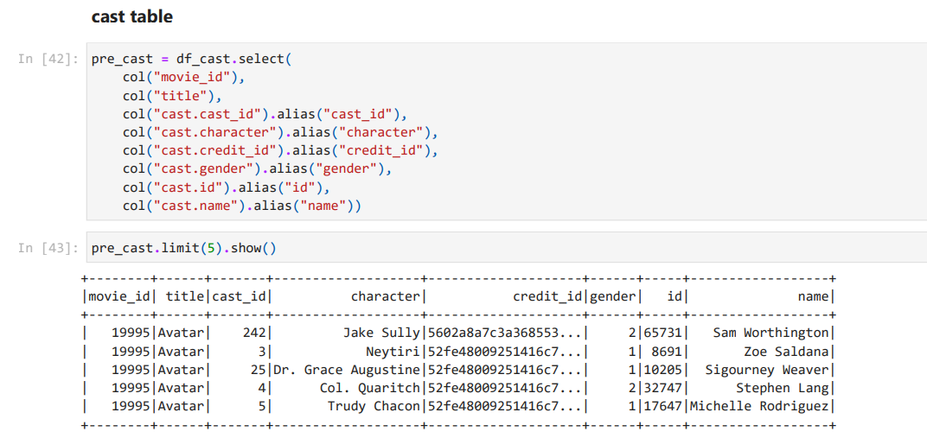
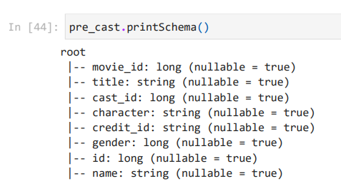
Apache Spark
cast ve crew sütunları → json structured
string → ArrayType(StructType())→ StructType()

Slide 12
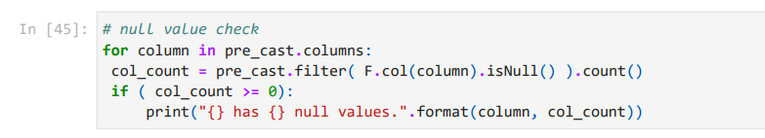
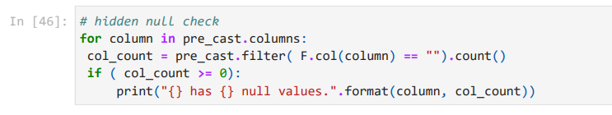
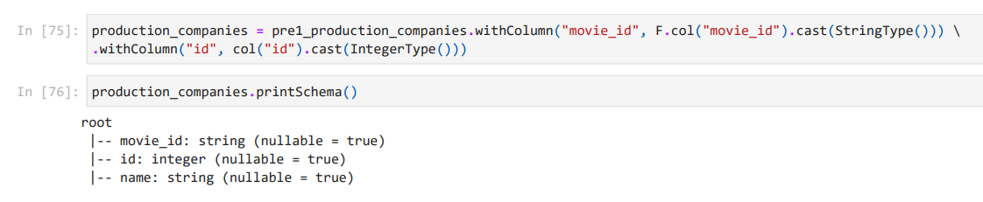
Apache Spark
null/hidden null check
ihtiyaç varsa data type conversion

Slide 13
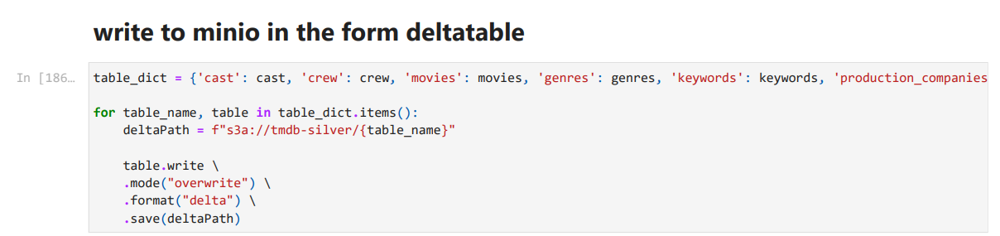
Apache Spark to MinIO

Slide 14
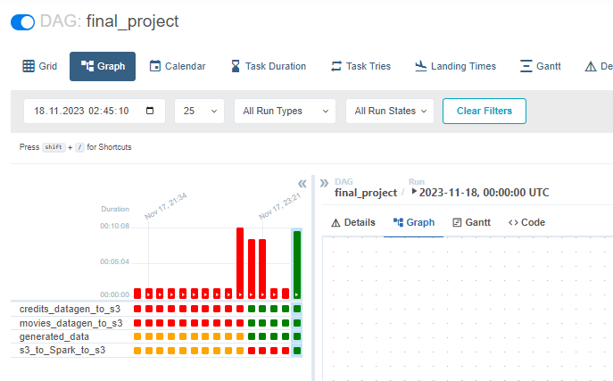
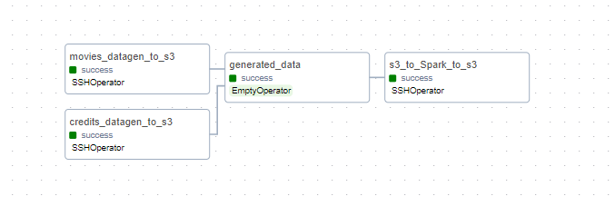
Apache Spark to MinIO

Slide 15
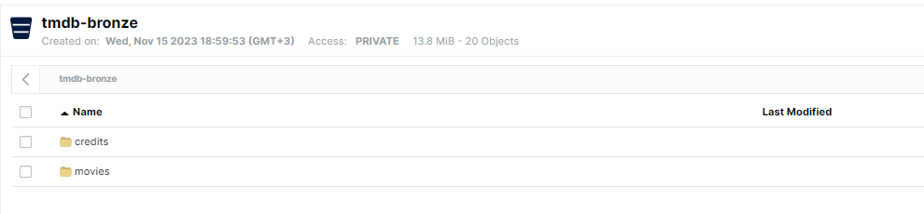
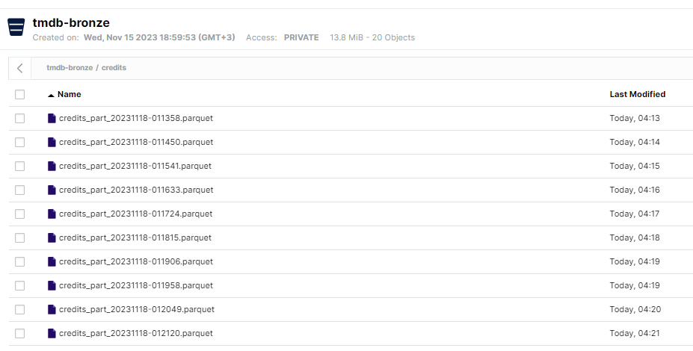
Bronze-Layer

Slide 16
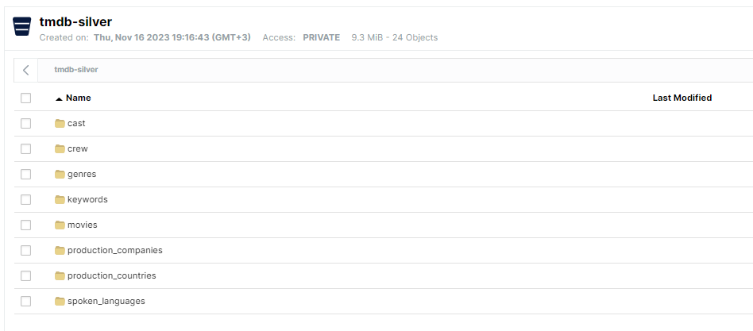
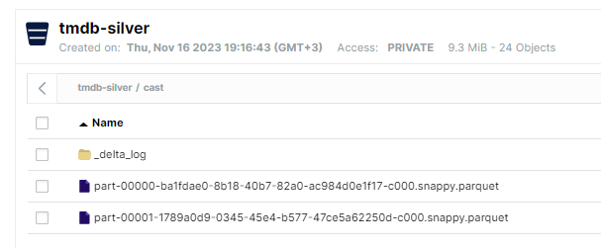
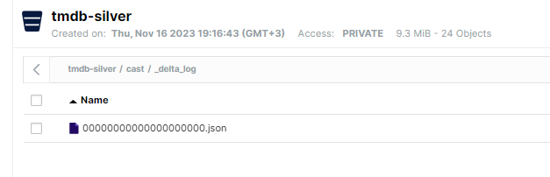
Silver-Layer

Slide 17
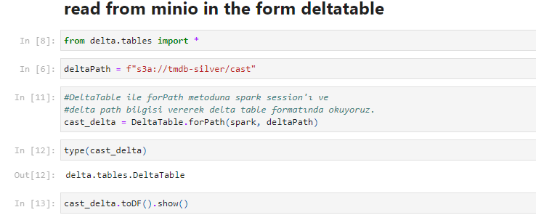
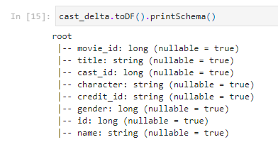
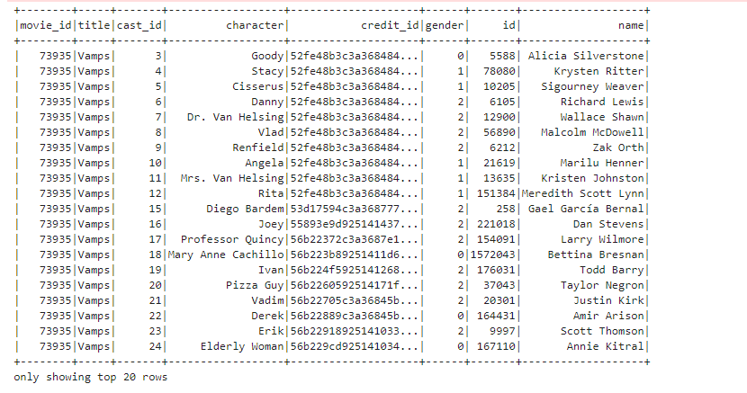
Silver-Layer

