Slide 1
«Why are citizens in some countries happier than others?»
Data : World Happiness Report 2015
Berfin Sarıoğlu

Slide 2
Variables
Country
Region
Happiness Score (0 to 10)
Economy (GDP per Capita)
Family (Social Support)
Health (Life Expectancy)
Freedom
Trust (Government Corruption)
Generosity

Slide 3
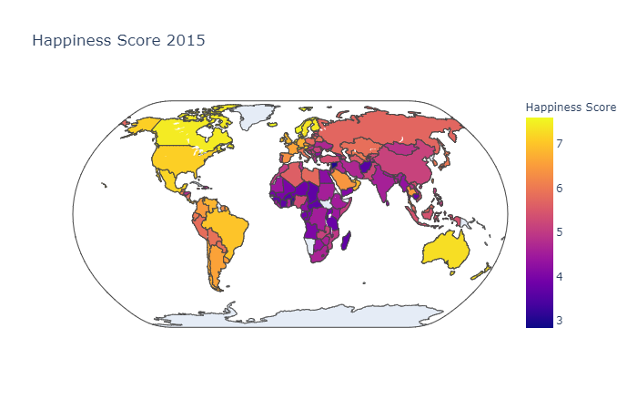
Choropleth-map for Happiness Score 2015

Slide 4
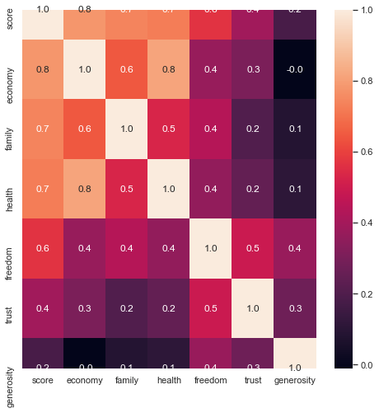
Heat Map

Slide 5
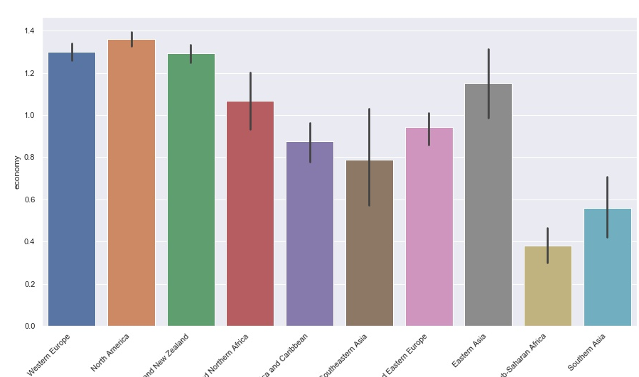
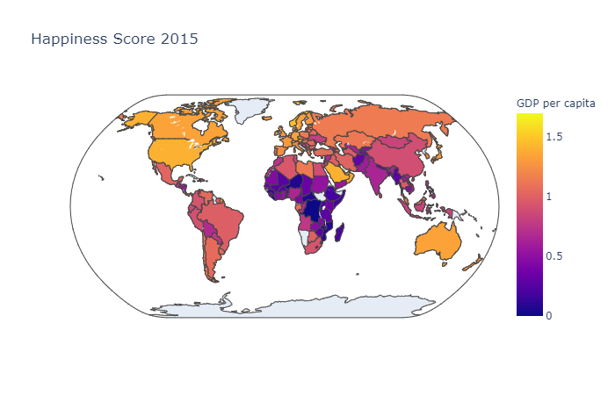
ECONOMY

Slide 6
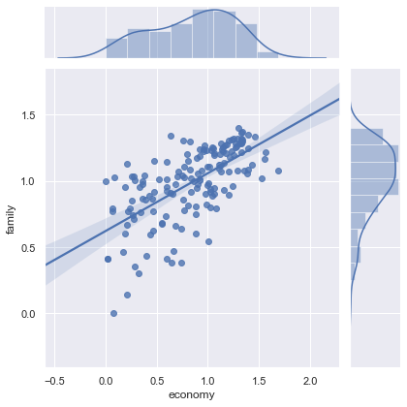
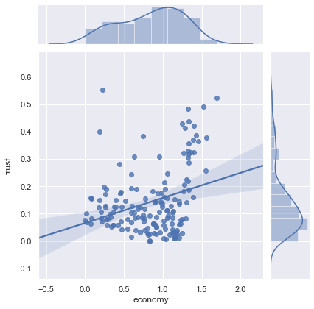
The relationship of the economy with trust and family

Slide 7
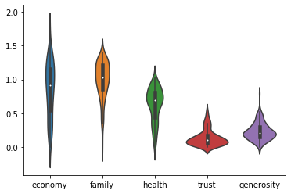
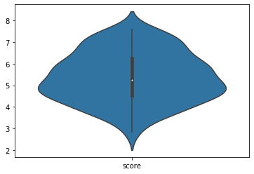
Variability range of values

Slide 8
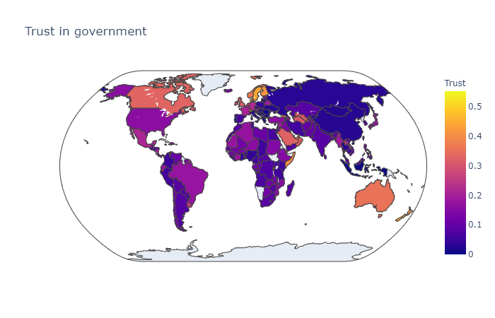
No trust in government all round the world, except Norway, Sweden, and Finland.

Slide 9
Future Work
Changing of happiness score by years
Correlation of happiness score with Covid-19
Correlation of happiness score with suicide rates
Differences between happiest countries like Sweden and Finland.

Slide 10
THANK YOU

