Slide 1

Improving Software Quality by Monitoring its Evolution
Expositor: Marco Orellana
1

Slide 2
Overview
Software produced by industry has many defects:
- Often of low quality
- Costly to maintain
Microsoft sponsored survey
Chilean companies spend 52.5 M USD to maintain their software
Urgent necessity for a practical solution to monitor and control software development quality
2

Slide 3
Current solutions
Rewrite of the software
Delegating the maintenance to specialized companies
Manually code review
Recurrent training of the programmers
Limited analysis tools
Drastic consequences with unaddressed quality problems
6

Slide 4
Our solution: QualityMonitor
Tools to monitor and control the quality of software
Real time monitoring of the quality
Metaphor: x-ray to identify tumors in human bodies
QualityMonitor: visualization to identify deficiencies in software
Based on more than 10 years of international research effort (150 articles)
7

Slide 5


Market Segment
Average income of Chilean companies
Export of the total production
Constant augmentation of 9% each year
Quality certification helps software companies increase their profits by reducing maintenance costs
9

Slide 6
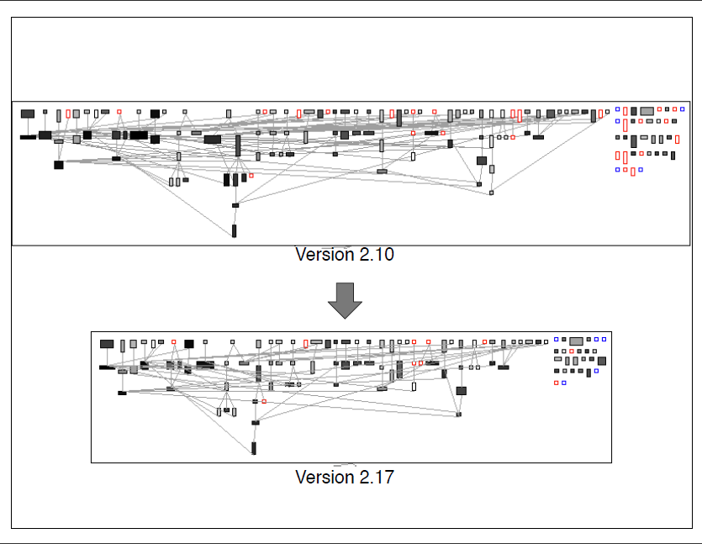
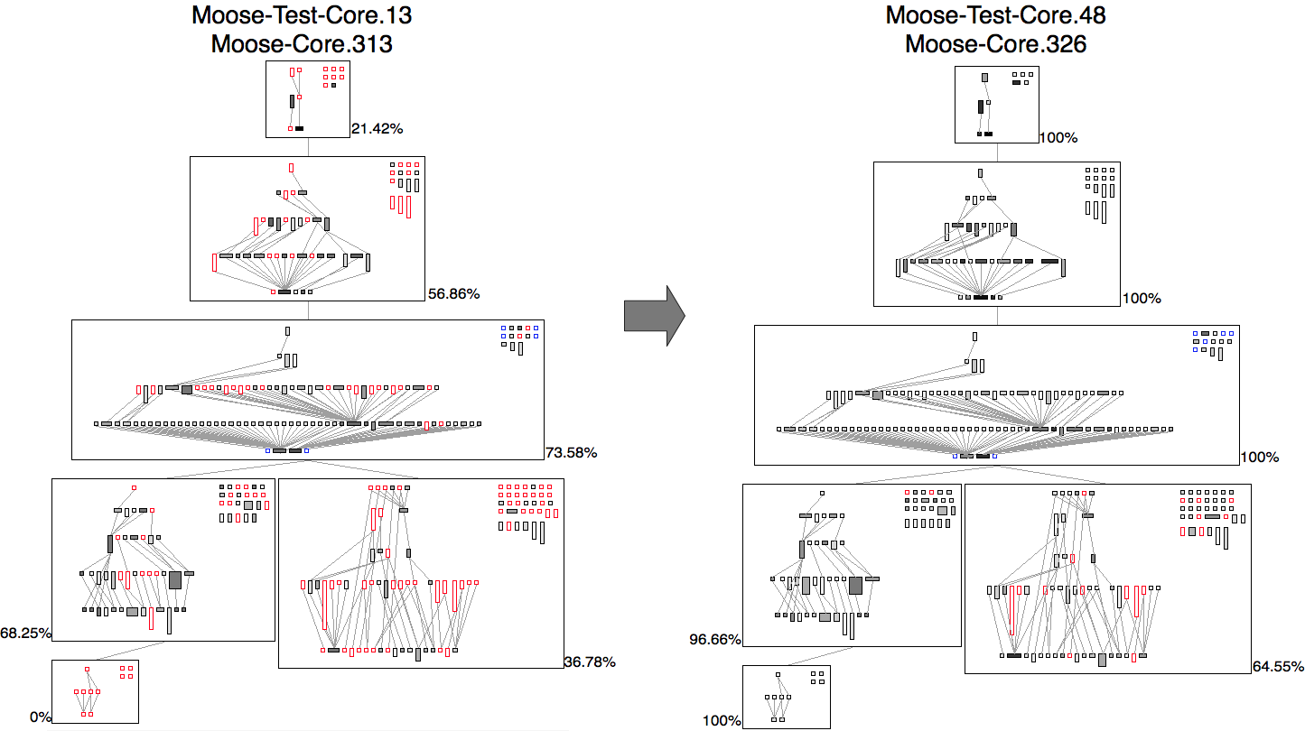
Software radiography
8

Slide 7
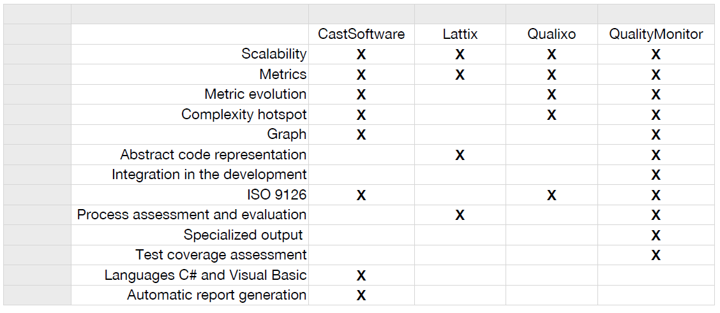
Our competitors
Other tools: Visio, pex, genexus, enterprise architect, …
10

Slide 8
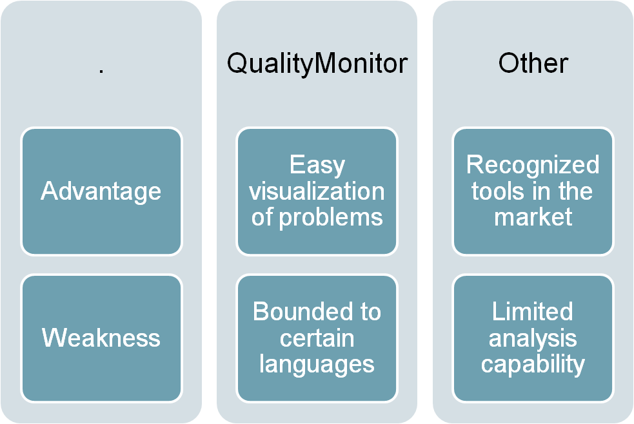
Our competitors
10

Slide 9
Service
Currently have a robust prototype
Tried in NIC-Chile, Caesar Systems, Renault, Airbus
Current try in “Compañia de Petroleos de Chile “(COPEC)
Today, significant effort is required by a company to use QualityMonitor
11

Slide 10
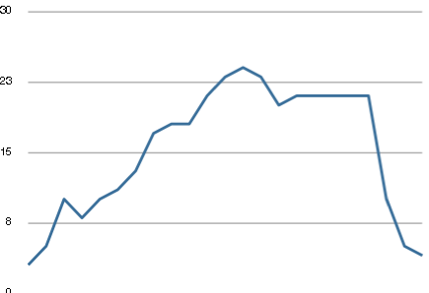
Case study: presence of bugs
Use of QualityMonitor
Used in NetStyle.ch
April 10
June 10
May 11
19
19

Slide 11
Benefits for a client
Savings for a 6-person Chilean company on a 7-month project: 9,800 USD
Validated by a controlled experiment
    Cost of Quality Monitor: 2,200 USD
    Quality Monitor reduced development time by one man-month
12

Slide 12
Business model
Clients will subscribe to the service
    Membership: client will regularly receive analyses of their software quality
    1,000 USD initial fees + 200 USD monthly
Clients will receive analyses and recommendations for improvement
Comparable prices with competitors
Key actors:
    software producers (clients)
    Incubator, Network for software improvements (SPIN, ACTI)
13

Slide 13


Market strategy: first stage
13

Slide 14




Market strategy: second stage
13

Slide 15
Our need
6 months are necessary for commercialization
Initial capital 175,000 USD
    90,000 USD from a Governmental grant
    15,000 USD from the Desafio Intel
    70,000 USD from other source
Economical indicators predicts a return on investment of 30%
NPV for QualityMonitor: 800,000 USD
14

Slide 16







Team
Prof. Dr. Alexandre Bergel
(scientific consulting, development)
Christian Palomares
(development)
Marco Orellana
(commercial, business plan)
Dr. David Rötlisberger
(scientific consulting, development)
15

Slide 17






Collaborators
17

Slide 18
Thanks for listening
18
18

Slide 19
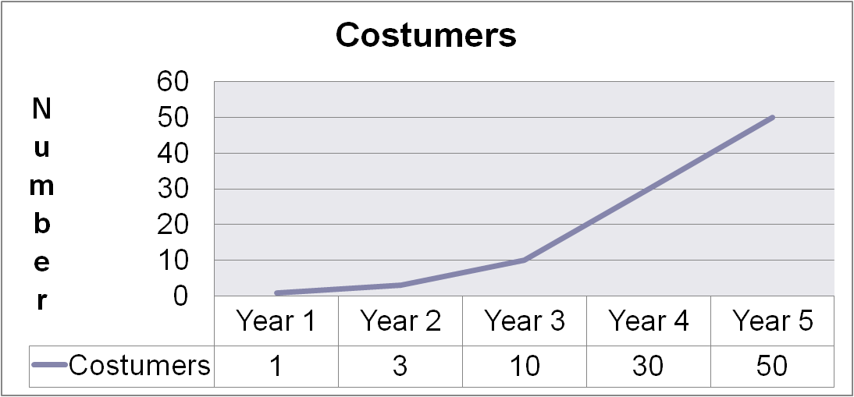
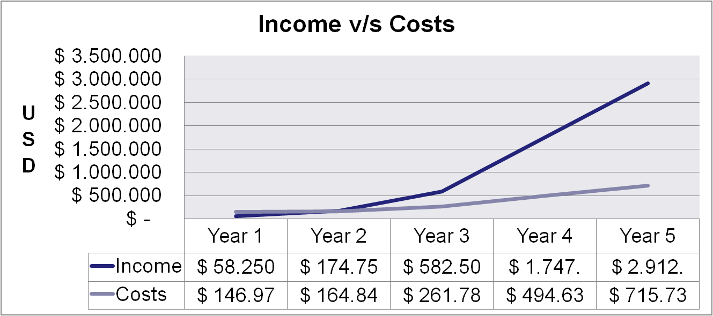
18
18

