Slide 1

Improving Software Quality by Monitoring its Evolution
Expositor: Marco Orellana

Slide 2








Team
Prof. Dr. Alexandre Bergel
Christian Palomares
Marco Orellana
Dr. D. Rötlisberger

Slide 3












Software ubiquity
Bancos
Retail
Telecomunicaciones
Minería

Slide 4

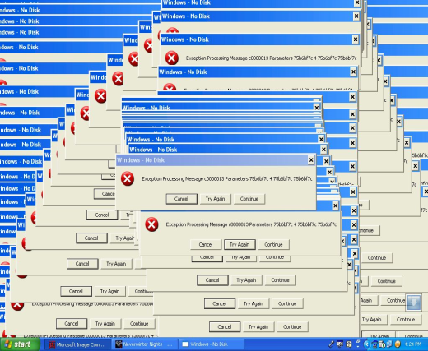


Necessity from the industry
50-70% of the cost of a development are spent on maintaining the software [Sommerville 2000]
Small and medium companies spend 52.5 M USD/year to maintain their software [Gechs 2010]

Slide 5
Grave consequences
High cost to replace software programmers
Often implying a complete rewrite of the software
Difficulty to maintain outsourced software (e.g., Codelco and Banco de Chile)

Slide 6
Current solutions
Frequent change of software
Delegating the maintenance to specialized companies
Manual revision of the software
Recurrent training of the programmers
Limited analysis tools

Slide 7
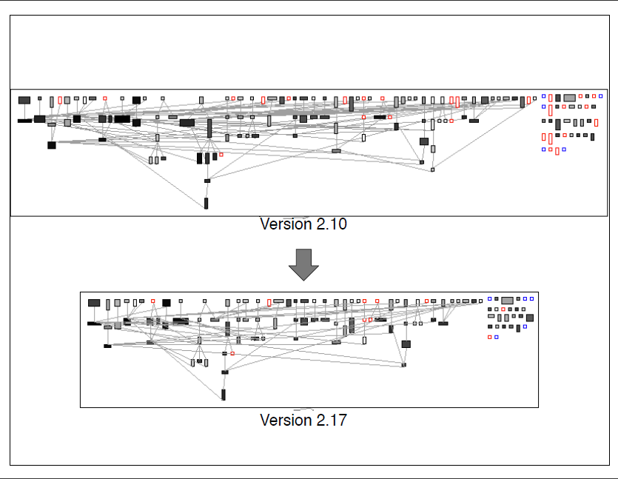
Our solution: QualityMonitor
Tools to monitor and control the quality of software
Real time monitoring of the quality

Slide 8
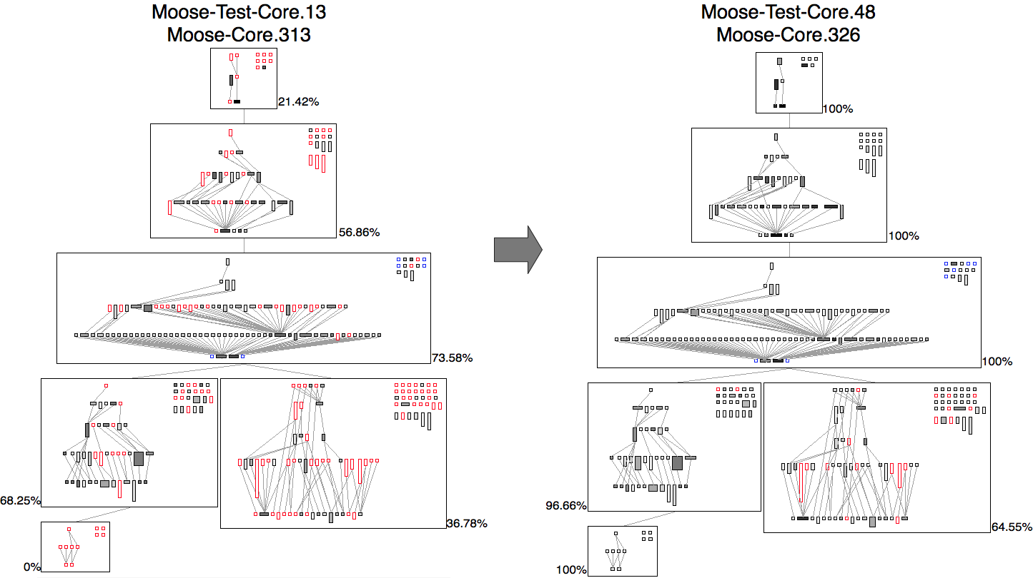
Software radiography
Result of a 10 years international research effort (150 articles)

Slide 9
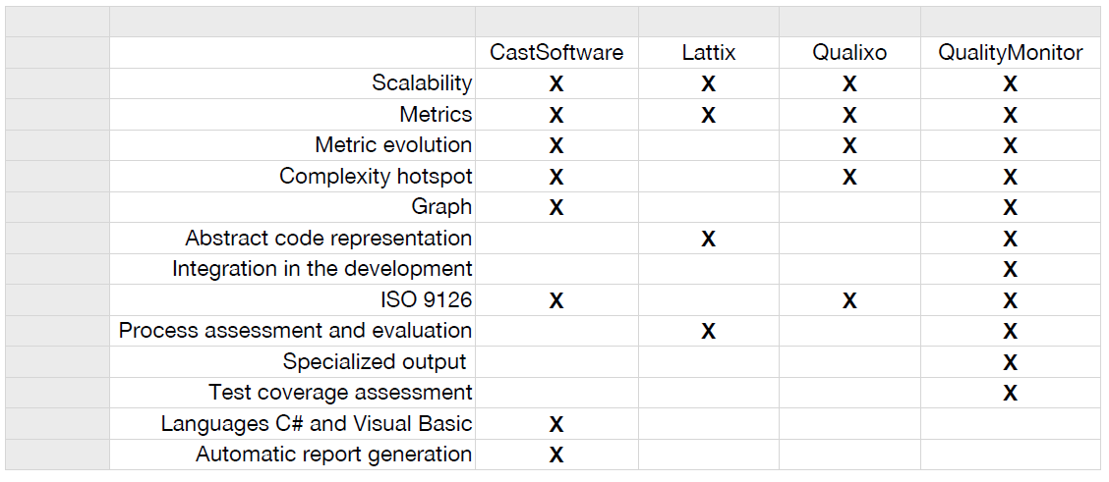
Our competitors

Slide 10


Market Segment
Constant augmentation of 9% each year
Quality certification are crucial for our customers to export

Slide 11


Robust prototype
Result of a major international effort:
Tried in NIC-Chile, Caesar Systems, Renault, Airbus
Current try in Compañia de Petroleos de Chile (COPEC)
Today, a significant effort is required by a company to use QualityMonitor

Slide 12
Our need
6 months are necessary for a commercialization
Initial capital 120,000 USD
  90,000 USD from a Governmental grant
  15,000 USD from the Desafio Intel
  5,000 USD from other source
We foresee a benefit net of 16,000 USD after 1 year
Economical metrics indicates a return on investment of 130%
La evaluación económica del proyecto para una tasa de retorno del 30% es de $USD800.000 a 5 años

Slide 13
Benefits for a client
Saving for a chilean company large of 6 persons, on a 7 months project: 9,800 USD
Indicated by a controlled experiment
  cost of Quality Monitor: 2,200 USD
  Estimation reduction of the development by 1 month

Slide 14







Collaborators

Slide 15
Thanks for listening

Slide 16
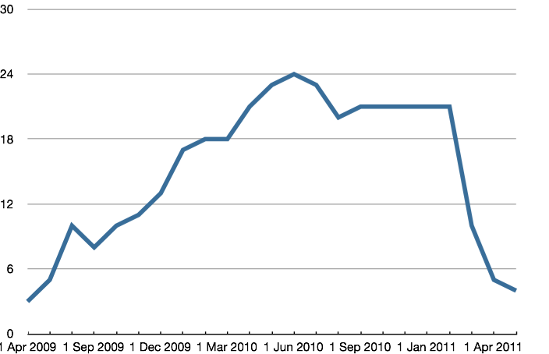
Evolution of bugs
Use of QualityMonitor

