Slide 1

Improving Software Quality by Monitoring its Evolution
Expositor: Marco Orellana
1

Slide 2
Overview
The software industry presents many deficiencies to produce
    software product
    software systems
Microsoft sponsored survey
Chilean companies spend 52.5 M USD to maintain their software
Urgent necessity for a practical solution to monitor and control software development
2

Slide 3
Current solutions
Rewrite of the software
Delegating the maintenance to specialized companies
Manually code review
Recurrent training of the programmers
Limited analysis tools
Drastic consequences with unaddressed quality problems
6

Slide 4
Our solution: QualityMonitor
Tools to monitor and control the quality of software
Real time monitoring of the quality
Metaphor: x-ray to identify tumors in human bodies
QualityMonitor: visualization to identify deficiencies in software
Based on more than 10 years of international research effort (150 articles)
7

Slide 5
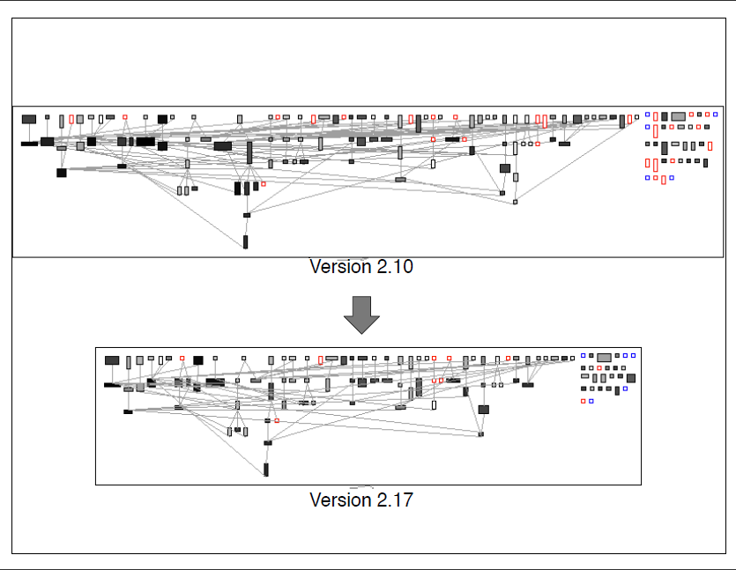
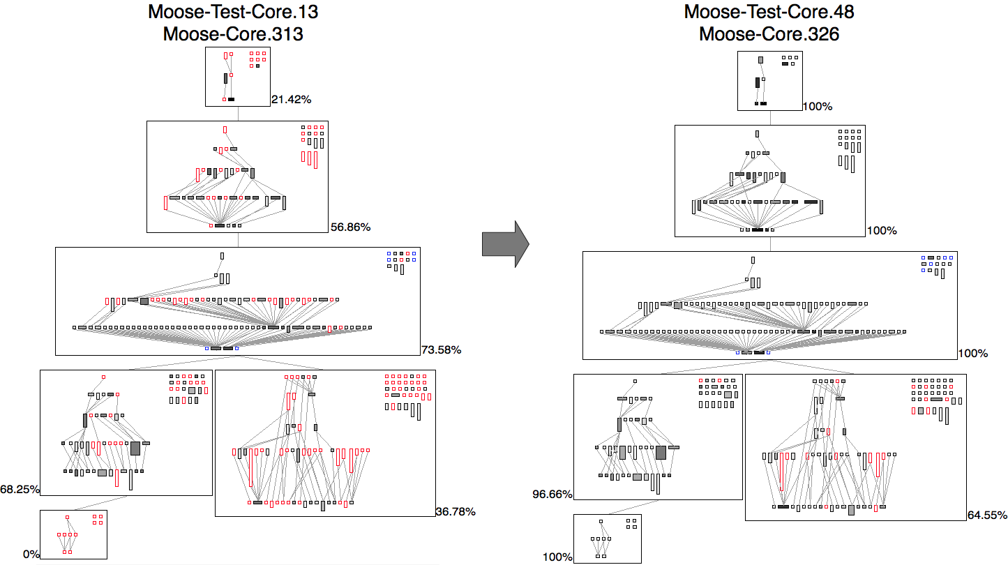
Software radiography
8

Slide 6


Market Segment
Average income of Chilean companies
Export of the total production
Constant augmentation of 9% each year
Quality certification are crucial for our customers to export
9

Slide 7
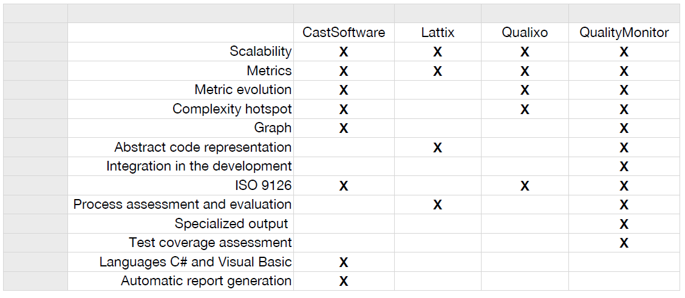
Our competitors
Other tools: Visio, pex, genexus, enterprise architect, …
10

Slide 8
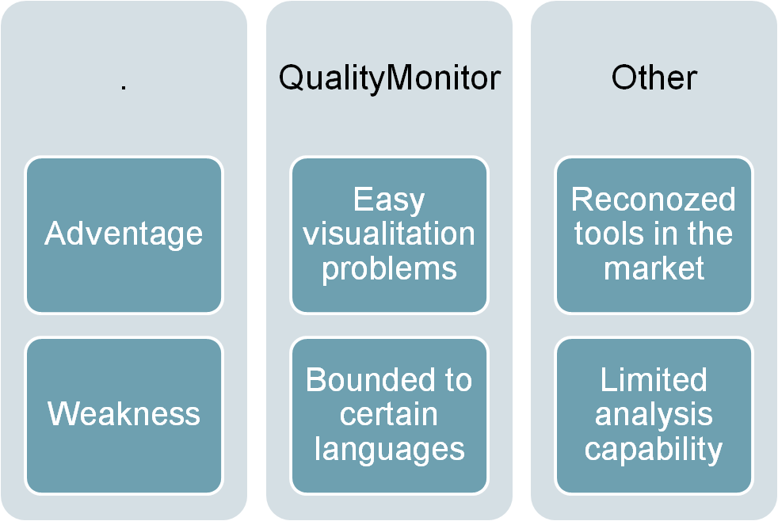
Our competitors
In the market there are various code analysis software, such as:Cast, Qualix, Lattix
Other tools: Visio, pex, genexus, enterprise architect, …
10

Slide 9
Service
Offered by a robust prototype
Tried in NIC-Chile, Caesar Systems, Renault, Airbus
Current try in “Compañia de Petroleos de Chile “(COPEC)
Today, a significant effort is required by a company to use QualityMonitor
11

Slide 10
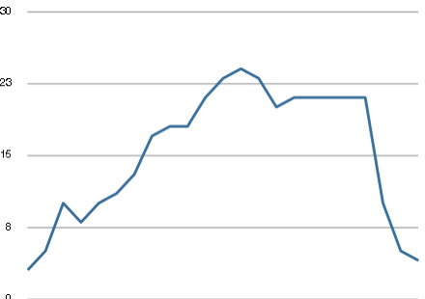
Case study: presence of bugs
Use of QualityMonitor
Used in NetStyle.ch
April 10
June 10
May 11
19
19

Slide 11
Benefits for a client
Saving for a chilean company large of 6 persons, on a 7 months project: 9,800 USD
Indicated by a controlled experiment
    cost of Quality Monitor: 2,200 USD
    Estimation reduction of the development by 1 month
12

Slide 12
Business model
Clients will subscribe to the service
    Membership: client will regularly receive analyses of a development
    1,000 USD initial fees + 200 USD monthly
Clients will receive analyses and recommendations for improvement
Comparable prices with competitors
Key actors:
    software producers (clients)
    Incubador, Network for software improvements (SPIN, ACTI)
13

Slide 13



Market strategy
13

Slide 14
Our need
6 months are necessary for a commercialization
Initial capital 175,000 USD
    90,000 USD from a Governmental grant
    15,000 USD from the Desafio Intel
    70,000 USD from other source
We foresee a benefit net of 16,000 USD after 1 year
Economical metrics indicates a return on investment of 130%
14

Slide 15







Team
Prof. Dr. Alexandre Bergel
(scientific consulting, development)
Christian Palomares
(development)
Marco Orellana
(commercial, business plan)
Dr. David Rötlisberger
(scientific consulting, development)
15

Slide 16
Financial aspect
Funds will be used in human resources
We need a working capital of 175.000 USD
Economical indicators predicts a return on investment of 30%
NPV for QualityMonitor: 800,000 USD
16

Slide 17







Collaborators
17

Slide 18
Thanks for listening
18
18

Slide 19












Software ubiquity
Bank
Retail
Telecomunication
Mining
3

Slide 20

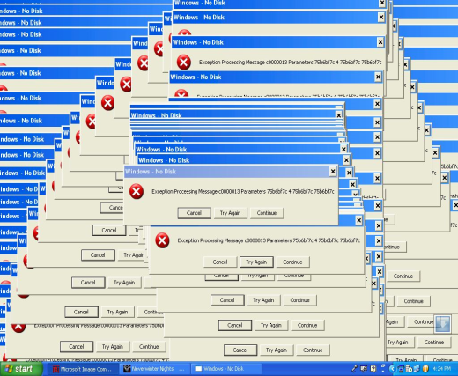


Necessity of the industry
50-70% of the cost of a development are spent on maintaining software [Sommerville 2000]
High cost to replace software programmers
Often implying a complete rewrite of the software
Difficulty to maintain outsourced software (e.g., Codelco and Banco de Chile)
5

