Slide 1
Layering Strategy
Manual layering (3 full days)
2 levels
  Individual class level
  Package level
References
  Our class-role labels
    e.g. Information Holders are more likely to be Business Entity
    e.g. SPs, COs are more likely to be Business Component
  SAD of K-9Mail
    https://k9mail.github.io/documentation/development.html
    Bagheri’s paper: “Software architectural principles in contemporary mobile software: from conception to practice”

Slide 2
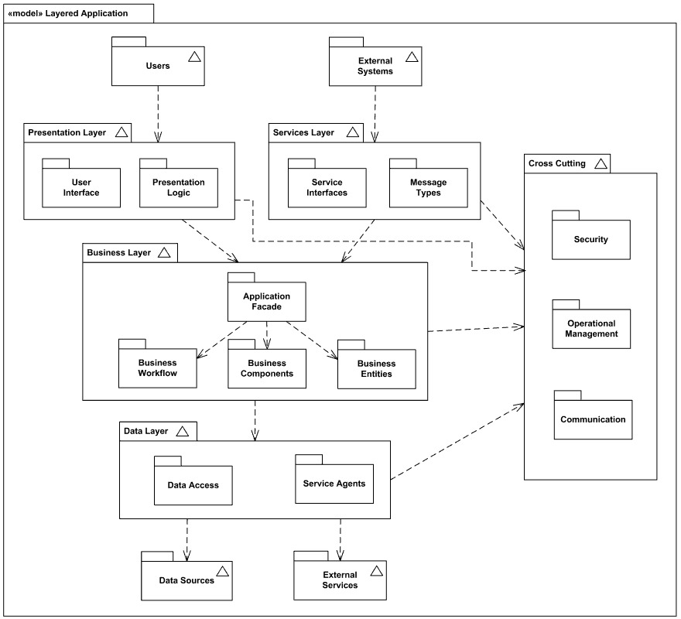
Layers
This is the reference layers
1. Presentation Layer
1.1. User Interface
1.2. User Interface Logic
2. Service Layer
2.1. Content Provider
2.2. Intent Provider
3. Business Layer
3.1. Business Facade
3.2. Business Work Flow
3.2.1. Scheduling
3.2.2. Talking with mail providers
3.2.3. MIME encoder | decoder
3.2.4. Other
3.3. Business Component
3.4. Business Entity Component
4. Data Access Layer
4.1. DAO Interface
4.2. DAO Implementation
5. Cross-cutting

Slide 3
All packages
K9mail-library
k9mail
mail
mail.filter
mail.oauth
mail.store
k9
autocrypt
mailstore
mail.helper
mail.power
account
cache
mailstore.migrations
mail.internet
mail.ssl
activity
controller
mailstore.util
mail.message
mail.store
(imap, pop2, webdav)
acitivity.compose
crypto
message
acitivity.loader
fragment
message.extractors
acitivity.misc
helper
message.html
acitivity.setup
helper.jsoup
message.quote
message.signature
ui
service
notification
ui.compose
setup
power
ui.crypto
search
preferences
ui.dialog
view
provider
ui.message
widget.list
remotecontrol
ui.messageview
search

Slide 4
Presentation Layer (1.)
Service Layer (2.)
Cross-cutting (5.)
user-interface (1.1.)
user-interface-logic (1.2.)
content provider (2.1.)
intent provider (2.2.)
layout (.xml files, .kt)
activity.*
ui.*
notification
provider.*
(Attachment, DecryptedFile, Account)
com.fsck.k9.intent.action.*
fragment.*
view
widget.list
com.fsck.k9.intent.extra
Business layer (3.)
Business Façade (3.1.)
controller.MessagingController
uses
controller.MessagingControllerCommand
Business Workflow (3.2.)
Business Entity Components (3.4.)
Scheduling (3.2.1.)
mail
mailstore
preferences
AlarmManager API
service.*
message.*
account
crypto
helper
cache
autocrypt
Talk with mail-providers (3.2.2.)
MIME encoder | decoder (3.2.3.)
Other (3.2.4.)
Business Components (3.3.)
mail.transport
mail.internet
search
mail.ssl
mail.power
mail.message
mail.store
(imap, pop2, webdav)
mail.helper
mailstore.migrations
mailstore.migrations
mail.oauth
mail_providers
mail.filter
power
(IdleManager)
k9
Data Access Layer (4.)
mailstore.util
mailstore
SQLiteDB

Slide 5
Presentation Layer
Service Layer
Cross-cutting
user-interface
user-interface-logic
ContentProvider
IntentProvider
Activity
Layouts
Activity
Fragment
Attachment, DecryptedFile, Account
EmailProvider
Business layer
AlarmManager API
Scheduling
K9AlarmManager
BootReceiver
CorerReceiver
System Intents
Encryption
mail.transport
encoder/decoder
mail_providers
mail.store
RemoteStore
decode mail from MIME
k9.mailstore
LocalStore, Local Folder, LocalBodyPart
encode email
mail.internet
Data Access Layer
LockableDatabase, StorageManager
SQLiteDB

