Slide 1
Some Useful Tools, Their Configurations, and More
ETG, Performance Capacity Management - Distributed
Xiaobo Zhang
First Edition: 8/27/2014
Last Update: 10/21/2021
Notes:
Use white title slide for printed presentations only. To print, use this title slide instead of the previous orange one to save toner.

Slide 2
Tools
You must be in local Administrators group to install software on your desktop/laptop.
Putty: Required.
WinSCP: Required.
Xming: Optional.
SAS9.4M6 Clients: New users required; Current users recommended.
SAS/EG: required.
Korn Shell: Optional.
MS Telnet client: Optional.
Notes:
Bullet slide example

Slide 3
Putty
The free telnet/SSH client to access our AIX SAS servers.
Available in Software Center.
Fiserv approved but unsupported.
Install it if necessary.
Notes:
Background information is available from the One Pager Document and the Solutions Consulting Proposal.

Slide 4
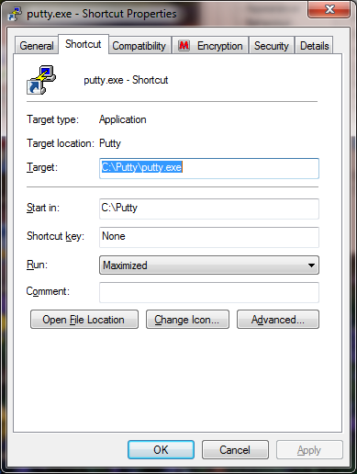
Putty
Maximize putty session by default.
Send a shortcut to your desktop, right click it, select “properties”. In its shortcut tab, set ‘Run: Maximized’
Notes:
Background information is available from the One Pager Document and the Solutions Consulting Proposal.

Slide 5
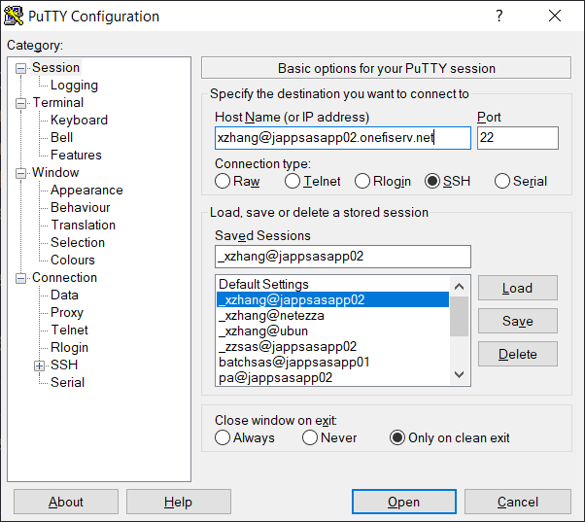
Putty
Define username@jappsasapp02.onefiserv.net in Host Name field.
Define its session name in Saved Sessions field.
Notes:
Background information is available from the One Pager Document and the Solutions Consulting Proposal.

Slide 6
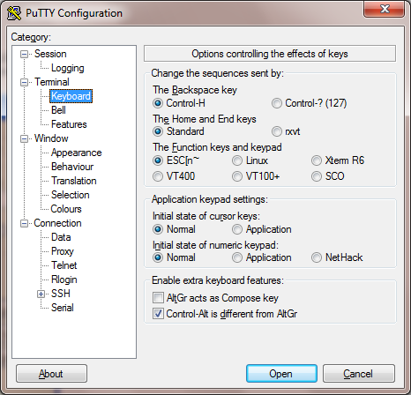
Putty
Click “Keyboard” and check “Control H” for Backspace Key.
Notes:
Background information is available from the One Pager Document and the Solutions Consulting Proposal.

Slide 7
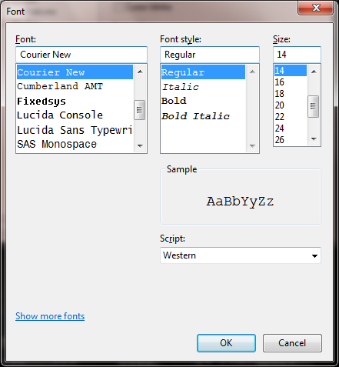
Putty
Click “Appearance”, then “Change” in “font setting”, make change accordingly. The default font size is 10. Suggest to make it 14.
Notes:
Background information is available from the One Pager Document and the Solutions Consulting Proposal.

Slide 8
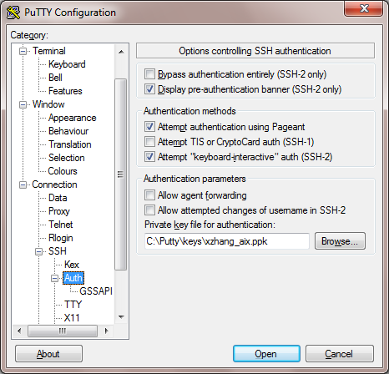
Putty
If you use key authentication, click “Connection/SSH/Auth”, define your private key .
Notes:
Background information is available from the One Pager Document and the Solutions Consulting Proposal.

Slide 9
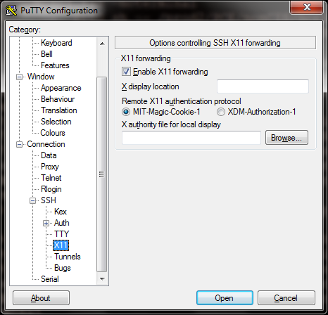
Putty
To support X terminal simulator such as Xming, click “Connection/SSH/X11”, check “Enable X11 forwarding”.
Notes:
Background information is available from the One Pager Document and the Solutions Consulting Proposal.

Slide 10
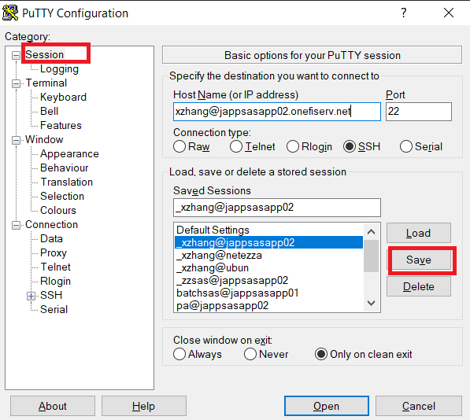
Putty
Make any other changes per your wish. After all changes, click “Session” and save it.
Notes:
Background information is available from the One Pager Document and the Solutions Consulting Proposal.

Slide 11
Putty
Example: double click my saved “putty” session to logon to it.
The session is maximized.
No need to type my username and password due to key authentication.
The back space key is fixed.
The font size is 14.
Supports the simulator of X terminal such as Xming.
More on k-shell settings.
Notes:
Background information is available from the One Pager Document and the Solutions Consulting Proposal.

Slide 12
Questions for putty

Slide 13
WinSCP
The free SFTP, SSH, FTP client to access our AIX SAS servers.
Available in Software Center.
Fiserv approved but unsupported.
Install it if necessary.
Notes:
Background information is available from the One Pager Document and the Solutions Consulting Proposal.

Slide 14
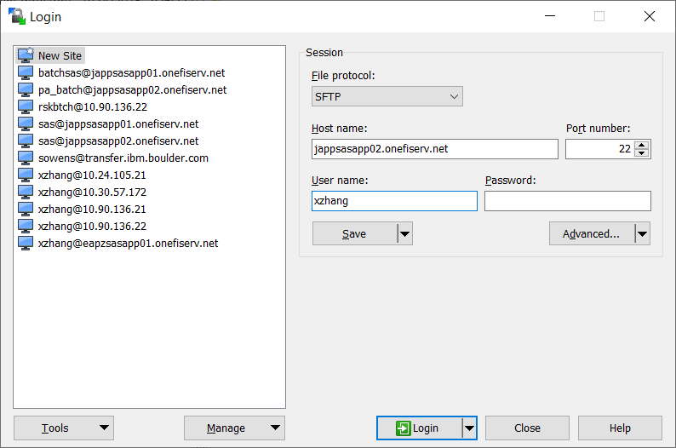
WinSCP
Click “New Site”, put jappsasapp02.onefiserv.net in “Host name” field and your IDM account name in “User name” field.
Notes:
Background information is available from the One Pager Document and the Solutions Consulting Proposal.

Slide 15
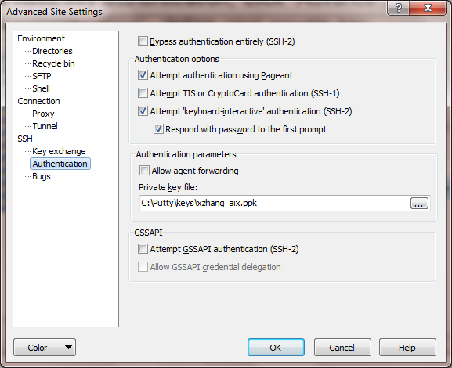
WinSCP
If you have key authentication, click “Advance”, then “SSH/authentication”, define your private key.
Notes:
Background information is available from the One Pager Document and the Solutions Consulting Proposal.

Slide 16
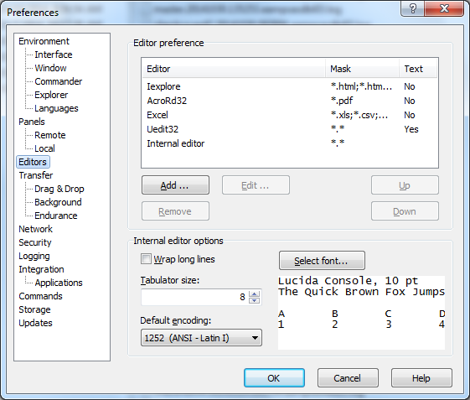
WinSCP
After login, select “Options/Preferences” (Ctrl+Alt+p), then click “Editors”.
Notes:
Background information is available from the One Pager Document and the Solutions Consulting Proposal.

Slide 17
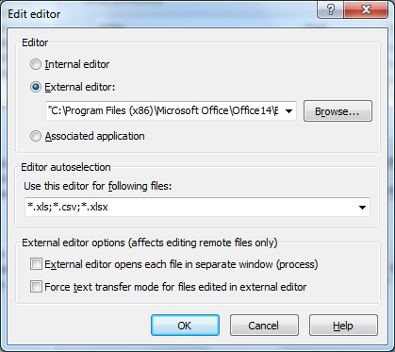
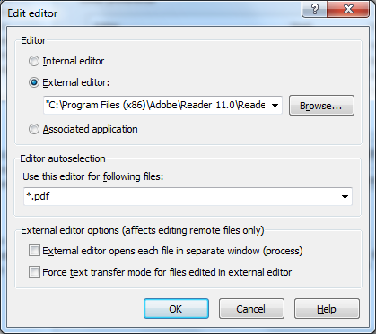
WinSCP
Add “Excel” for following files: *.xls;*.csv;*.xlsx.
Add “Adobe Reader” for *.pdf files.
Uncheck “Force text transfer mode for files edited in external editor”. Otherwise, it won’t open PDF/Excel file on server end correctly.
Notes:
Background information is available from the One Pager Document and the Solutions Consulting Proposal.

Slide 18
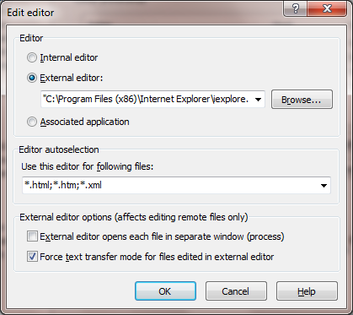
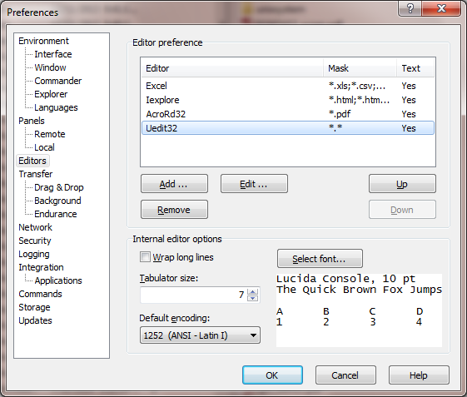
WinSCP
Add IE for following files: *.html;*.htm;*.xml.
If you have UE or other preferred text editor, add it for all other files in the bottom. Otherwise, WinSCP will use its own text editor for all other files.
Notes:
Background information is available from the One Pager Document and the Solutions Consulting Proposal.

Slide 19
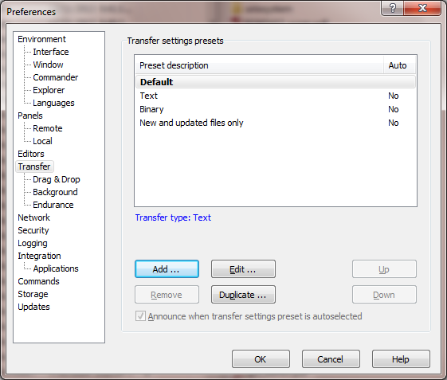
WinSCP
Click “Transfer”, make sure “Default” is highlighted.
Click “Add” if this is your first time setup. Otherwise, click “Edit”.
Notes:
Background information is available from the One Pager Document and the Solutions Consulting Proposal.

Slide 20
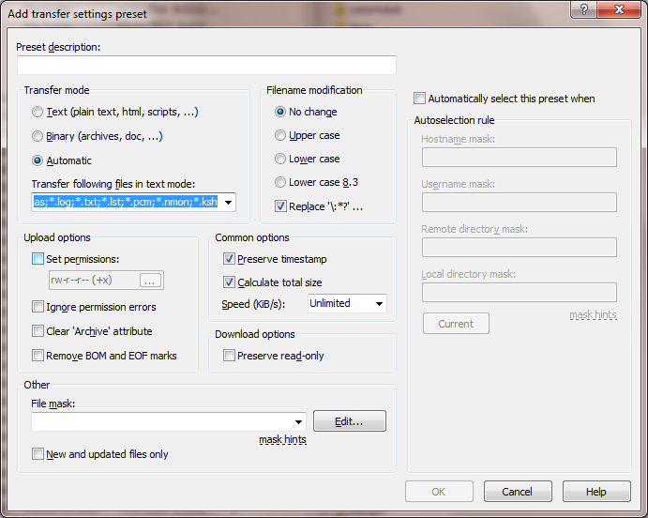
WinSCP
Click “Automatic”, then add following file types to “Transfer following files in text mode”: *.html; *.htm; *.xtml; *.cfg; *.csv; *.sas; *.log; *.txt; *.lst; *.ksh (modify accordingly)
Notes:
Background information is available from the One Pager Document and the Solutions Consulting Proposal.

Slide 21
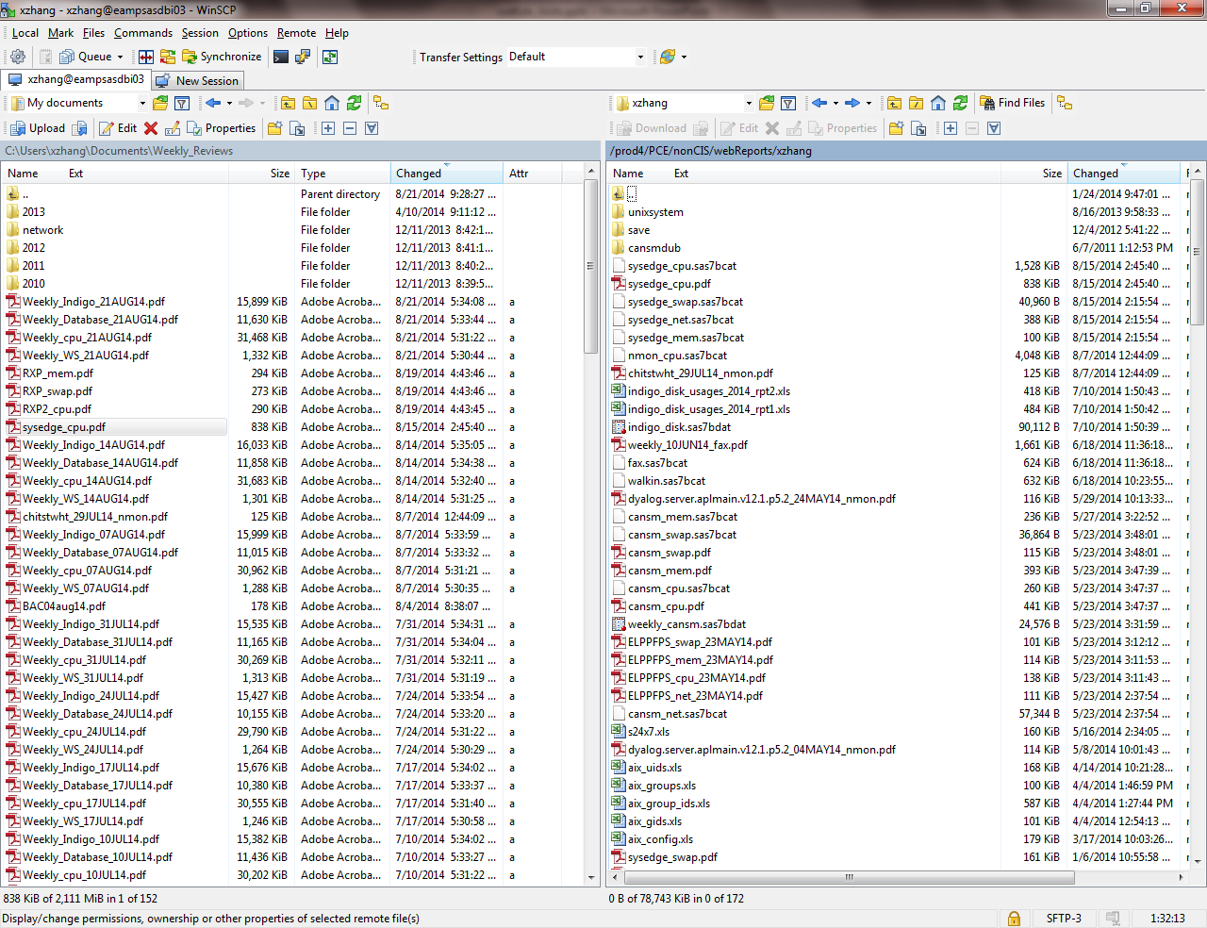
WinSCP
After login, your local PC is on left hand site and AIX server is on right hand site.
New WinSCP version supports multiple sessions. Click “New Session” tab to show new WinSCP login page to open new session.
Notes:
Background information is available from the One Pager Document and the Solutions Consulting Proposal.

Slide 22
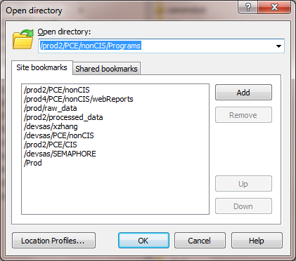
WinSCP
Bookmark your favorite locations: Click “Open directory” icon, type the target directory you want WinSCP to remember for you, then click “Add”.
WinSCP will remember all configurations automatically.
Notes:
Background information is available from the One Pager Document and the Solutions Consulting Proposal.

Slide 23
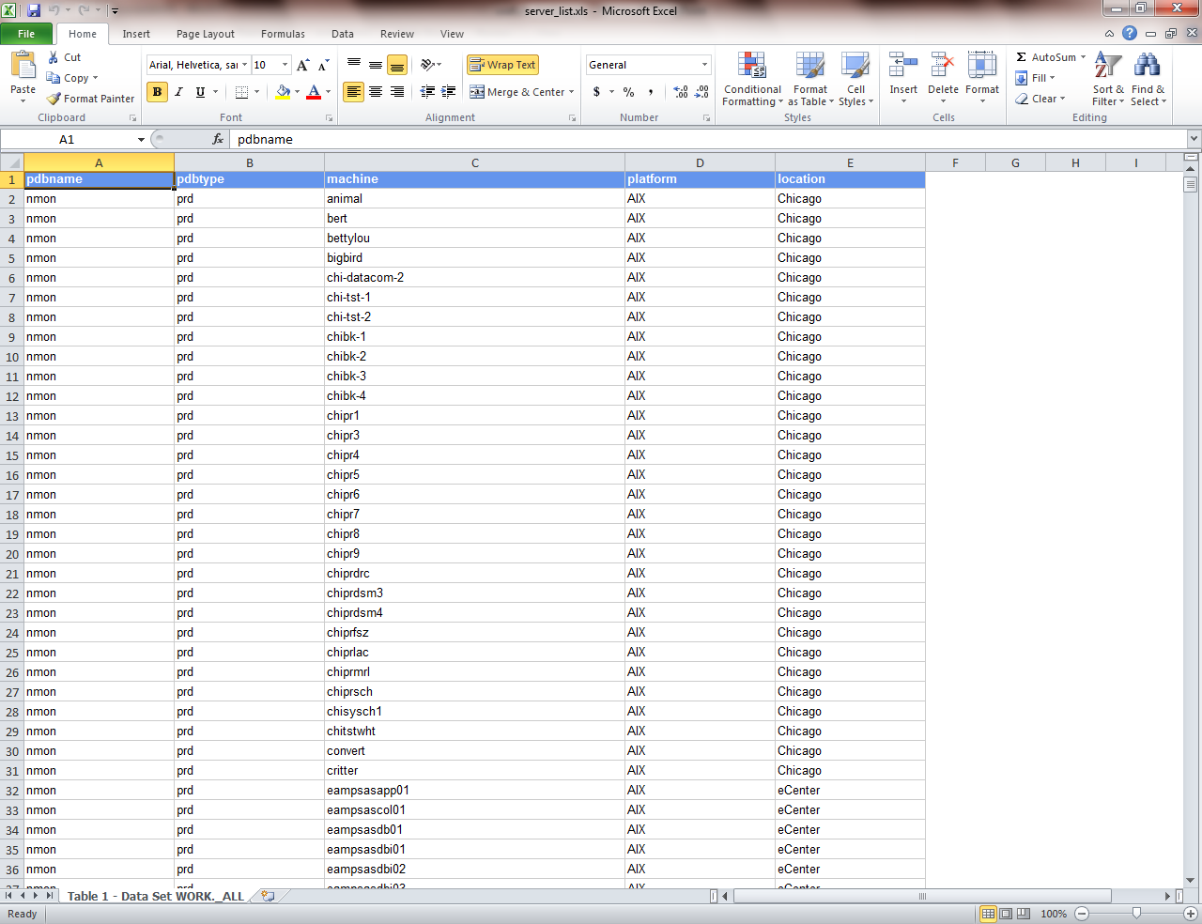
WinSCP
Example: Double click Excel file on AIX server to open it directly.
Notes:
Background information is available from the One Pager Document and the Solutions Consulting Proposal.

Slide 24
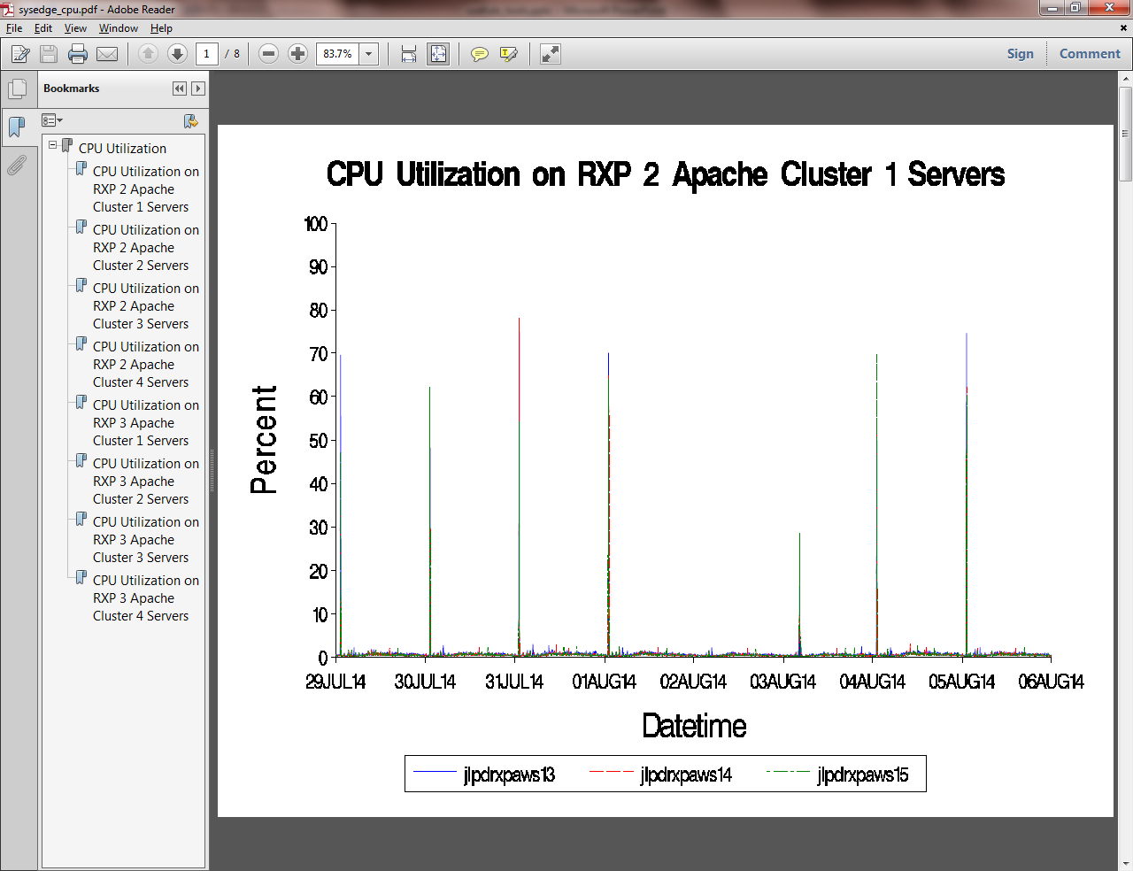
WinSCP
Example: Double click PDF file on AIX server to open it directly.
Notes:
Background information is available from the One Pager Document and the Solutions Consulting Proposal.

Slide 25
Questions for WinSCP

Slide 26
Xming
Free X terminal simulator.
Download site: http://sourceforge.net/projects/xming/
Fiserv approved but unsupported.
Remember to check “Enable X11 forwarding”.
Notes:
Background information is available from the One Pager Document and the Solutions Consulting Proposal.

Slide 27
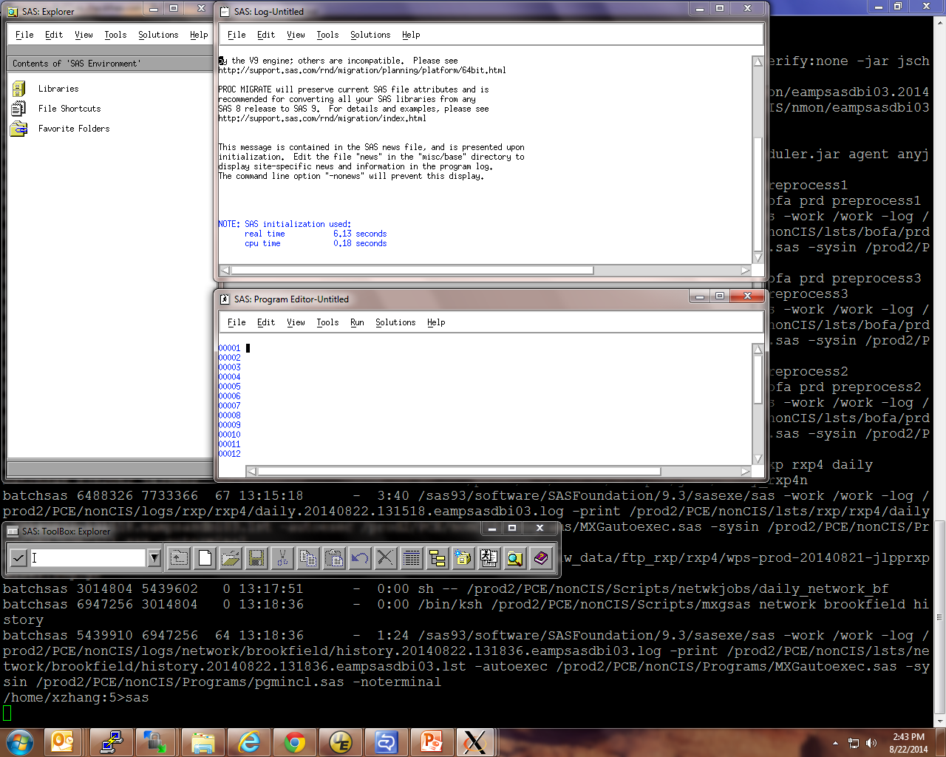
Xming
Example: Double click Xming icon to lunch it before you invoke X terminal application.
Invoke X terminal application such as “SAS” and it will show in Xming windows.
Notes:
Background information is available from the One Pager Document and the Solutions Consulting Proposal.

Slide 28
Questions for Xming

Slide 29
SAS9.4M6 Clients
If necessary, open your Windows Explorer and create a directory to save SAS depot. It is “C:\Users\xzhang\Documents\SAS_Clients” in my case.
Connect your WinSCP session to JAPPSASAPP02. On right hand side (remote server), go to “/home/sas_depot94m6”. On left hand side (your PC), go to the newly created depot directory.
Highlight SAS_Enterprise_Guide_Independent_Installer on right hand side and either drag and drop it to left hand side or click “Download” icon to download it. See the screenshot in next slide.
Repeat above step for SAS_Add-In_for_Microsoft_Office_Independent_Installer folder if necessary.
You will need Admin credentials for installation.
Notes:
Background information is available from the One Pager Document and the Solutions Consulting Proposal.

Slide 30
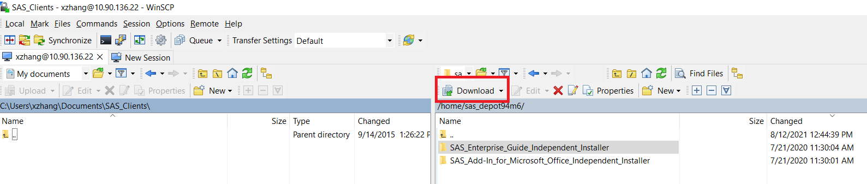
SAS9.4M6 Clients
Notes:
Background information is available from the One Pager Document and the Solutions Consulting Proposal.

Slide 31
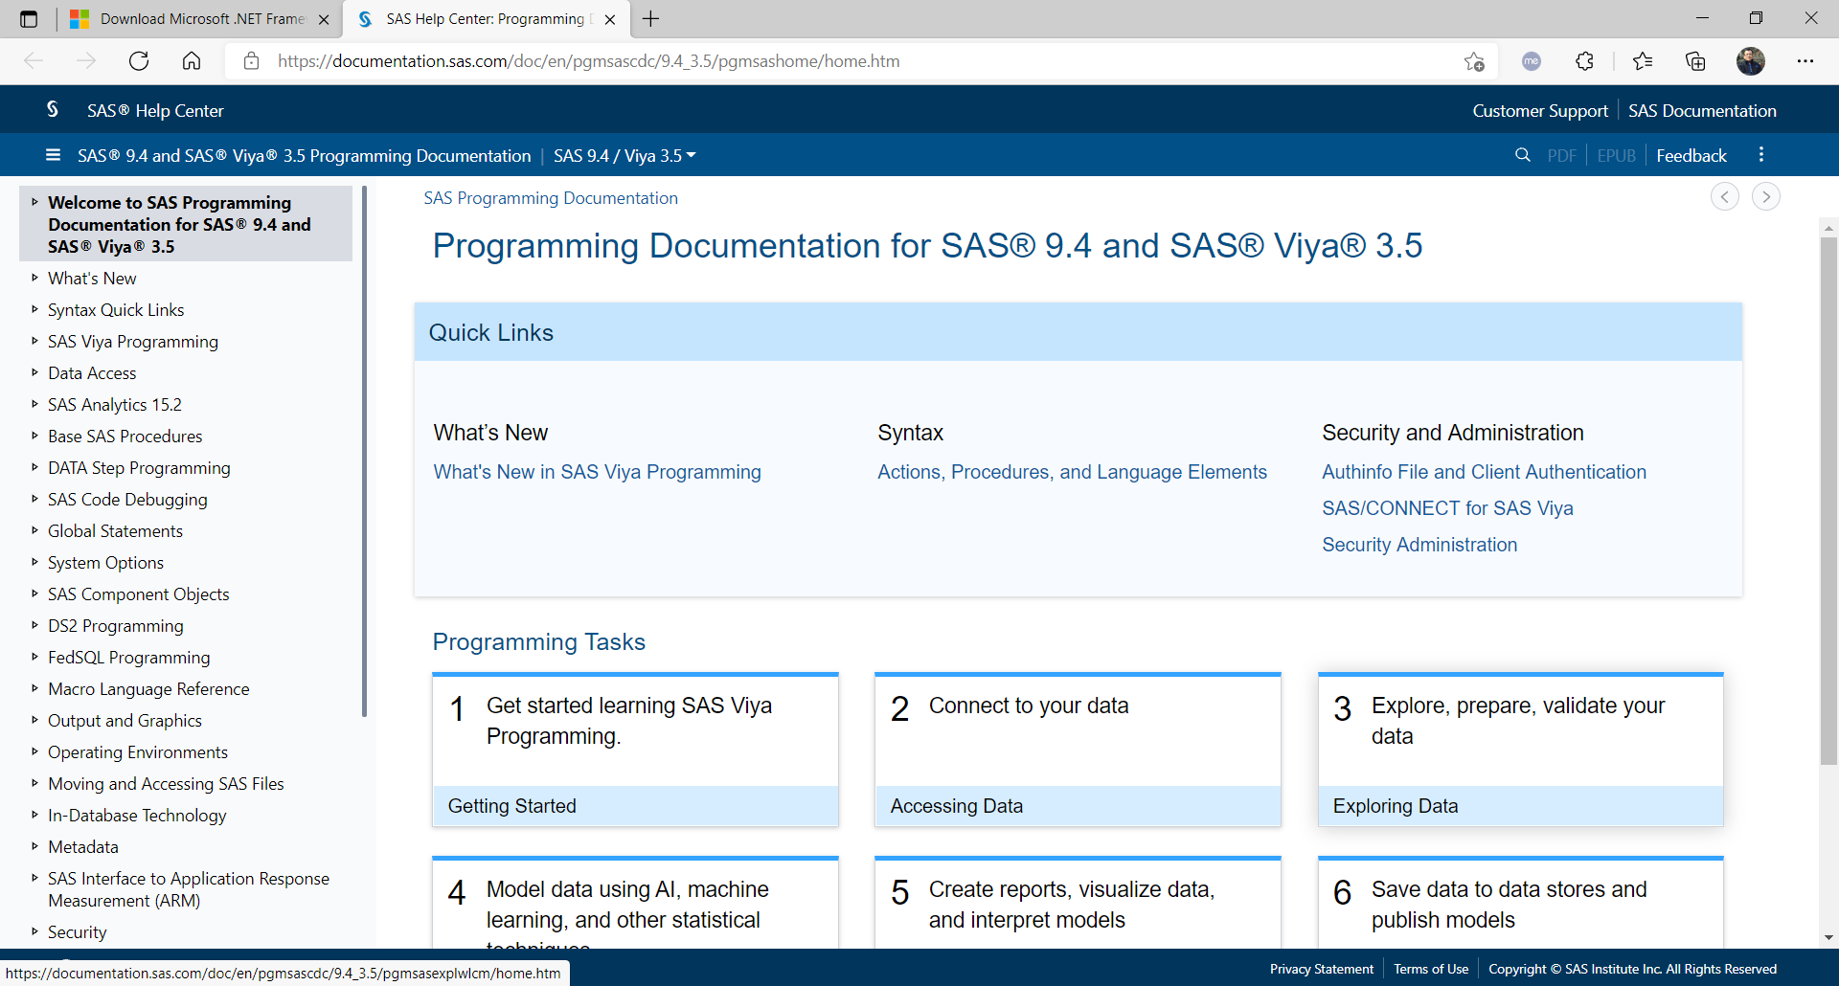
SAS9.4M6 Clients
SAS9.4 doesn’t come with CHM documentation file as SAS9.3 does. Here is the link to SAS9.4 online documentation: SAS Help Center: Programming Documentation for SAS 9.4 and SAS Viya 3.5.
Notes:
Background information is available from the One Pager Document and the Solutions Consulting Proposal.

Slide 32
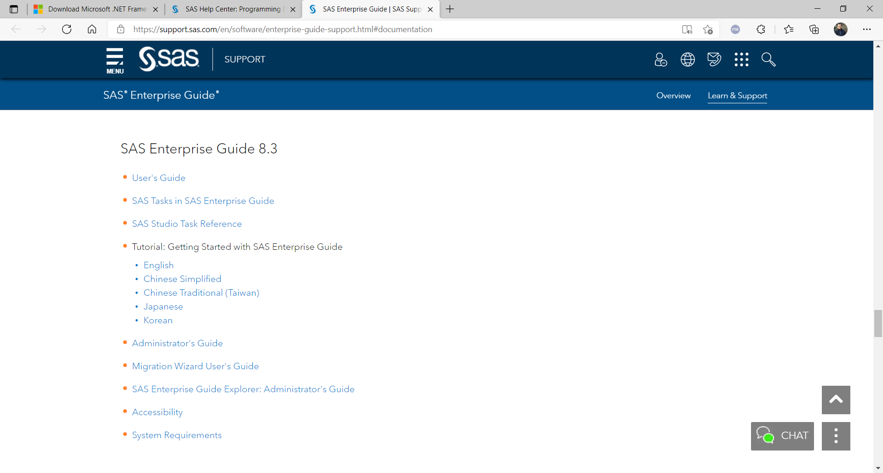
SAS9.4M6 Clients
If you are new to SAS EG, here is the link to the tutorial of SAS EG8: SAS Enterprise Guide | SAS Support.
Notes:
Background information is available from the One Pager Document and the Solutions Consulting Proposal.

Slide 33
Questions for SAS9.4M6 Clients

Slide 34
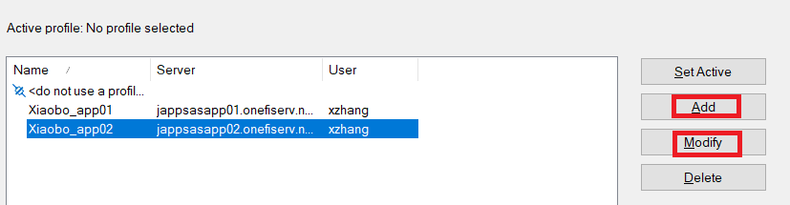
SAS/EG: Profile Setup
After EG installation, you will get connection prompt for the first time to invoke SAS/EG session. Click “Yes”
Otherwise, click “Tools/Connections”, then “Add” for new connection or “Modify” for current connection.
Notes:
Background information is available from the One Pager Document and the Solutions Consulting Proposal.

Slide 35
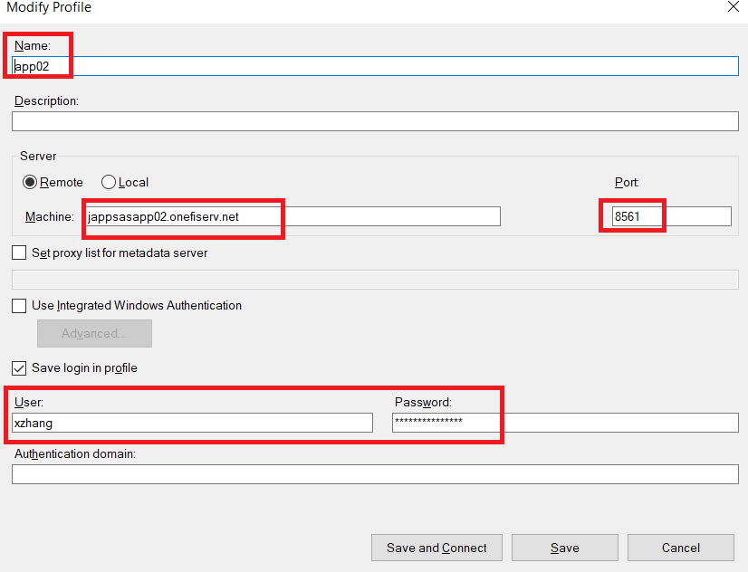
SAS/EG: Profile Setup
Put necessary information as below (app02, jappsasapp02.onefiserv.net, 8561, your IDM account, your IDM password).
The IP of jappsasapp02 is 10.90.136.22 in case you prefer IP.
Click “Save and Connect”.
Click “Close” next.
Notes:
Background information is available from the One Pager Document and the Solutions Consulting Proposal.

Slide 36
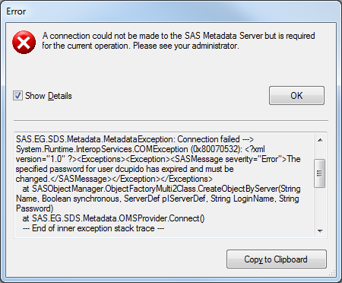
SAS/EG: Error caused by expiring password
You have an expiring password if your EG session stops working and you get following error message: “The specified password for user xxxxxx has expired and must be changed”. Follow instructions in “Fiserv IDM Account” to reset your IDM password if necessary.
Notes:
Background information is available from the One Pager Document and the Solutions Consulting Proposal.

Slide 37
SAS/EG
Declaration
For maintenance reason, it is scheduled to recycle SAS services at 3:05am (ET) daily. Most likely, your overnight long running EG session will be terminated during the recycle period.
SAS/EG session is not for long running job. Please work with Xiaobo to schedule batch job if necessary.
I am not a SAS/EG expert, hence I won’t provide EG programming support.
Here is the link to the tutorial of SAS EG8 : SAS Enterprise Guide | SAS Support.
Notes:
Background information is available from the One Pager Document and the Solutions Consulting Proposal.

Slide 38
Questions for SAS/EG

Slide 39
Korn Shell
Korn Shell is the operating system (shell) on our AIX SAS servers.
Published by David Korn of Bell Lab in 1983.
A superset of Bourne shell, with some best features of C shell.
Notes:
Background information is available from the One Pager Document and the Solutions Consulting Proposal.

Slide 40
Korn Shell
The “.profile” file inside user’s home directory is the configuration file to define the values of KornShell reserved variables.
The “.kshrc” file is to define aliases in my case.
They are hidden files to be shown by “ls –al” (list all files in long format)
The default “.profile” file only checks your AIX email.
PATH=$PATH:/u/secapl:.
export PATH
if [ -s "$MAIL" ] # This is at Shell startup. In normal
then echo "$MAILMSG" # operation, the Shell checks
fi # periodically.
There is no default .kshrc file.
The changes in .profile and/or .kshrc files will be effective in your next logon.
Notes:
Background information is available from the One Pager Document and the Solutions Consulting Proposal.

Slide 41
Korn Shell
Below are some of my “.profile” definitions.
set –o allexport
umask 002
PATH=/bin:/usr/bin:/etc:/usr/ucb:/usr/bin/X11:/usr/local/bin
PATH=$PATH:/sas93/software/SASFoundation/9.3:/prod2/PCE/nonCIS/Scripts:./
HISTFILE=$HOME/history/.history$$
HISTSIZE=500
FCEDIT=vi
set -o vi
ENV=$HOME/.kshrc
export PATH HISTFILE
PS1='$PWD:!>'
Notes:
Background information is available from the One Pager Document and the Solutions Consulting Proposal.

Slide 42
Korn Shell
set –o allexport
Export the value, data type, and attributes of every variable defined in .profile to be used by your (child) scripts.
umask 002
File creation mask. 002 means owner and group have NO restricted access to created files; others is restricted to write access.
PATH=/bin:/usr/bin:/etc:/usr/ucb:/usr/bin/X11:/usr/local/bin
Paths for most commonly used AIX commands.
PATH=$PATH:/sas93/software/SASFoundation/9.3:/prod2/PCE/nonCIS/Scripts:./
Add following 3 paths: SAS9.3, Scripts path for Capacity group, current directory.
/sas93/software/SASFoundation/9.3
/prod2/PCE/nonCIS/Scripts
./
Notes:
Background information is available from the One Pager Document and the Solutions Consulting Proposal.

Slide 43
Korn Shell
HISTFILE=$HOME/history/.history$$
Define the history files to store your issued commands
Remember to create your “history” subdirectory: “mkdir ~/history”.
HISTSIZE=500
Define the max number of accessible commands from your history file.
FCEDIT=vi
Use “vi” to edit history line.
set -o vi
Run “vi” text editor as command line.
ENV=$HOME/.kshrc
KShell will automatically invoke this script whenever a new KShell is started.
I use it purely for definitions of aliases.
PS1='$PWD:!>‘
Primary prompt is defined to show “current directory:command line number>”
Example: /home/xzhang:50> My current directory is /home/xzhang and command line number is 50.
Notes:
Background information is available from the One Pager Document and the Solutions Consulting Proposal.

Slide 44
Korn Shell
Aliases are nicknames for Kshell scripts/programs/commands and their combinations.
They are used for convenience and to reduce typing.
Defined in my $HOME/.kshrc.
Notes:
Background information is available from the One Pager Document and the Solutions Consulting Proposal.

Slide 45
Korn Shell
Below are some of my alias definitions in $HOME/.kshrc.
alias lla='ls -Al'
alias psas='ps -ef |grep sas|grep -v "egrep|sasels|server|jproxy|sshd:|-ksh|root"|sort +4 -7 +1 -2'
alias pmeta='ps -ef |grep metaserver|sort +0 +1‘
alias dfg='df -g'
alias dug='du -g'
alias k9='kill -9'
alias top='topas'
alias hs='history'
alias cronl='crontab -l'
alias cronr='crontab -r'
alias cron='crontab'
alias unzl='unzip -l'
alias vip='vi ~/.profile'
alias vik='vi ~/.kshrc'
alias x='exit'
Notes:
Background information is available from the One Pager Document and the Solutions Consulting Proposal.

Slide 46
Korn Shell
Now, “hs” is the alias of “history”.
It will show your last 16 commands by default.
The maximum history command line is defined as 500.
If you want to show your history commands in a particular range, such as from 10 to 20, “hs 10 20”.
/home:66>hs 10 20
10 k9 24182838
11 ps
12 mxgsas dummy prd testsql&
13 cd
14 cd logs
15 lla testsql*
16 vi testsql.20140826.091109.eampsasdbi02.log
17 mxgsas dummy prd testsql&
18 lla testsql*
19 vi testsql.20140826.091239.eampsasdbi02.log
20 mxgsas dummy prd testsql&
Notes:
Background information is available from the One Pager Document and the Solutions Consulting Proposal.

Slide 47
Korn Shell
If you want to repeat a history command, such as line 12, “r 12”.
/home:67>r 12
mxgsas dummy prd testsql&
[1] 27066422
If you want to modify a history command with “vi” editor, “fc 12”.
/home:68>fc 12
mxgsas dummy prd testsql&
It will open “vi” editor automatically to modify line 12. After modification, save and quit vi, the modified command will run automatically.
/home:70>fc 12
mxgsas dummy dev testsql&
[2] 26935520
Notes:
Background information is available from the One Pager Document and the Solutions Consulting Proposal.

Slide 48
Korn Shell (file access permissions)
For security reason, UNIX (including AIX) has 3 levels of file access permissions: user/owner, group, others. Use “ls -l” to show long listing of your files/subdirectories.
drwxrwx--- 13 xzhang PCE-RW 4096 Jan 22 12:21 sysedge
The line above shows “xzhang” in “PCE-RW” group is the owner of “sysedge” subdirectory (d=>directory). The user/owner and group members from “PCE-RW” group have full “r/w/x” access but others have no access.
-rwxrwx--- 1 xzhang PCE-RW 328 Oct 27 2014 daily.sas
The line above shows “xzhang” in “PCE-RW” group is the owner of “daily.sas” file (“-”=> normal file). The user/owner and group members from “PCE-RW” group have full “r/w/x” access but others have no access.
If you are the owner of file/directory, you can use “chmod” to change its mode.
Notes:
Background information is available from the One Pager Document and the Solutions Consulting Proposal.

Slide 49
Questions for Korn shell

Slide 50
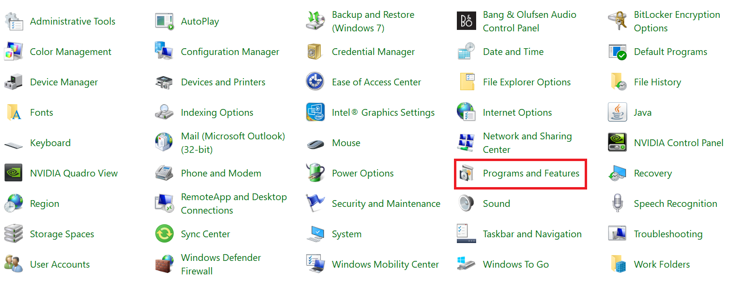
Telnet
Open “Control Panel” to get following screen.
Notes:
Background information is available from the One Pager Document and the Solutions Consulting Proposal.

Slide 51
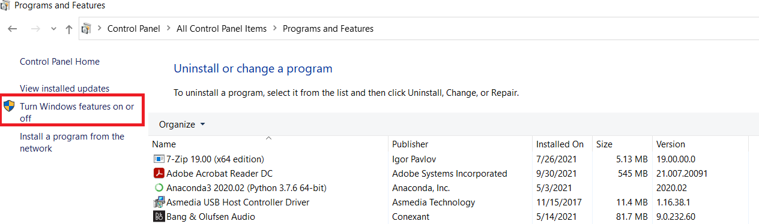
Telnet
Click “Programs and Features” to get following screen.
Notes:
Background information is available from the One Pager Document and the Solutions Consulting Proposal.

Slide 52
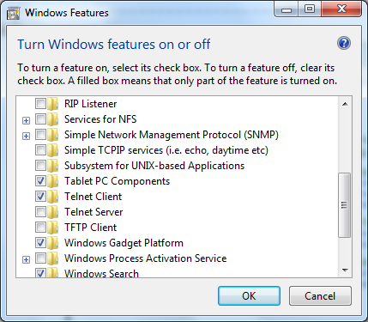
Telnet
Click “Turn Windows features on or off”. It will ask for Admin credentials.
After authentication, Check “Telnet Client” box. Click “OK” to quit.
Notes:
Background information is available from the One Pager Document and the Solutions Consulting Proposal.

Slide 53
Questions for telnet client

