Slide 1
Sampo Saaristo

Slide 2
What is MIN
Advanced Test Harness for testing Linux non-UI components
Toolkit for test case implementation and test cases execution
Framework for implementing test cases in separated test modules
Not an automatic test case creator but allows to concentrate to the actual test case implementation
MIN separates test case implementation and test environment
  Test cases implemented to separated test module
  Test module implements common test module API
  Test modules are running independently in own processes

Slide 3
What is MIN (continue)
Easy to use
  Usability has been one of the key considerations
  Simple and flexible interface to test modules
  Plenty of optional advanced features though
Write once, test everywhere
  E.g. test cases made during development phase can be used in system testing, automatic release testing, etc

Slide 4
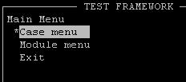
What MIN provides
User Interfaces for test cases execution
  MIN ConsoleUI
  MIN Command line interface
  ( MIN External Interface)
Test engine for test module management and generating
test reports.
Common API for test modules
Tools e.g. MIN Parser, MIN Logger and Test Module Wizard for helping test case implementation

Slide 5
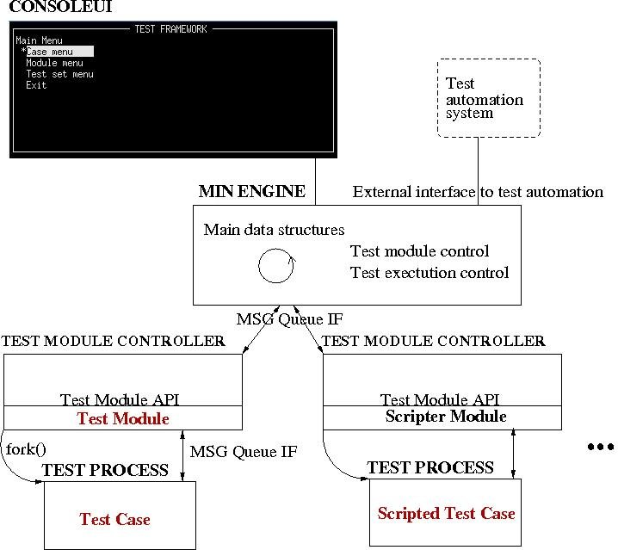
MIN Architecture

Slide 6
MIN Features
Error and crash handling
Concurrent test case execution
Test module template wizard (createtestmodule)
File parsing with MIN Parser
Logging facilities for test modules with MIN Logger
Scripted test cases with Test Scripter
Test case combining with Test Scripter
xUnit style test cases with MINUnit
Test case synchronization with Event System
Test case grouping by creating test sets with MIN Console UI
Support for test cases written in Lua
Support for test cases written in Python
Support for stress/interference testing
Support "make check" target for compiling/executing MIN tests

Slide 7
MIN requirements and building
Pre requirements
  Linux operating system
  MIN release
  Test Module(s)
MIN build process
  Decompress MIN release
  Use dpkg-buildpackage, which generates min and min-dev Debian packages.
  Use dpkg --install command to install the package(s)
  OR
  Decompress MIN release
  Use build.sh script to compile MIN
  Use ’make install’ to install MIN

Slide 8
Task: Setting Up & Demomodule (cont’)
MIN start-up
  sminDemoModule is installed as default, so it’s loaded automatically
  Start MIN:
    $ min
  Check Modules menu to see that minDemoModule is loaded
  Start test case Demo_1 (Case menu->Start new case->Demo_1)
  Start multiple test cases
  See execution results from Passed, Failed and Aborted/Crashed cases

Slide 9
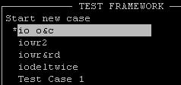
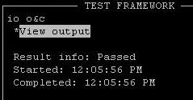
ConsoleUI
ConsoleUI is text based UI running in shell
Provides good test case controlling and monitoring possibilities
  Test case starting, pausing, resuming and aborting
  Output from test cases
  Executed test cases are listed in different menus according to their execution status and result
  Allows forming a group of test cases and running them either
  sequentially or in parallel

Slide 10
Command line Interface
MIN command line interface can be used for running test cases when UI is not needed or it cannot be used
When starting MIN without the console UI all test cases in all test modules which are configured to MIN initialization file (min.conf) are executed sequentially
MIN can be started in cuiless mode by command:
$ min –console
MIN can also made to omit the module definitions in min.conf(s) and execute the cases from a test module specified on the command line with switch –execute (or –x).
$ min –console –execute:/path/to/testmodule.so[:/path/to/configuration_file.cfg]

Slide 11
MIN Engine
Test Engine component manages the test case execution
Test Engine uses an initialization file (min.conf), which defines e.g. Test Module Controller and test modules location.
User can define ModSearchPath(s) for MIN.
User can define test module absolute path, or if path is configured to ModSearchPath only module name is needed.
[Engine_Defaults]
TmcBinPath=/usr/bin/tmc
ModSearchPath=/usr/lib
ModSearchPath=$HOME/.min
[End_Defaults]
[New_Module]
ModuleName=/usr/lib/minDemoModule.so
[End_Module]

Slide 12
MIN test module controller and test modules
Test layer consists of following components:
  Test Module Controller(s)
  Test Module(s)
  MIN Scripter
  Tools
    MIN Parser
    MIN Logger
    MIN Event System

Slide 13
Test Module Controller
Test Module Controller = TMC
Provides “sand box” for test module
For each test module, there exists one TMC
TMC gets requests from the Test Engine
TMC handles requests itself or calls the corresponding function from the test module

Slide 14
Test Module
Test module implements test cases
Test module implements Test Module API
  No other requirements or restrictions
    Allows to use old code as basis and write complex test cases
Usually there is one module that tests one component or feature
  BT test module
  Camera test module
  Audio test module
  Networking test module
Test modules are libraries loaded by TMC
Currently four different test module types are supported in MIN:
  Hardcoded
  normal
  MINUnit
  Test class (test scripter)

Slide 15
Test Module Configuration File
Optional
Delivered to test module during test module initialization
Set via MIN initialization file (min.conf)
Test module may use initialization file to get some common, test case independent, information
  E.g. debug level, log file name, dial-up phone number, hardware/component/environment initialization settings, priority of the test cases run, etc.
Content is determined by test module, i.e. MIN just passes the filename to test module

Slide 16
Test case
Test case is a single test that tries to verify that something operates as specified
Test case returns a result after completion
  Result code
    TP_CRASHED
    TP_TIMEOUTED
    TP_PASSED
    TP_FAILED
    TP_NC
    TP_LEAVE
  String containing additional description about failure
    Shown on consoleUI

Slide 17
Test Case File
Can be used by test module to pass test parameters to test cases
Test case file name is delivered to test module when test cases are queried and executed
Multiple test case files are supported concurrently
Set via MIN initialization file
Content is determined by test module, i.e. MIN just passes the filename to test module
  Existing test case definitions can be used conveniently

Slide 18
MIN Parser
MIN UI
min.conf
Easy-to-use parser for test modules
  E.g. for initialization
  file and test case file
  parsing
Support for hierarchical parsing
  Section
  Subsection
  Line
  String
  Character
  Integer
MIN Engine
MIN Parser
TMC
test data
(file or buffer)
Test Module
MIN Parser
Component
under test

Slide 19
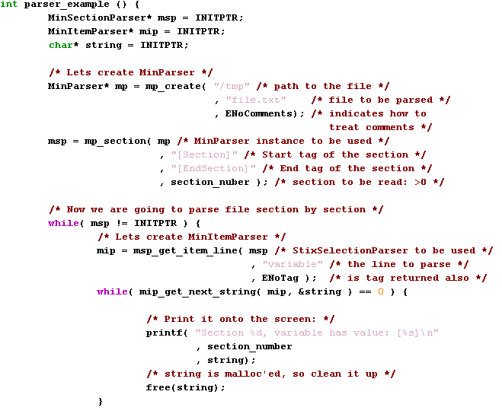
Example: MIN Parser
...

Slide 20
MIN Logger
MIN UI
Easy-to-use logging facility for the test modules
Versatile configurable features
  Different logging formats supported: txt, html
  Different output targets: file and syslog
  Information importance can be specified (e.g. important information is written in red when generating html)
  Configurable via min.conf file
Used also for test framework logging
MIN Logger
MIN Engine
Log file
TMC
Test Module
MIN Logger
Log file
Component
under test

Slide 21
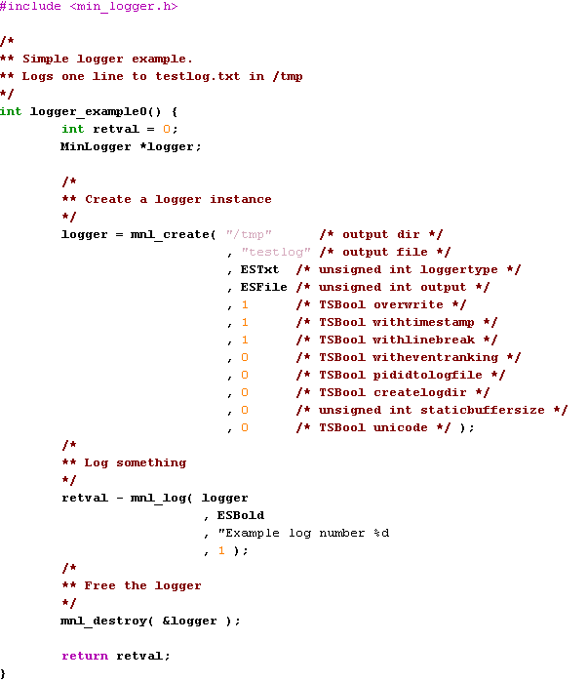
Example: MIN Logging

Slide 22
MIN Logger output example
cat /tmp/testlog.txt
  15.Apr.2008 05:16:23.220 Example log number 1

Slide 23
MIN Event System
Provides easy-to-use interface for synchronization between test cases
State events
  Indicate that some state is active/inactive and they can be set and unset
  E.g. phone call active/inactive
Indication events
  Indicate that some event happened and they can only be set
  E.g. received SMS
Identified with character string
Event commands:
  Set event
  Unset event
  Request event
  Wait event
  Release event

Slide 24
Example: State Events
[Test]
title wait for call
request call state
wait call
release call
[Endtest]

Slide 25
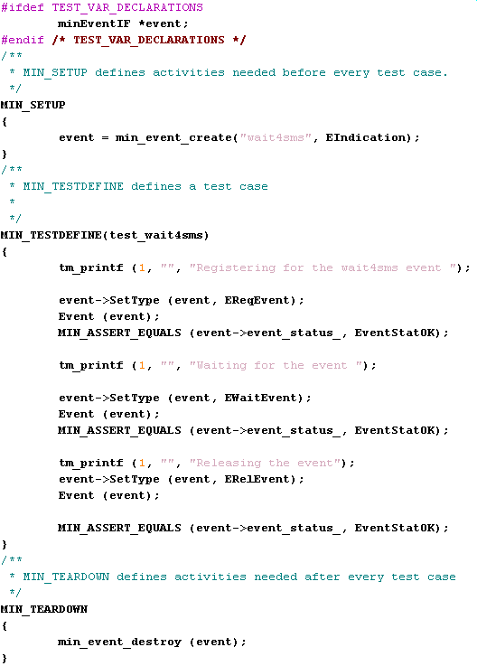
Example: Indication Events

Slide 26
Task: Using indication events
Create one hardcoded test module e.g. Event
Create two test cases for it using events (See Section MIN Event System from MIN_Test_Framework_Users_Guide.doc for more information)
  Test case WaitEvent that requests, waits and then releases indication event “CoffeeReady”
  Test case SetEvent that sets indication event “CoffeeReady”
Add include “min_test_event_if.h”
Run them with Console UI
  First run WaitEvent
  See that WaitEvent is on Ongoing cases list
  Run SetEvent
  See that both cases are executed

Slide 27
MIN Test Module Wizard
For generating Test Module templates
Procedure:
  Run script createtestmodule
  Enter test module type, name and creation path
  Creates new test module project, ready to be compiled
  Go to created test module directory
  Run script build.sh
Possible test module template types of MIN currently are:
  hardcoded (for hardcoded test module)
  Normal (for normal test module)
  minunit (for MINUnit test module)
  testclass (for scripter test module)

Slide 28
Hardcoded test module
MIN UI
All test cases implemented inside a test module
  See one example in directory min/src/test_libraries
    One of those can be used to try out MIN
Used if
  No parameterization in test cases
  No initialization in test cases
Recommended way to use
  Basic way for test case implementation
  Parameterization is not possible
  Reusing the code of other test case more difficult
MIN Engine
TMC
Hardcoded
test module
MINLogger
Log file
Component
under test

Slide 29
Task: Implementing test cases for Hardcoded test module
Create your own hardcoded test module (e.g. TMHardcoded) using createtestmodule

Slide 30
Normal Test Module
Normal test module template used
for general purposes
Used if
  Parameterization is needed
  Test scripter can’t be used
  Unique type of test cases are made
    Does not limit implementation
Recommended way to use
  Test cases use parameters
  from test case file
MIN UI
MIN Engine
test case file
TMC
MIN Parser
Normal
test module
MINLogger
Log file
Component
under test

Slide 31
Task: Implementing test cases for normal test module and using MIN Parser
Create your own normal test module (e.g. TMNormal) using createtestmodule
Make your own test case file (e.g. TMNormal.cfg)
Use MIN Parser to read data from your .cfg file
  How to use parser? More information from MIN Test Framework User's Guide
In GetTestCases –function read names(titles) of your test cases
In RunTestCase –method read all data of your test cases and use Print –function to print data to MIN Console UI

Slide 32
Task: Implementing test cases for normal test module and using MIN Logger
Use MIN Logger to create logs from your test module

Slide 33
MINUnit Test Module
Compliant with popular xUnit test pattern.
The fastest way to implement test cases
MINUnit has clean and neat structure:
  MINUnit groups code common for all test cases which makes test cases shorter
  Use of ASSERT macros eliminates the need to use conditional expressions to make decision about result of a test. Macros take as a parameters expected and actual values
MIN UI
MIN Engine
TMC
MINUnit
test module
MINLogger
Log file
Component
under test

Slide 34
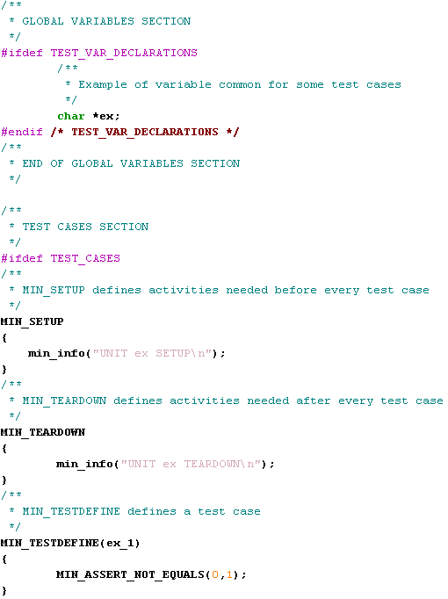

Slide 35
Test Scripter Test Module
provides one way to implement scripted test cases
it executes methods listed in the test case file from test classes
Idea:
  Implement small building blocks, i.e. functions, with unlimited number of parameters to test class
    E.g. wrapper to API function calls
  Create test cases to script file (test case file)
    E.g. call functions in different sequences with different parameters
Ready made script runner
  Script file parsing
  Execution of functions from test class

Slide 36
TestScripter test module (cont’)
Used if
  Want to make test cases using small building blocks
  Events used
    Events controlling is handy from test script file
  A lot of same type of test cases
  Want to change testing steps execution order between test cases
  Want to make more test cases without coding
    Test class implemented once and more test cases made by adding new lines to script (text file)
Recommended way to use
  Test cases defined in test script file (text file)
    Easy to understand what the test case is doing by reading test script file

Slide 37
Test Script File
TestScripter is controlled with test script file
Contains test case definition's
  title: test case title which is showed to tester in UI
  createx: create new object from specified test class
  delete: delete specified object
  Other lines begin with the name
  of the created object followed with
  command executed from that
  object with its arguments
[Test]
title Capture
createx CameraTest cam1
cam1 Init primary highres
cam1 capture “/tmp/pic.jpg"
cam1 Close
delete cam1
[Endtest]

Slide 38
Task: Test class & Test Scripter
Create test class(e.g. TMTestClass) and build it
See Example.cfg from Group folder of your test class
Edit min.conf file
  Add Scripter to ModuleName
  Add Example.cfg to TestCaseFile
Run Example test case from MIN Console UI and check parameters of test case via screen of Console UI
Add new method Example2 and one test case for it to Example.cfg file
  Use parser to get integer data from test case
Add new method Example3 and one test case for it to Example.cfg file
  Use parser to get char data from test case

Slide 39
Test Scripter test Combining feature
Allows to create new test cases from existing ones
  Extend and combine existing cases
  Efficient way of implementing negative test cases
Combining functionality can be used to
  TMC’s with multiple clients
  Test operations when resources are in use
  Simulate client crashes
  Simulate client out-of-resource situations, i.e. buffer overflow
Simple scripting language for test generating
  Start test case
  Abort, pause and resume test
  Wait until test is completed
  Use event system easily

Slide 40
Example: Test Combining features in System Testing
Assume that there is networking test module
  CSD and GPRS data transfer test cases
Assume that there is Camera test module
  Test case that takes a picture
Combine camera test case and networking test case to
  Take picture when
  CSD call is on
  Take picture when
  GPRS data transfer
  is ongoing
[Test]
title Take a picture while CSD is active
request CSDCallActive
run netmodule nettests.txt 3
wait CSDCallActive
run cameramodule cameratests.txt 1
release CSDCallActive
[Endtest]

Slide 41
Example: Test Combining features in Module Testing
Start CSD data transfer and when phone call is active kill test thread
  Simulates a client crash when making CSD call
  Similar cases can be implemented with any server
Test process can also be paused
  Causes buffer overflows
  Simulate system
  overload situation
[Test]
title Phone application crash
request CSDCallActive
run netmodule nettests.txt 3 testid=nettest
wait CSDCallActive
pause nettest
cancel nettest
release CSDCallActive
[Endtest]

Slide 42
Task:Test Scripter combiner functionality
Create new test case file e.g. Event.cfg
Add scripter and your test case file to min.conf file
Implement Scripter test case
  Request “CoffeeReady” event
  Run SetEvent test case from your Event test module
  Wait “CoffeeReady” event
  Release “CoffeeReady” event
Run your Scripter test case with MIN Console UI
And after that some extra tasks ☺
  Try to run other test cases by using Test Scripter combiner functionality
    TMHardcoded, TMNormal, TMTestClass etc...

Slide 43
Stress/interference testing
MIN supports stress/interference testing, using sp-stress package tools. It allows for testing the code under conditions of:
    Heavy cpu load
    High memory usage
    Heavy IO operations
Feature requires sp-stress package to be installed
Can be used in scripted and “coded” test cases.

Slide 44
Stress/Interference Examples
Coded cases:
int test_1 (TestCaseResult * tcr)
{
int i = 0;
testInterference* disturbance = ti_start_interference(ECpuLoad,76);
long double x1 = 0;
long double x2 = 11.34223;
for (i = 0;i<100000000;i++){
x1 = sinl(x2);
}
ti_stop_interference(disturbance);
tm_printf(1,"xxx","res = %f",x2);
tm_printf(1,"xxx","iterations = %d",i);
RESULT (tcr, TP_PASSED, "PASSED");
}
Scripted cases:
[Test]
title interference - scr
createx heavycTestModule math
testinterference disturbance start cpuload 80 0 1111
math Heavy_math foo
testinterference disturbance stop
delete math
[Endtest]

Slide 45
Task: Using MIN in real HW
Create MIN Debian packages in Scratchbox for ARM target
Create Debian package(s) from your test module
Install Debian packages in target device
Run tests

Slide 46
Python support:
It is possible to run test cases written in Python. Python script interpreter module is similar in use to „scripter” module – user defined test cases are implemented in „test case file” – in this case : Python script. Examples of use would be:
Testing C code in python extension modules, with test logic defined in Python
Testing code written from the beginning in Python.

Slide 47
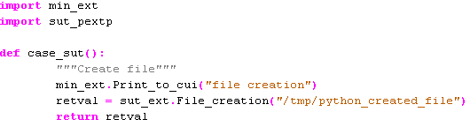
Python test case definition:
To use min specific functionality , min_ext extension library needs to be imported (reference for available functions in user manual)
If user wants to use his own C code, he needs to create and import his own C extension
Min treats Python function with name strating with case_ as a test case
Title can (but does not have to) be defined in docstring
Cases defined this way are executed the same way as other test cases

Slide 48
Lua support:
It is possible to run test cases written in Lua.
Lua Scripter module is similar in use to MIN Scripter module.
User defined test cases are implemented in test case file that, in this case, is written in Lua.
Examples of use would be:
Testing C code in as it has been done by using MIN Scripter.

Slide 49
Lua test case definition:
function case_function() -- Test Case tite
ret = min.run(„TestModule”,1);
return TP_PASSED;
end
Function case_function2() -- Loading test module
hnd = min.load(„LuaTestClass”);
ret = hnd.Example();
return ret;
end
No dependencies to external libraries are present, Lua comes with MIN out of the box
If user wants to use his own C code, he needs to create Lua Test Module
MIN sees test cases from test case file only when they are prepended with „case_”
Title can (but does not have to) be defined in the same line on which function is declared, in a comment (comment in Lua starts with --).
Cases defined this way are executed the same way as other test cases

Slide 50
DBus plugin for MIN:
MIN exposes its functionalities through Dbus. It is possible to use MIN being connected to MIN over Dbus.
In order to use MIN over Dbus one must install mindbusplugin package which depends on GLib, DBus and Glib-DBus.
DBus client to MIN can be written in any programming language, it is just required that particular language has DBus bindings.

Slide 51
MIN Contact Info
Documentation Included in release (user guide)
Contacts:
  MIN Contact: antti.heimola@nokia.com
  Report bugs to: DG.MIN-Support@nokia.com

Slide 52
GNU Free Documentation License
See http://www.gnu.org/licenses/fdl-1.2.txt

