Slide 1
Title
Author

Slide 2
Scenarios
Item 1
Item 2
Item 3

Slide 3
Summary Data
Column | Column | Column | Column | Column | Column | Column | Column | Column | Column | Column | Column | Column | Column
0 | 0 | 0 | 0 | 0 | 0 | 0 | 0 | 0 | 0 | 0 | 0 | 0 | 0
0 | 0 | 0 | 0 | 0 | 0 | 0 | 0 | 0 | 0 | 0 | 0 | 0 | 0
0 | 0 | 0 | 0 | 0 | 0 | 0 | 0 | 0 | 0 | 0 | 0 | 0 | 0
0 | 0 | 0 | 0 | 0 | 0 | 0 | 0 | 0 | 0 | 0 | 0 | 0 | 0
0 | 0 | 0 | 0 | 0 | 0 | 0 | 0 | 0 | 0 | 0 | 0 | 0 | 0

Slide 4
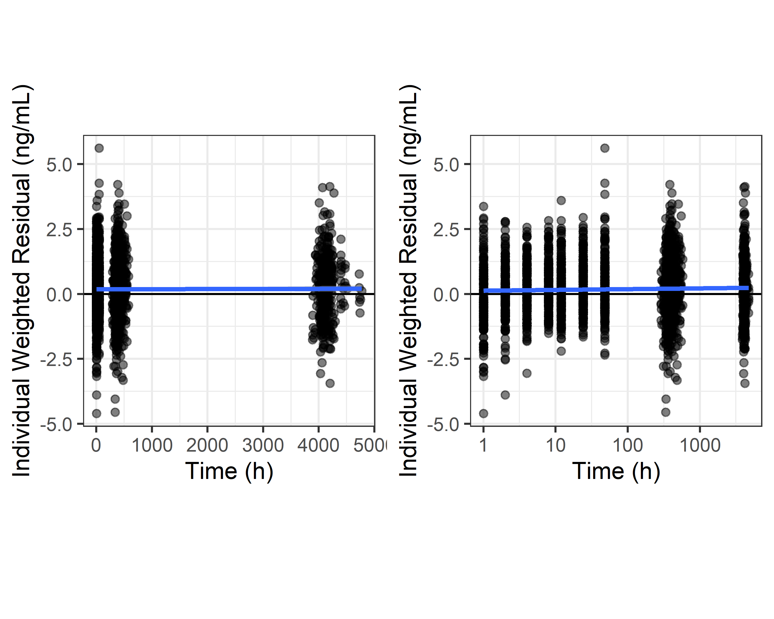
Figure
All Scenarios

Slide 5
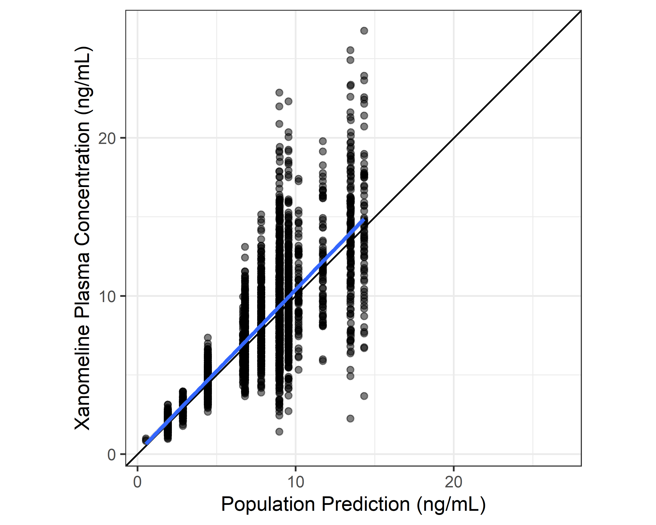
Figure and Text
Text goes here.
Figure caption.

