Slide 1
Xanomeline Model Diagnostic Plots
Tim Bergsma

Slide 2
Data Diagnostics

Slide 3
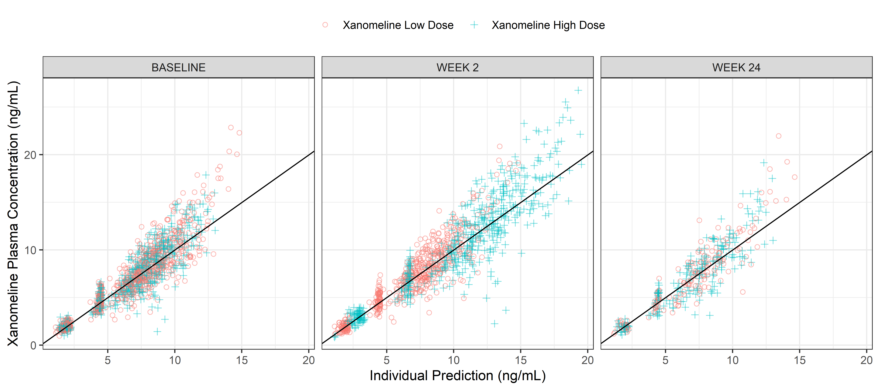
Observations vs Individual Predictions by Arm, per Visit
DV-IPRED-ACTARM-VISIT.png

Slide 4
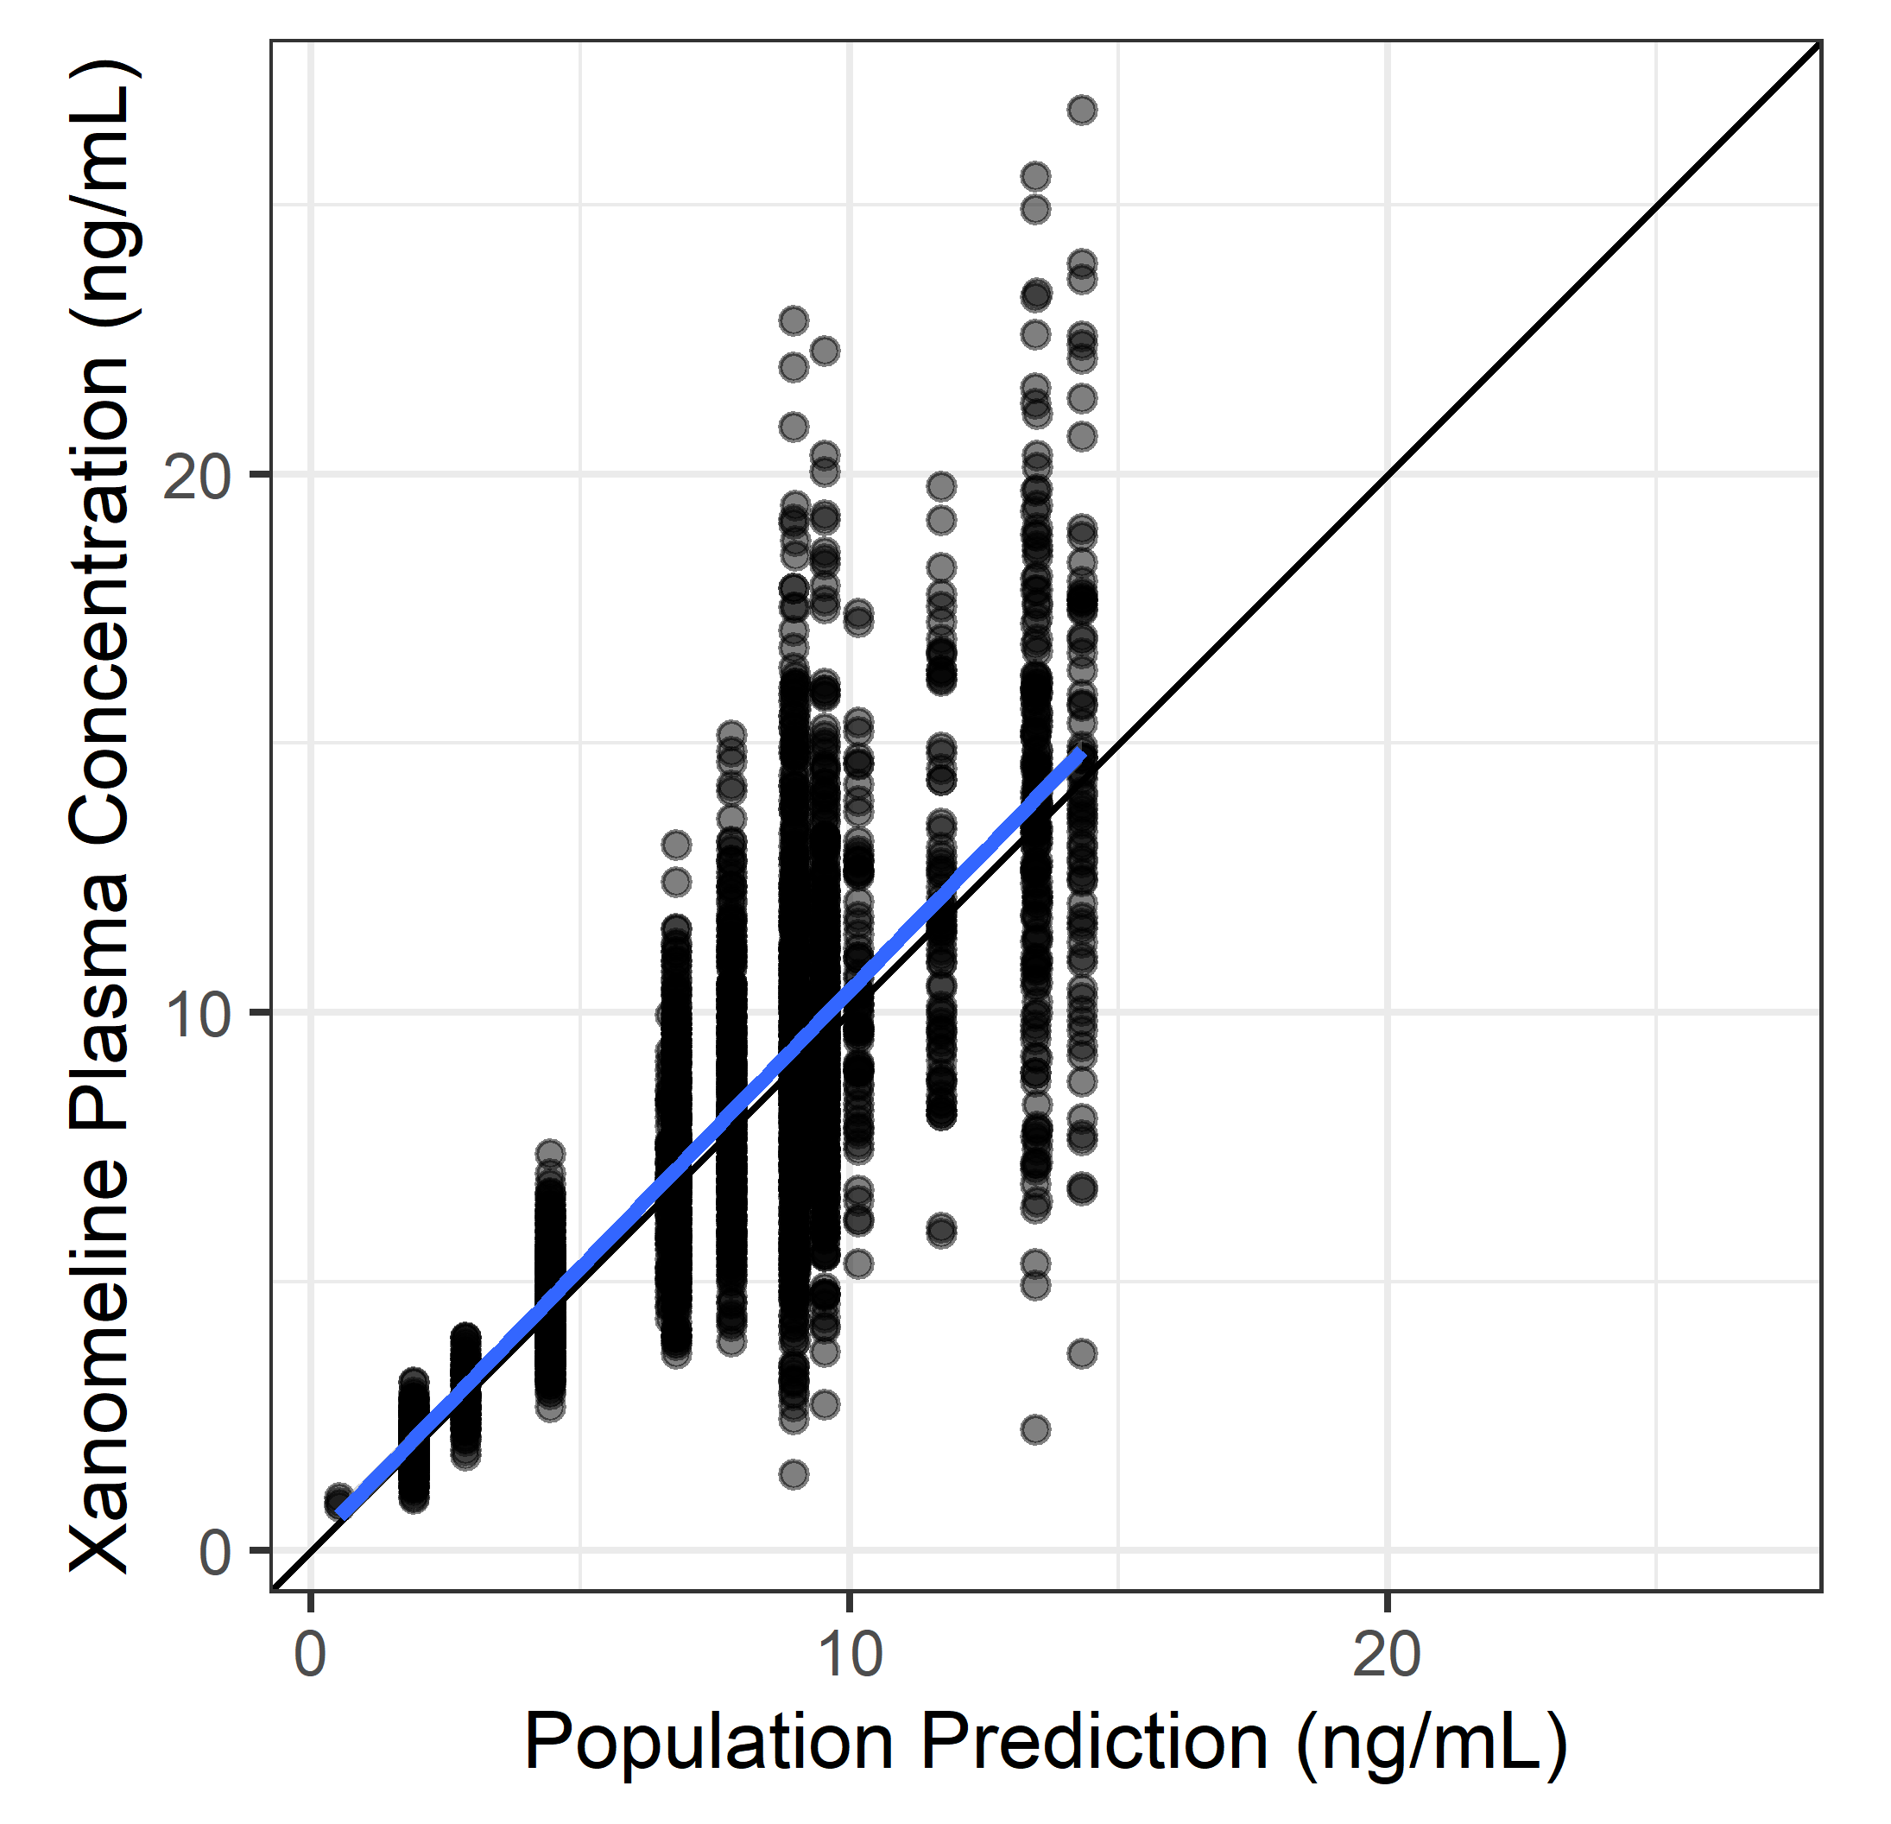
Observations vs Individual Predictions
x %>% isoplot(DV, PRED)

Slide 5
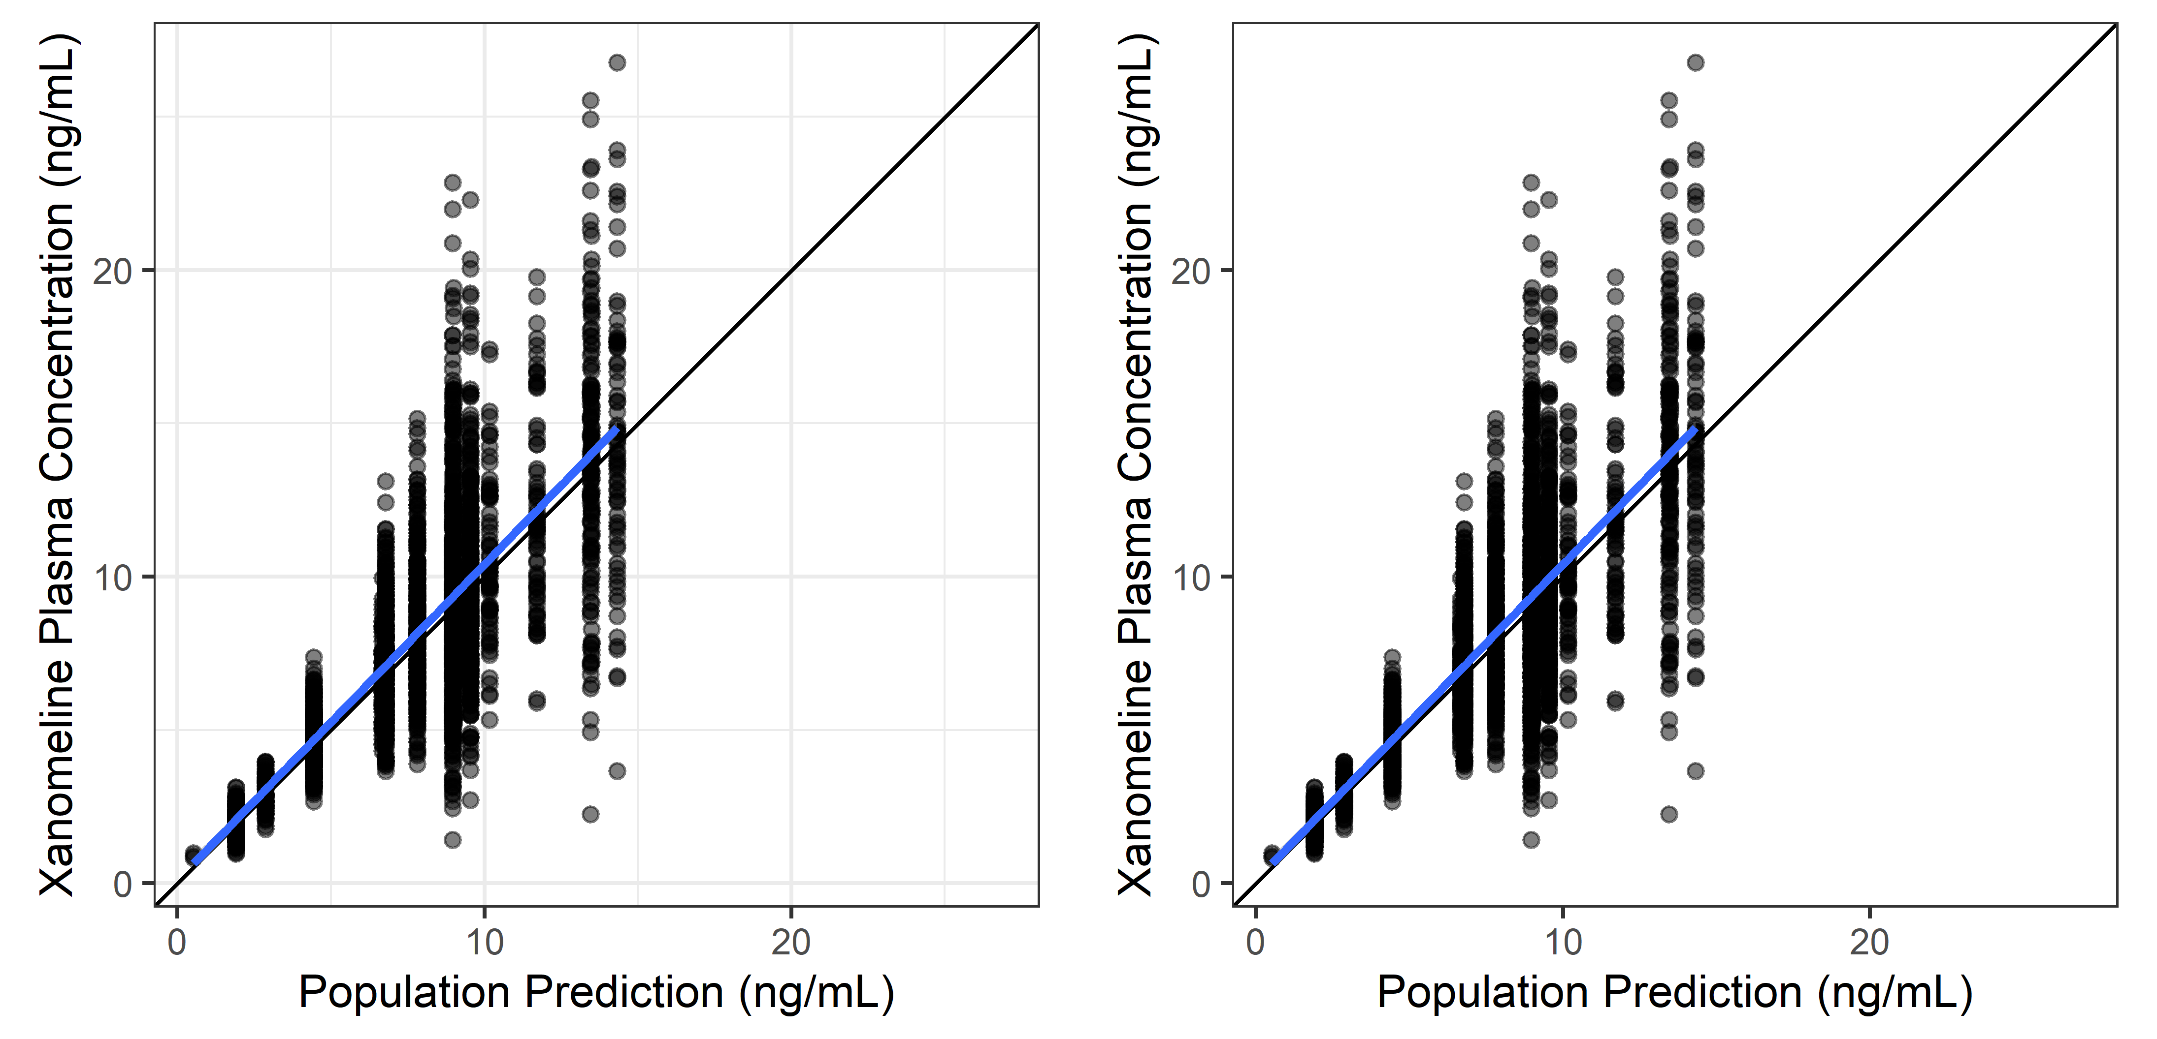
Observations vs Individual Predictions, With/without Grids
x %>% isoplot(DV, PRED)

Slide 6
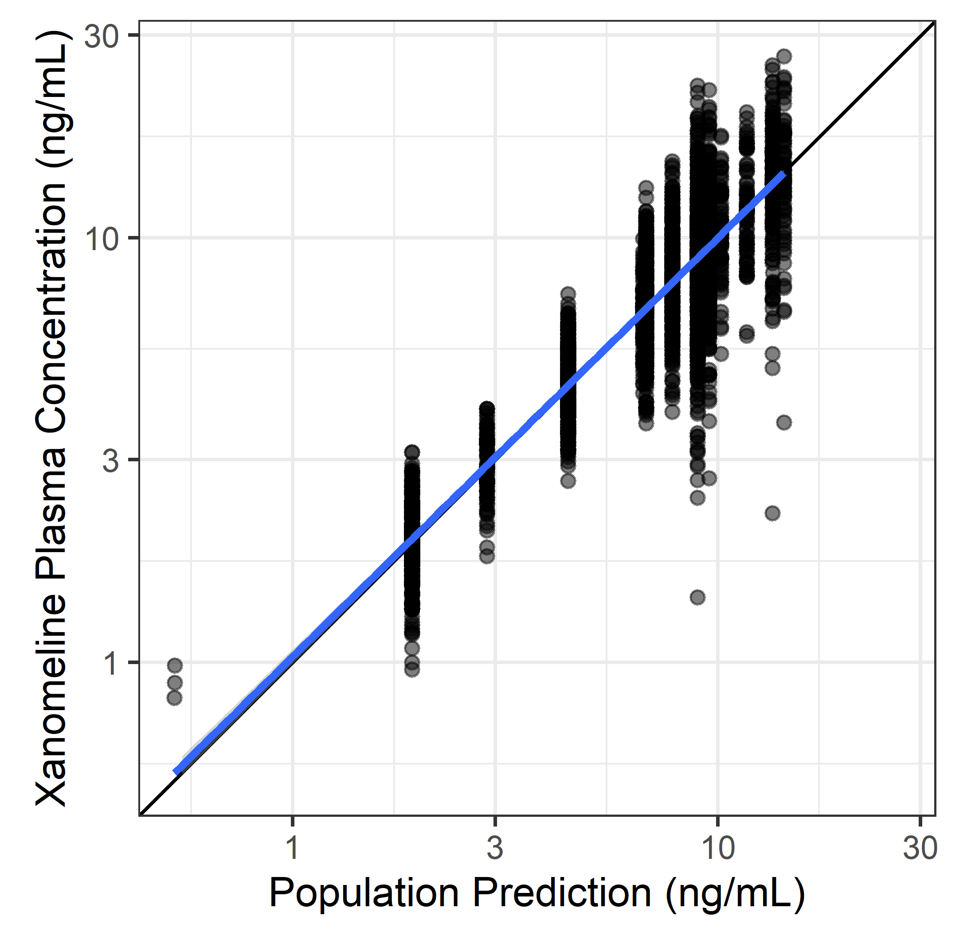
Observations vs Population Predictions, Log-log
x %>% isoplot(DV, PRED, trans = ‘log10’)

Slide 7
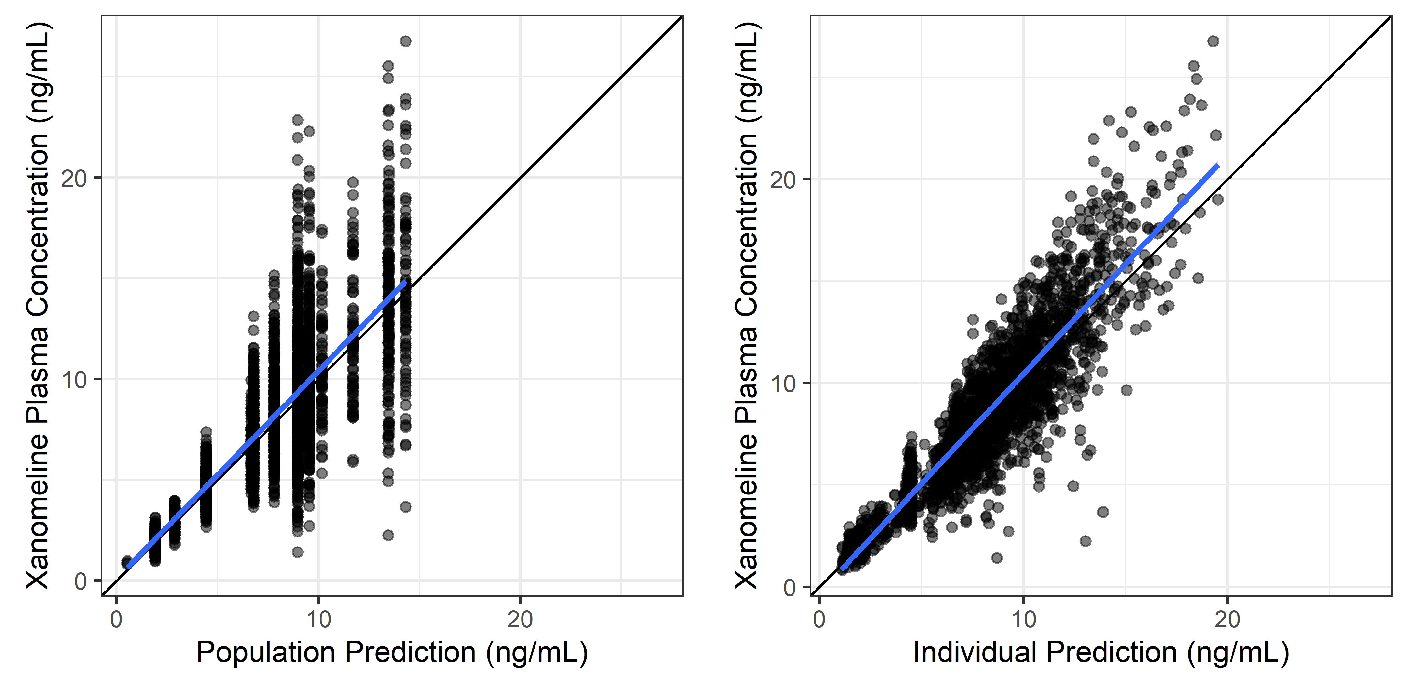
Observations vs Population and Individual Predictions
x %>% isopair(DV, PRED, DV, IPRED)

Slide 8
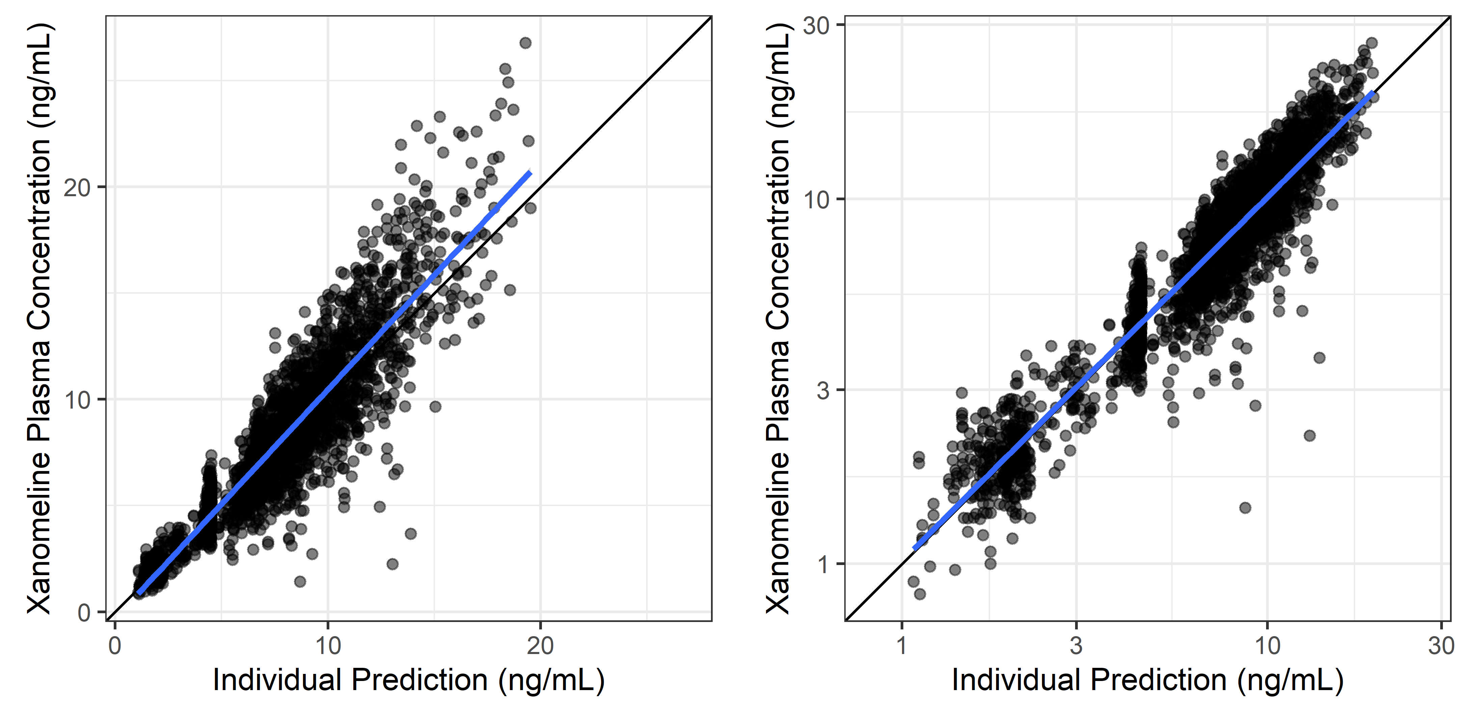
Observations vs Individual Predictions, Untransformed and Log-log
x %>% isopair(DV, IPRED, DV, IPRED, trans = c(‘identity’,‘log10’))

Slide 9
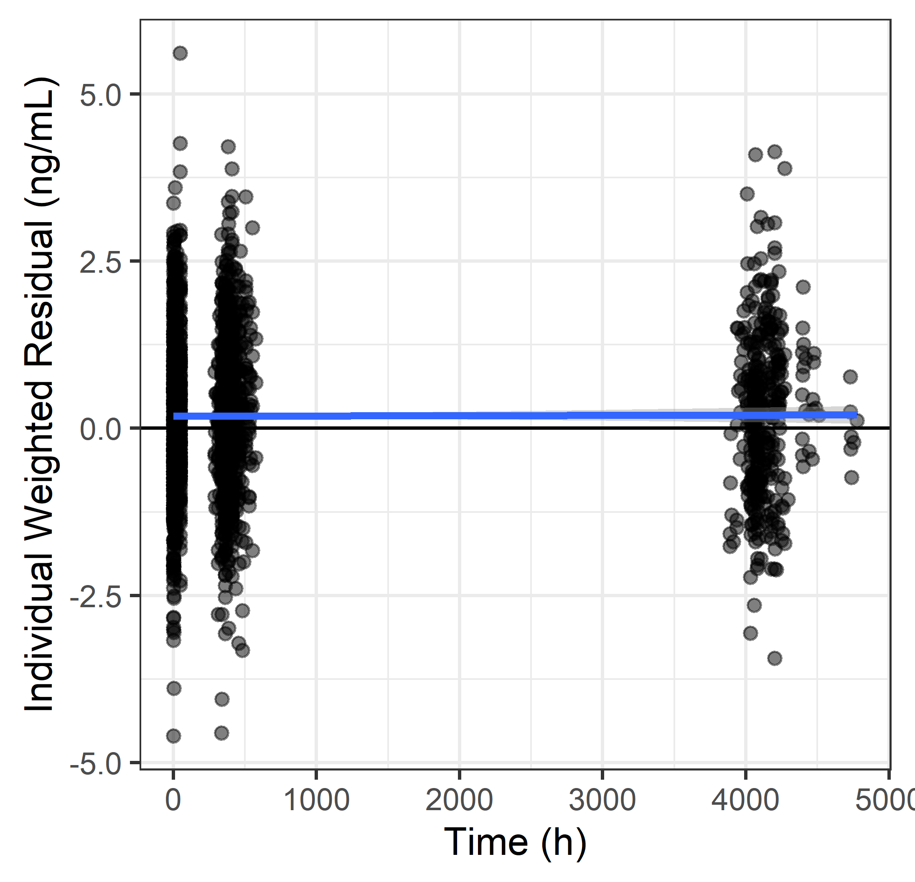
Individual Weighted Residuals vs Time
x %>% trendplot(IWRES, TIME)

Slide 10
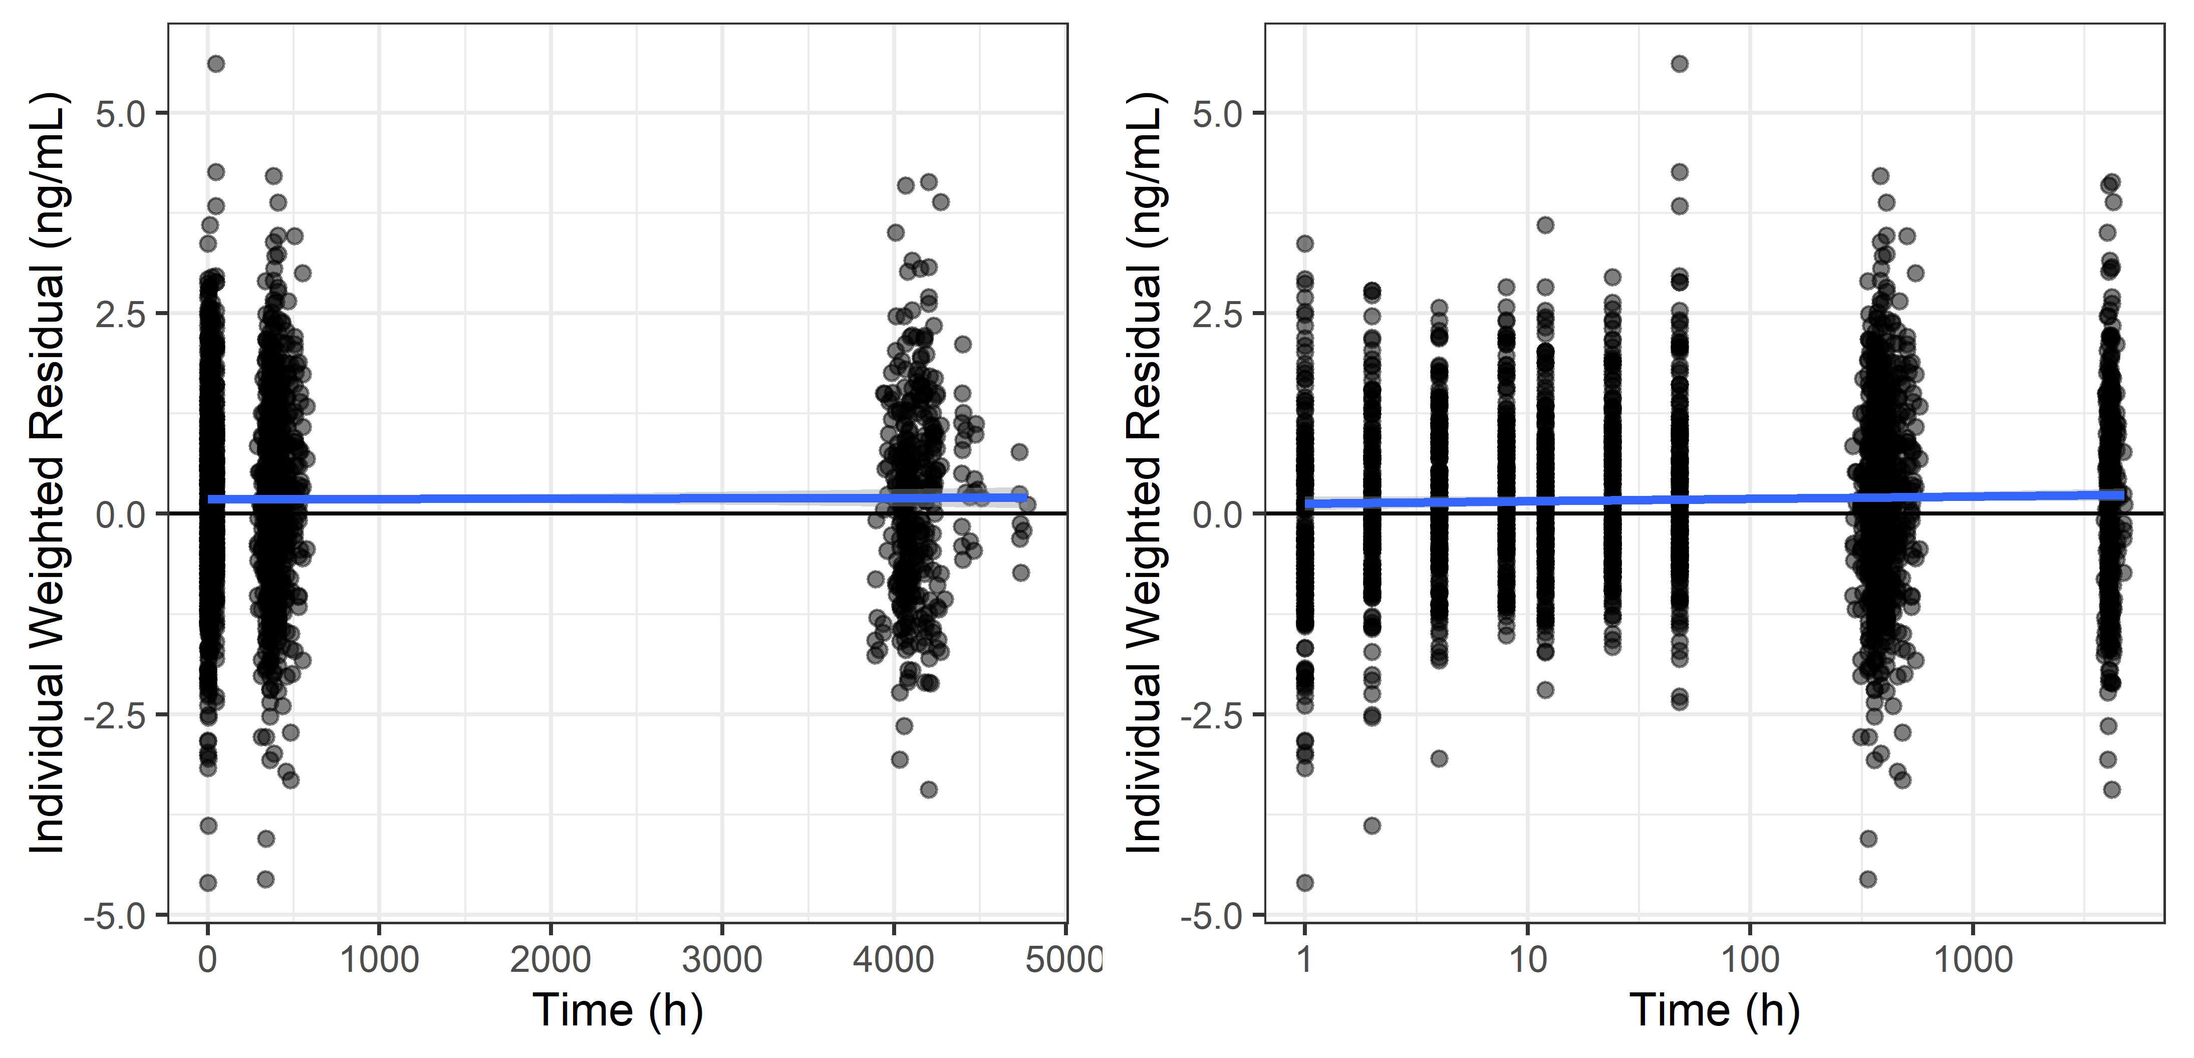
Individual Weighted Residuals vs Time, Untransformed and Log-log
x %>% trendpair(IWRES, TIME, IWRES, TIME, trans2 = c(‘identity’, ‘log10’))

Slide 11
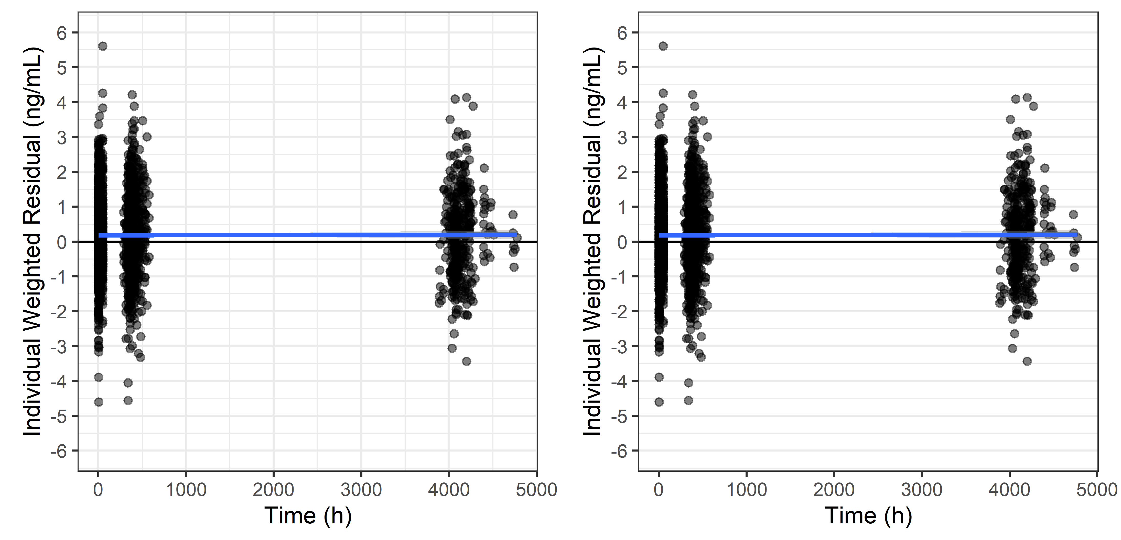
Individual Weighted Residuals vs Time, Full Grid vs Horizontal Grid

Slide 12
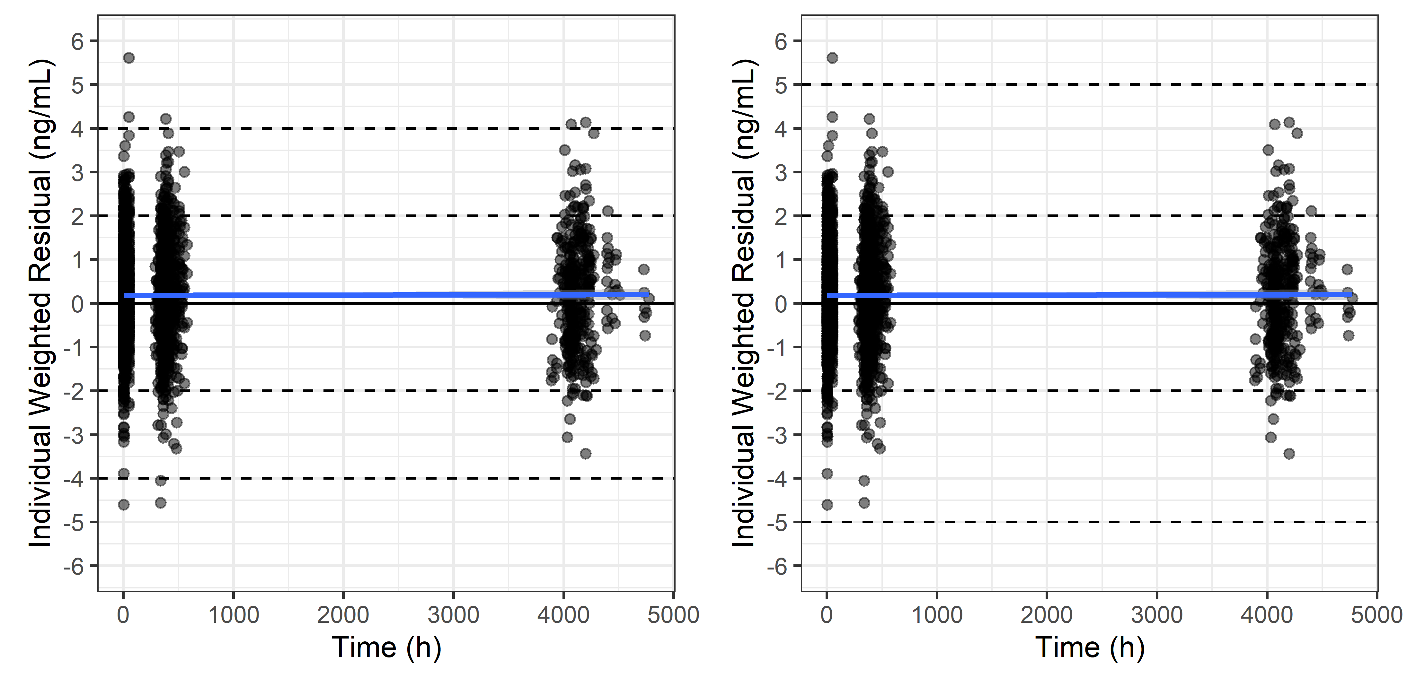
Individual Weighted Residuals vs Time, Various Horizontal Reference Lines

Slide 13
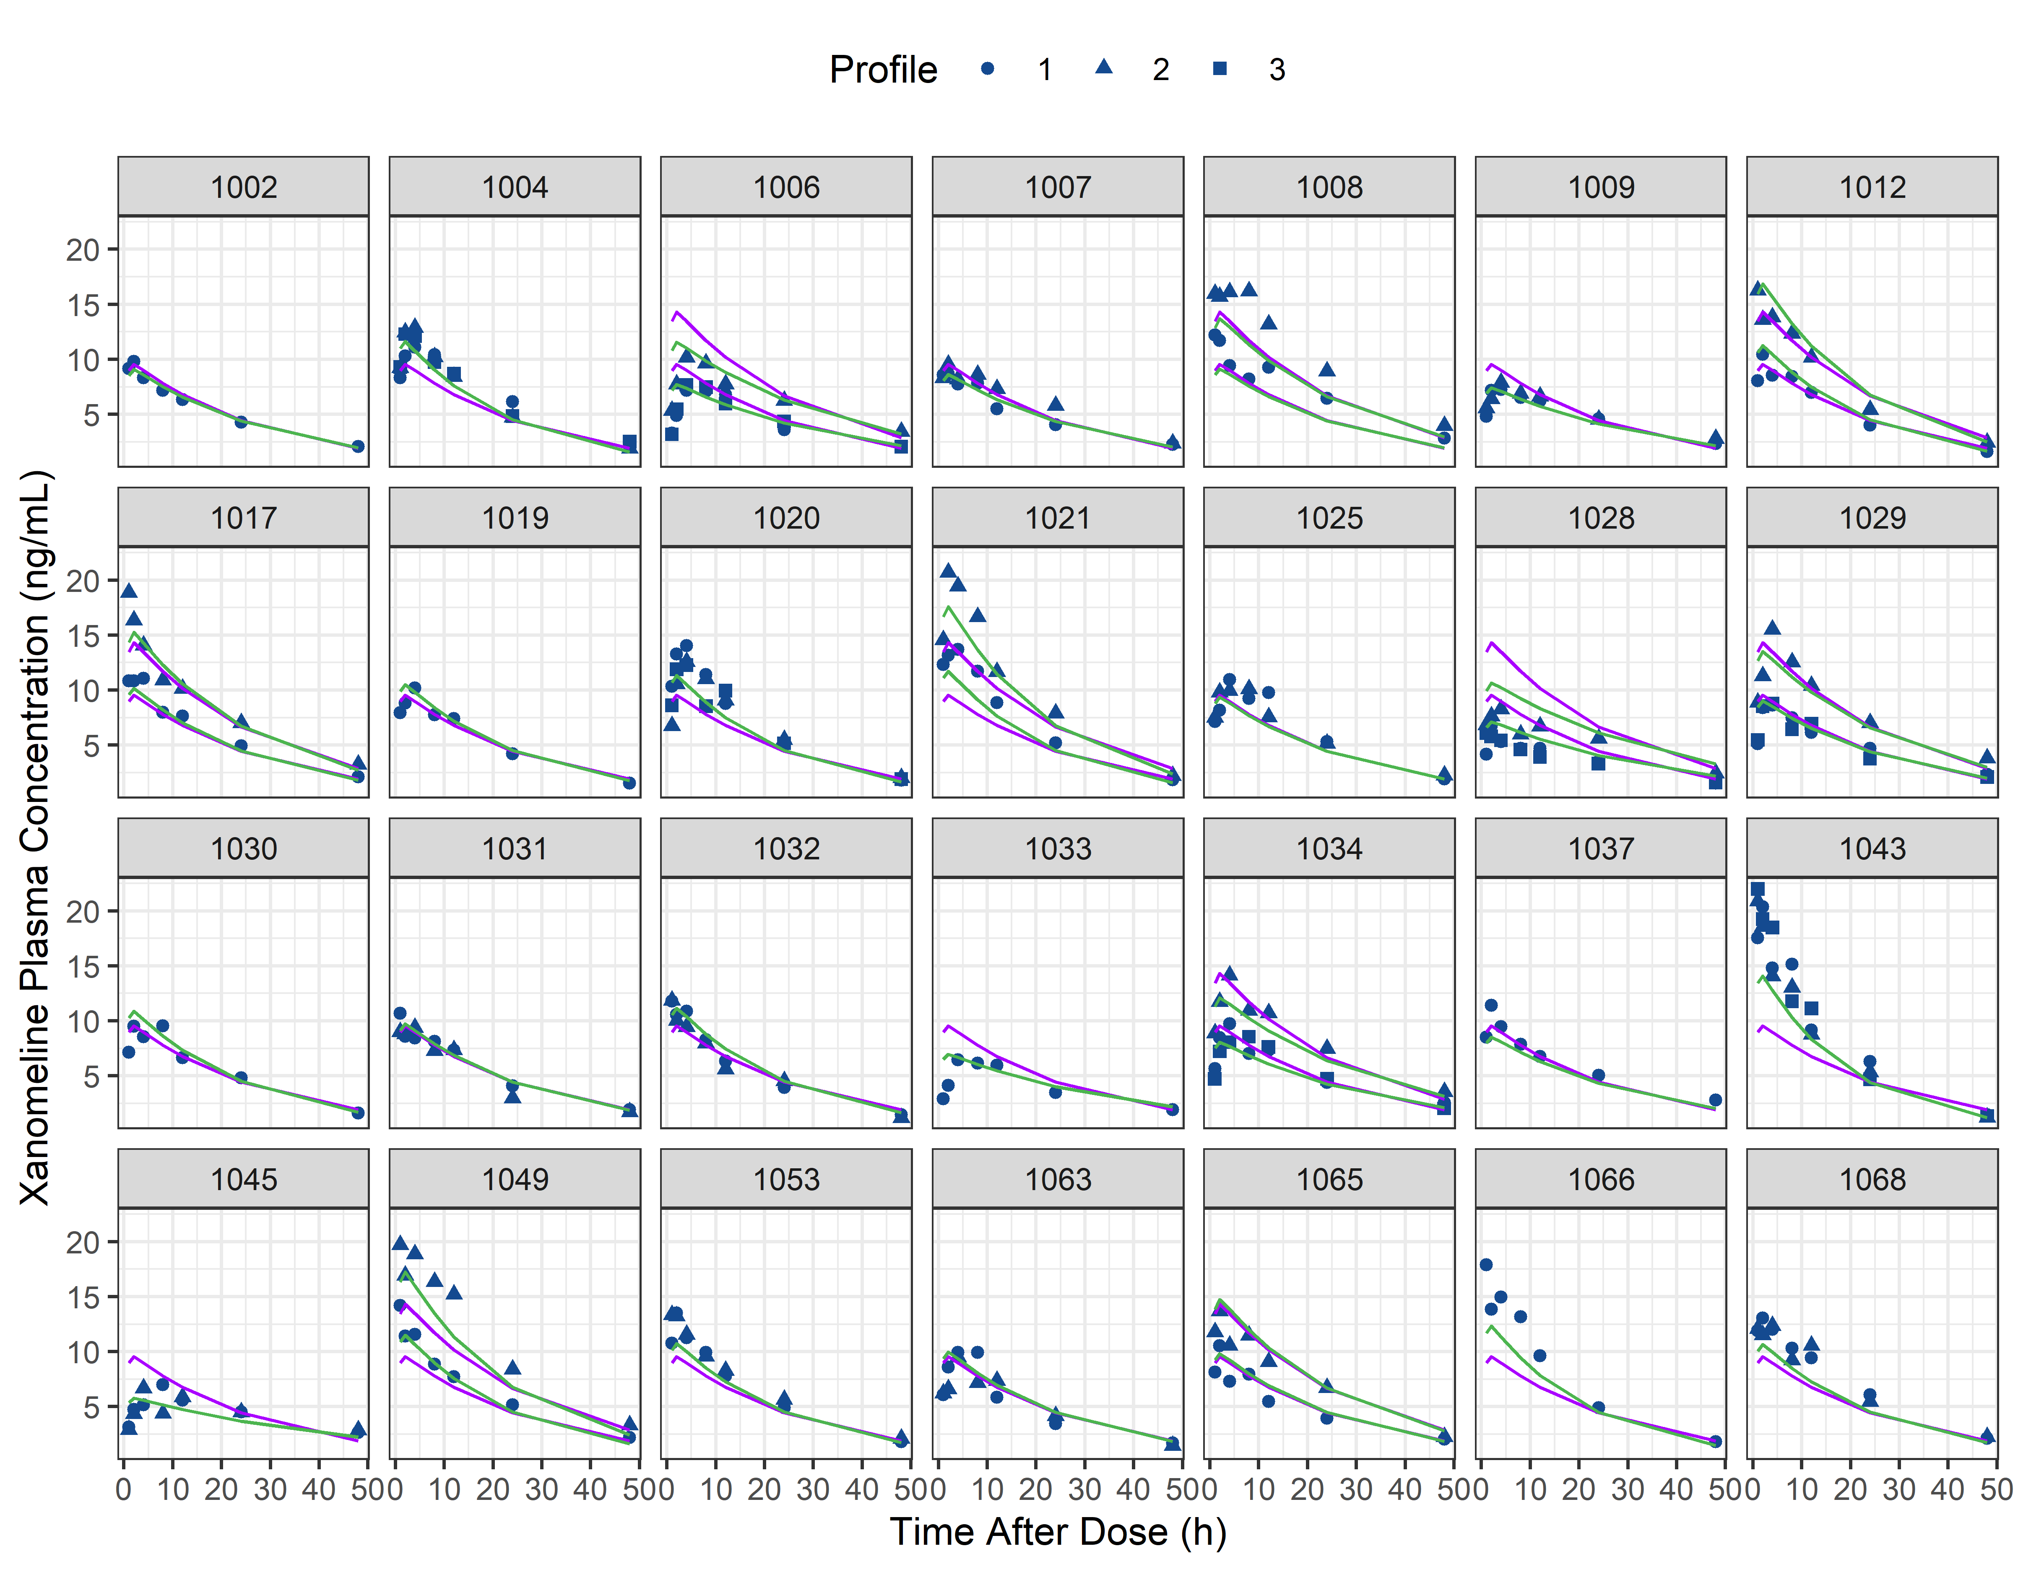
Individual Plots

Slide 14
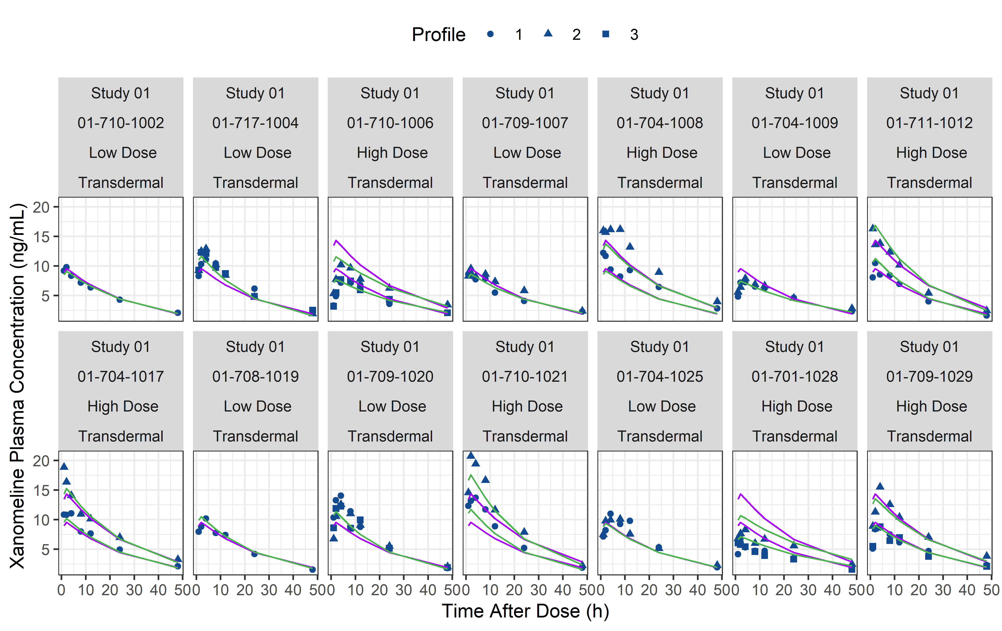
Individual Plots – Detailed Panel Strip

