Slide 1
Xanomeline Model Diagnostic Plots
Tim Bergsma

Slide 2
Data Diagnostics

Slide 3
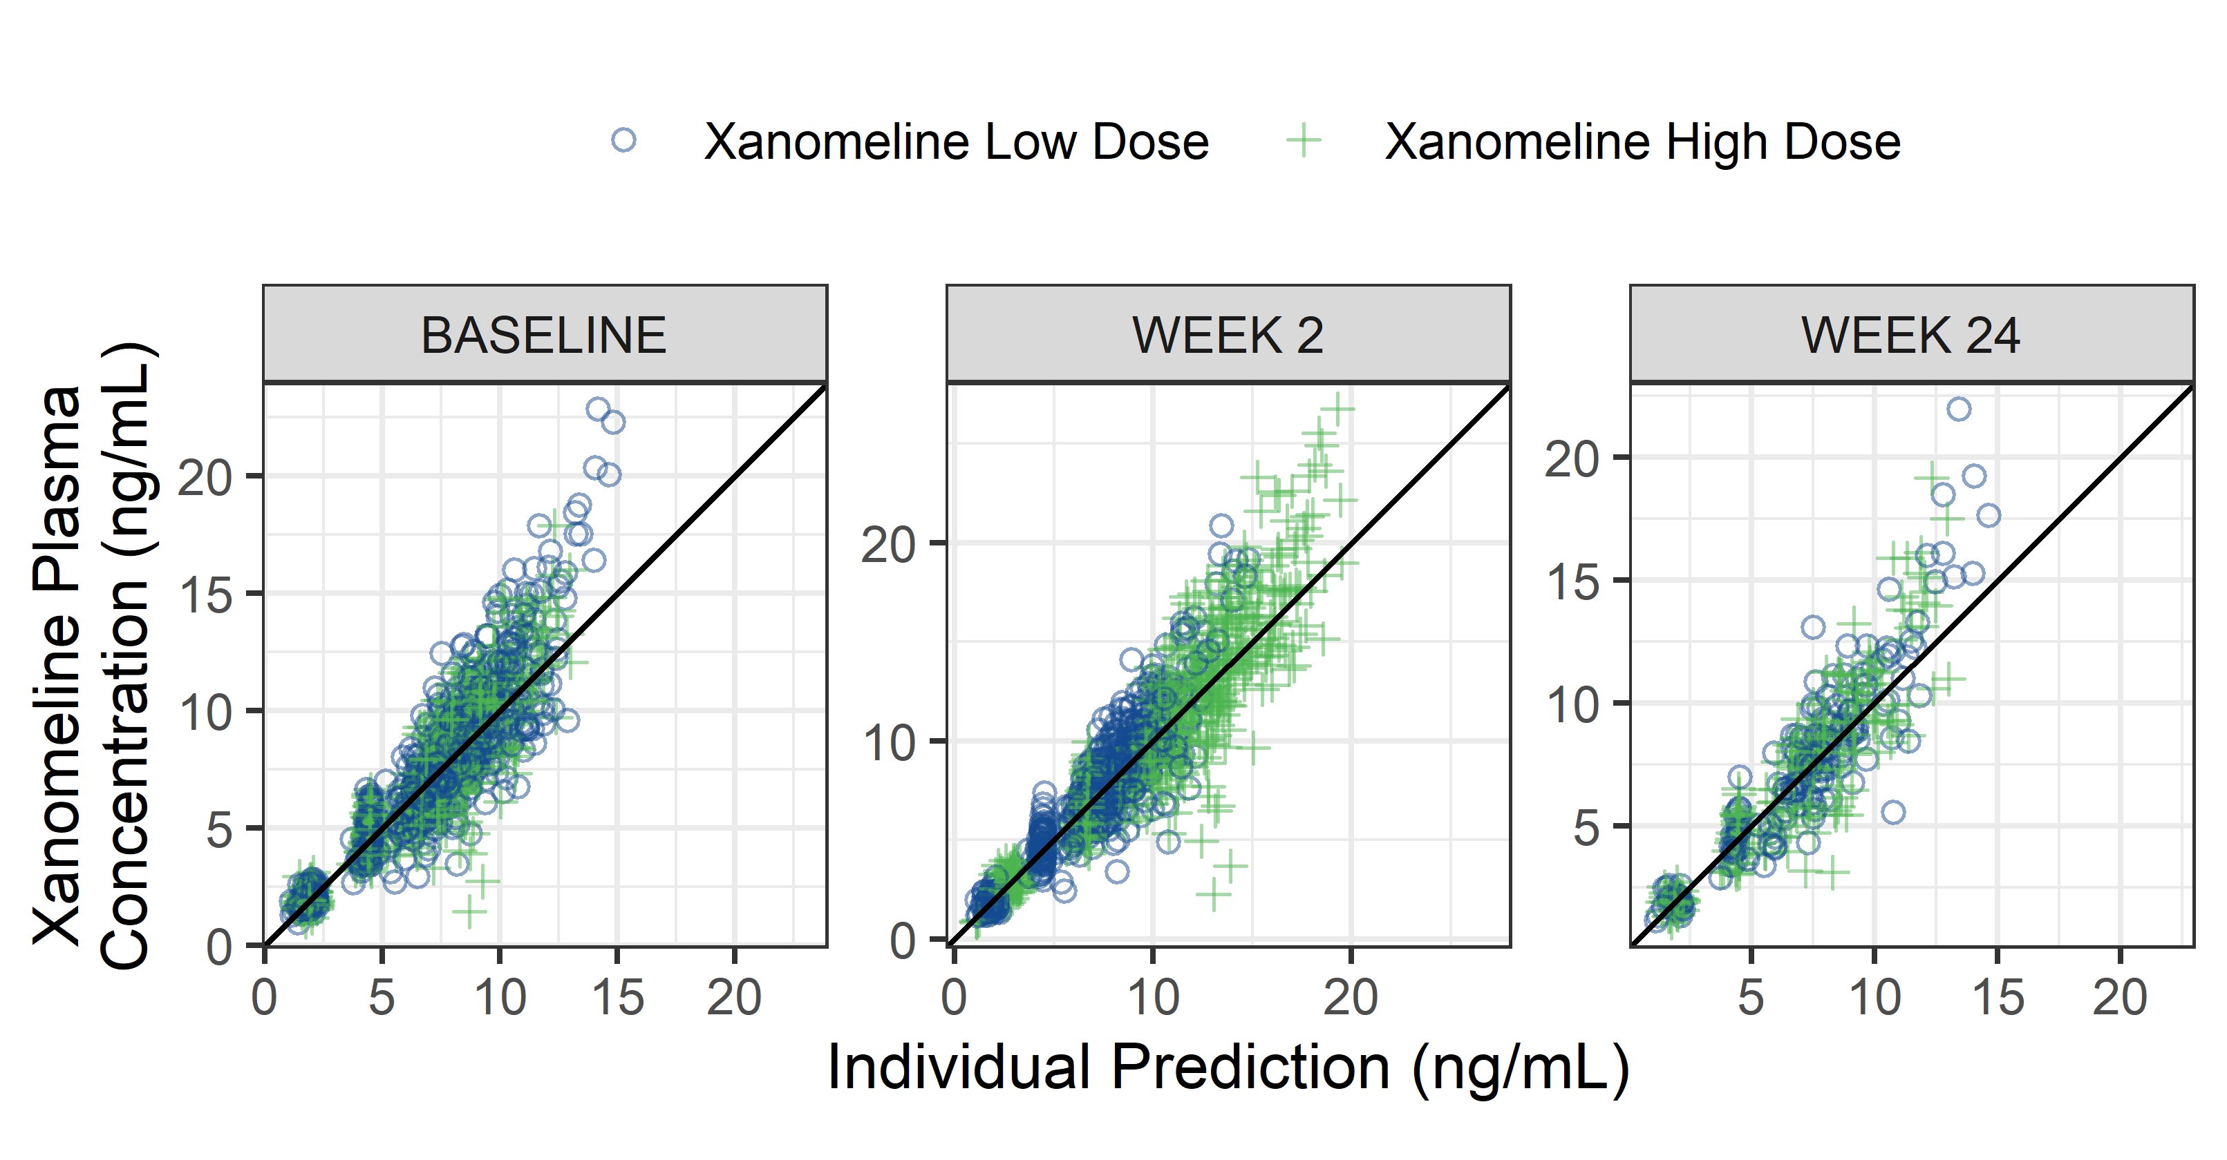
Observations vs Individual Predictions by Arm, per Visit
DV-IPRED-ACTARM-VISIT.png

Slide 4
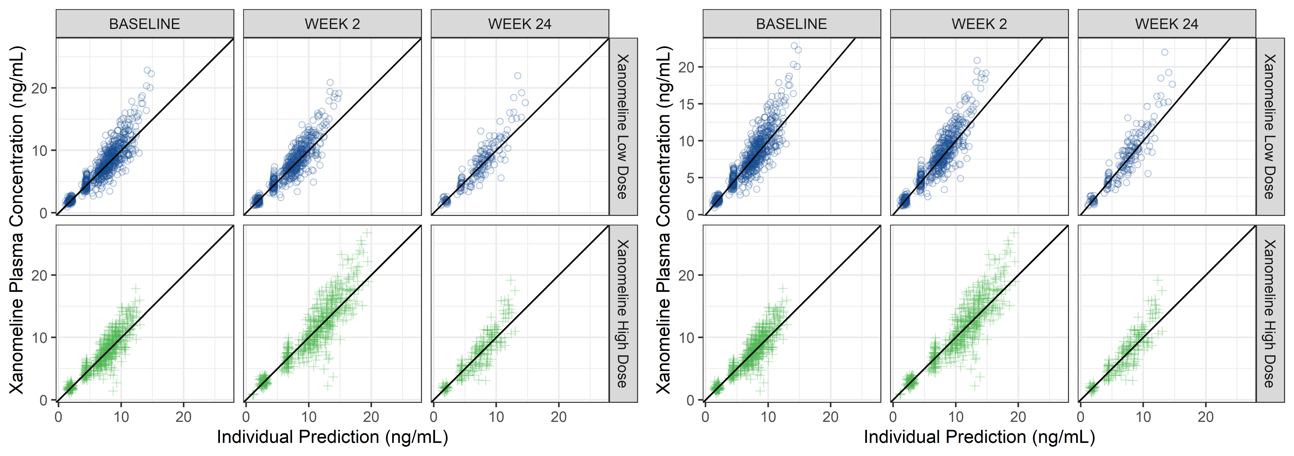
Observations vs Individual Predictions by Arm and Visit, and for scales = ‘free’
DV-IPRED-ACTARM-VISIT-GRID.png

Slide 5
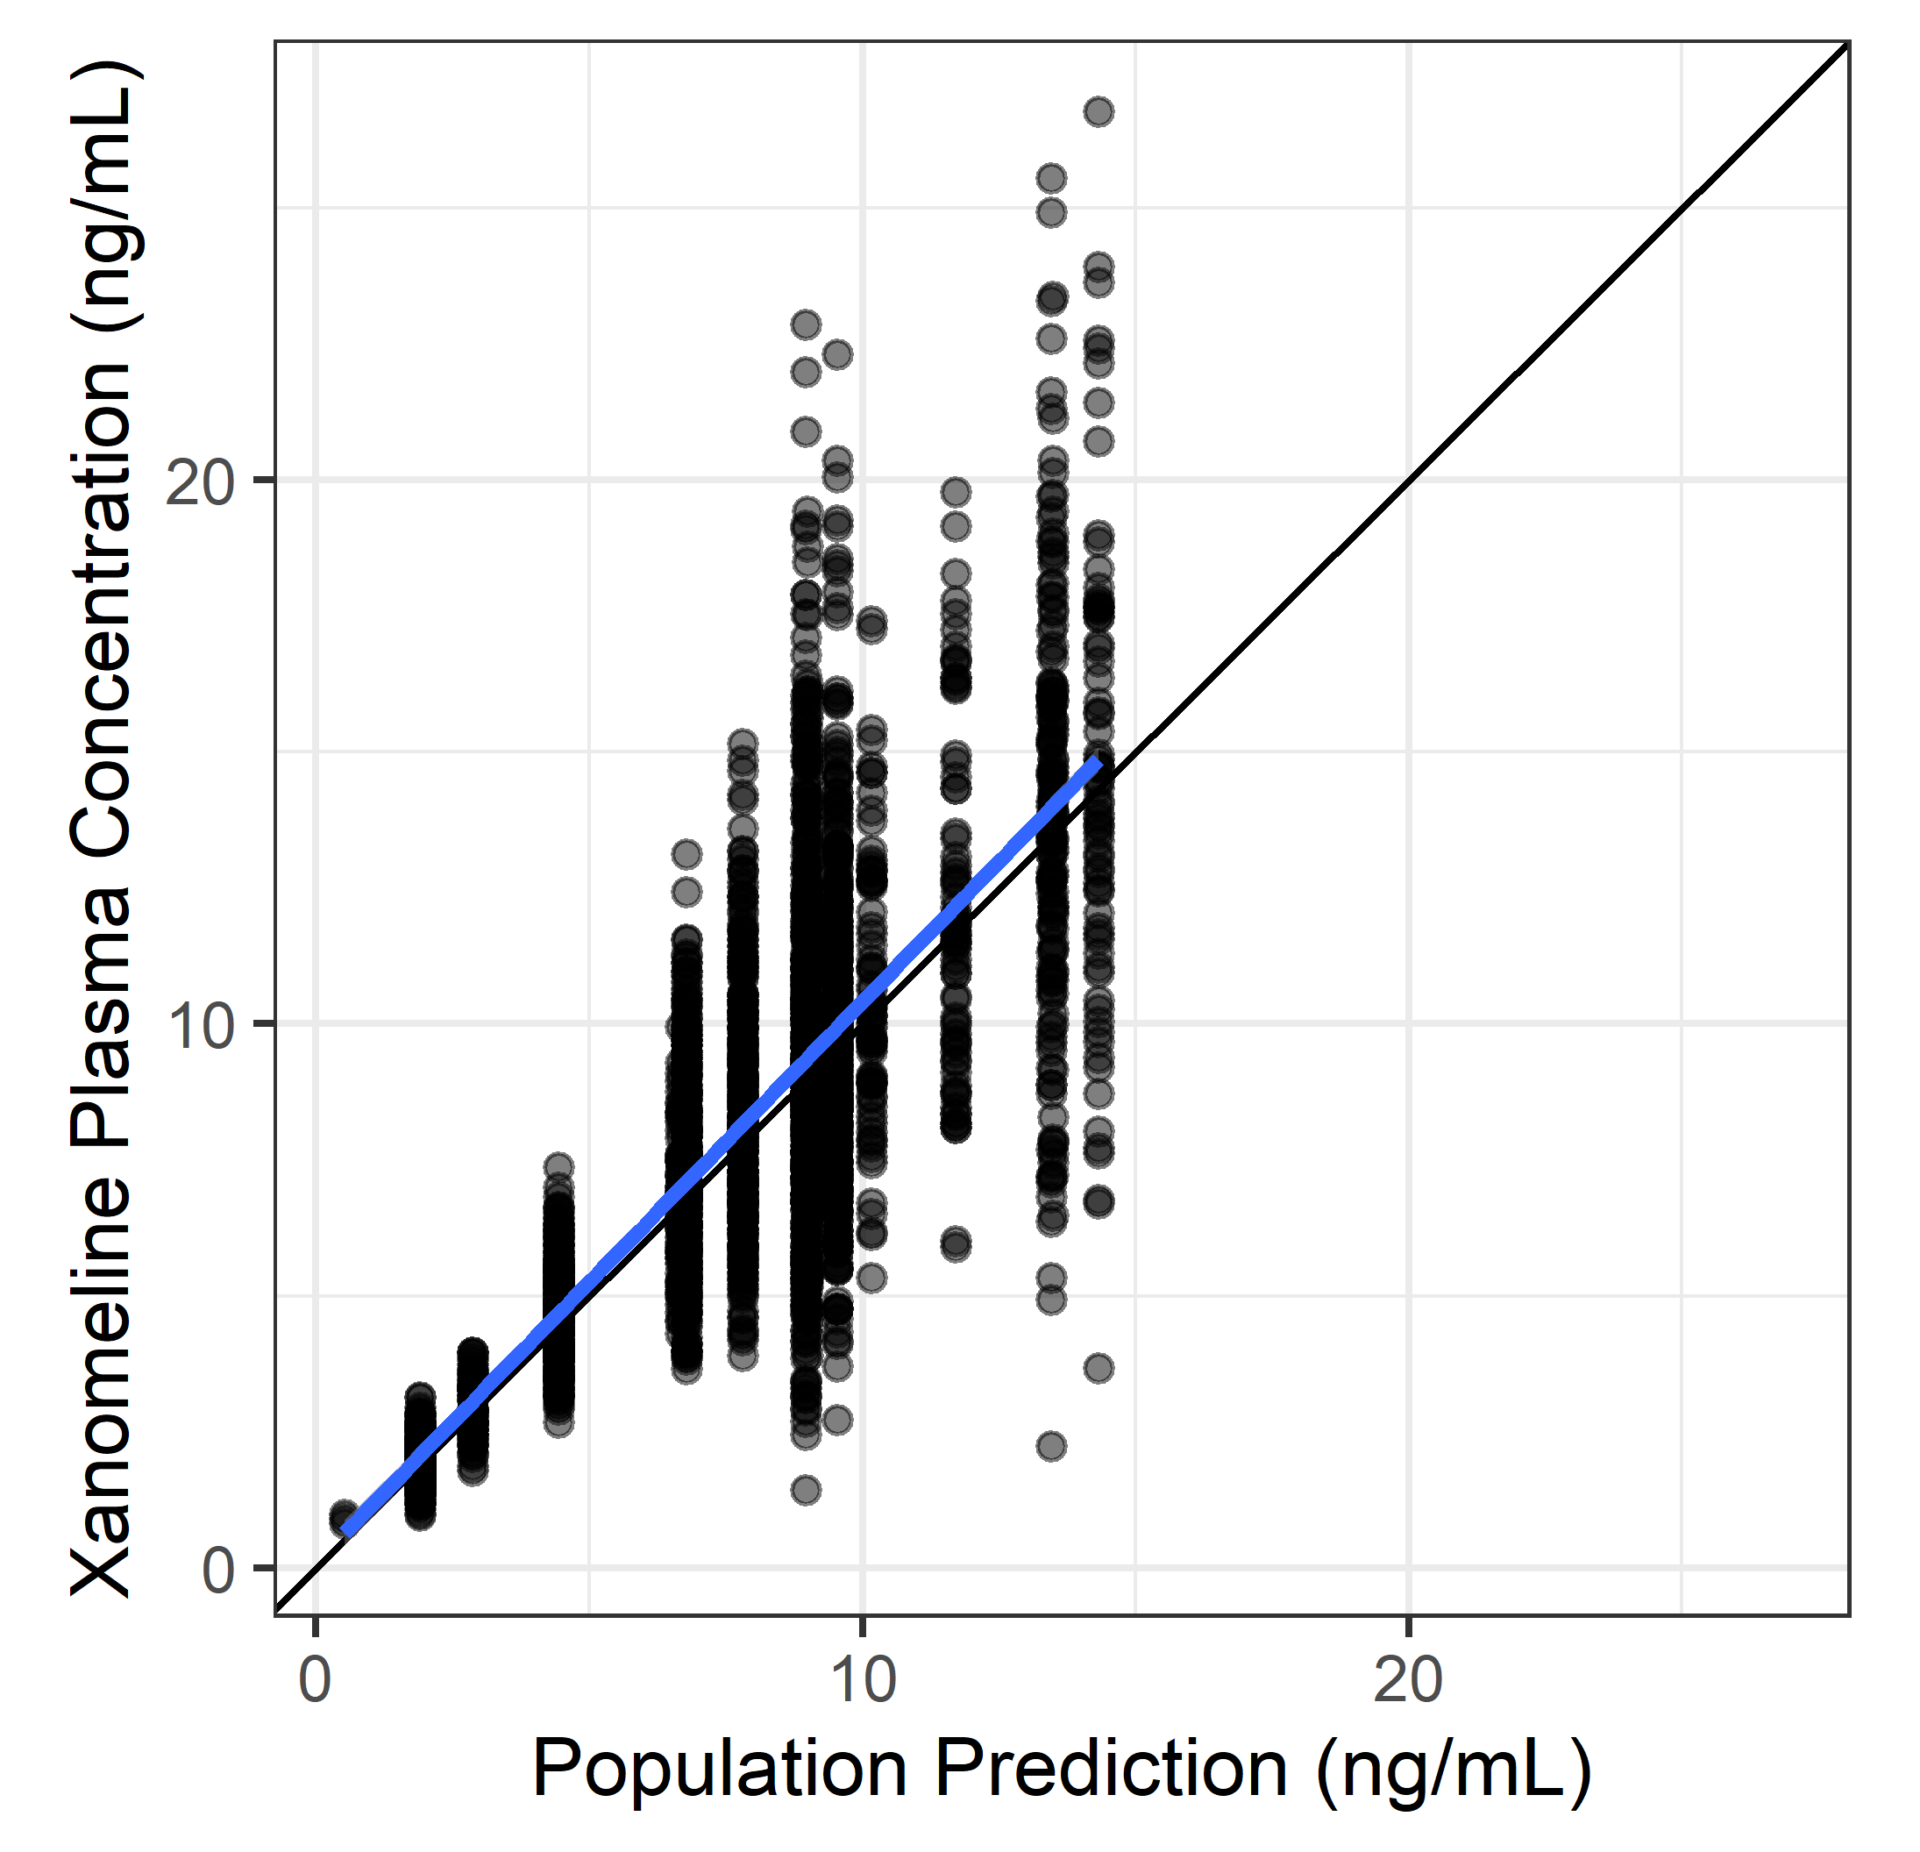
Observations vs Individual Predictions
x %>% isoplot(DV, PRED)

Slide 6
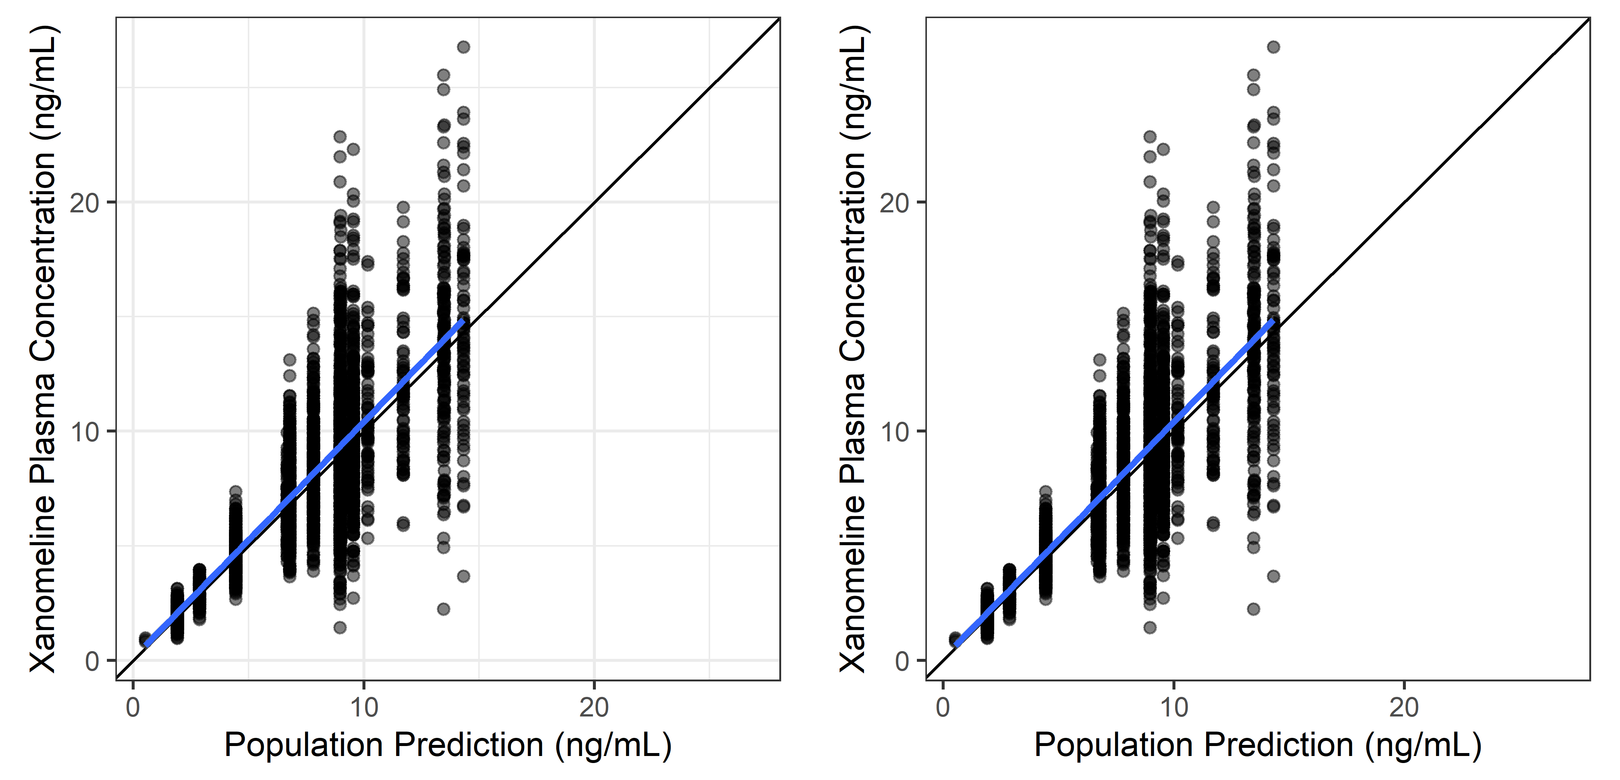
Observations vs Individual Predictions, With/without Grids
x %>% isoplot(DV, PRED)

Slide 7
Observations vs Population Predictions, Log-log
x %>% isoplot(DV, PRED, trans = ‘log10’)

Slide 8
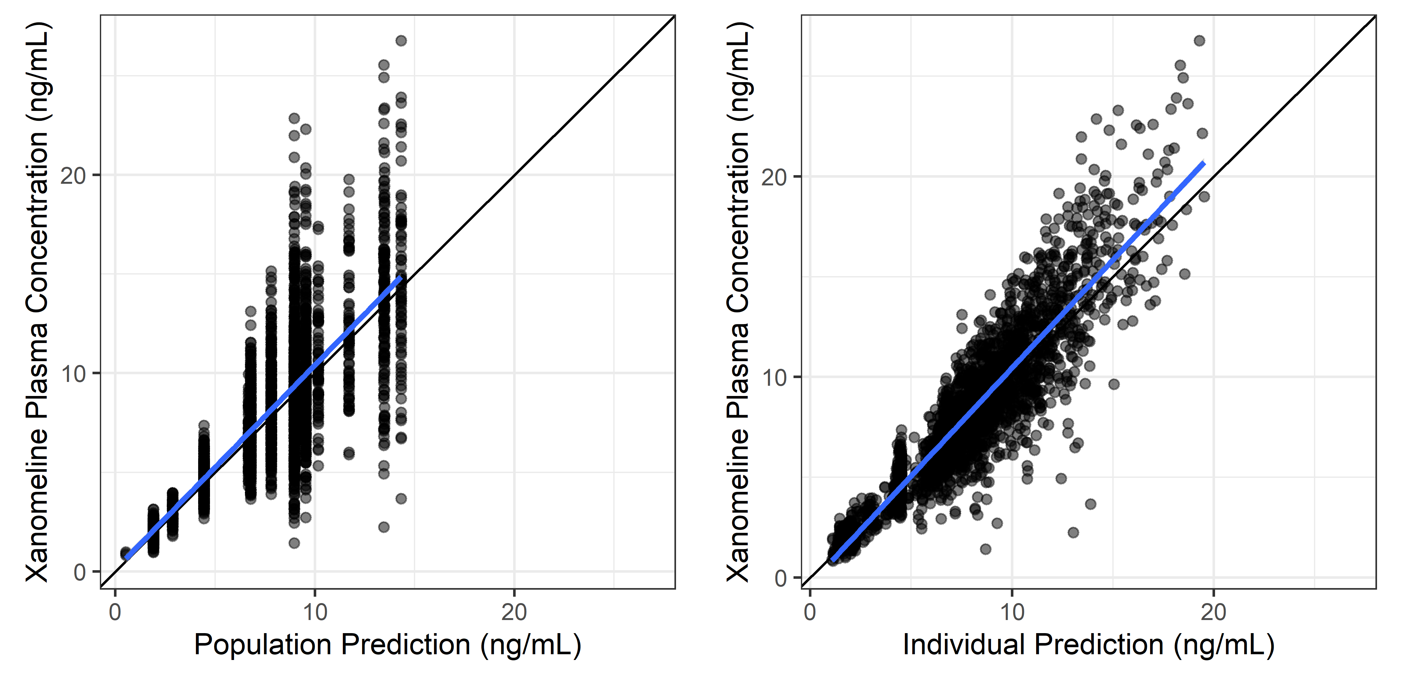
Observations vs Population and Individual Predictions
x %>% isopair(DV, PRED, DV, IPRED)

Slide 9
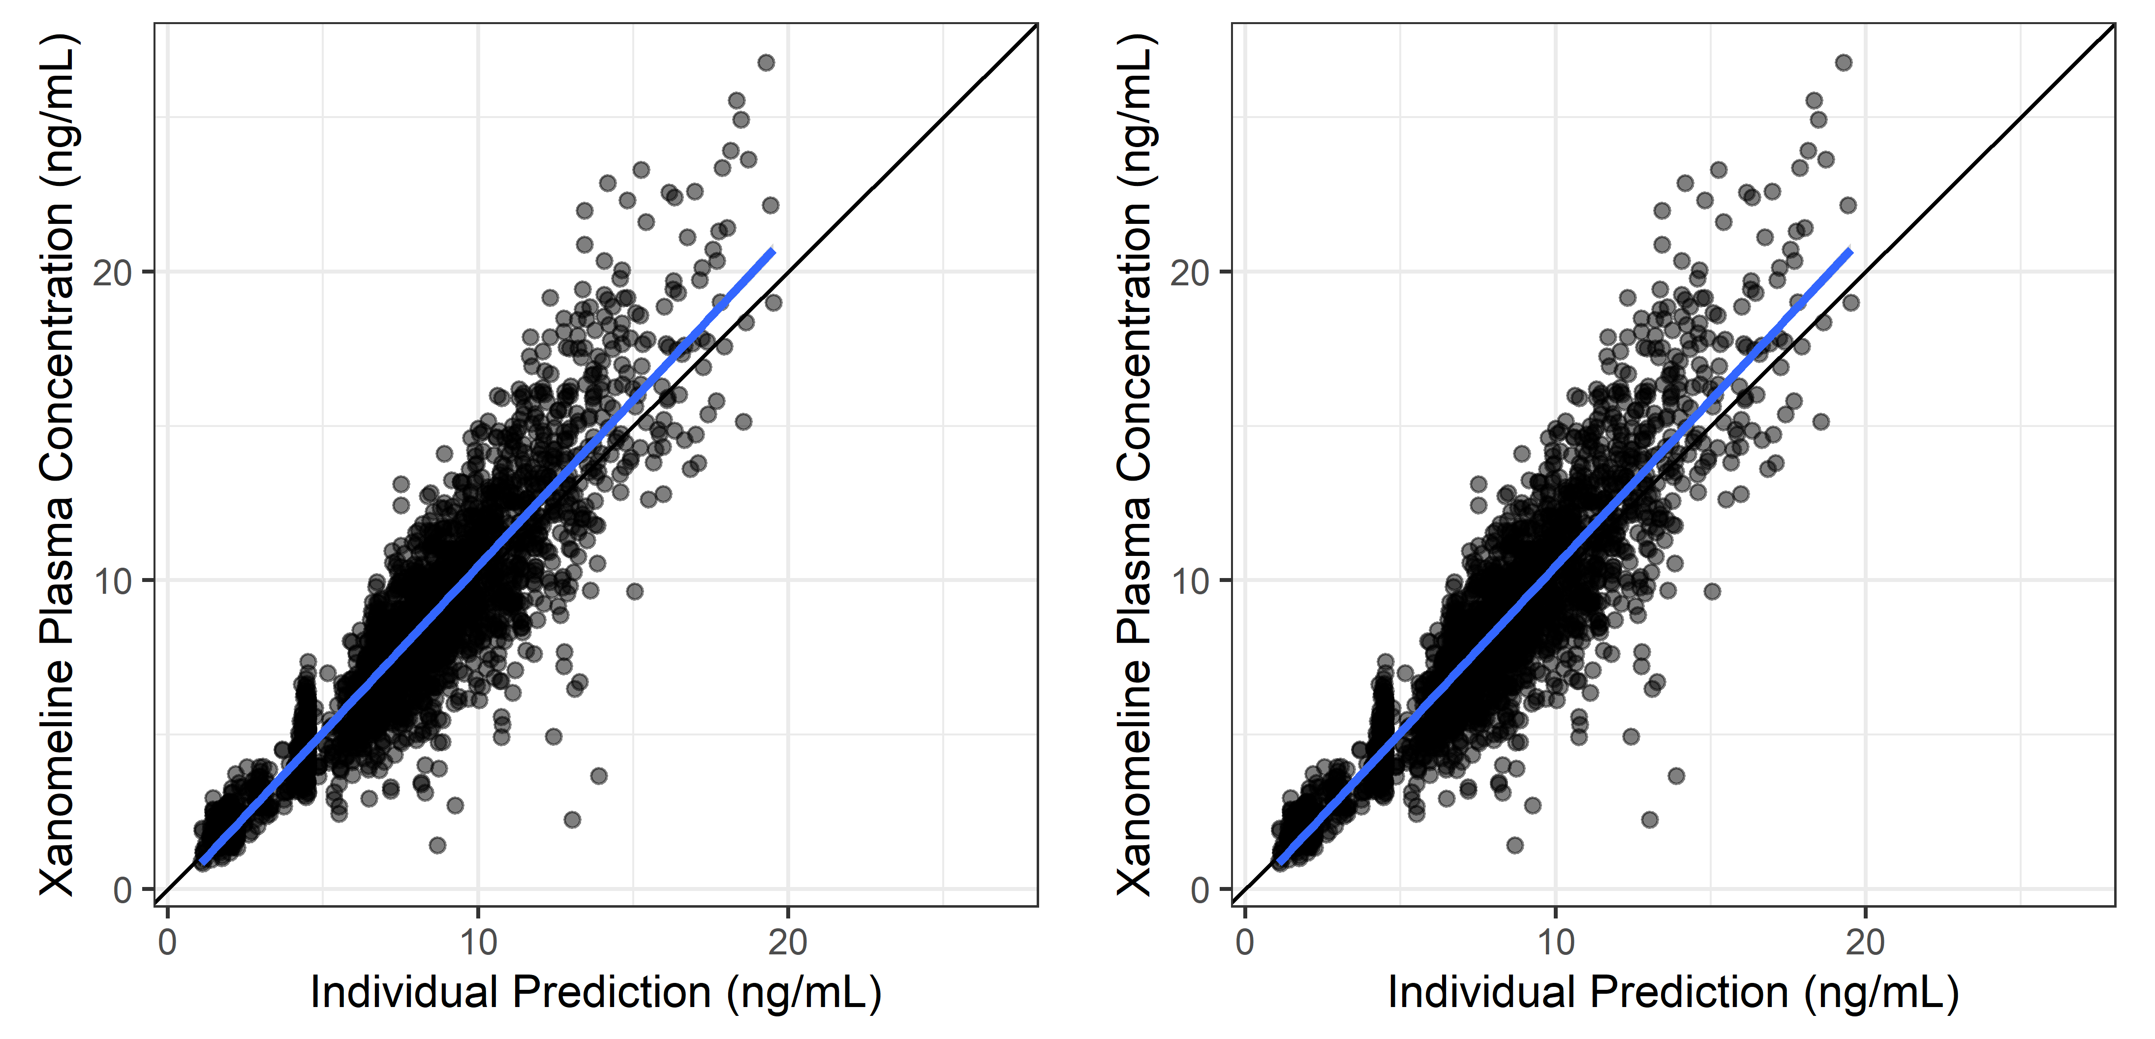
Observations vs Individual Predictions, Untransformed and Log-log
x %>% isopair(DV, IPRED, DV, IPRED, trans = c(‘identity’,‘log10’))

Slide 10
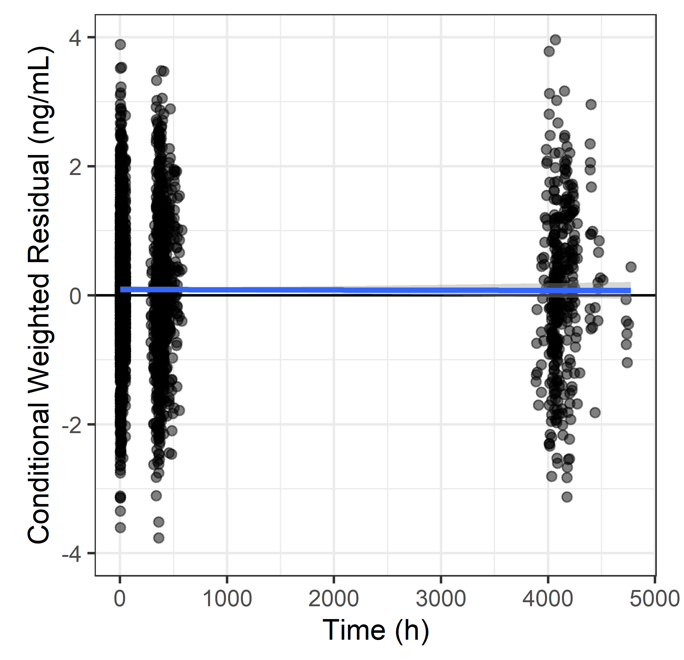
Conditional Weighted Residuals vs Time
x %>% trendplot(CWRES, TIME) + symmetric()

Slide 11
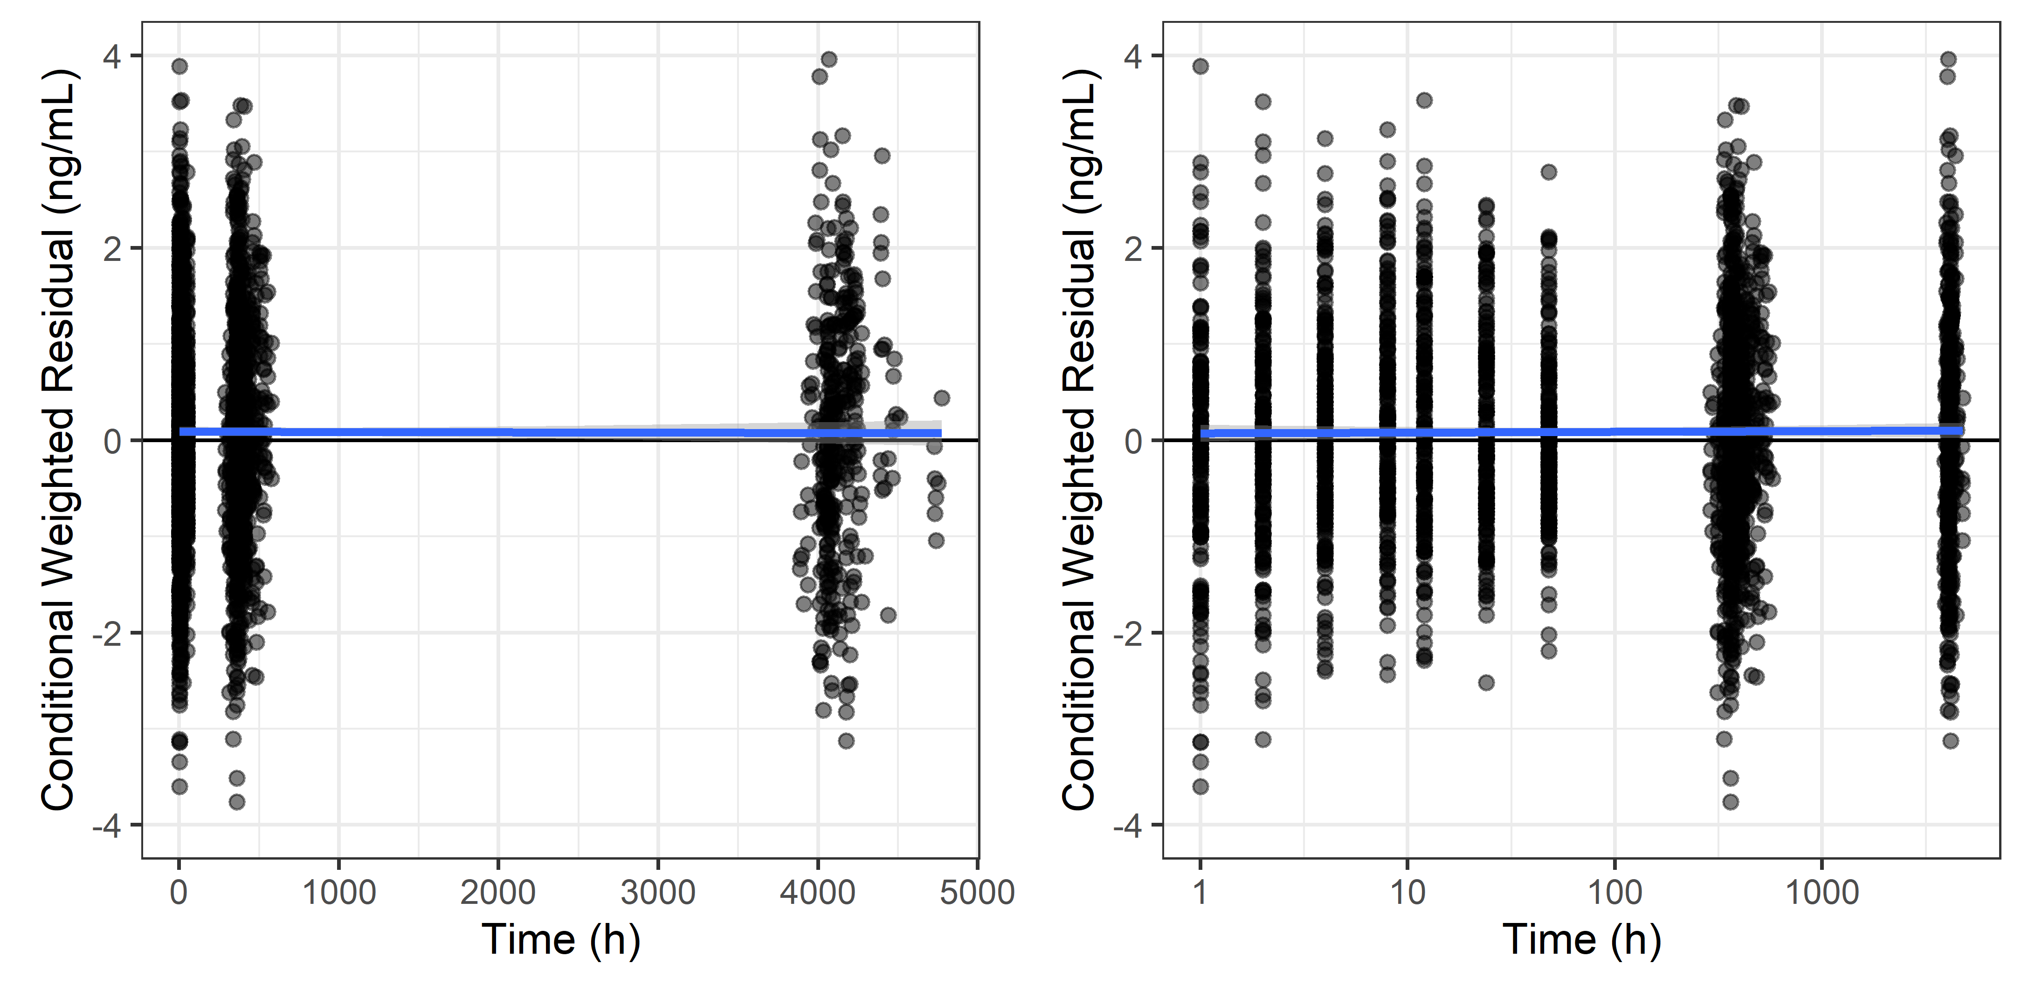
Conditional Weighted Residuals vs Time, Untransformed and Log-log
x %>% trendpair(CWRES, TIME, CWRES, TIME, trans2 = c(‘identity’, ‘log10’), symmetric = TRUE)

Slide 12
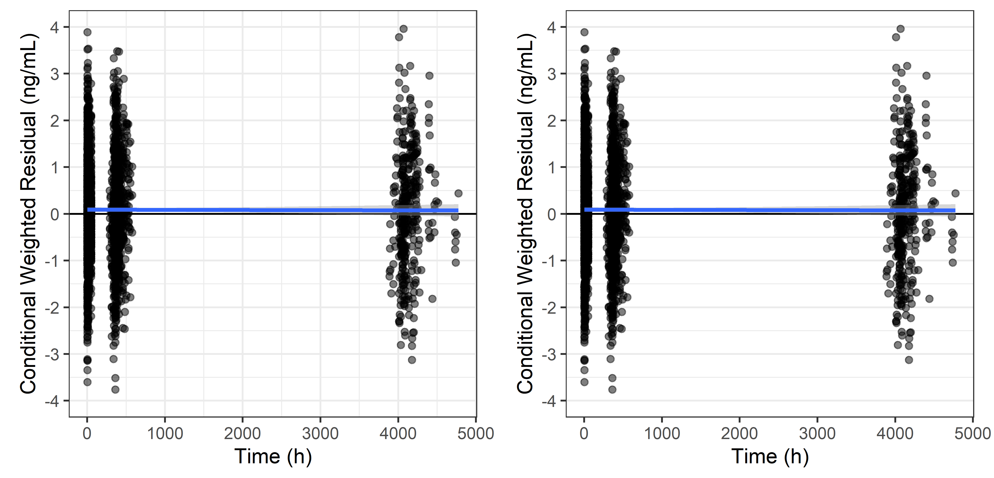
Conditional Weighted Residuals vs Time, Full Grid vs Horizontal Grid

Slide 13
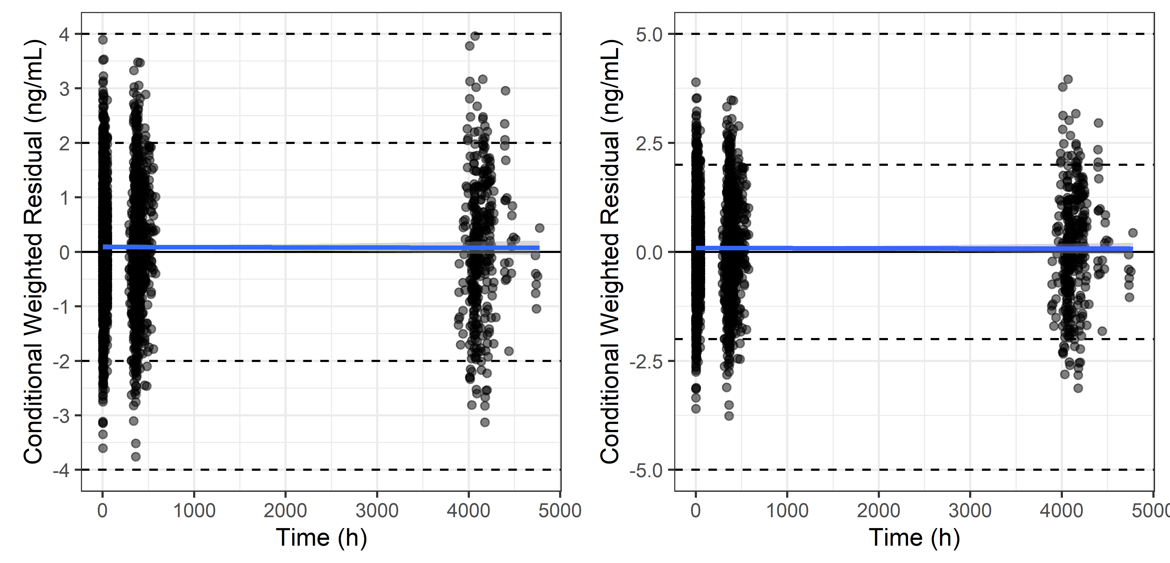
Conditional Weighted Residuals vs Time, Various Horizontal Reference Lines

Slide 14
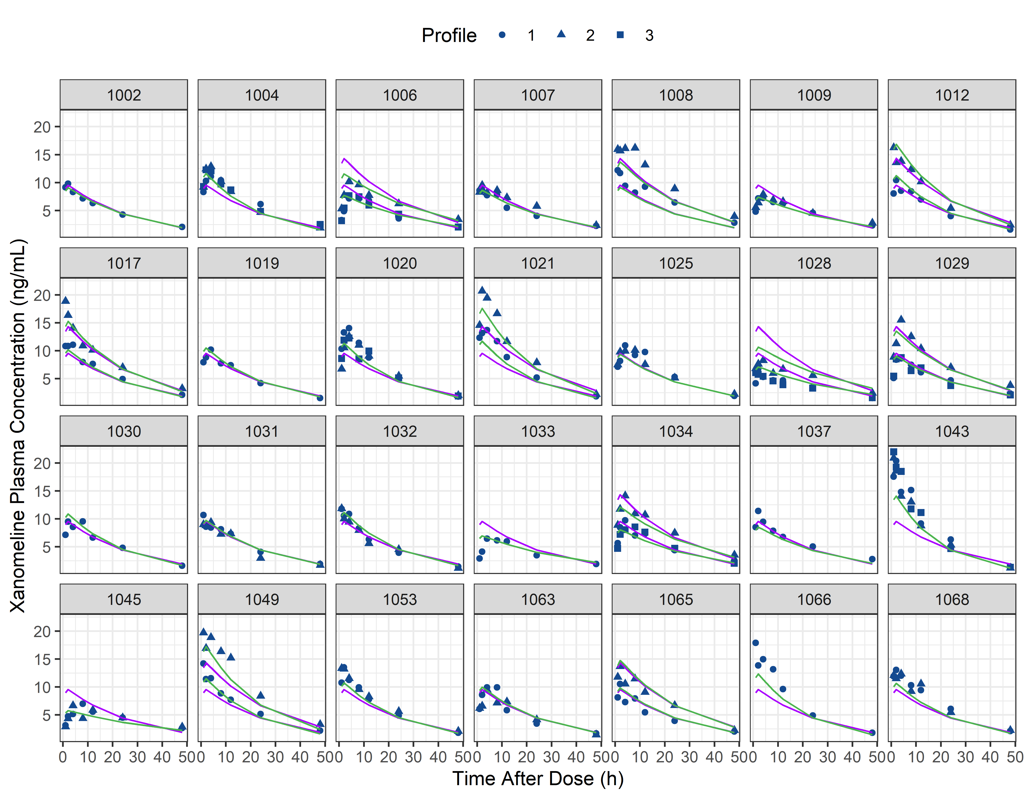
Individual Plots

Slide 15
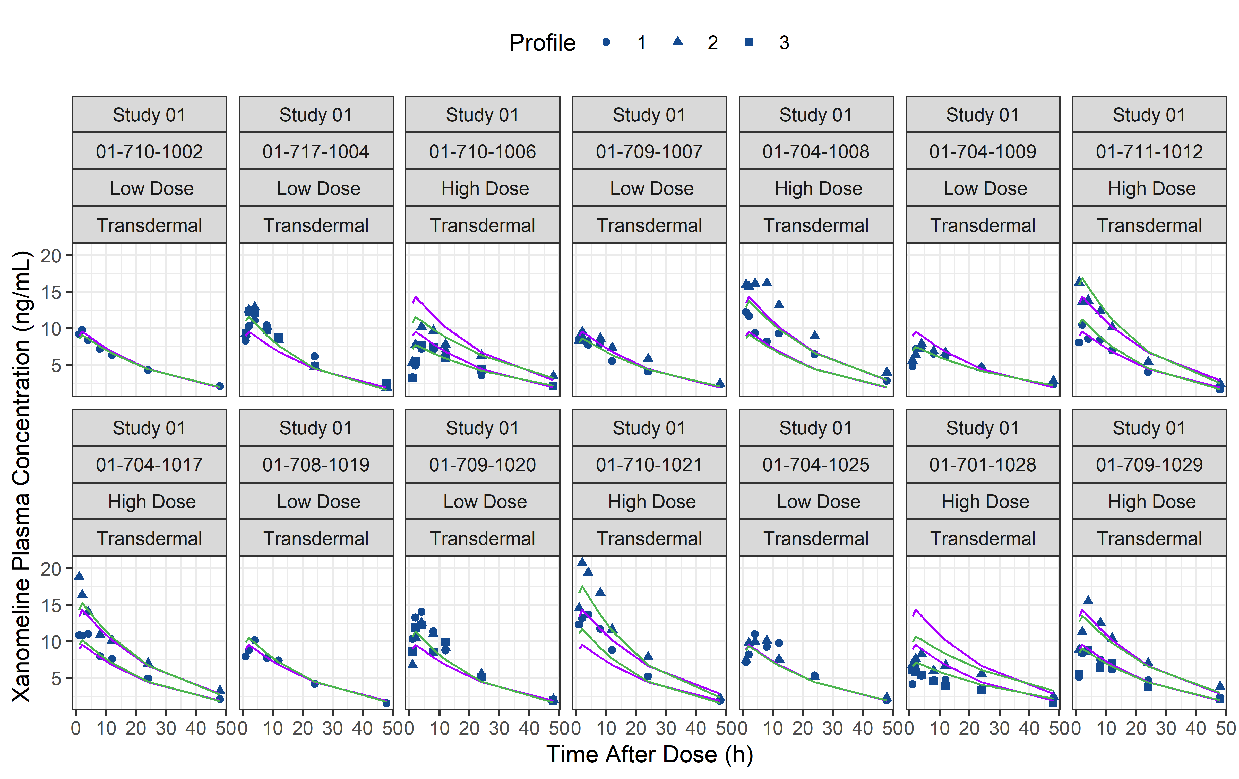
Individual Plots – Detailed Panel Strip

Slide 16
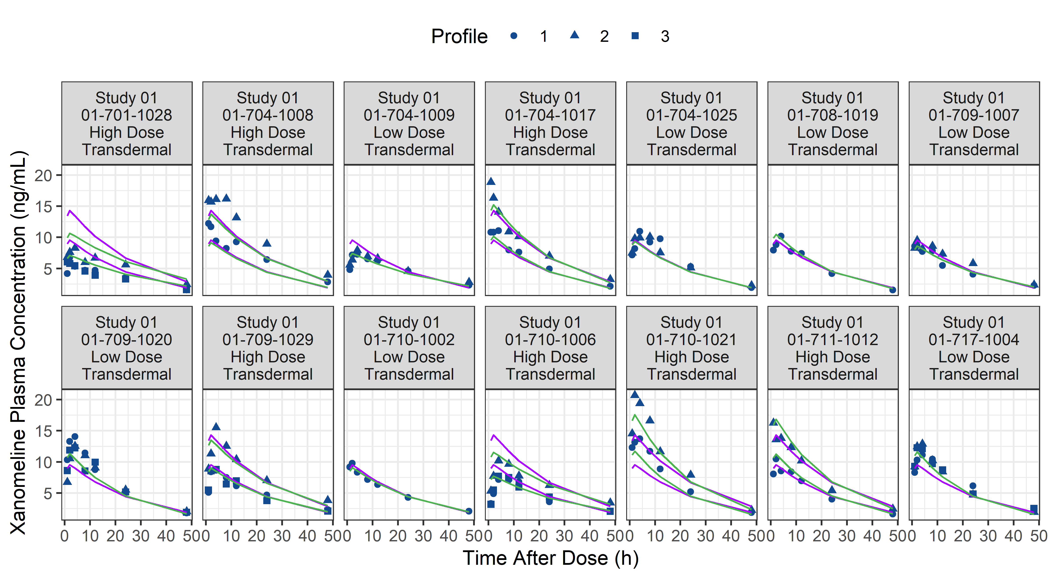
Individual Plots – Unscaled Panel Strip

Slide 17
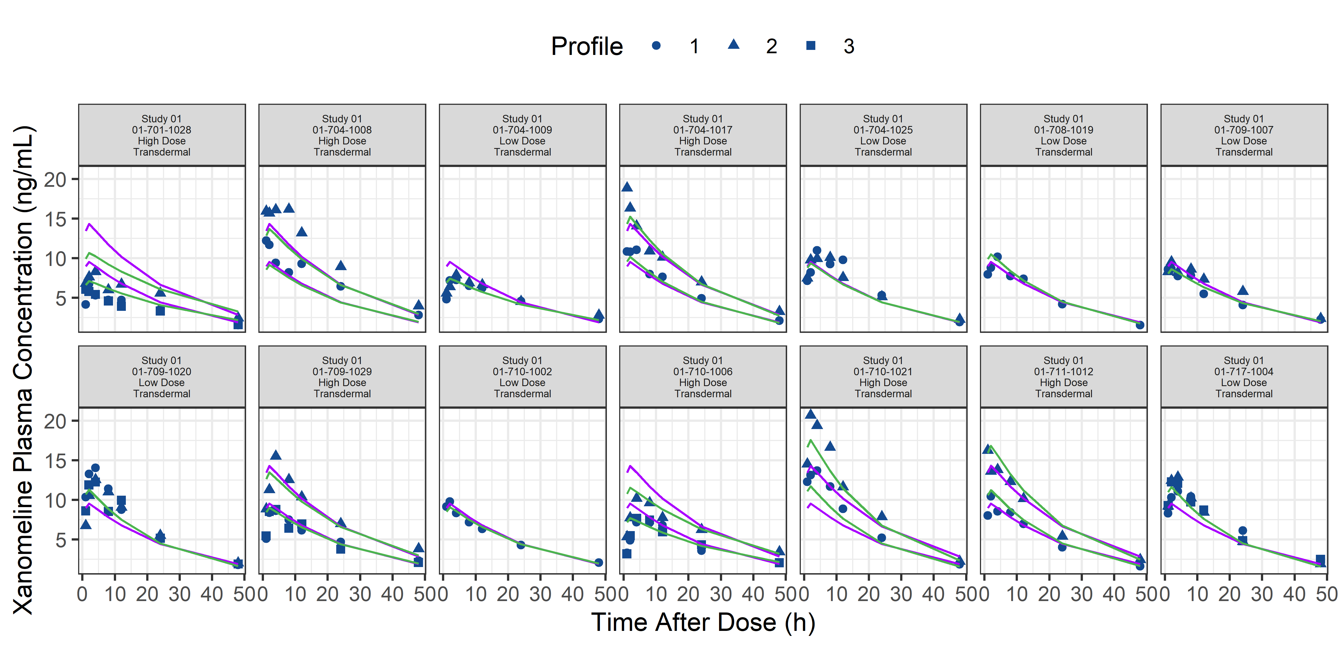
Individual Plots – Scaled Panel Strip
p + scale_striptext()

