Slide 1
Xanomeline Model Diagnostic Plots
Tim Bergsma

Slide 2
Data Diagnostics

Slide 3
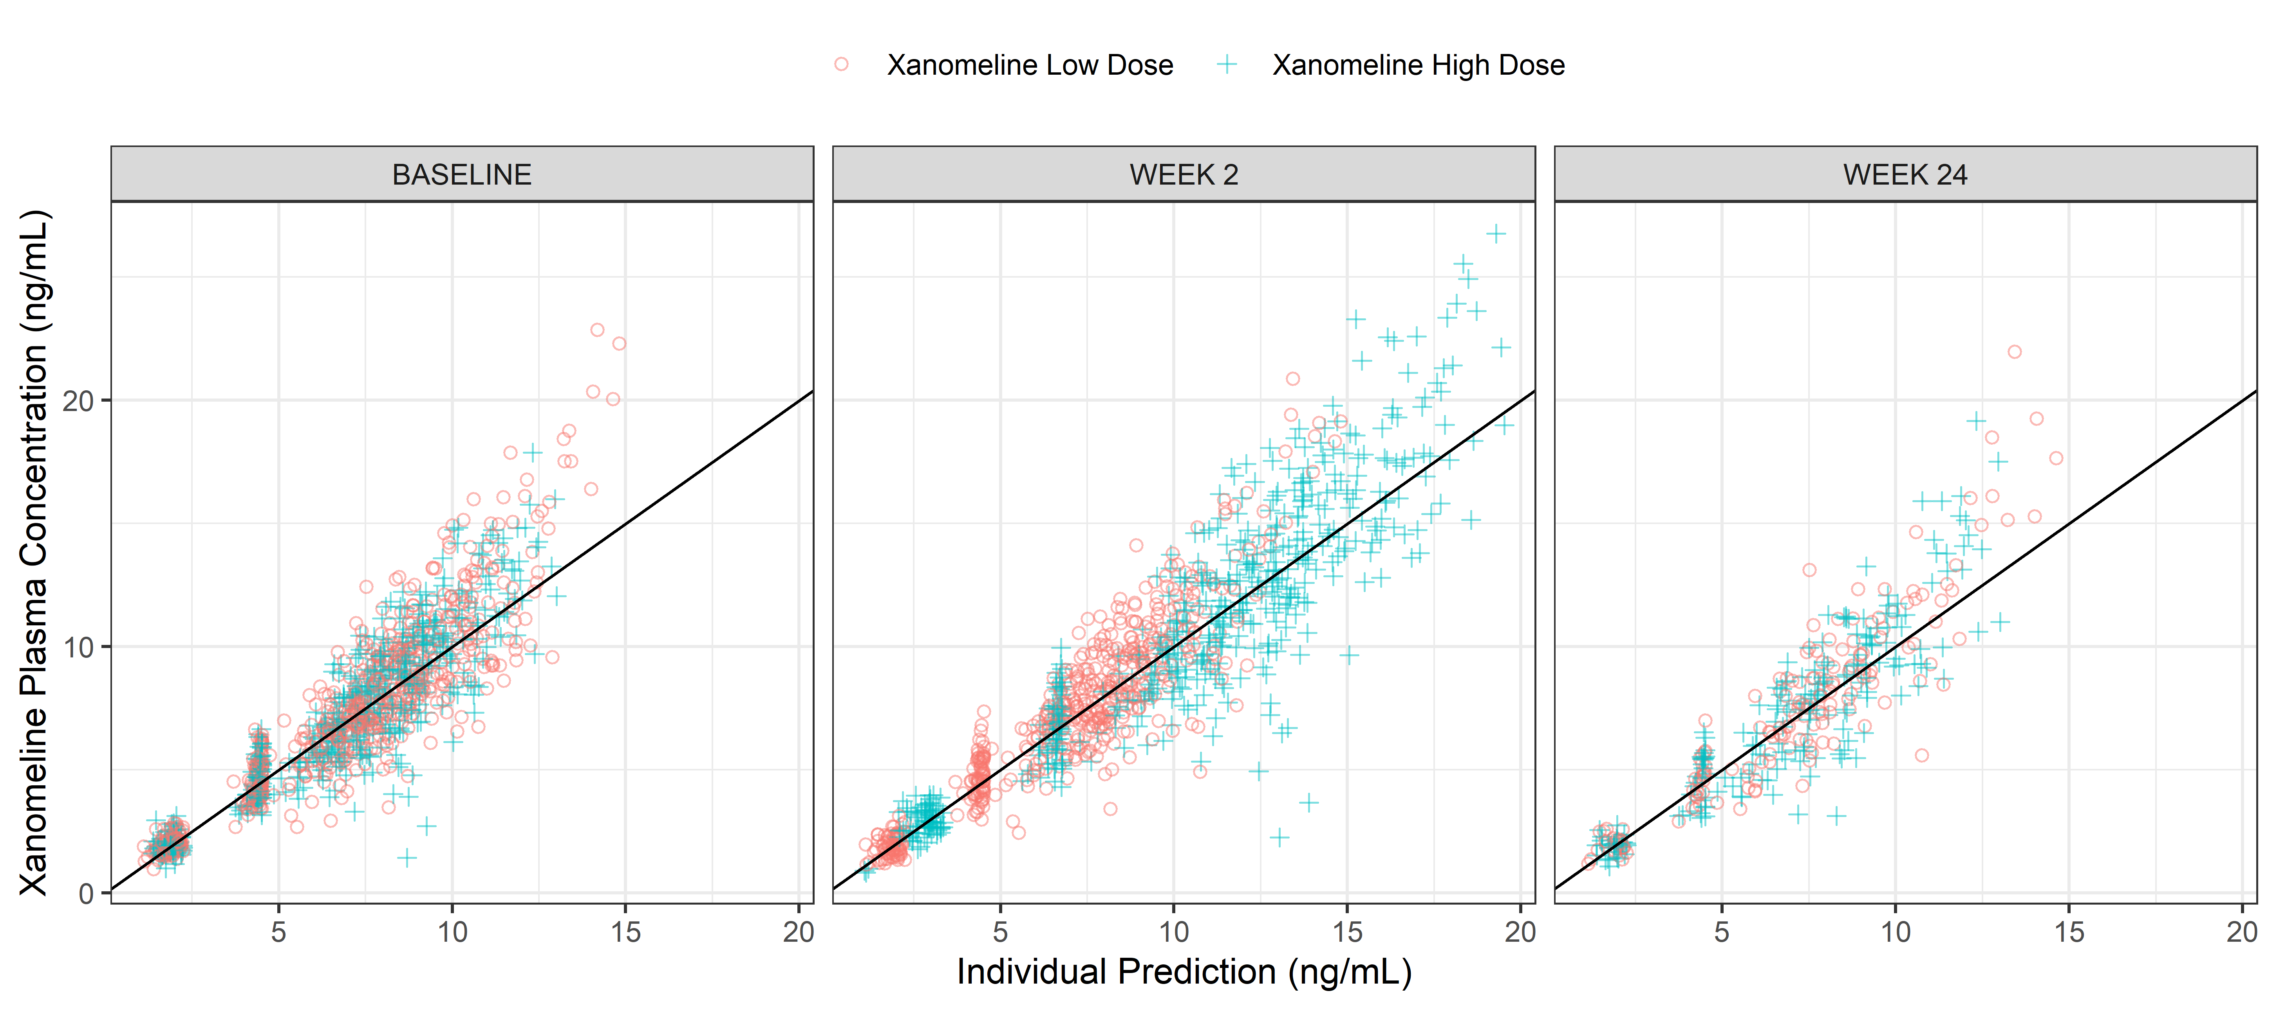
DV vs IPRED by ACTARM per VISIT
DV-IPRED-ACTARM-VISIT.png

Slide 4
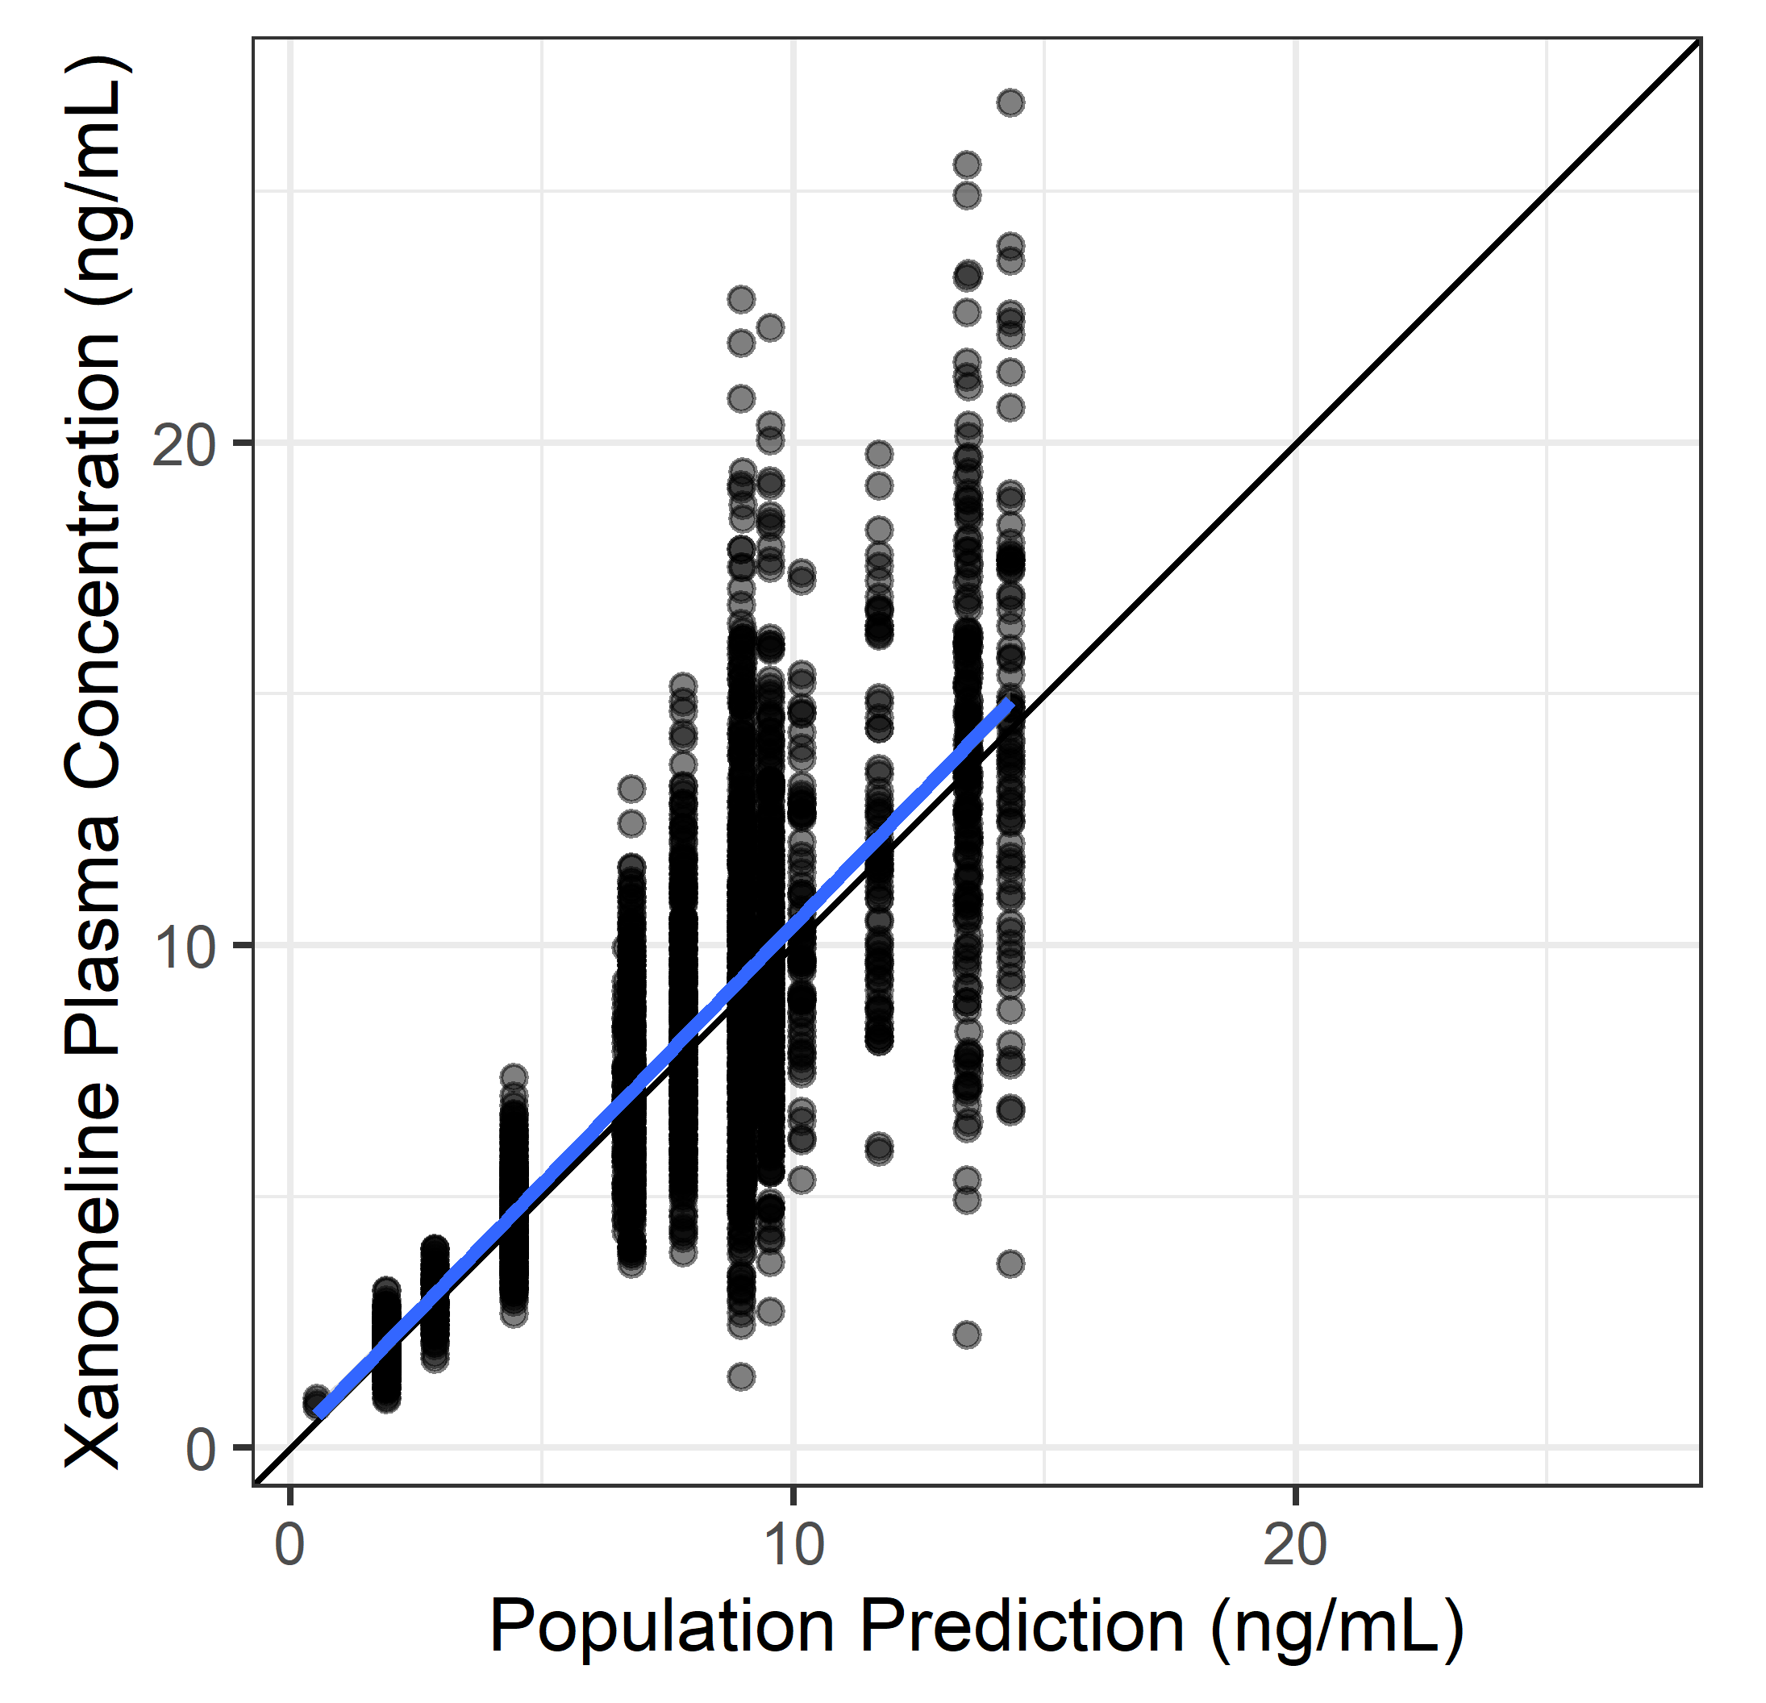
Observations vs. Individual Predictions
x %>% isoplot(DV, PRED)

Slide 5
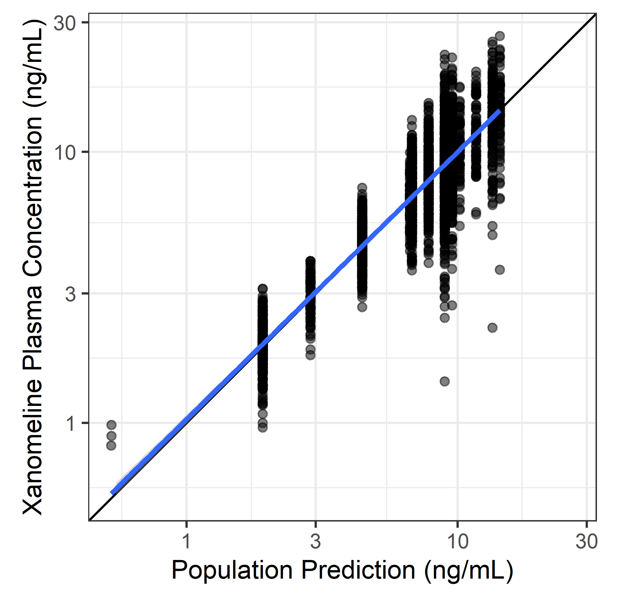
DV vs PRED log-log
x %>% isoplot(DV, PRED, trans = ‘log10’)

Slide 6
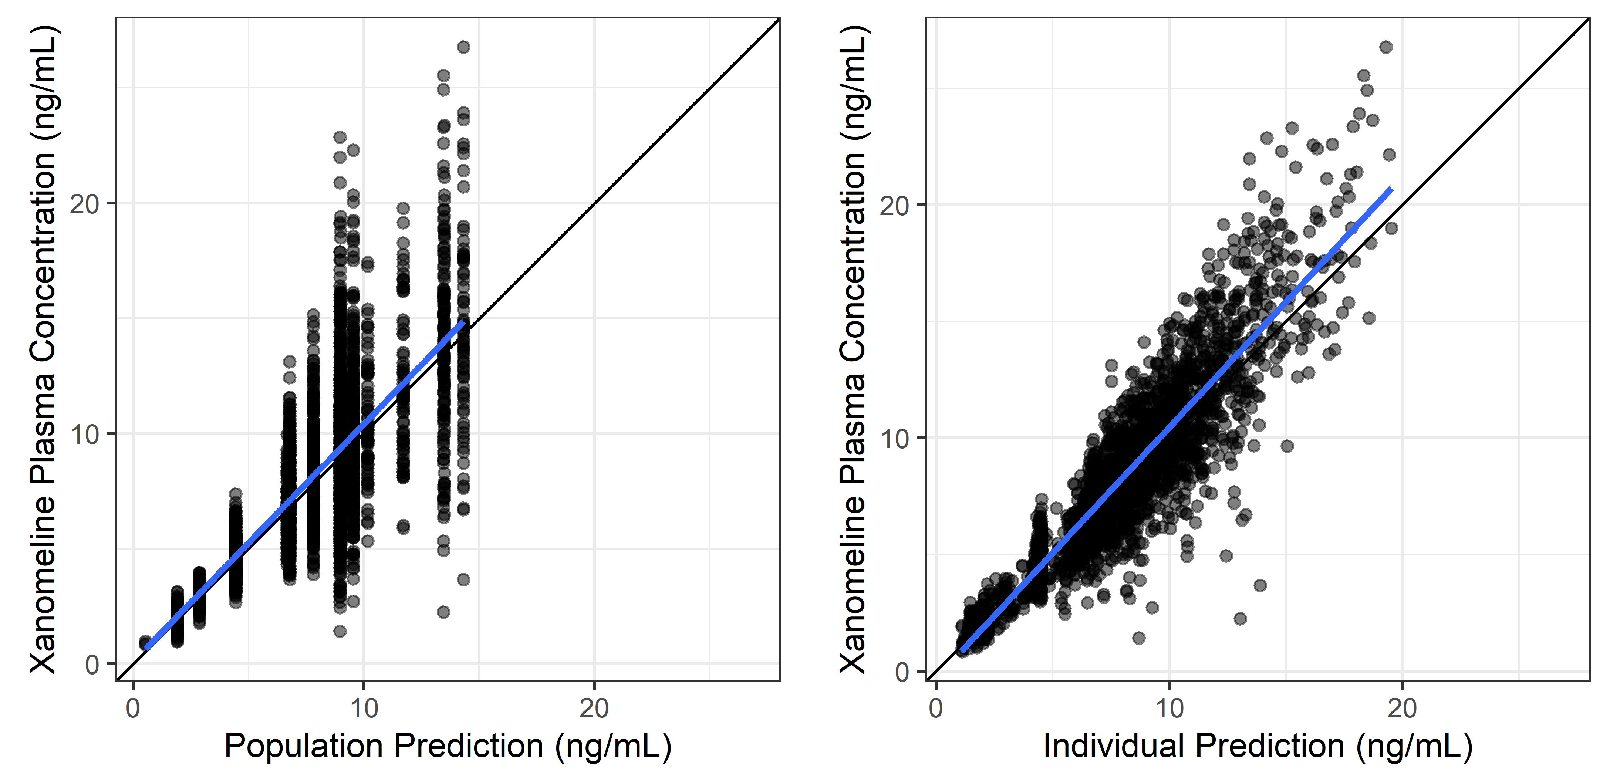
DV vs PRED and IPRED
x %>% isopair(DV, PRED, DV, IPRED)

Slide 7
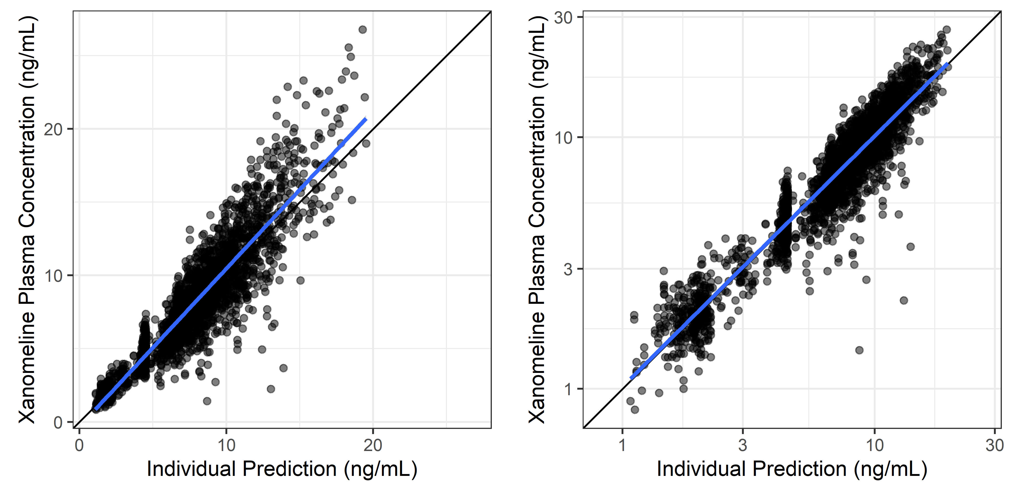
DV vs IPRED, untransformed and log-log
x %>% isopair(DV, IPRED, DV, IPRED, trans = c(‘identity’,‘log10’))

Slide 8
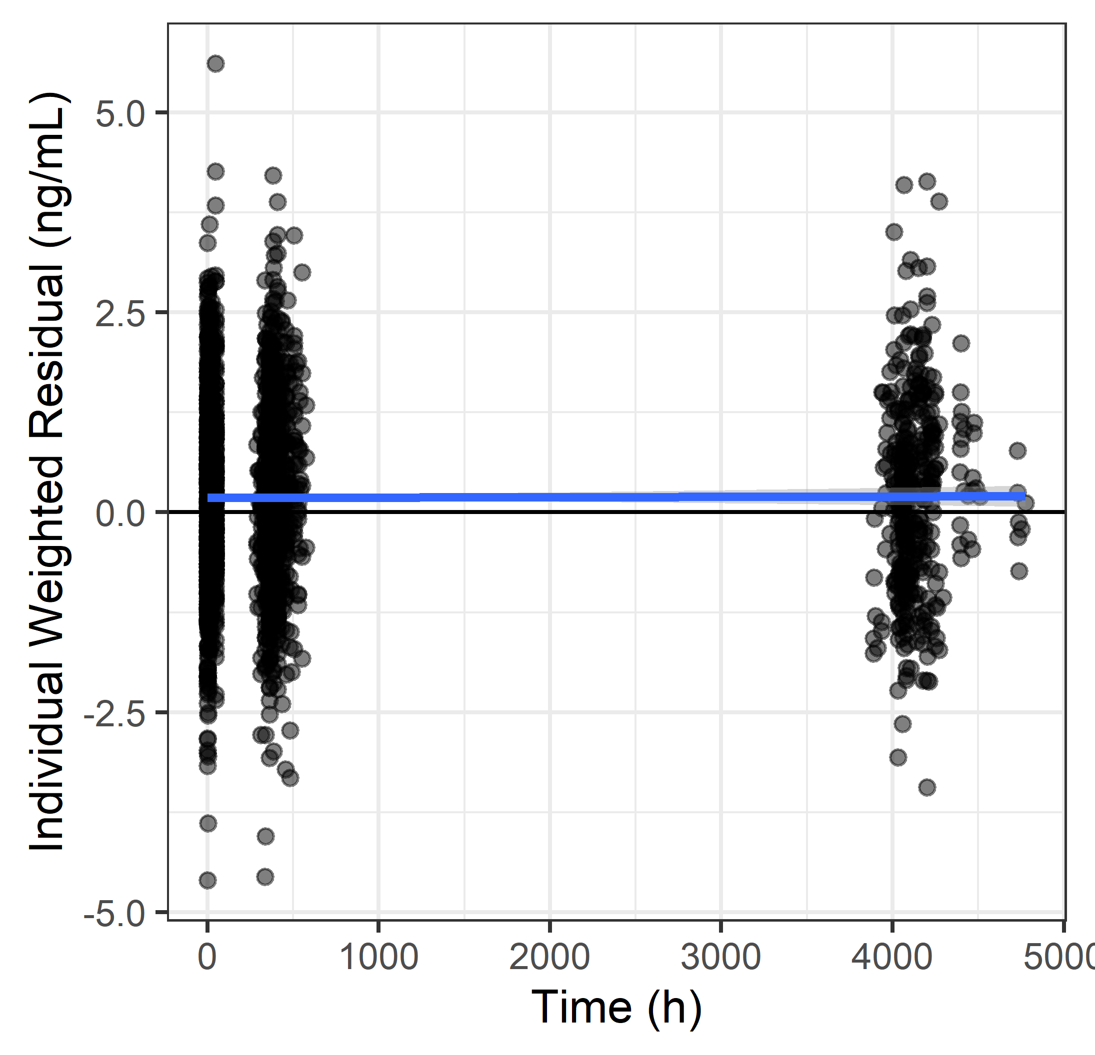
IWRES vs TIME
x %>% trendplot(IWRES, TIME)

Slide 9
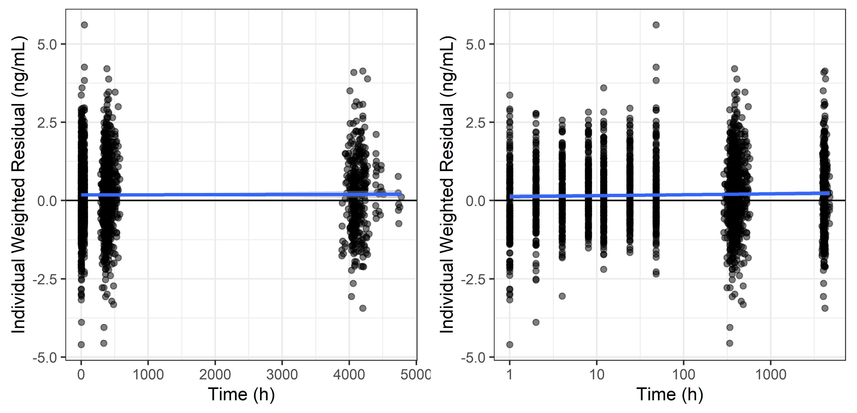
IWRES vs TIME, untransformed and log-log
x %>% trendpair(IWRES, TIME, IWRES, TIME, trans2 = c(‘identity’, ‘log10’))

