Slide 1
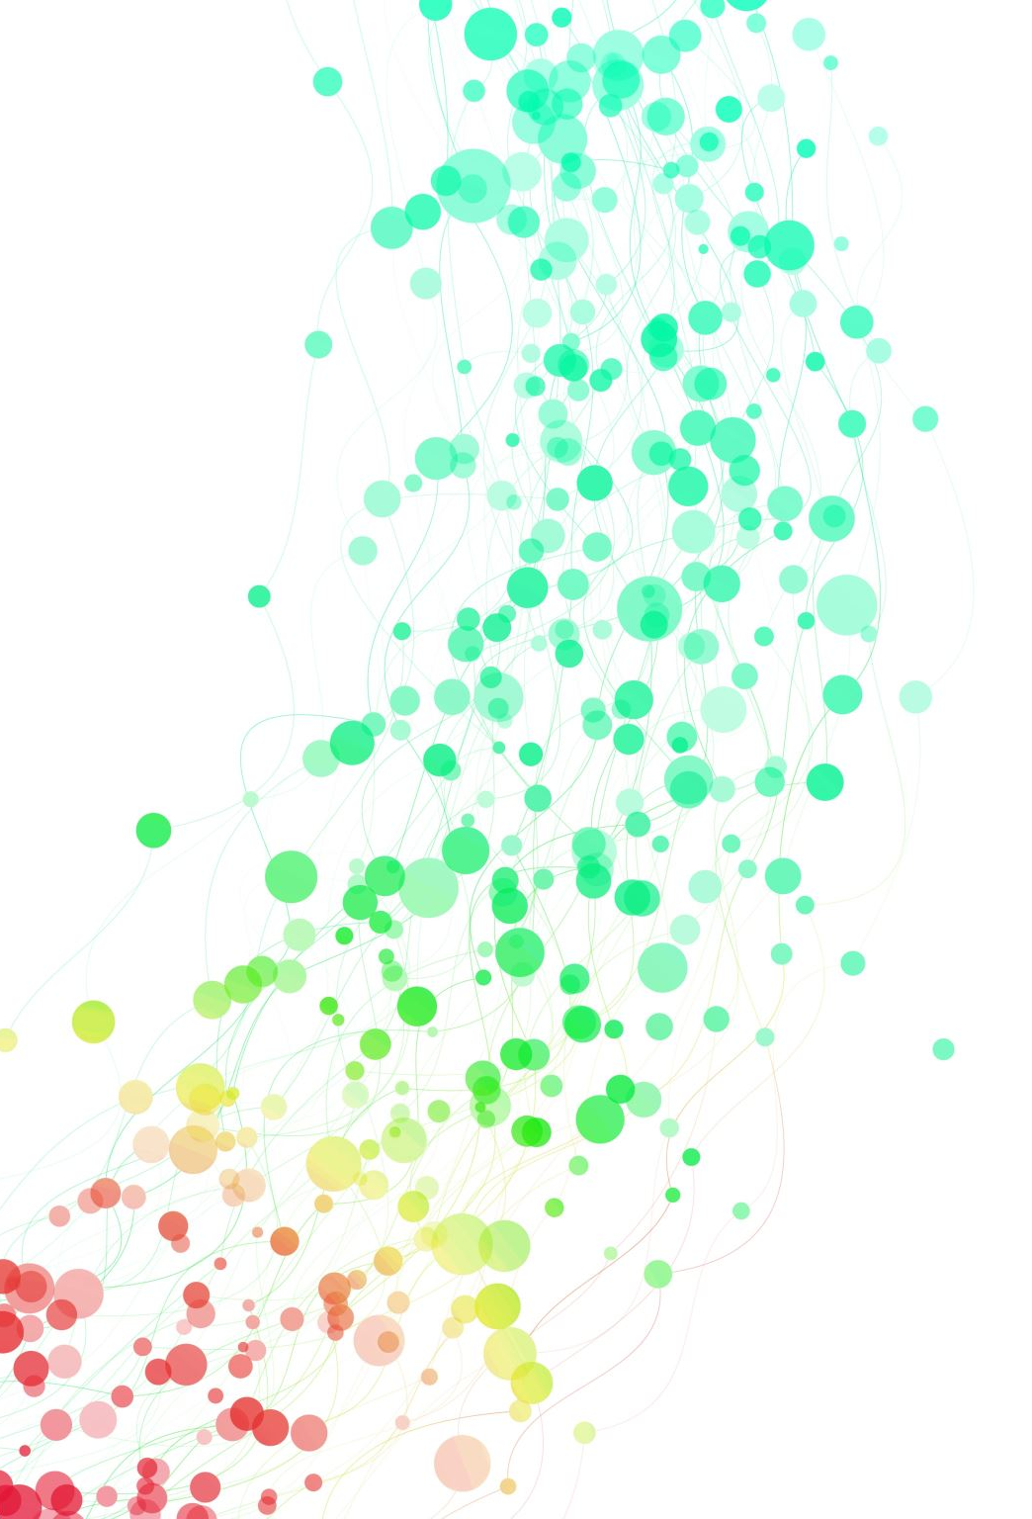
WCS Project
Store Sales – Time Series Forecasting
Group 11 – Adithya, Konstantinos, Sudarsan

Slide 2
Introduction
We picked the Store Data Forecasting using Machine Learning.
We will try to answer
If Holiday Events influence Sales Prices?
If Oil Prices influence Sales Prices?
Our objective is to develop a machine learning model for accurate store sales predictions. It would minimize stockouts, reduce waste, and optimize pricing strategies
Similar Time-Forecasting machine learning algorithms can be applied to other problems.
Create generalized pipeline in BRANE

Slide 3
Dataset
The dataset for this competition consists of time series data from Favorita stores in Ecuador, including features such as store number, product family, promotion status, and sales.
The training data in 'train.csv' contains information on store numbers, product families, promotion status, and the corresponding sales.
The test data in 'test.csv' has the same features, and the objective is to predict the sales for the 15 days following the last date in the training data.
Supplementary files include store metadata, daily oil prices, and information on holidays and events.

Slide 4
Data cleaning
Feature Selection and Transformation: Remove unnecessary columns and convert selected columns to the appropriate data types.
Aggregation:
Group the data by store numbers and sum the sales for each date.
Merge the processed data with store location information using store numbers.
Merge transaction data with the inputs and add lag features.
Adjust holiday data to include additional holidays and events.
Scale the total sales data using MinMaxScaler and create lag features for time series analysis.
Modify the test data to include a "sales" column filled with zeros and select relevant columns.
Data Validation and Cleanup: Remove any remaining missing values and set the "date" column as the index.

Slide 5
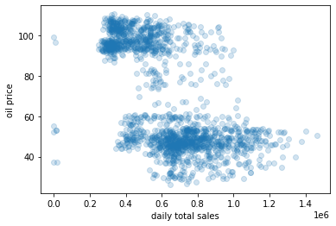
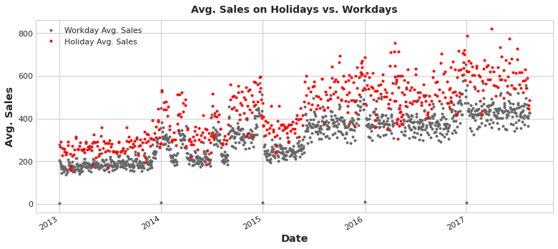
Analysis
Sales vs Oil Prices:
No obvious linear correlation between both of them. Observed Trend – Higher the Oil Price, Lower the Sales.
Sales vs Holiday/Events:
Generally sales are higher on the day of holidays and events.
Fine grained analysis on impact of different holiday on sales using AB test.

Slide 6
Training and Prediction
In the training phase, the linear regression model learns the relationship between the input features and the target variable
In the prediction phase, the model takes the input features of the testing data (such as date, store number, product family, and holiday information) and calculates the predicted sales values.
It is a simple and interpretable model that works well when the relationship between the features and the target variable is approximately linear.

Slide 7

Brane
Orchestrates the jobs on the compute cluster.
Like SLURM job manager in DAS
Defines and executes the pipeline jobs
Easy to use interface

Slide 8
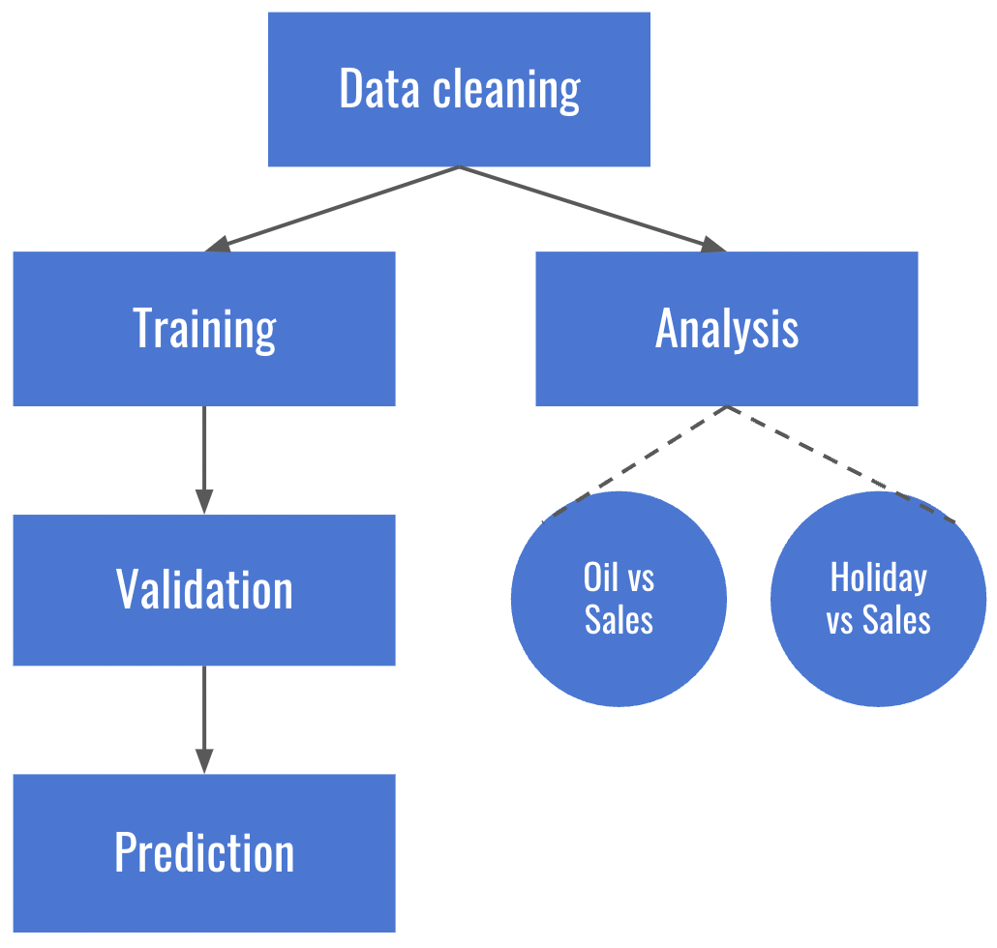
Pipeline
Initial pipeline design for the problem
The arrow represent data dependency
The Oil v Sales and Holiday v Sales jobs can be done parallelly.
Pipeline can be more fine-grained as we explore.

Slide 9
Discussion
The work is still in progress.
We need to fine tune the functions to be more reusable.
Looking to parallelize the operations as planned and identify data dependencies across jobs.

Slide 10

Questions?

