Slide 1
Sales Intelligence & Forecasting
EXECUTIVE BUSINESS REVIEW
Executive Business Review
Pipeline Performance | Forecast Confidence | Revenue Strategy
Henok Berhane | Data & Business Intelligence
October 2026 | Synthetic Portfolio Simulation

Slide 2
Executive Performance Snapshot
FY2026 Q3 | Revenue Performance & Forecast Readiness
Total Bookings
$40.13M
Total Quota
$24.65M
Quota Attainment
162.82%
Open Pipeline
$91.35M
Weighted Pipeline
$47.94M
Weighted Coverage
1.95x
Executive Highlights
• Bookings reached 162.82% of quarterly quota, exceeding the target.
• Weighted pipeline of $47.94M represents approximately 52.5% of the $91.35M open pipeline.
• Forecast confidence and deal-level risk warrant continued management attention.
Source: Power BI Command Center | FY2026 Q3 | Synthetic Portfolio Data

Slide 3
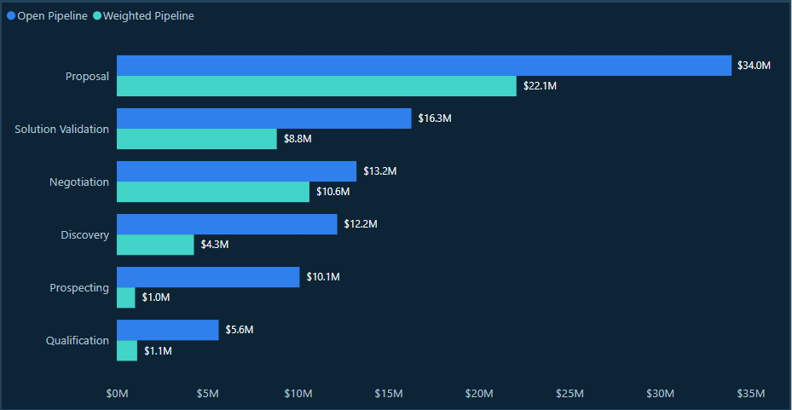
Sales Pipeline Performance
FY2026 Q3 | Pipeline Distribution & Forecast Readiness
Executive Takeaway
Proposal leads with $34.0M in open pipeline and $22.1M in weighted pipeline. Across all stages, the $91.35M open pipeline translates to $47.94M in weighted value, highlighting forecast uncertainty and the importance of deal progression.
Source: Power BI Command Center | FY2026 Q3 | Synthetic Portfolio Data

Slide 4
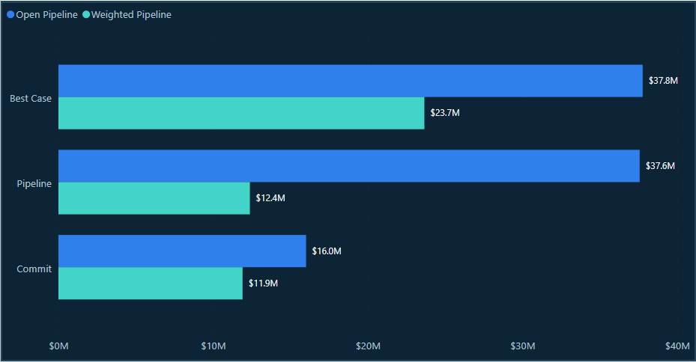
Revenue Forecast & Outlook
FY2026 Q3 | Forecast Category & Revenue Confidence
Executive Takeaway
Best Case leads weighted pipeline at $23.7M. The Pipeline category holds $37.6M in open value but only $12.4M after probability weighting, highlighting forecast uncertainty and the need to prioritize deal qualification and progression.
Source: Power BI Command Center | FY2026 Q3 | Synthetic Portfolio Data

Slide 5
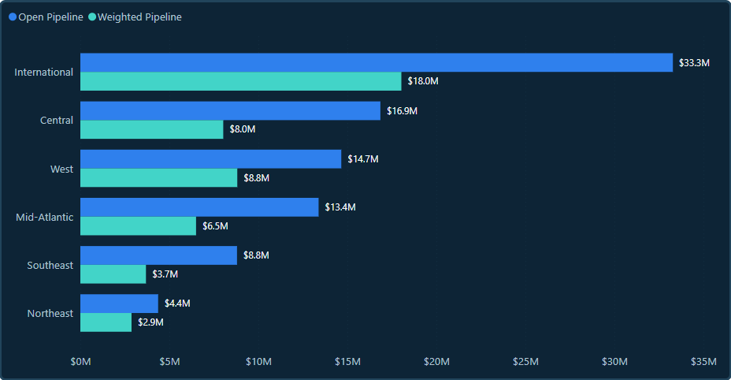
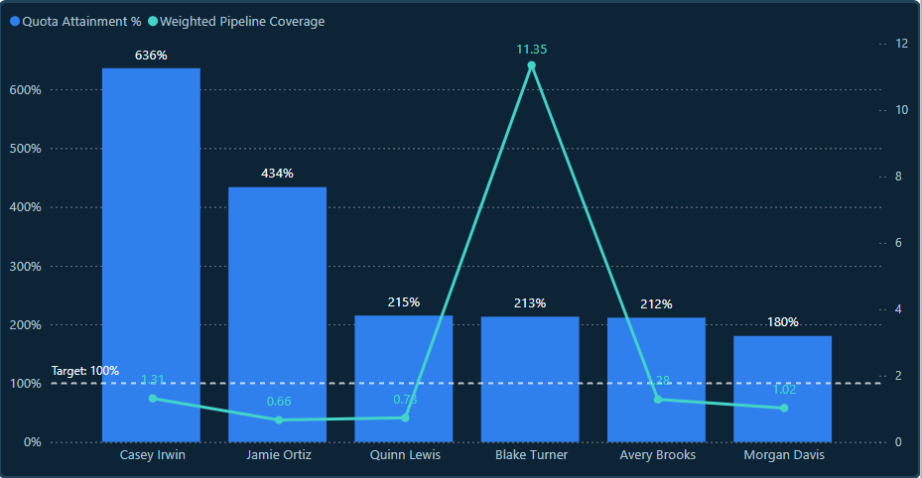
Regional & Sales Rep Performance
FY2026 Q3 | Pipeline Distribution & Sales Execution
Executive Takeaway
International leads regional open pipeline at $33.3M, with $18.0M in weighted value. Quota attainment ranges from 180% to 636% across the six displayed representatives, highlighting performance variation and the need to validate quota targets and coverage outliers.
Source: Power BI Command Center | FY2026 Q3 | Synthetic Portfolio Data

Slide 6
Risks & Opportunities
FY2026 Q3 | Forecast Risk & Recommended Areas of Focus
Stale Opportunities
24
90+ Days Stale
Review deal activity, next steps, and ownership.
Forecast Alignment
12
Stage / Forecast Mismatches
Reconcile forecast categories with sales stages.
Close-Date Changes
10
3+ Close-Date Pushes
Reassess deal timing and forecast commitments.
Executive Takeaway
Stale opportunities are the most frequently flagged risk driver (24), followed by stage/forecast mismatches (12) and repeated close-date pushes (10). Prioritizing deal hygiene, forecast alignment, and close-date reviews may improve forecast reliability.
Source: Power BI Forecast Risk Drivers | FY2026 Q3 | Synthetic Portfolio Data

Slide 7
Strategic Recommendations
FY2026 Q3 | Leadership Action Plan
Improve Deal Hygiene
01
Review stale opportunities, confirm next steps, and assign clear ownership.
Strengthen Forecast Accuracy
02
Reconcile stage and forecast mismatches and reassess repeatedly pushed close dates.
Optimize Sales Execution
03
Review regional pipeline concentration and investigate quota and coverage outliers.
Executive Recommendation
Implement recurring pipeline reviews, forecast validation, and targeted sales coaching to improve pipeline visibility and support more reliable decision-making.
Source: Power BI Command Center | FY2026 Q3 | Synthetic Portfolio Data

Slide 8
Methodology & Data Validation
Technical Workflow | Data Quality & Reporting Integrity
Data Preparation
01
SQL profiling, Excel staging, data cleanup, and validation.
BI Modeling & Reporting
02
Power BI data modeling, DAX measures, forecasting, and risk analysis.
CRM Import & Validation
03
Salesforce opportunity upserts, source ID filtering, and reporting checks.
Data Validation Results
1,406
Salesforce records imported or updated
0
Data Loader Errors
94.4%
CRM quality pass rate
Source: Salesforce CRM Simulation & Power BI Command Center | Synthetic Portfolio Data

