Slide 1




What can natural language
processing and generation achieve for SBB?
Notes:
logo

Slide 2
Clarification of the used terms:
A request or an e-mail is a method for written communication that is generated by a customer or a potential customer and sent to SBB customer center
A response is a method for written communication that is generated by SBB customer center to respond to each incoming request or e-mail
A feedback is the reaction of the customer to the response/solution of the SBB customer center
A conversation is the total written communication (request+response+feedback) that has happened between the SBB customer center and a person, who created the request
A positive conversation is a conversation that has positive feedback from the customer

Slide 3
Which problems do we aim to solve?
The customers of SBB face same or similar issues -> similar requests or e-mails are sent to SBB customer center every day
Each request must be responded individually but each request is not distinct or different
Employees spend several hours per day to generate similar or even the same responses to requests from different customers
Employees face challenges during decision-making process, e.g., which path to choose in order to solve the underlying issue and prevent potential issues that might arise from her/his decision.
New employees must gain experience in order to learn how the system at SBB works in order to become productive -> learning by doing -> there is a better solution

Slide 4
Solution: Automation of communication
A new request arrives, similar requests/e-mails are filtered from the past through text similarity
The appropriate response is selected among past responses
The employee can see the whole conversation in order see how his/her decisions will reflect on customer
In this way similar requests can be automatically responded without employee writing anything
For a similar solution, please check the website: https://review.response.beratics.com

Slide 5
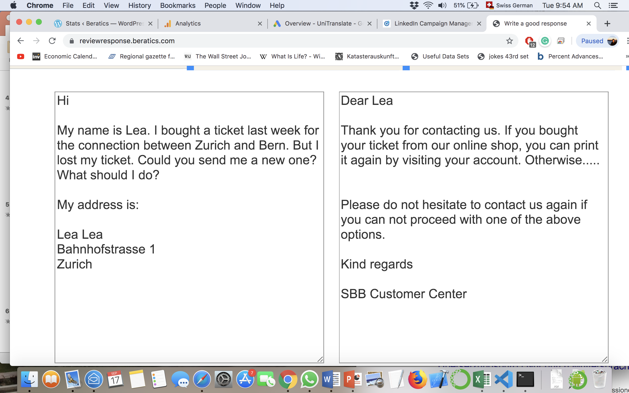
A simple visualization of the solution
The request appears on the left textarea and the appropriate response appears on the right side.
The next best responses can also to be seen by scrolling

Slide 6
The working principles of the system
Past requests and their responses are saved in a database (in this step bad responses from the past can be eliminated)
A new incoming request is equated through text similarity with similar requests that already exist in the database
The similarity can be calculated based either on the whole text of the request, on a sentence or keyword
Or employees create their own phrases to search in the system/database
Show the requests from the past and their corresponding answers or solutions

Slide 7
Benefits of the solution
Several hours per day is saved per employee (for a better estimation we need more information about SBB customer center)
Employees can use the saved time to do more creative activities rather than repetitive work
Fewer mistakes while solving customer issues since the past will become a guidance for everyone
A better customer experience with customer center thanks to text analytics
A big step for SBB Customer Center into Industry 4.0

Slide 8
What else results from the solution?
The SBB regulations can be integrated into our solution so that the system checks if the prepared response is in line with SBB policies, e.g. if a benefit might be granted to a customer or not
The system learns with time which responses are often chosen and becomes better in predicting thanks to machine learning
We can train the system by creating artificial requests that are similar to real customer requests
A big percentage of all incoming requests can be responded automatically in the following years

Slide 9
What else results from the solution?
One can analyze thousands of conversations and can see which services perform best and result in less requests or which services/benefits are loved most by the customers
Through text and sentiment analytics of thousands of conversations SBB can see how its policies on solving issues reflect on customer
Before a new product (e.g. a new abonnement) is launched one will be able to learn from past; what issues are likely to arise and how they can be prevented

Slide 10
About us
Beratics is a solution of NLP GmbH that focuses on business digitalization through natural language processing.
NLP GmbH is a recognized spinoff from ETH Zurich in the area of natural language processing (https://ethz.ch/spin-offs).
A similar concept that was developed by Beratics is the review response software that helps hotel managers to respond to online reviews automatically (https://beratics.com/reviewresponse/).
Official website: https://beratics.com
Contact person for this project: M.Sc. ETH Berhan Polat, CEO of NLP GmbH.
bpolat@beratics.com

Slide 11
Which problems do we aim to solve?
We are categorizing all incoming requests under two categories, universal issues and private issues.
Universal issues are a result of the SBB system or products that everyone might experience, such as; I bought a train ticket from Zurich to Bern but my flight to Zurich was late that is why I missed the train. Can I get a refund? This experience can happen to anyone disregarding their personal characteristics.
Let’s have a look at the following issue, which is private; I was mistreated by the SBB employee and feel discriminated that is why I left the train and demand my money back.
In the private issue, we can not really know what has happened or verify that the event has happened as the employee tells it. It is an issue that is claimed to happen in an SBB train but has nothing to do with the services of SBB. Nevertheless, SBB must respond to the customer. SBB will probably show goodwill although can not verify that claim is true. But how to show the goodwill? SBB is a very old institution and probably any type of human that we can imagine of used its services. SBB customer relations handled millions of requests from customers.
Universal issues might arise for everyone and are not likely to depend on the characteristics of the underlying person, such as ethnicity, psychological condition or anything sort of.

