Slide 1
The halting problem - proof
Undecidability

Slide 2
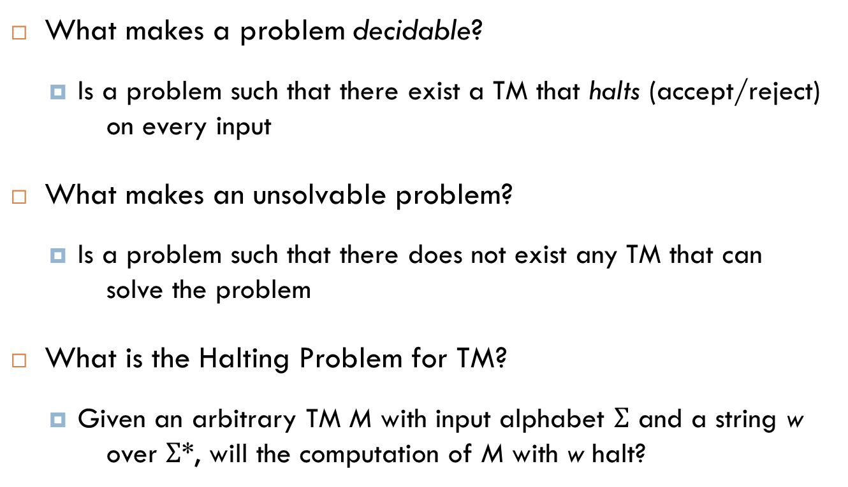
Solving Problems
What makes a problem decidable?
Is a problem such that there exist a TM that halts (accept/reject) on every input
What makes an unsolvable problem?
Is a problem such that there does not exist any TM that can solve the problem
What is the Halting Problem for TM?
Given an arbitrary TM M with input alphabet $Σ$ and a string w over $Σ$*, will the computation of M with w halt?

Slide 3
Halting Problem
Is the Halting Problem decidable/undecidable?
There is no algorithm that solves the halting problem, thus the halting problem is undecidable
A solution to the halting problem requires a general algorithm that answers the halting question (i.e., equivalent to the “acceptance” question of a string for a TM) for each combination of TM and input string
The proof of the fact that the halting problem is undecidable is done by contradiction and using the encoding of an arbitrary TM and a string as the starting point

Slide 4
Halting problem is undecidable - Proof
Proof by contradiction
Assume that there is a TM H that solves the halting problem
The computation of H can be depicted as follows:
M halts with input w
H
Accept
E(M)w
Reject
M does not halt with input w

Slide 5
Halting problem is undecidable - Proof
We modify H to construct a new TM H’, which behaves as described below.
The computations of H’ are the same as H, except that H’ loops indefinitely whenever H terminates in an accepting state, i.e., whenever H halts on input w, and halts otherwise
M halts with input w
H’
Loop
E(M)w
Halt
M does not halt with input w

Slide 6
Halting problem is undecidable - Proof
H’ is combined with a copy machine to construct a new TM D:
The input to D is a TM representation E(M)
A computation of D begins with copying the string E(M) to yield E(M)E(M)
The computation continues by running H’ on E(M)E(M)
M halts with input E(M)
Loop
Copy
H’
E(M)
E(M) E(M)
Halt
M does not halt with input E(M)
D

Slide 7
Halting problem is undecidable Proof
Since M is any TM, and D is one of them.
Consider a computation of D with input E(D).
D halts with input E(D)
Copy
H’
Loop
E(D)
E(D) E(D)
Halt
D
D does not halt with input E(D)
Examining the preceding computation, we see that:
D halt on input E(D) iff D does not halt on input E(D), which is a contradiction
Therefore, the original assumption is wrong, and the halting problem is undecidable

