Slide 1
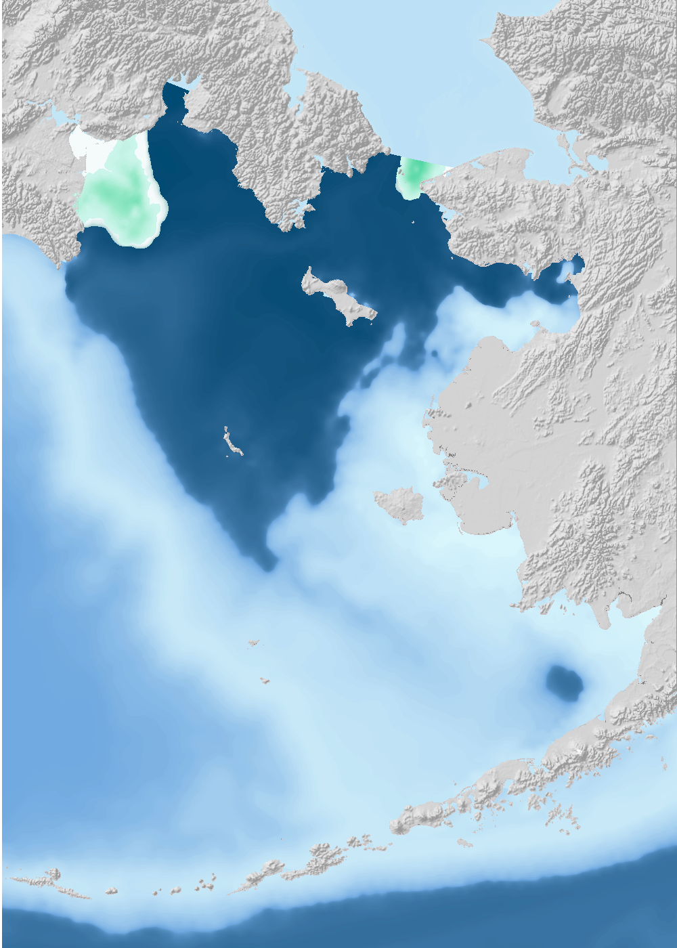
Bering Sea operational oceanographic model hindcasts and short-term forecasts
Bering Sea ROMS/NPZ modeling: Kerim Aydin, Al Hermann, Kelly Kearney, Ivonne Ortiz, Wei Cheng, Kirstin Holsman
This workshop is part of the NOAA Modeling, Analysis, Predictions, and Projections (MAPP) Bering Seasons project
March 2021

Slide 2
Workshop Purpose
Indroduce oceanographic model outputs of recent and historical Bering Sea conditions (hindcasts) to be provided on an operational basis to Ecosystem-Based Fisheries Management processes.
Provide software tools for accessing the publicly-available data.
Collaboratively prioritize future use of the models for production of ecosystem indices and other products.
Discuss the current science and prognosis for developing seasonal (1-9 month) forecasts of ocean conditions.

Slide 3



Model History
2006 – 2012: Models developed as part of NSF/NPRB Bering Sea Integrated Research Program (UW/AFSC/UAF collaboration)
2012 – present: Model improvement, validation, and pilot project for delivering hindcasts and seasonal forecasts (NOAA IEA Program)
2016 – present: Use of the model for long-term (80-100 year) climate projections through the ACLIM project (NOAA FATE, SAAM, AFSC, RTAP)
2017 – present: Extensive testing/validation of hindcasts and short-term forecasts (NOAA MAPP Bering Seasons Project)

Slide 4
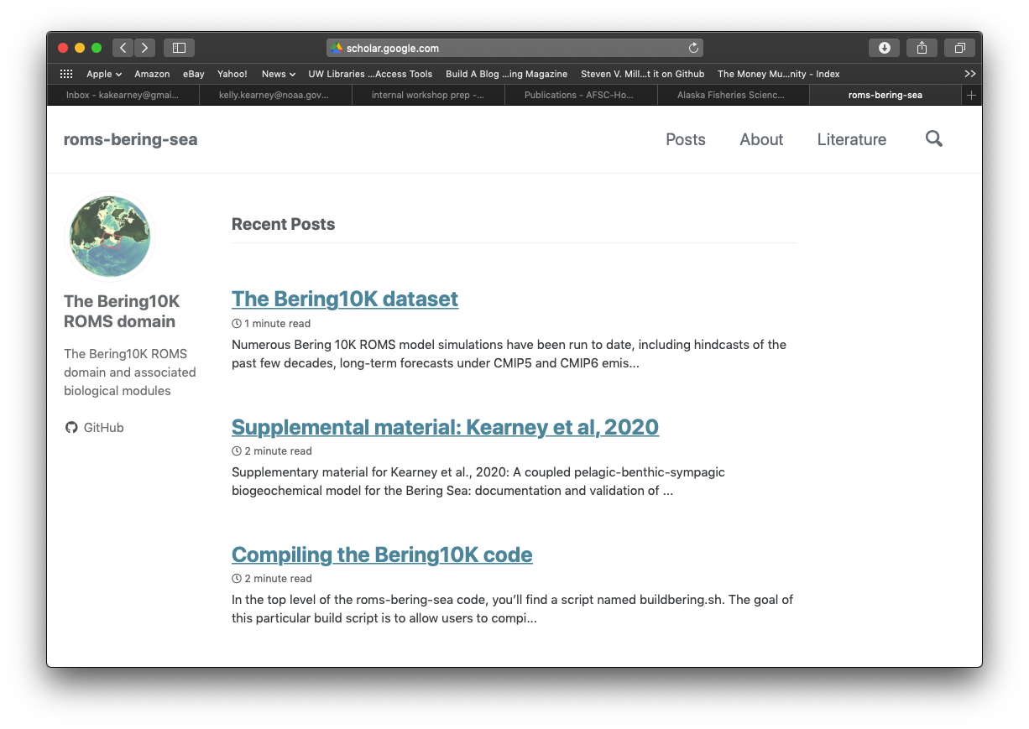
More info
https://beringnpz.github.io/roms-bering-sea/

Slide 5
Logistics and Agenda
WebEx Meeting alias (both days): bit.ly/beringocean
Presentations at:
bit.ly/beringinfo (Google Drive Alias, NOAA accounts only)
github.com/beringnpz/MAPP_Bering_ROMS_workshop (right click/save as for each file)
Questions can be entered in chat
Tues March 9th (times are Pacific time)
10-12:
Introduction (Aydin)
Model and data overview (Kearney, Hermann, Cheng)
1-3:
Oceanographic files and server overview (Hermann)
R download and analysis tools lab (Aydin, Holsman)
GIS tool overview (Ortiz)
Thurs March 11th
10-12:
Hindcast quality, validation, and products (Kearney, Hermann, Cheng).
Discussion on product priorities and model update timing for EBFM use, surveys (all)
1-3:
Seasonal (1-9 month) forecasts, quality, prognosis (Kearney, Hermann, Cheng)
Discussion on forecasts – usefulness and timing (all)

Slide 6
R Session
Examples and toolbox at https://github.com/kholsman/ACLIM2
Scroll down to README, if desired run following code:
Section 2.1 (Minimal Install, only works on early examples)
Section 2.2 (Full install, choosing one of Options 1-3) and
Section 2.3 - takes time!
Full install generates ~ 1GB of shapefiles and other resources

