Slide 1
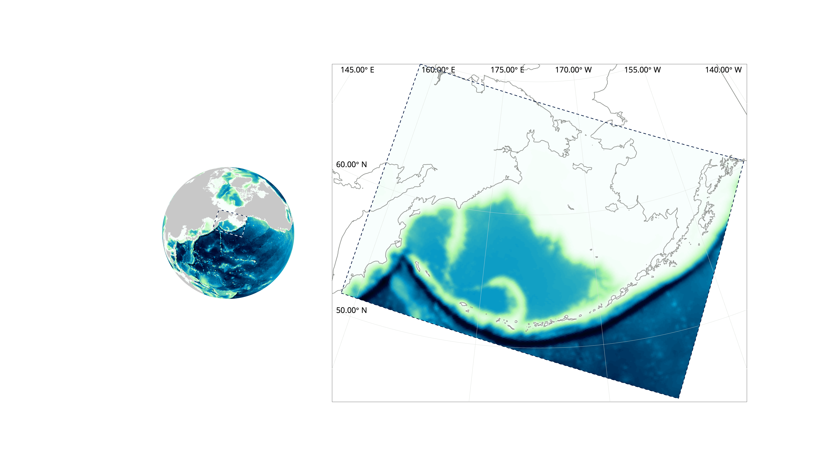
What is ROMS, exactly?
ROMS = Regional Ocean Modeling System
Bering Seasons workshop
kelly.kearne@noaa.gov
Notes:
Our first definition: ROMS stands for Regional Ocean Modeling System. It can be used as a standalone ocean model (as we do) or can be coupled to other atmospheric and wave models. ROMS refers to the generic code framework, which can be customized to specific regions. Our particular model, the Bering10K ROMS model, covers the Bering Sea and a bit of the Gulf of Alaska.
More info about ROMS here: https://www.myroms.org.

Slide 2
What is ROMS, exactly?
“ROMS is a free-surface, terrain-following, primitive equations model”
Bering Seasons workshop
kelly.kearne@noaa.gov
Notes:
Another definition, courtesy of the official ROMS website. Let’s dissect the definition…

Slide 3
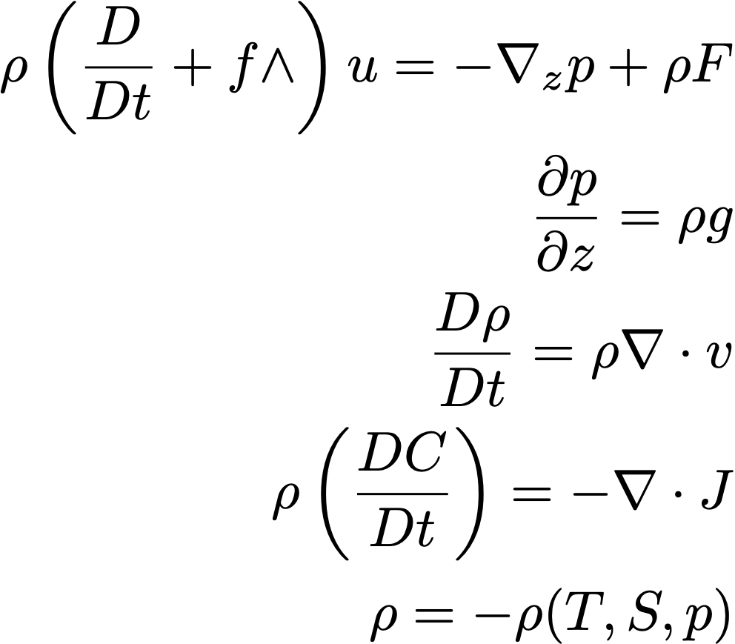
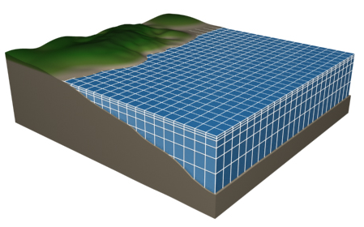
What is ROMS, exactly?
“ROMS is a free-surface, terrain-following, primitive equations model”
Horizontal momentum
Hydrostatic balance
Mass continuity
Conservation of tracers
Equation of state
Bering Seasons workshop
kelly.kearne@noaa.gov
Notes:
“Primitive equations”: These equations underly most atmospheric and ocean models. They describe how fluid moves on a rotating sphere, based on a few simple rules and constraints: Motion results from the balance of pressure gradient force, gravity, Coriolis force, and friction; mass must be conserved; water is incompressible; and the density of water is a function of temperature, salinity, and pressure. Numerically solving these equations, and deciding how to discretize them, and dealing with sub-grid-scale stuff, etc. gets tricky (hence the thousands of lines of ROMS code), but these are the basics.

Slide 4
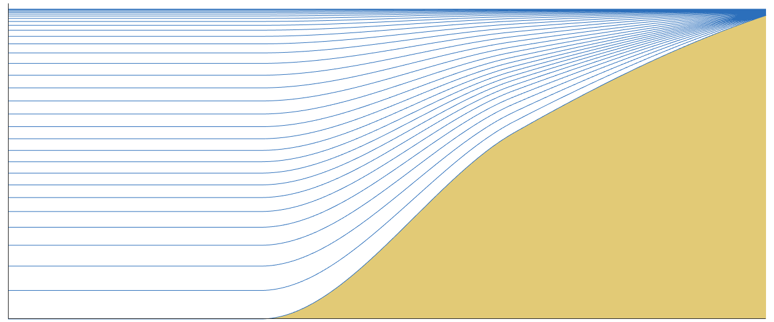
What is ROMS, exactly?
“ROMS is a free-surface, terrain-following, primitive equations model”
Bering Seasons workshop
kelly.kearne@noaa.gov
Notes:
“terrain-following”: ROMS is a sigma-coordinate model, meaning that its vertical layers follow terrain topography (compared to z-surface models with fixed depth levels, or isopycnal models that use density surfaces for the vertical coordinate). Sigma coordinates can be advantageous, mathematically, when simulating regions that span a wide depth range, as is the case in most coastal regions. In our domain, the eastern Bering shelf ranges from 10-200 m, while the basin region is ~4000 m, with depths over 7000 m south of the Aleutian Islands; we need to resolve all these regions sufficiently within our model. In our model, layers are thinnest near the surface; the exact thickness varies as a function of bottom depth and surface height.

Slide 5
What is ROMS, exactly?
“ROMS is a free-surface, terrain-following, primitive equations model”
Bering Seasons workshop
kelly.kearne@noaa.gov
Notes:
“free-surface”: Finally, ROMS is a free surface model, meaning the location of the atmosphere/ocean boundary is free to move. This allows ROMS to capture variation in sea surface height due to winds, heat, and tides. The vertical layers in the model expand and contract in response to the moving surface.

Slide 6

What is ROMS, exactly?
The Bering10K domain:
ocean + sea ice + biogeochemistry
10-km horizontal resolution
30 depth levels
Sea Ice
?
Ocean
Biogeochemistry
Bering Seasons workshop
kelly.kearne@noaa.gov
Notes:
The Bering10K ROMS model couples together the ocean model with a simple sea ice model. It also includes a biogeochemical model, known as BESTNPZ. The model runs with 10-km horizontal resolution and 30 depth levels. All state variables (temperature, salinity, current speeds, biological tracers, etc.) are solved for in each of the 3D grid cells.

Slide 7
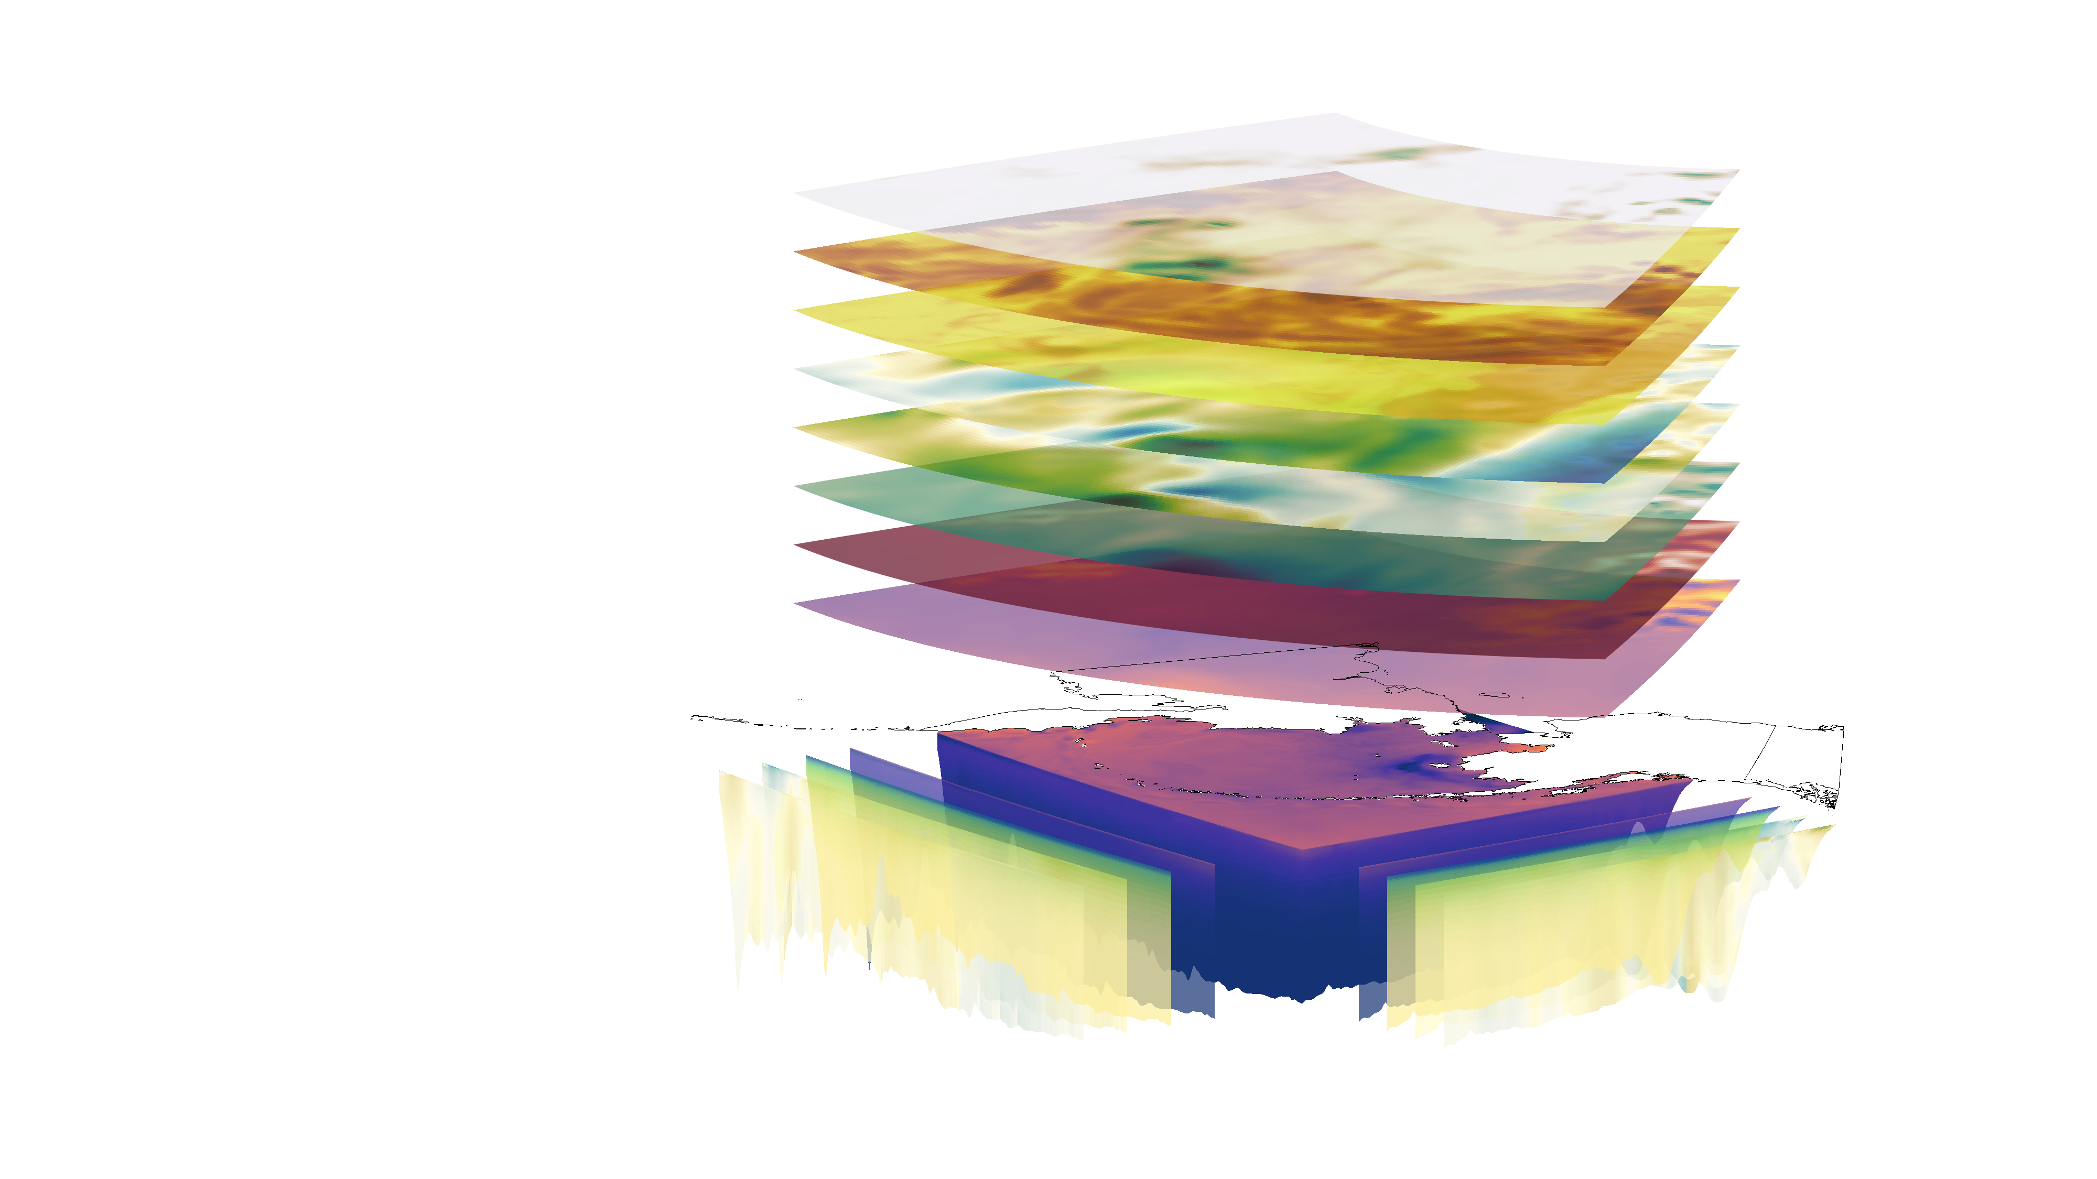
ROMS Bering10K is a downscaling tool
atmospheric boundaries:
precipitation
solar radiation
winds
humidity
pressure
temperature
The Bering10K ROMS model requires external surface and lateral boundary conditions.
Bering Seasons workshop
kelly.kearne@noaa.gov
ocean boundaries: temperature, salinity, currents
Notes:
Because it does not include an atmospheric component, ROMS is not a standalone tool (unlike e.g. global coupled atmosphere-ocean models). It requires external atmospheric and lateral boundary conditions to run. These boundary conditions may come from observational datasets, global coupled models, or from larger-domain regional models. In this setup, ROMS acts as a dynamical downscaling tool, bringing higher resolution (and its own sea ice and biogeochemical processes) to a small region.

Slide 8

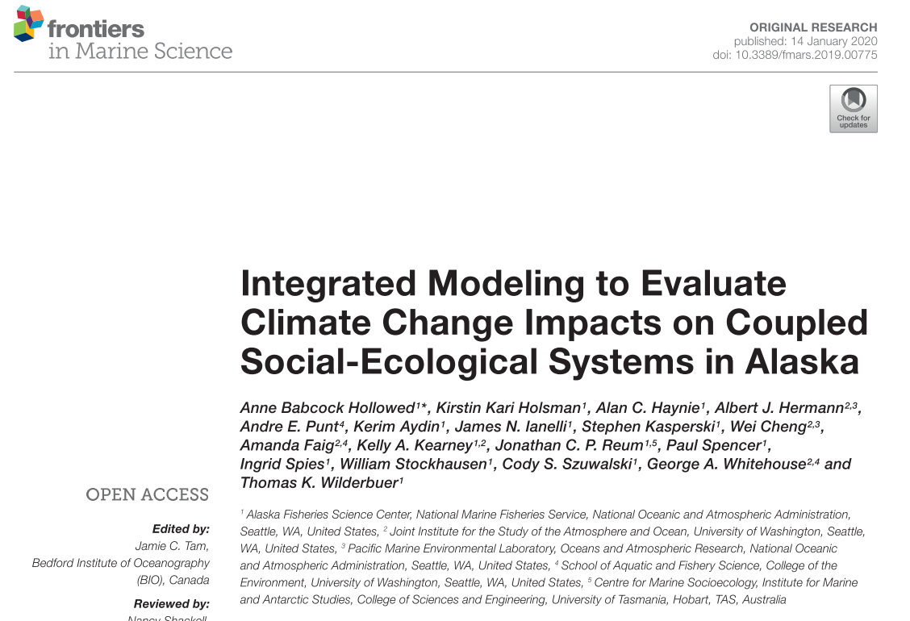
ROMS Bering10K is a downscaling tool
Sea Ice
?
Ocean
Biogeochemistry
The Bering10K ROMS model requires external surface and lateral boundary conditions.
01 Hindcasts: 1970-present 1970-present Climate Forecast System Reanalysis (CFSR): data-assimilating climate model Coordinated Ocean Research Experiments (COREv2): global air-sea flux product | 02 Long-term forecasts present - 2100 CMIP5/6 IPCC-class coupled climate models (Hollowed et al., 2020, Front Mar Sci 6:1–18) | 03 Seasonal forecasts 9- to 12-month forecasts CFS operational forecasts North American Multimodel Ensemble (NMME) seasonal reforecasts
Bering Seasons workshop
kelly.kearne@noaa.gov
Notes:
To date, we’ve run Bering10K using 3 different types of parent datasets:
The hindcasts: These run from 1970-present, and use historical reanalysis data products as boundary conditions. These simulations attempt to simulate the real-world conditions in the Bering Sea over this time period.
Long-term forecasts: These simulations use input from selected coupled climate models and emissions scenarios in the CMIP5 and CMIP6 suites. They are primarily focused on century-scale climate change, and run from present day to 2100. These simulations form the basis for the ACLIM project (see Hollowed et al., 2020, DOI: 10.3389/fmars.2019.00775; not discussed further in this presentation.)
Seasonal forecasts: These simulations use input from the North American Multimodel Ensemble (NMME). These are retrospective forecasts, and run for 9 to 12 months. They are focused on quantifying predictability over seasonal timescales.

