Slide 1
Caching
Attaining overall speed up in your applications

Slide 2
Agenda
what, why, where, when and how
alternatives
helpful tools
memory resizing
cache replication
demo

Slide 3
What is caching?
storing objects away in memory or disk for future use
  objects can vary based on your application needs

Slide 4
Why cache?
speed, speed, speed
scaling - handle more in less time
save yourself database round trips
reduce network latency
give end users a better experience
put your hardware to good use

Slide 5
What to cache?
Read-only data
Read-write data (seldomly changed ones)
Entire web pages
Page fragments

Slide 6
Where to cache?
Persistence tier
  Domain objects, wrapper objects, etc
Service tier
  Results from service calls, e.g. DTOs
Web tier
  Results from controller calls, entire pages, page fragments, etc

Slide 7
2LC with Hibernate
baked right into the core module
transparent for entities once configured
configured declaratively or via annotations
ehcache is the default
caches entities (@Entity) and/or queries

Slide 8
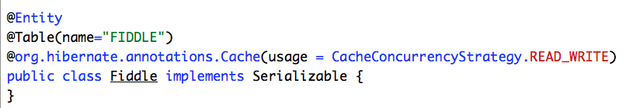
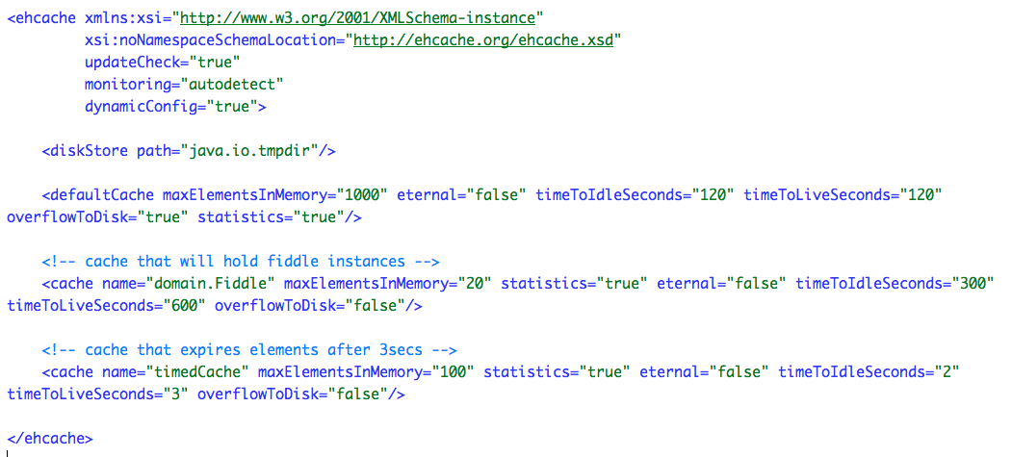

Slide 9
Problems
how many elements to cache?
what if the sizes of the elements change?
cache could overgrow available heap i.e. OOME
changes to heap size
changes in your usage pattern

Slide 10
Solution: memory resizing
can specify how much entire cache can grow to
allows to provide cache size in terms of percentage
auto tunes itself! Goodbye OOME
memory configuration centralized in config file
removes guess work on element sizing

Slide 11
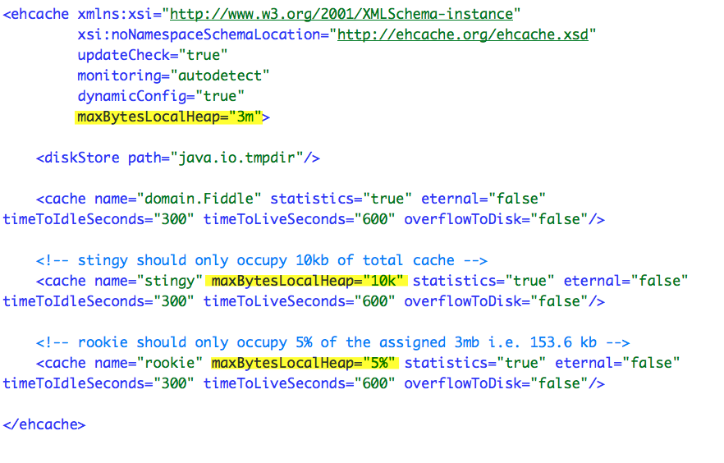

Slide 12
Demo

Slide 13
Cache replication
lets cluster nodes share cache info
can use rmi, jgroups or jms for info sharing
achievable in 3 easy steps

Slide 14
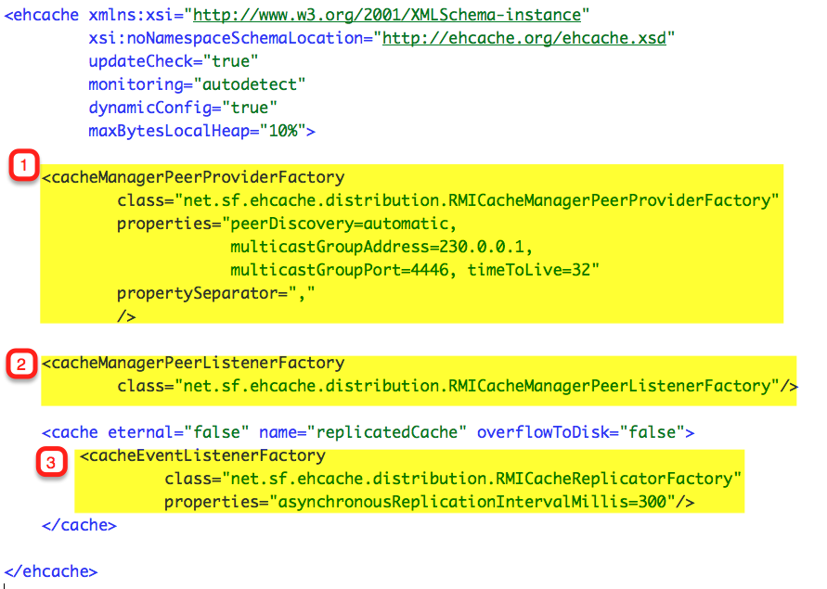

Slide 15
Alternatives?
infinispan (http://www.jboss.org/infinispan)
memcached (http://code.google.com/p/hibernate-memcached/)
oscache (from open symphony)

Slide 16
Helpful Tools
Ehcache API has some methods for cache analysis (e.g. Cache.getStatistics())
Ehcache monitor
Terracotta Developer Console
Profiler (jprobe, yourkit, jprofiler, etc)

Slide 17
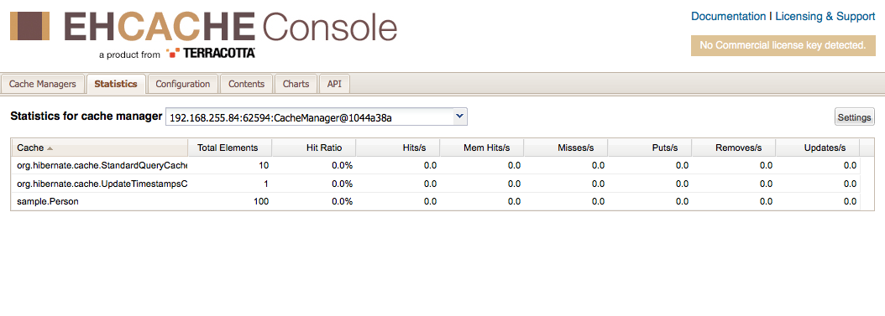
Ehcache monitor

Slide 18
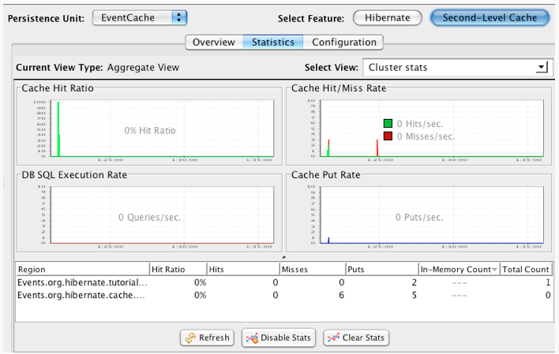
Terracotta Developer Console

Slide 19
Helpful Tips
have a profiler handy
profile before caching and after caching add-on
know the application’s usage pattern
caching might not always cure the bottleneck
Notes:
+ knowing the usage pattern helps decide eviction policies

Slide 20
Helpful Resources
http://www.ehcache.org/documentation/user-guide/hibernate
http://dsoguy.blogspot.com/2011/07/easy-java-performance-tuning-manage.html
http://docs.jboss.org/hibernate/core/3.6/reference/en-US/html_single/#performance-cache

Slide 21
Thank you! Questions?

